Slide 1


Cyber Disarmament,National Security and Defence Procurement
Dr. Surabhi Pandey
Assistant Professor
(ICT & e- Governance)
Indian Institute of Public Administration,New Delhi

Slide 2
Learning Approach
Learning path
Goal
Strategy
Vision
NATION PREPAREDNESS AND BETTER DEFENSIVE CPABILTIES .
ENHANCING KNOWLEDGE ON ECONOMIC WELL BEING TO NATIONAL SECURITY
UP SKILLING FROM BASIC TO ADVANCE CONCEPT
CASE STUDIES

Slide 3
Learning outcomes:
Overview of Cyber Disarmament
Cyber Diplomacy and Warfare
Nation Preparedness and Cyber Strategy
Strategies and Structures for National Security
Indian Defence: Procurement Process and Policy
New Procurement Policy to Boost India’s Self-reliance in Arms

Slide 4

Session 1: Overview of Cyber Disarmament
Introduction to Cyber Disarmament
Potential approaches to cyber disarmament
Cyber warfare
Probable cyber weapons
Case study I – Stuxnet,

Slide 5
What is cyber Disarmament
Cyber : Digital world and virtual technologies
Disarmament is the act of reducing, limiting, or abolishing weapons. Important strengthen the world peace and security.
International Cyber Conflict and Cyber Peace

Slide 6


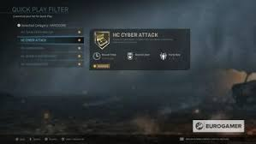
What is cyber Disarmament
Cyber Disarmament provides framework which could bring together all the overlapping issues around technological weaponisation – data security, national security, concepts of privacy and cybersecurity.

Slide 7
Cybersecurity studies focus on the “phenomenon of digital war” as conducted by military powers under the political control of state actors (eg. Russian interference in the US elections).
Cybersecurity include other issues of statecraft directly related to military affairs, such as arms control and crisis management, because they influence the potential for and character of war.

Slide 8
Nation-States & their Vulnerabilities
Weak States | Strong States
Highly vulnerable to most types of threats | Particularly vulnerable to political threats
Particularly vulnerable to military threats | Relatively invulnerable to most types of threat (less inclined to characterize issues as military)
Corrupt, Repressive | Good Performers

Slide 9
Why cybersecurity is a national concern for a nation-state?
Nation-states need flexible and dynamic cyber security strategies to react to the cyber threats in a constantly changing and emerging environment such as cyberspace.
Although cyberspace has no physical boundaries, countries often formulate cyber security strategy independently based on their own ideas and own security perceptions only.
This causes very different cyber security strategies to be found in different countries.
This is true although many international agencies offer suggestions to formulate the main aspects and elements of national cyber security strategy.

Slide 10
Phases of national cybersecurity
Developing the strategy
Executing the Strategy
01
02
Updating and Maintaining the Strategy
03
Evaluating the Strategy
04

Slide 11
FOUR PILLARS OF NATIONAL CYBERSECURITY STRATEGY
Building a resilient infrastructure
Creating a safer cyberspace
Developing a Vibrant Cybersecurity Ecosystem
Strengthening international partnerships

Slide 12
Cybersecurity is important for the welfare state
01.
Cybercrimes are increasing everyday
Protecting its citizens from malicious software and data attacks is the paramount duty of the modern governments

Slide 13
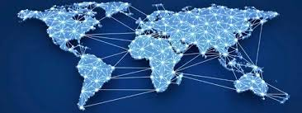
The world is confronted with cyberattacks, it is the age of cyber-warfare where the most vulnerable countries are those that do not have cybersecurity infrastructure in place.

Slide 14
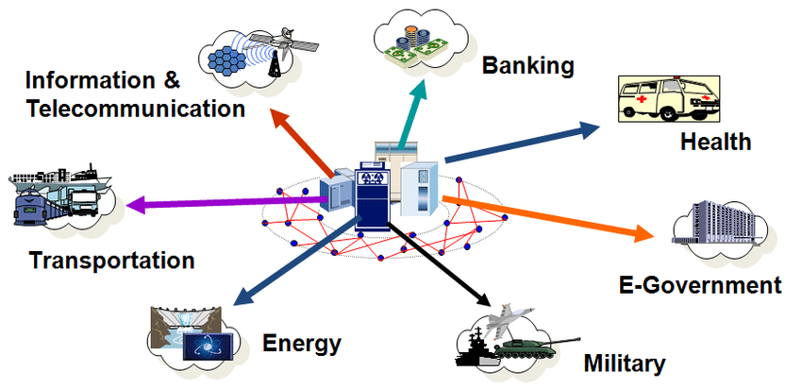

Slide 15
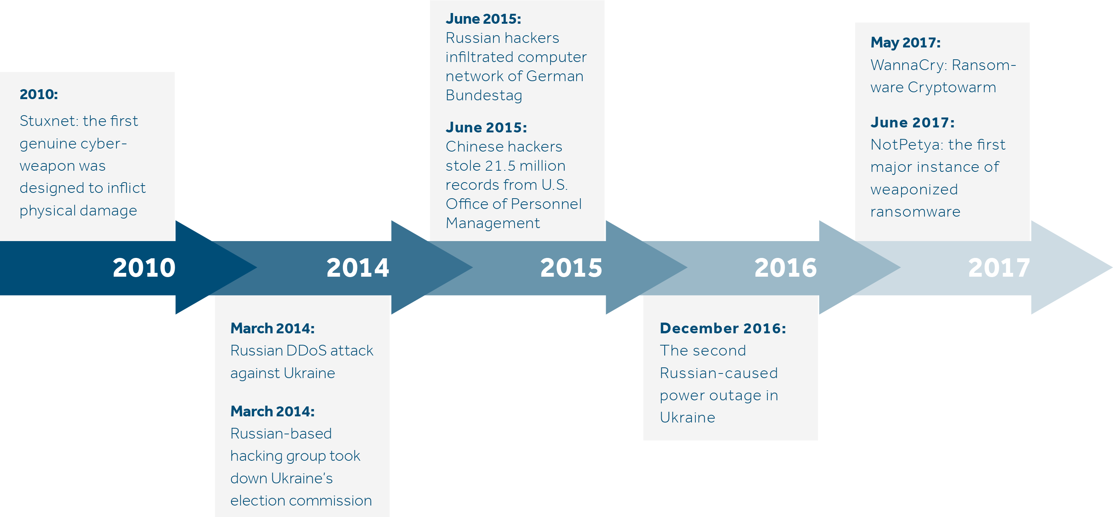
Cyber War Timeline

Slide 16
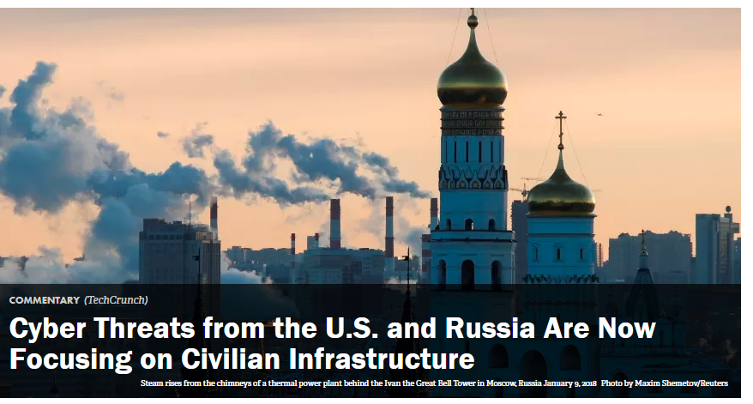
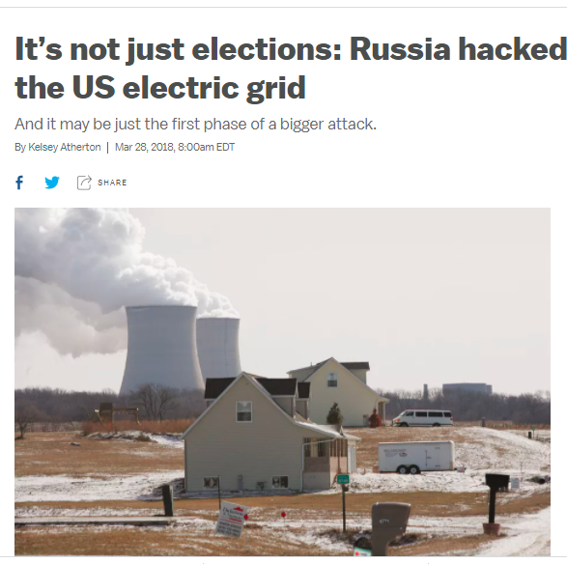
Virtual conflict, real damage
According to an alert from the United States Computer Emergency Readiness Team yesterday, Russia has hacked into many of our government entities and domestic companies in the energy, nuclear, commercial facilities, water, aviation and critical manufacturing sectors – essentially most of what makes our country go.

Slide 17


Iran attempted cyber attack on Israeli water and sewage facilities
Water Authority and Israel National Cyber Directorate confirmed the “attempted cyber breach on water command and control systems.”
there was no harm to the water supply and it operated, and continues to operate, without interruption,”

Slide 18

Venezuela is blaming a crippling 5-day blackout on US cyber warfare -
Venezuela is entering the fifth day of a nationwide blackout that has plunged even critical infrastructure like hospitals into darkness.

Slide 19
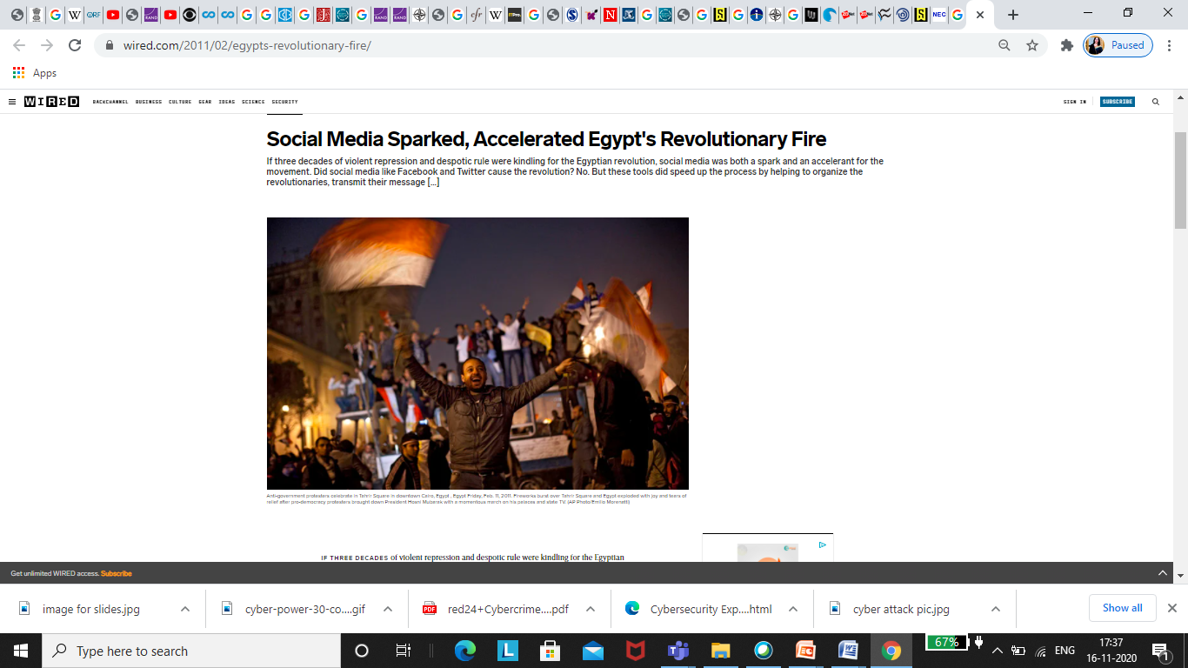
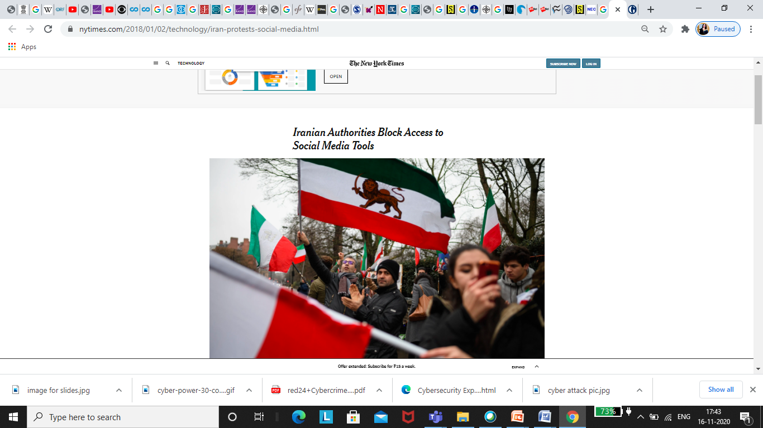
Social Media platform used for propaganda

Slide 20
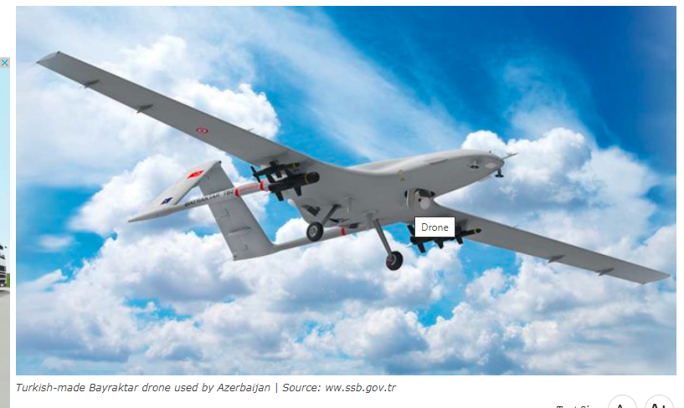
Drones helped Azerbaijan defeat Armenia, and the implications for future modern warefare
This is actually the first war in the history of modern warfare that has been won almost entirely on the strength of drone warfare,”

Slide 21
Stuxnet Worm Attack on Iranian Nuclear Facilities
Stuxnet, the world's first military-grade cyber weapon that can destroy pipelines and cause explosions at power plants and factories, as well as manipulate machinery. It is the first worm that corrupts industrial equipment and is also the first worm to include a PCL (programmable logic controller), software designed to hide its existence and progress. In August, security software company Symantec states that 60% of the computers infected with Stuxnet are in Iran.

Slide 22
Cyber warfare
Cyber warfare involves the actions by a nation-state or international organization to attack and attempt to damage another nation's computers or information networks through, for example, computer viruses or denial-of-service attacks.

Slide 23
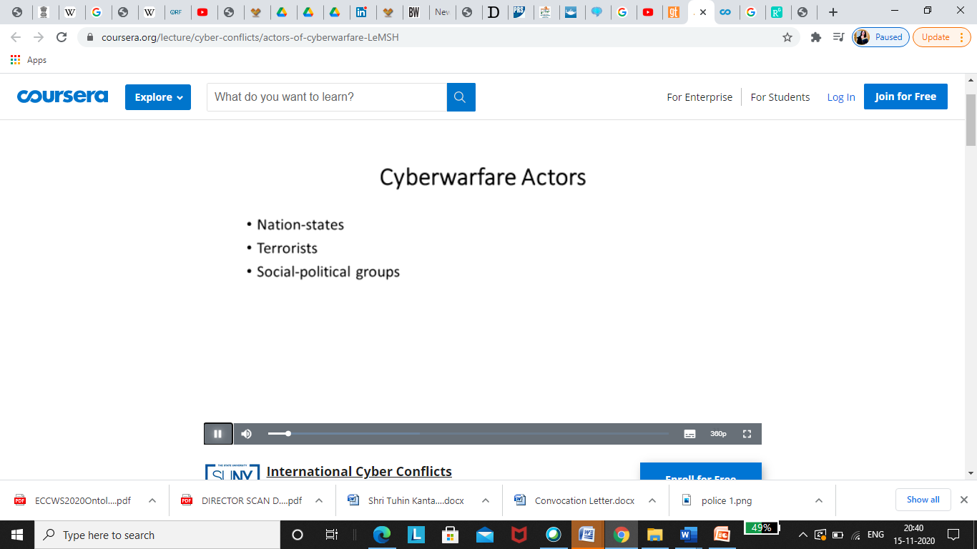

Slide 24
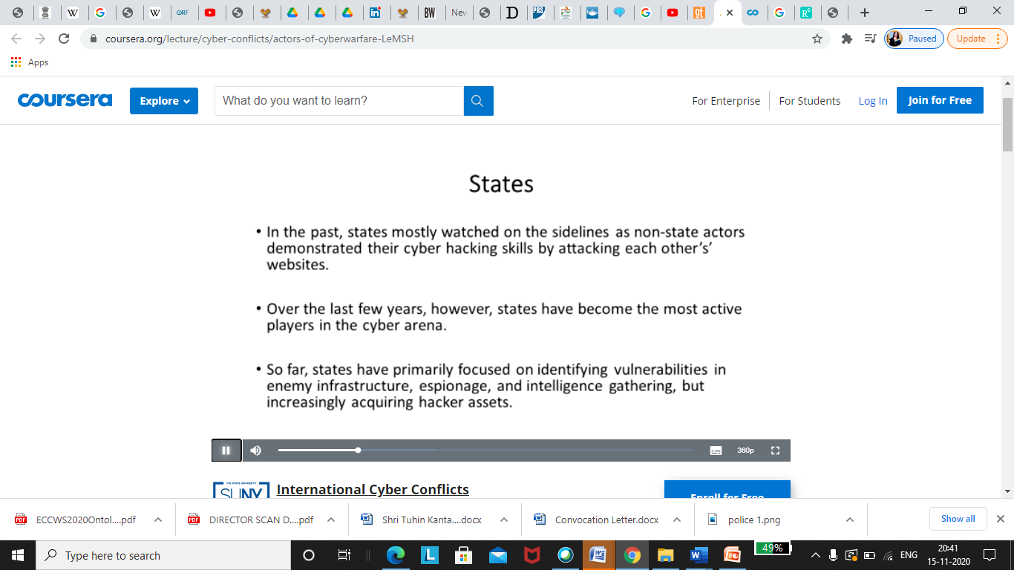

Slide 25
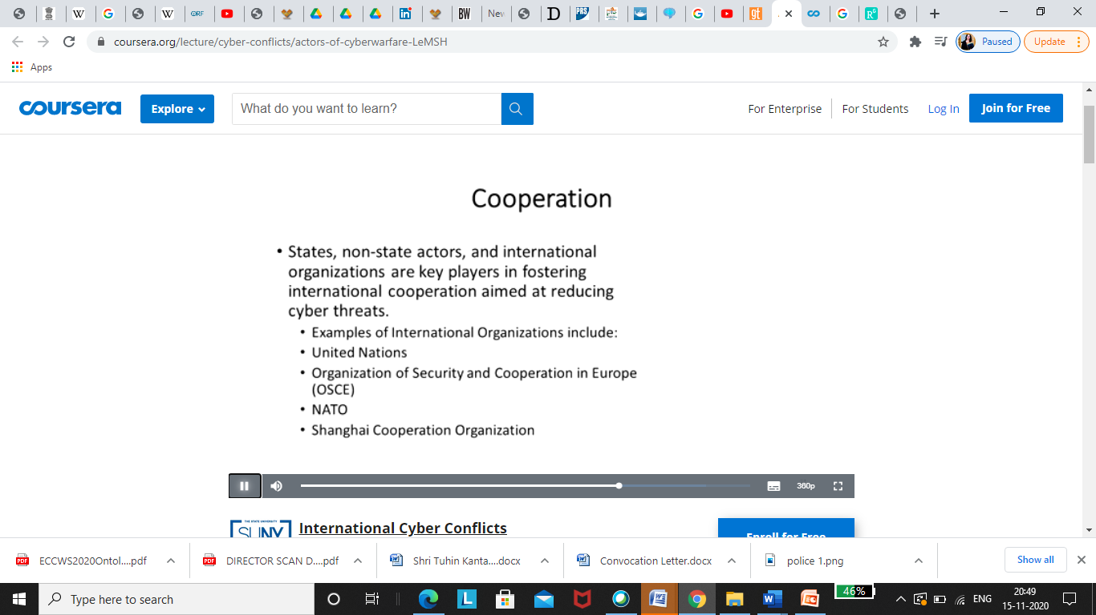

Slide 26
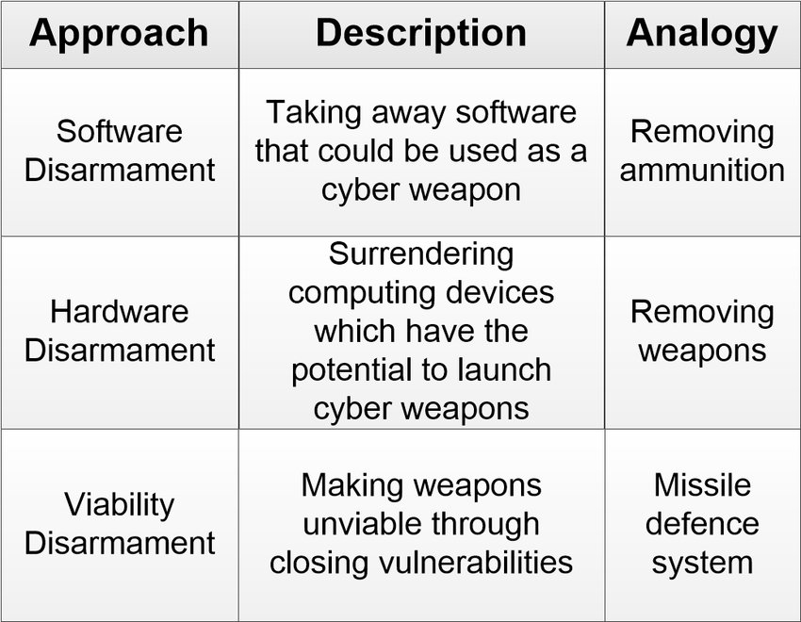
Potential approaches to cyber disarmament

Slide 27
7 Terrifying Tools of Cyber Warfare
Grid Hacking. ...
University Attacks. ...
Crypto Crimes. ...
Election Meddling. ...
Negotiation by Ransomware. ...
Hackers for Hire. ...
Assaults on Truth.

Slide 28
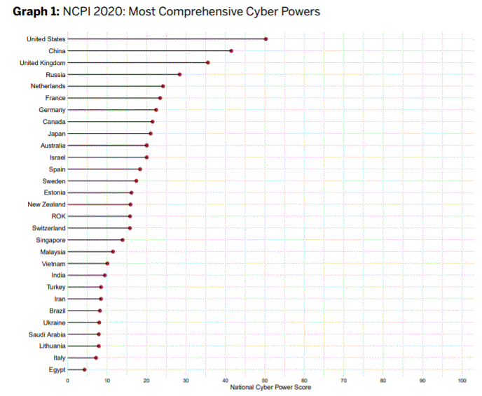
Rankings: the 10 most powerful cyber nations in the world

Slide 29
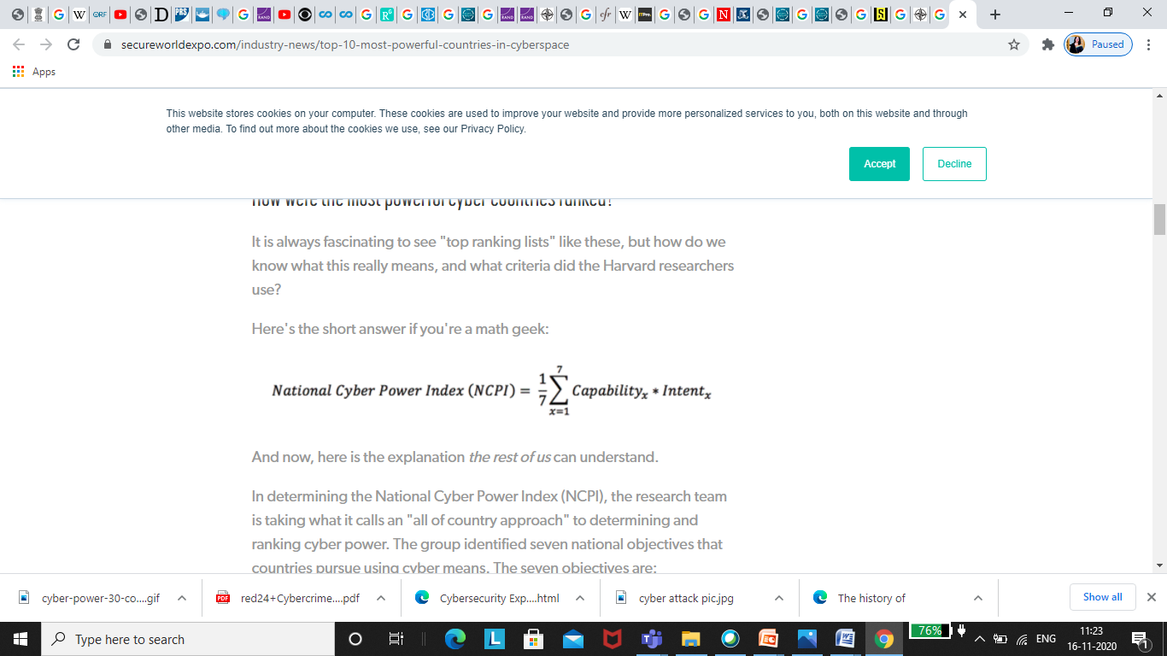
How were the most powerful cyber countries ranked?

Slide 30
The seven objectives are:
Surveilling and Monitoring Domestic Groups;
Strengthening and Enhancing National Cyber Defenses;
Controlling and Manipulating the Information Environment;
Foreign Intelligence Collection for National Security;
Commercial Gain or Enhancing Domestic Industry Growth;
Destroying or Disabling an Adversary's Infrastructure and Capabilities; and,
Defining International Cyber Norms and Technical Standards.

Slide 31
The overall NCPI assessment measures
The overall NCPI assessment measures the 'comprehensiveness' of a country as a cyber actor.
Comprehensiveness, in the context of NCPI, refers to a country's use of cyber to achieve multiple objectives as opposed to a few. The most comprehensive cyber power is the country that has (1) the intent to pursue multiple national objectives using cyber means and (2) the capabilities to achieves those objective(s)."

Slide 32
Discussion
Why Satellite Hacking Has Become The ‘Biggest Global Threat’ For Countries Like US, China, Russia & India?
What limits should be placed on cyber warfare and how should they be enforced?
Should it be considered a state’s responsibility to defend itself against an attack or the UN’s?
What is the best way to limit cyber warfare and to nullify the threat as best as possible and why?
Capstone

