Slide 1
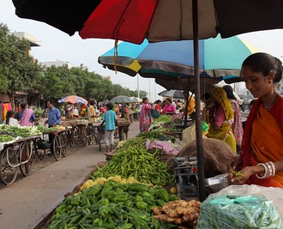
Role of Street vendors in URBAN LAND SCAPE MANAGEMENT
Amit Kumar Singh
Notes:
NOTE:
To change the image on this slide, select the picture and delete it. Then click the Pictures icon in the placeholder to insert your own image.

Slide 2
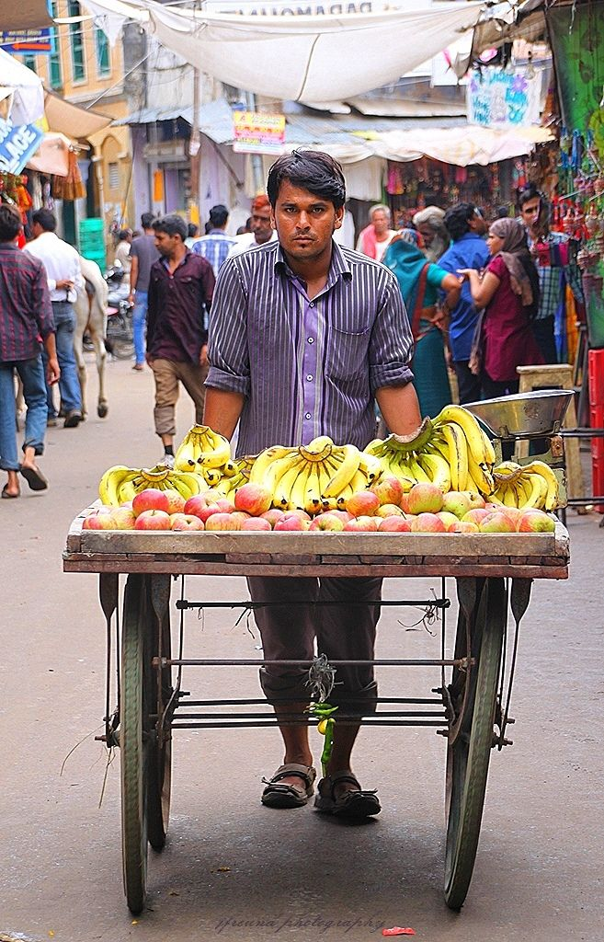
Street Vendors
According to Street Vendors (Protection of livelihood and Regulations of Street Vendors) Act 2014,
“Street Vendor” means a person engaged in vending of articles, goods, wares, food items or merchandise of everyday use or offering services to the general public, in a street, lane, sidewalk, footpath, pavement, public park or any other public place or private area, from a temporary built up structure or by moving from place to place and includes hawker, peddler, squatter and all other synonymous terms which may be local or region specific.

Slide 3
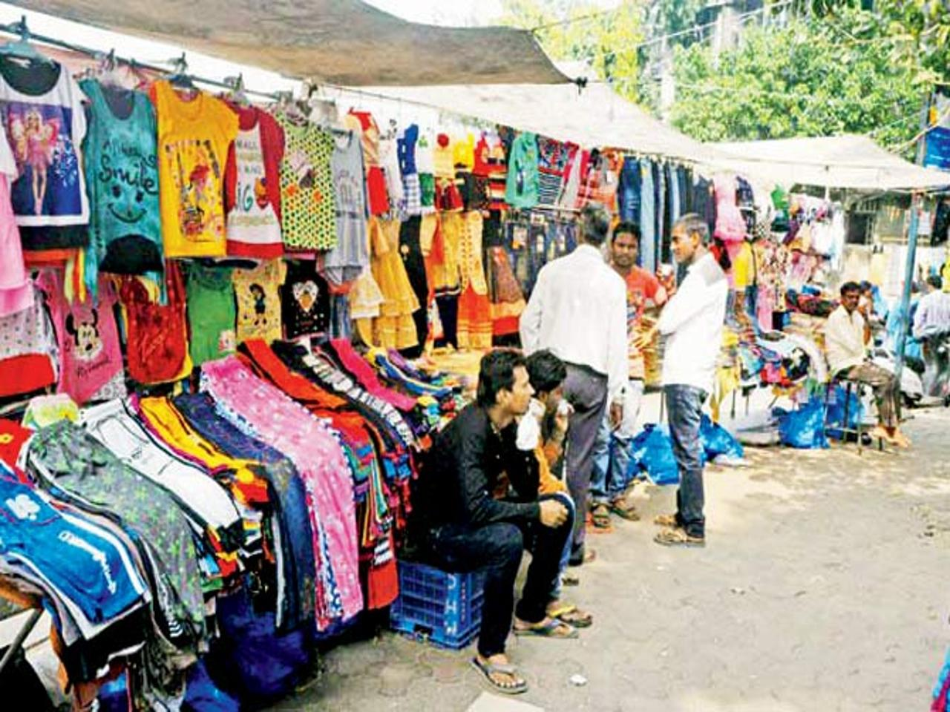
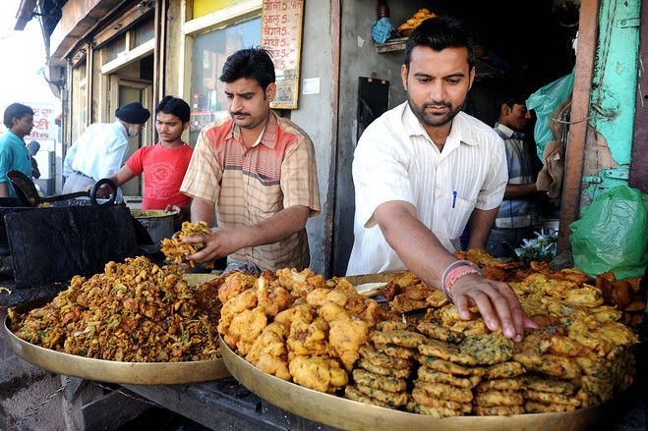
Introduction
Street vending is a vibrant sector of the urban informal economy, 2.5% population of urban area consists of Street Vendors .
Survival of street vending is not only important for the livelihood of the street vendors but also for the extended livelihood support they provide to vast population connected with marginalized small trade activities like small scale traders, home based workers, small manufactures, marginalized farmers etc.
Street vending provides entrepreneurial opportunities to people who cannot afford to buy or rent fixed premises.

Slide 4
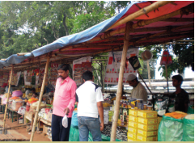
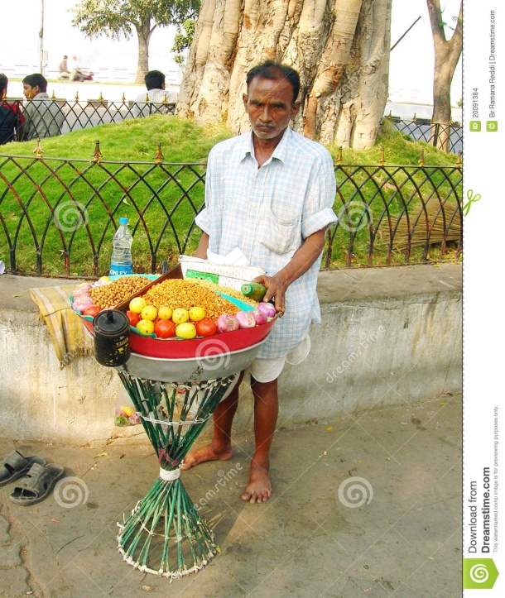
Introduction………..
Provides Affordable Goods: In addition to that, street vendors are the only retail source for 77% urban poor population who does not have the financial capacity to buy their food, clothes and other products from established shops.
Affordable foods to Urban Poor: As per WHO and FAO food hawkers provide 1000 kilocalorie food value within the range of RS.7 to RS. 10 with a choice of more than 300 type of food. Food vendors play a very important role in food security and they helps to preserve indigenous traditional food.
Provides social safety-net: Street vending is laboratory for entrepreneurship, family business and social interaction

Slide 5
Economic Importance of Street Vendors in India
Employment for vulnerable: 93% workforce in India is unorganized workers which generates 65% of the GDP and the street vending are the second largest workforce in informal workers besides Agricultural workers.
In India, street vending makes up 11 per cent of total (non-agricultural) urban employment, and 14 per cent of total (non-agricultural) urban informal employment.
Strength – 4 Crore including Urban, Rural, Rail, Hut, Weekly Market, phare-wala and other hawkers. Selling – products of small, tiny, home-based producers window of the low circuit economy, selling 80% produces of agricultural products

Slide 6

Economic Importance of Street Vendors in India…….
Street vendors contribute directly to the overall level of economic activity, and to the provision of goods and services;
Total 10 crore people depending on this sector including vendors family members and producers
Turnover – 800 crore/day Business – Applying tradition business acumen of India Social Protection – Still Largely Unprotected Serves – mostly the urban & rural poor
Street vending is an actual or potential source of government tax revenues;

Slide 7
Problems due to Street Vendors
Vehicular and pedestrian congestion,
Street vendors may cause traffic accidents
Lack of Parking Space
Littering in public space
Law and Order Issues
Increase the levels of vehicle-generated air pollution,
Street vendors do not pay taxes on their earnings, and to charge sales or value added taxes to their customers
Street vendors of food and drink pose major public health problems;
Less professional, committed and responsible than general shopkeepers

Slide 8
Problems of Street Vendors
Viewed as illegal activity in many cities across the world
Lack of a fixed and secure workplace in the city and the threat of evictions and relocations from vending sites
The government does not recognize the contribution of street vendors towards economic and social wellbeing of urban population.
Street vendors are usually associated with infringement of public spaces, causes traffic congestion, inadequate hygiene, and poor waste disposal.
They are compulsory forced to pay 15 to 20 percent of their daily income as inducements to local police.
Lack of workplace Amenities and urban Infrastructure (eg: shelter, street drainage, water and toilets, or storage)
Lack of capital/high interest rates

Slide 9
Supreme Court Ruling (1989)on Street Vending
“If properly regulated, according to the exigency of the circumstances, the small traders on the side walks can considerably add to the comfort and convenience of the general public, by making available ordinary articles of everyday use for a comparatively lesser price.
An ordinary person, not very affluent, while hurrying towards his home after a day’s work, can pick up these articles without going out of his way to find a regular market.
The right to carry on trade or business mentioned in Article 19 (1) g of the Constitution, on street pavements, if properly regulated, cannot be denied on the ground that the streets are meant exclusively for passing or re-passing and no other use." [Sodan Singh & Others versus New Delhi Municipal Council, 1989]

Slide 10
Major directions of SC verdict
Every ULB shall form TVC
Every TVC with 40% SVs ( 30% are Women)
TVC shall function as per NSV Policy 2009
TVC shall demarcate ULB into Vending Zones
TVC shall conduct survey and register SVs
Registration shall be completed in 4 months
TVC shall meet once in a month compulsory
All SVs shall be free to approach HC benches for redressal of their grievance
High Court shall form a bench to deal SV cases
All ULBs shall implement NSVP 2009 for SVs

Slide 11
Recognition of Street Vendors
In 2000 National Hawkers Federation(NHF) was formed to bring justice to the hawking community of India, with a membership of 550 independent hawkers unions / associations / organizations along with 11 Central Trade Union affiliated unions.
Relentless movement & advocacy leads to undertake 1st hawkers policy in 2004.
Later in 2009, a Bill (The Street Vendors (Protection of livelihood and regularization of Hawking) Act, 2009 was drafted undertaken with a greater mobility and justice to the hawking communities.

Slide 12
Salient features of 2009 Act
Protection of livelihood and regularization of hawking.
The Act provides for designating Vending and Non- Vending Zones
It states maximum number of street vendors who can be accommodated in any vending zone. If number exceeds, draw of lots
A maximum of 2.5 % of a city’s population could be accommodated in the vending zones, depending on the holding capacity.
Recognizing that every city and every street is different, the Policy calls for participation of street vendors in policy-making through Town and Ward Vending Committees, calling for local solutions to local problems.
Beautification and clean up programs undertaken by the states or towns should actively involve street vendors in a positive way as a part of the beautification programme.
The Act also states that the plan for street vending will contain consequential changes needed in the existing master plan, development plan, zonal plan, layout plan etc. for accommodating street vendors in the designated vending zones.

Slide 13
Spatial Planning norms - demarcation of vending zones
The demarcation of hawking zones should be city/town specific.
It should take into account the natural propensity of the Street vendors to locate in certain places at certain times in response to patterns of demand for their goods/services
City authorities should provide sufficient spaces, designated as ‘vendors markets’ in layout plans at locations.
Mobile urban vending should be permitted in all areas even outside the designated vendors’ markets, unless designated as ‘no-vending zone’ through a participatory process.
With the growth of city/town every new area should have adequate provisions for Street vendors.

Slide 14
Town Vending Committee
The 2009 policy greatly clarifies the composition, duties and functions of the Town Vending Committees. Town Vending Committee to be headed by the Municipal Commissioner with representation of
40% of members from Street vending community
20% from ULB and other Govt Departments (local authority, planning authority and Revenue)
10% from Police Department.
10% representatives from Banks and LIC
10% elected members of ULB ( Area/Ward Sabha representatives Or CBOs) 10% from NGOs, Professional groups ( lawyers, doctor, town planners, architects

Slide 15
Functioning of Town Vending Committee
Registration of street vendors through photo census, registration, new entrants, ID cards, registration fee and process
Collection of revenue - registration fee, Monthly maintenance charges, fines and others •Recommending to the ULB for demarcation of vending Zones
Eviction, relocation and Confiscation
Promotional measures ( Public Health and Hygiene, Education and skill trainings, Credit and insurance, Social security, allotment of space, stationery stalls, rehabilitation of child vendors etc.,)
Maintenance of records
The Committee should ensure that provisions for space for vendors’ markets are pragmatic, consistent with formation of natural markets, sufficient for existing demand for vendor’s goods and services, as well as likely increase in line with anticipated population growth.

Slide 16
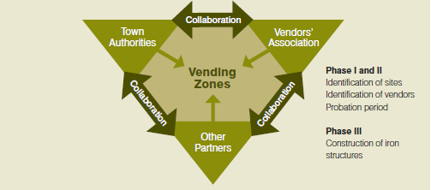
Bhubaneswar Model of Integrating Vendors into City Plans
Bhubaneswar Model of Integrating Vendors into City Plans – A Unique Public Private Partnership Model
Bhubaneswar is among the first cities in India to acknowledge street vendors as an integral part of the city and to manage and support them through a complex public, private, and community partnership model

Slide 17
Bhubaneswar Model of Integrating Vendors into City Plans
Success Factors
Political Will – Acknowledgement of vending as legitimate Profession
Able leadership from Vendors side
Social Dialogue, Consensus building and allowing multiple voices in debates
Effective Partnership among Local body, Vendors and Private Partners
A Three Phase Approach
Phase I: – Mapping of vendors’ spatial distribution jointly by Town Authorities and Vendors Associations
Phase 2: - Six Month Probation period – only bamboo structures permitted
Phase 3: Issue of permits and construction of Iron Kiosks in partnerships with private sector

Slide 18
Way Ahead
Street vendors are an integral part of urban economies
They offer easy access to a wide range of goods and services in public spaces
They sell everything from fresh vegetables to prepared foods, from building materials to garments and crafts, from consumer electronics to auto repairs to haircuts.
They provide the main source of income for their households, bringing food to their families and paying school fees for their children
They create jobs, not only for themselves but for porters, security guards, transport operators, storage providers, and others.
Street trade also adds vibrancy to urban life

Slide 19
Thank You

