Slide 1
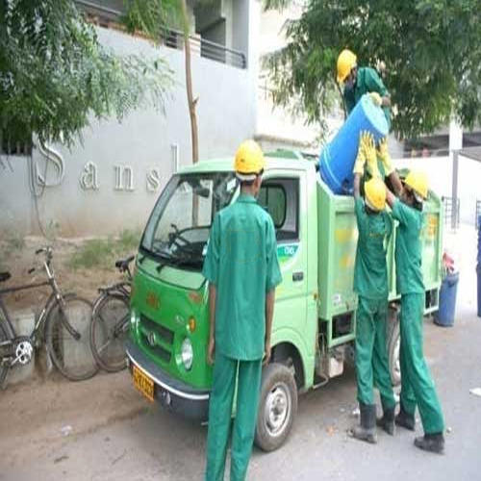
Role of community participation in ACHIEVING ZERO WASTE CITY
Amit Kumar Singh
Notes:
NOTE:
To change the image on this slide, select the picture and delete it. Then click the Pictures icon in the placeholder to insert your own image.

Slide 2
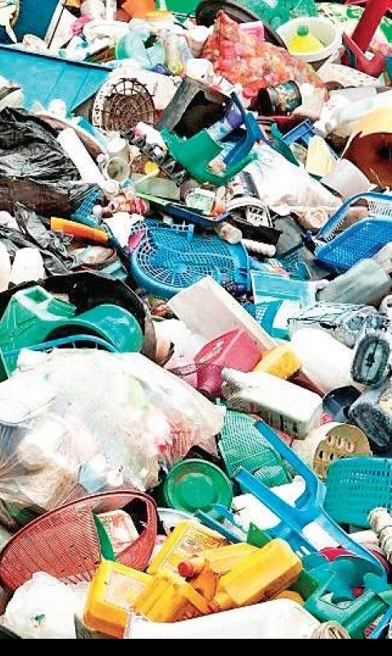
Introduction
Solid waste management (SWM) has become a major concern both to the natural environment and society.
The rapid urbanisation, change in consumer habit, diversification in the quality and consumption of waste generated and space constraints for dumping site has worsened the situation.
In India, waste generation is expected to increase from the present 500 grams to 945 grams per capita.
The estimated land requirement for disposal of such huge quantum of waste would be 169.6 sq. kms as compared to 20.2 sq. kms in 1997

Slide 3
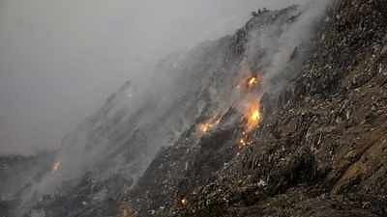
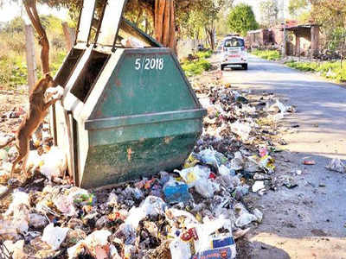
Fragile Waste Management System
Waste has been treated as a burden and social problem and thus largely managed by “end-of-pipe” solutions such as landfill.
The traditional waste management system, which primarily relies on landfill, significantly pollutes our environment, and thus an improved and efficient waste management system is required.
Most ULBs lack adequate infrastructure and face various strategic and institutional weaknesses, such as poor institutional capacity, financial constraints, and a lack of political will
Need for innovative and sustainable solutions.

Slide 4
Need for Zero Waste strategy
Mahatma Gandhi said that, “There is enough in the world for everyone's need, but not enough for everyone's greed.”
More recent scientific analysis indicates that we would need several planets to provide the world’s population with the typical European consumption patterns and several more if everyone consumed as much as the average American.
The huge amount of waste is the evidence that we are doing something wrong.
We have to design and manage products and processes systematically to eliminate the waste and materials, conserve and recover all resources and not burn or bury them.
Here a Zero Waste Strategy can take an important step towards addressing the issue

Slide 5
Concept of Zero Waste
Zero Waste: The conservation of all resources by means of responsible production, consumption, reuse, and recovery of products, packaging, and materials without burning and with no discharges to land, water, or air that threaten the environment or human health.
Zero Waste International Alliance
The Zero Waste strategy says no to incinerators, no to mega-landfills, no to the throwaway society and yes to a sustainable society
The visionary concept of zero waste advocates a systematic process of designing out waste and recovering resources from waste

Slide 6
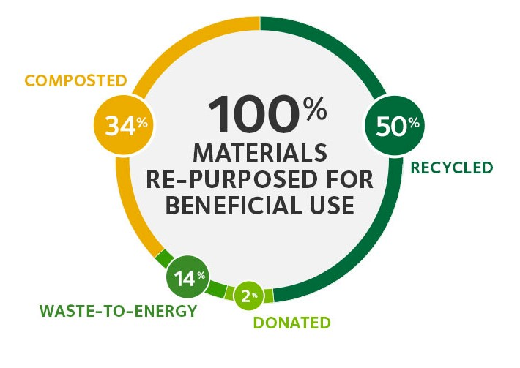
Objectives of Zero Waste
Zero Waste” is a philosophy of eliminating the generation of materials that have no viable or economic option for end-of-use management.

Slide 7
Achieving Zero Waste
The generation of waste can be lowered through a variety of options
The 3R principles are among the top three in the waste hierarchy and they are considered as the founding principles of sustainable waste management system.
But it is the Fourth ‘R’, which holds the key to sustainability.
Reduce
Reuse
Recycle
R =?

Slide 8
The Fourth R
The Fourth R is Responsibility, which holds the key to sustainability.
Individual Responsibility
We need every sector of the Society involved
We need community responsibility at the back end of the problem
Industrial entity must take responsibility for product design and manufacturing
Good political leadership to bring these two together
Community Responsibility
Industrial Responsibility
Professional Responsibility
Political Responsibility

Slide 9
Indian MSW Composition
Municipal waste in Indian Municipal Solid waste tend to have a higher organic and ash/grit content, and also a higher moisture content.
It has been estimated that recyclable content in solid waste varies from 13 to 20% and compostable material is about 65 to 80%.
Indian MSW Composition
Description | Percentage by weight
Vegetable leaves | 40.15
Grass | 3.80
Paper | 0.81
Plastic | 0.62
Glass/ceramics | 0.44
Metal | 0.64
Stones/ashes | 41.81
Miscellaneous | 11.73

Slide 10
Engage the whole community
Zero waste is a big challenge
Not to leave Zero Waste to “waste experts”.
Everyone has a role to play.
Citizens or communities need to take the leadership role in making their neighbourhood a Zero Garbage Society.
  Ensure almost 100% segregation of waste
  Ensure almost 100% collection of waste
  Maximize recycling of dry waste
  Processing of waste locally within the society/ward
  Minimal amount of waste sent outside the society
  Peoples participation through awareness drive
  Monitoring of collection and segregation level

Slide 11
Benefits of Zero Waste
Zero waste protects the environment, benefits communities and supports a strong local economy.
Good for the Economy: - Reducing, reusing and recycling create 10 times more jobs than disposal, Reduction in transportation cost for Municipal Corporation
Good for the Environment: It takes 20 time less energy to make an aluminum can from recycled materials than raw materials.
Once Natural resources are used, the goods are simply dumped in a landfill or destroyed in an incinerator.
Extracting raw materials from natural spaces requires large amounts of energy and causes pollution,
Zero waste is good for the community: Reducing and reusing means people buy less and as products are made to last.

Slide 12
Thank You

