Slide 1

Big Data Visualization using BI Tool : Tableau 10.2 Version
Dr. Surabhi Pandey
Indian Institute of Public Administration
Email: dr.pandeysurabhi@gmail.com
M: +91971771 0362

Slide 2

Tableau is one of the most fast-growing data visualization tools which is currently being used in the BI industry.
It is the best way to change or transform the raw set of data into an easily understandable format with zero technical skills and coding knowledge.

Slide 3
Why Tableau
In 2008, Tableau was a Codie award winner for "Best Business Intelligence Solution" by the Software and Information Industry Association.
The company was recognized as a leader in the Gartner Magic Quadrant for seven consecutive years between 2012 and 2019.

Slide 4
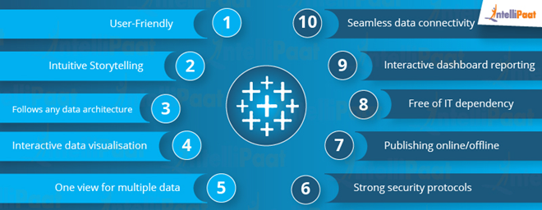
Advantages

Slide 5
Tableau Product Suite
Tableau Product Suite includes the following:
Tableau Server
Tableau Desktop
Tableau Reader
Tableau Online
Tableau Public

Slide 6
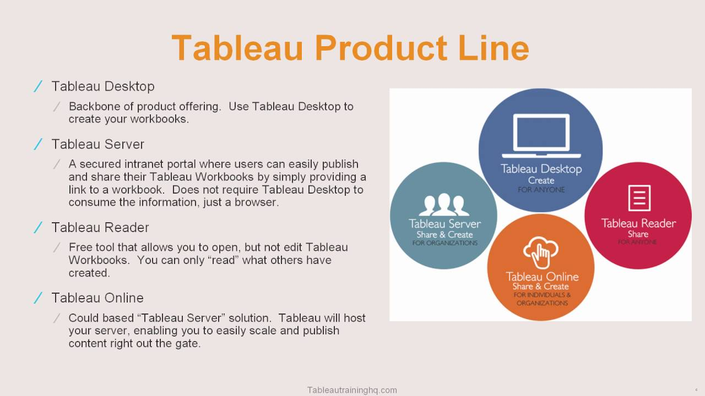
Tableau Product Lines

Slide 7


Slide 8
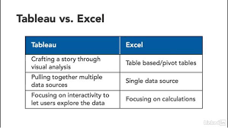

Slide 9


Slide 10
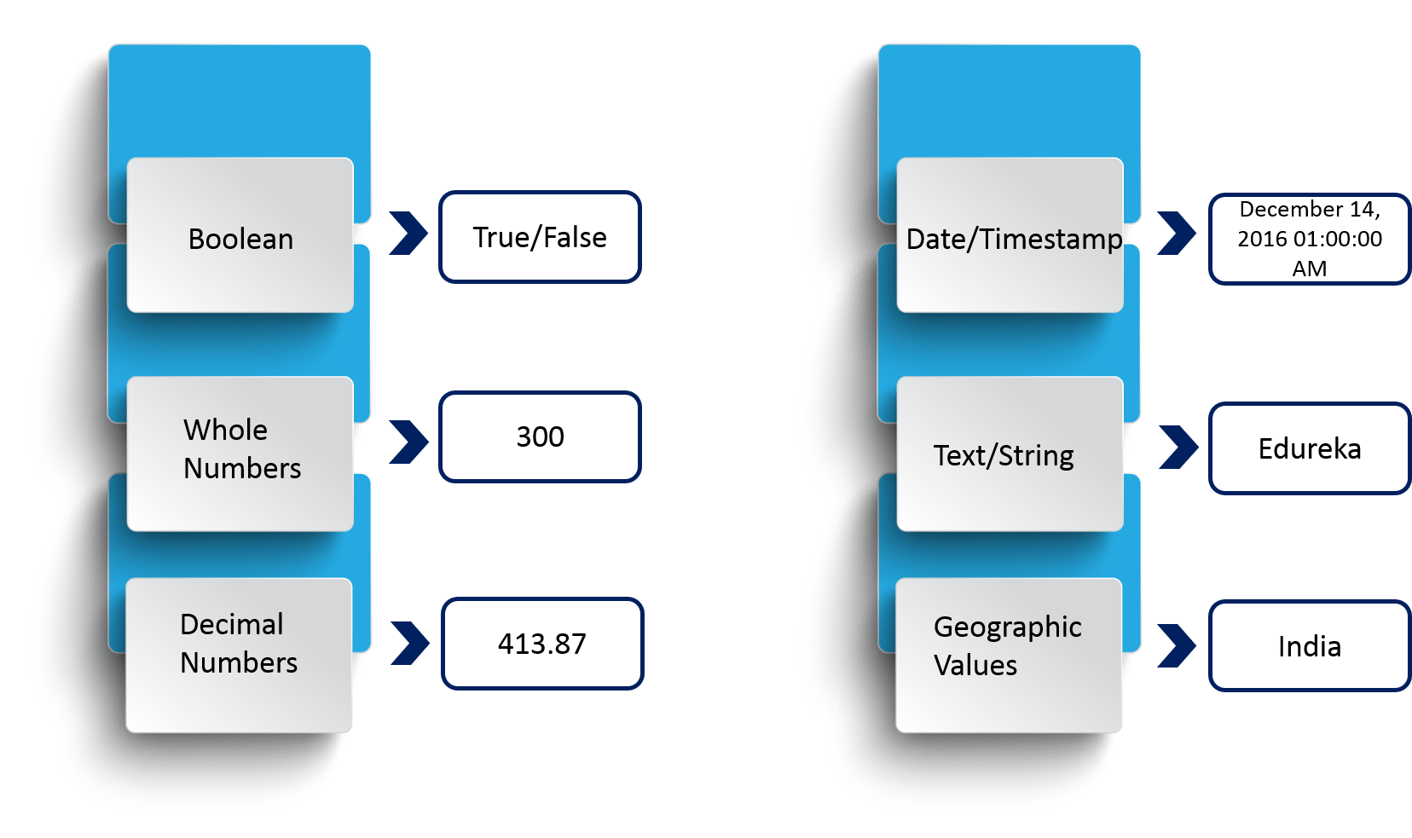
Tableau Data Types

Slide 11
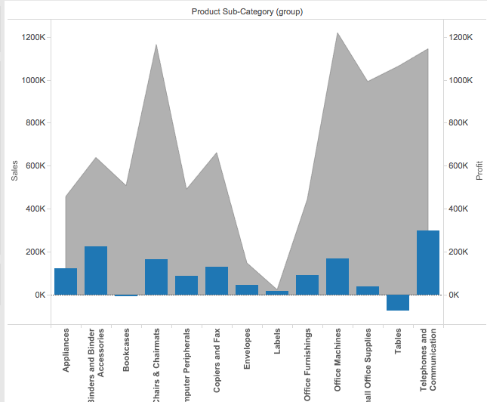
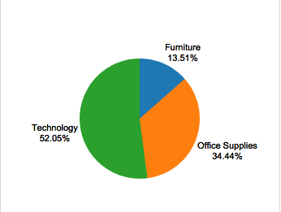
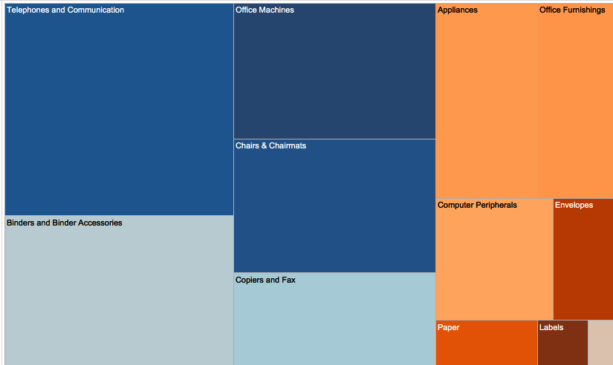
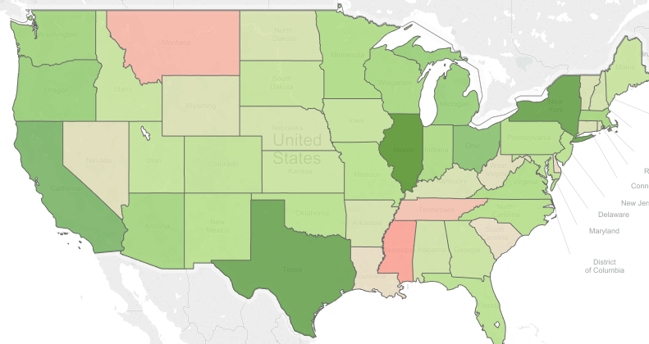
Tableau Visualization Examples

Slide 12
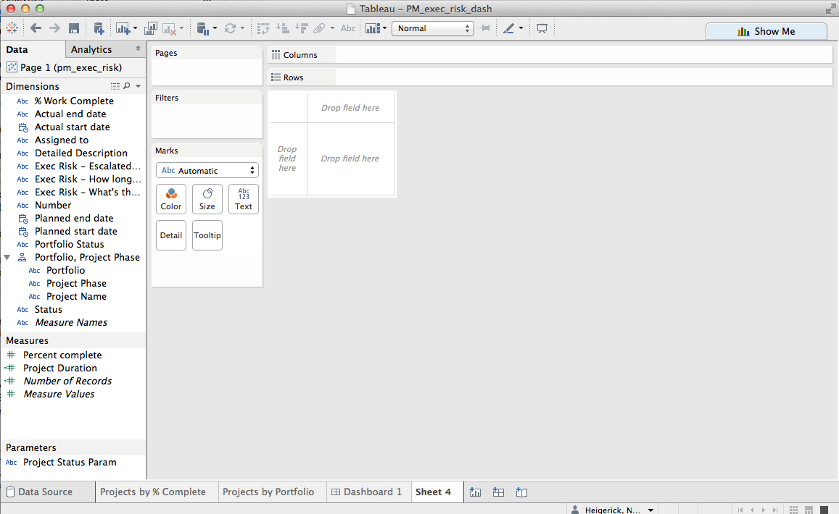
Tableau Desktop

Slide 13
Tableau
?
Questions

Slide 14
Thank You

