Slide 1
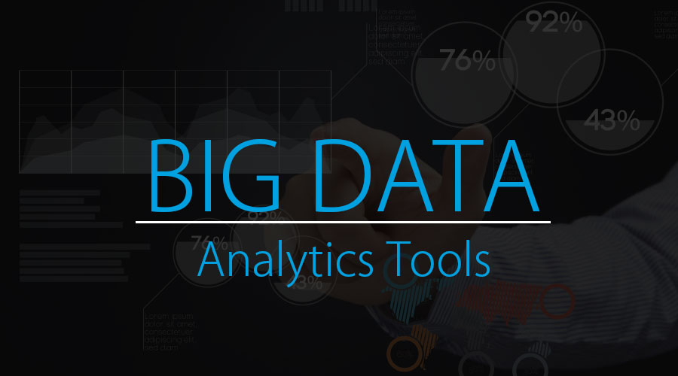

Slide 2
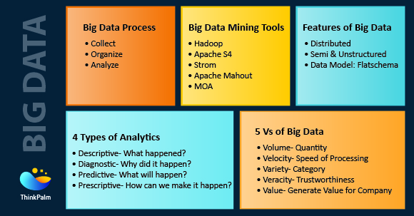

Slide 3
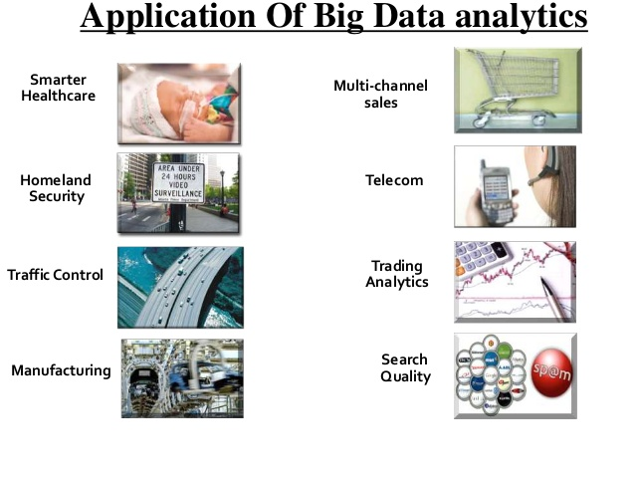

Slide 4
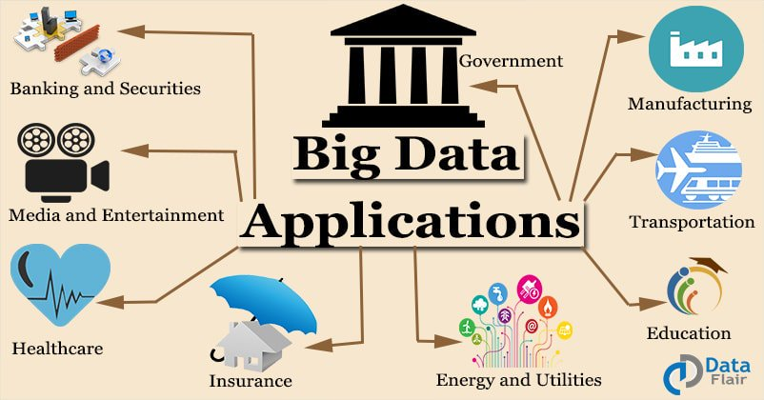

Slide 5
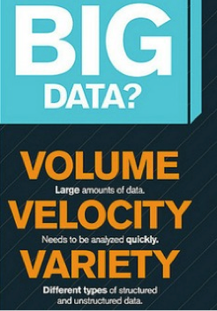
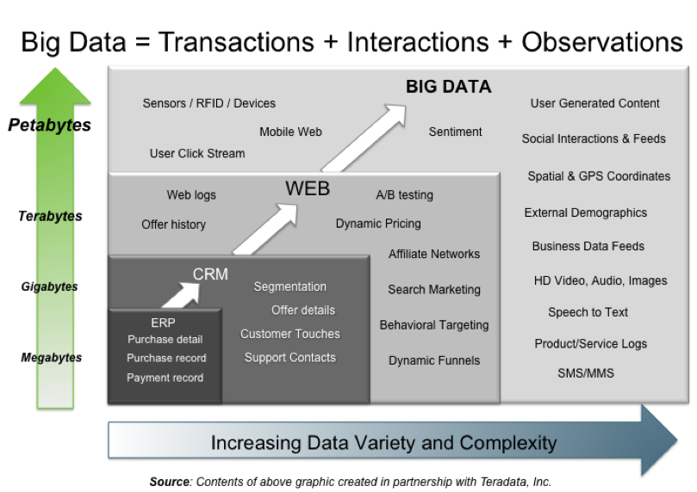
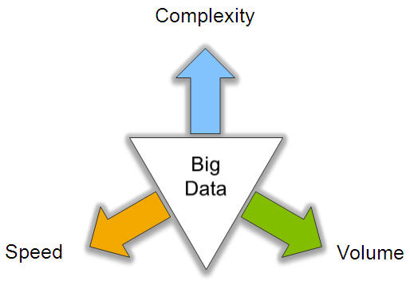
Big Data: 3V’s

Slide 6
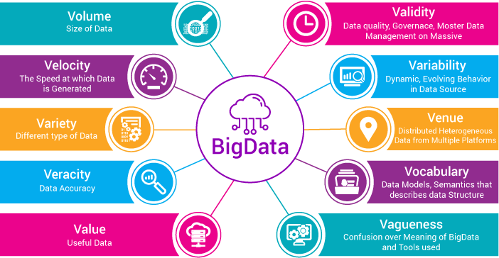

Slide 7
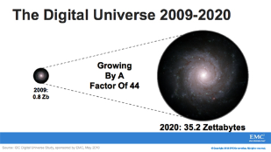
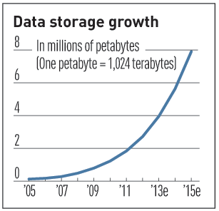

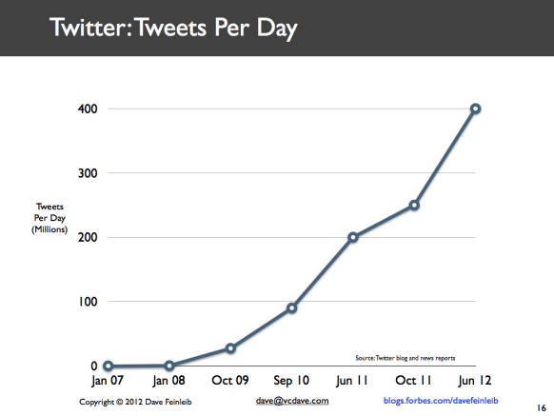
Volume (Scale)
Data Volume
  44x increase from 2009 2020
  From 0.8 zettabytes to 35zb
Data volume is increasing exponentially
Exponential increase in collected/generated data

Slide 8
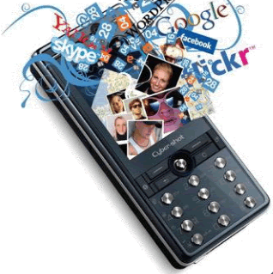
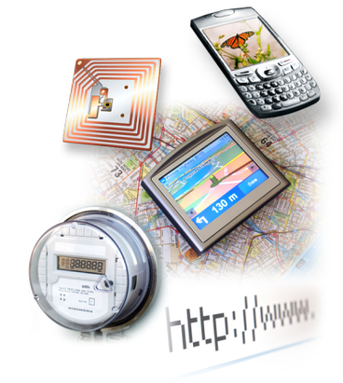

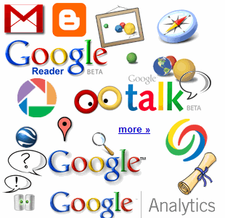

4.6 billion camera phones world wide
30 billion RFID tags today
(1.3B in 2005)
12+ TBs
of tweet data
every day
100s of millions of GPS enabled devices sold annually
? TBs of
data every day
25+ TBs of
log data every day
2+ billion people on the Web by end 2011
76 million smart meters in 2009…
200M by 2014

Slide 9
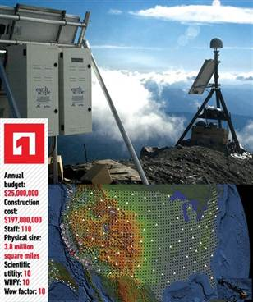
The Earthscope
1.
The Earthscope is the world's largest science project. Designed to track North America's geological evolution, this observatory records data over 3.8 million square miles, amassing 67 terabytes of data. It analyzes seismic slips in the San Andreas fault, sure, but also the plume of magma underneath Yellowstone and much, much more. (http://www.msnbc.msn.com/id/44363598/ns/technology_and_science-future_of_technology/#.TmetOdQ--uI)

Slide 10
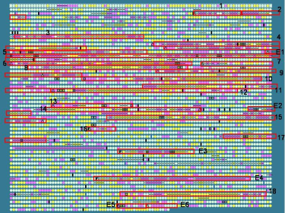
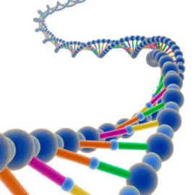
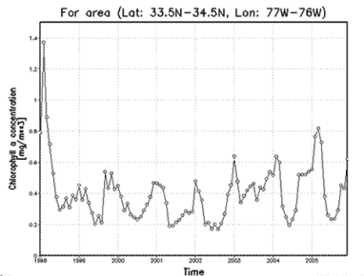

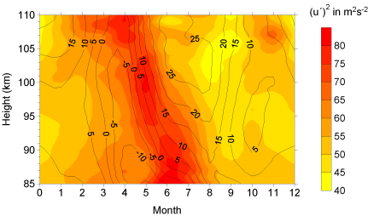
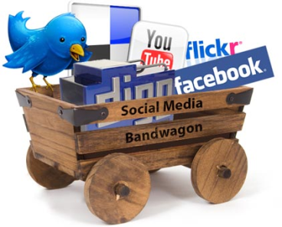
Variety (Complexity)
Relational Data (Tables/Transaction/Legacy Data)
Text Data (Web)
Semi-structured Data (XML)
Graph Data
  Social Network, Semantic Web (RDF), …
Streaming Data
  You can only scan the data once
A single application can be generating/collecting many types of data
Big Public Data (online, weather, finance, etc)
To extract knowledge➔ all these types of data need to linked together

Slide 11

















A Single View to the Customer
Social Media
Banking
Finance
Gaming
Our
Known
History
Customer
Entertain
Purchase

Slide 12

Velocity (Speed)
Data is begin generated fast and need to be processed fast
Online Data Analytics
Late decisions ➔ missing opportunities
Examples
  E-Promotions: Based on your current location, your purchase history, what you like ➔ send promotions right now for store next to you
  Healthcare monitoring: sensors monitoring your activities and body ➔ any abnormal measurements require immediate reaction

Slide 13
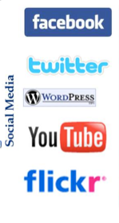
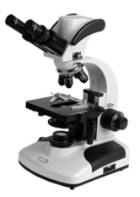
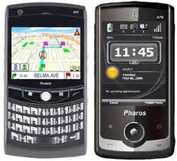
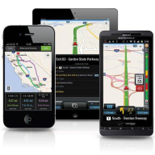
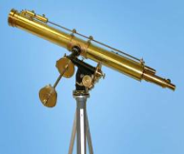
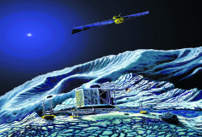
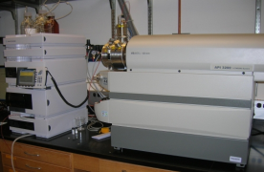
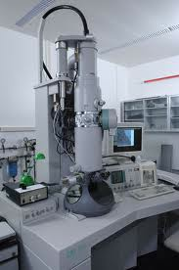
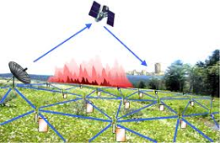
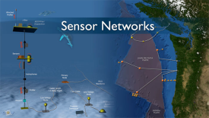
Real-time/Fast Data
Mobile devices
(tracking all objects all the time)
Social media and networks
(all of us are generating data)
Scientific instruments
(collecting all sorts of data)
Sensor technology and networks
(measuring all kinds of data)
The progress and innovation is no longer hindered by the ability to collect data
But, by the ability to manage, analyze, summarize, visualize, and discover knowledge from the collected data in a timely manner and in a scalable fashion

Slide 14
Real-Time Analytics/Decision Requirement
Product
Recommendations
that are Relevant
& Compelling
Learning why Customers
Switch to competitors
and their offers; in
time to Counter
Influence
Behavior
Customer
Friend Invitations
to join a
Game or Activity
that expands
business
Improving the
Marketing
Effectiveness of a
Promotion while it
is still in Play
Preventing Fraud
as it is Occurring
& preventing more
proactively

Slide 15
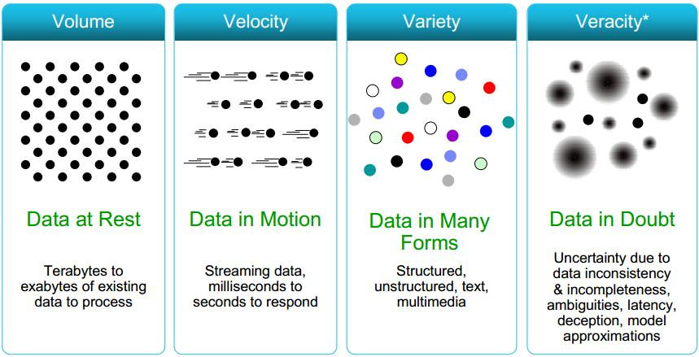
Some Make it 4V’s

Slide 16
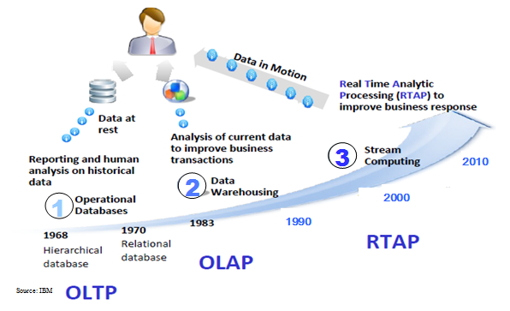
Harnessing Big Data
OLTP: Online Transaction Processing (DBMSs)
OLAP: Online Analytical Processing (Data Warehousing)
RTAP: Real-Time Analytics Processing (Big Data Architecture & technology)

Slide 17
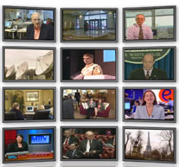
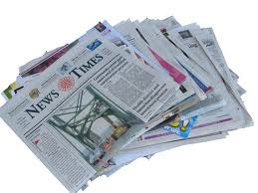
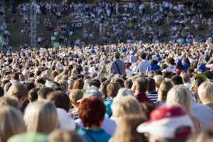

The Model Has Changed…
The Model of Generating/Consuming Data has Changed
Old Model: Few companies are generating data, all others are consuming data
New Model: all of us are generating data, and all of us are consuming data

Slide 18
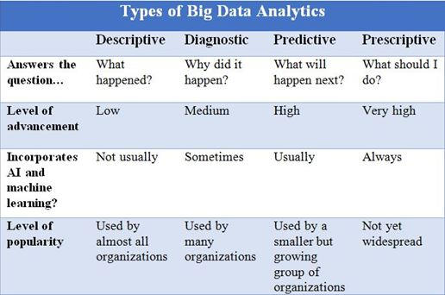

Slide 19
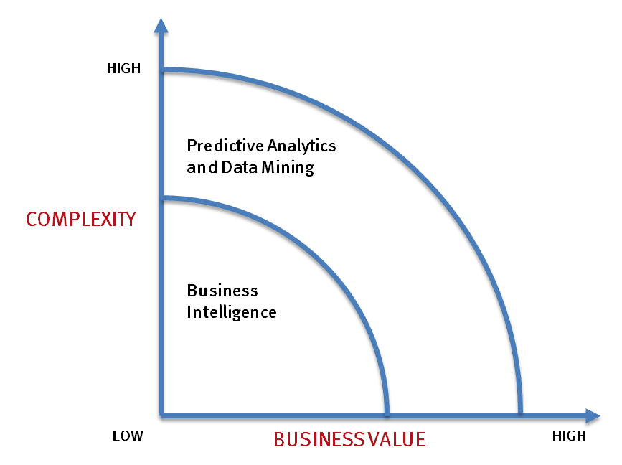
What’s driving Big Data
- Optimizations and predictive analytics
- Complex statistical analysis
- All types of data, and many sources
- Very large datasets
- More of a real-time
- Ad-hoc querying and reporting
- Data mining techniques
- Structured data, typical sources
- Small to mid-size datasets

Slide 20
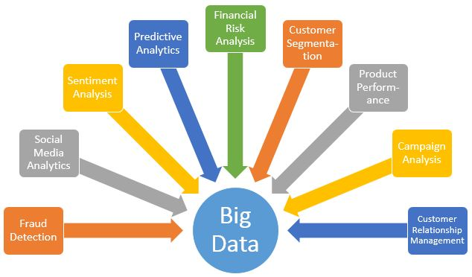

Slide 21
The Evolution of Business Intelligence
Interactive Business Intelligence &
In-memory RDBMS
QliqView, Tableau, HANA
Big Data:
Real Time &
Single View
Graph Databases
Speed
Scale
BI Reporting
OLAP &
Dataware house
Business Objects, SAS, Informatica, Cognos other SQL Reporting Tools
Big Data:
Batch Processing &
Distributed Data Store
Hadoop/Spark; HBase/Cassandra
Scale
Speed
1990’s
2000’s
2010’s

Slide 22
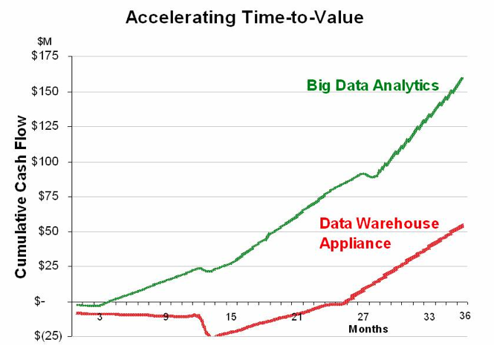
Big Data Analytics
Big data is more real-time in nature than traditional DW applications
Traditional DW architectures (e.g. Exadata, Teradata) are not well-suited for big data apps
Shared nothing, massively parallel processing, scale out architectures are well-suited for big data apps

Slide 23
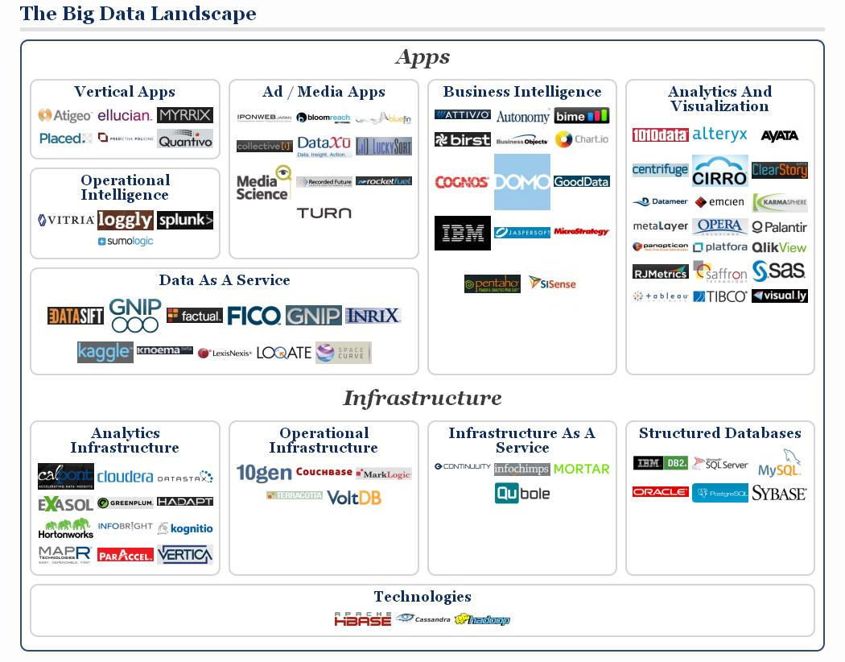

Slide 24
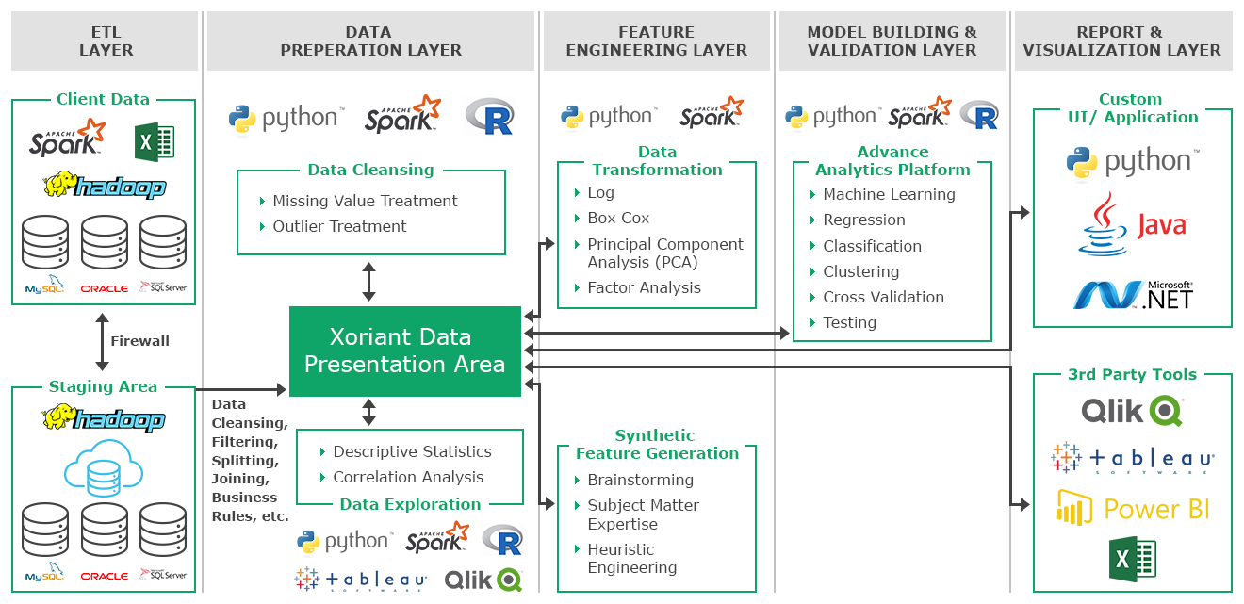

Slide 25
Topic 1: Data Analytics & Data Mining
Exploratory Data Analysis
Linear Classification (Perceptron & Logistic Regression)
Linear Regression
C4.5 Decision Tree
Apriori
K-means Clustering
EM Algorithm
PageRank & HITS
Collaborative Filtering

