Slide 1

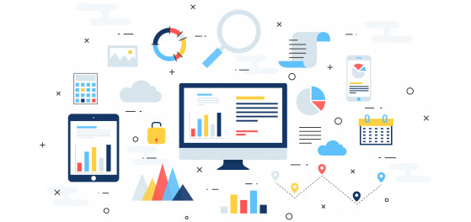
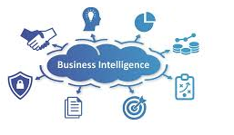
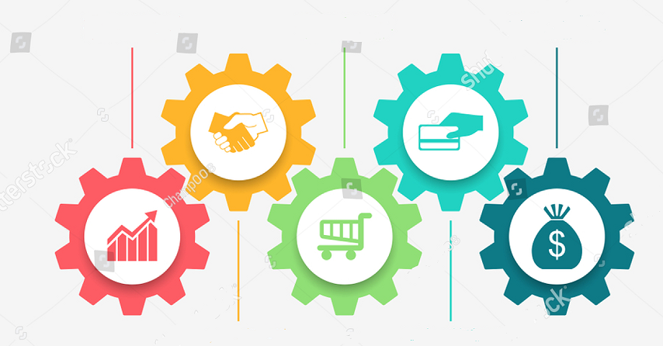
Business Intelligence and Analytics
Dr. Surabhi Pandey
Assistant Professor
(ICT & e- Governance)
Indian Institute of Public Administration,New Delhi

Slide 2
Learning Approach
Learning path
Goal
Strategy
Vision
HAVE A VISION FOR WHAT YOU ARE TRYING TO DO. USE DATA TO VALIDATE AND NAVIGATE THAT VISION.
THE GOAL IS TO TURN DATA INTO INFORMATION, AND INFORMATION INTO INSIGHT.
UP SKILLING FROM BASIC TO ADVANCE CONCEPT OF BI
USE of ANALYTICS TO MAKE DECISIONS

Slide 3
Session 1: Overview of Business Intelligence and Analytics
Explain Business Intelligence and Analytics
Types of Business Analytics
Application of Business Analytics
Case Study Discussion

Slide 4
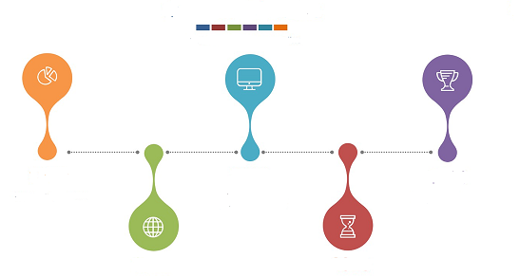
Business Intelligence and Analytics for Policy Making
concepts and components of Business Intelligence (BI).
Evaluate use of BI for supporting decision making in an organization.
Organisation Values and competitive edge
Data Visualisation
KPIs and performance Management

Slide 5
Business Analytics
Business Analytics is a scientific process that transforms data into insight that is used for fact-based or data-driven decision making.
It uses tools such as reports and graphs (simple), optimization, data mining, and simulation (complex)

Slide 6
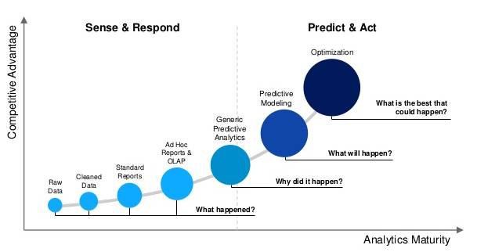
Data journey

Slide 7
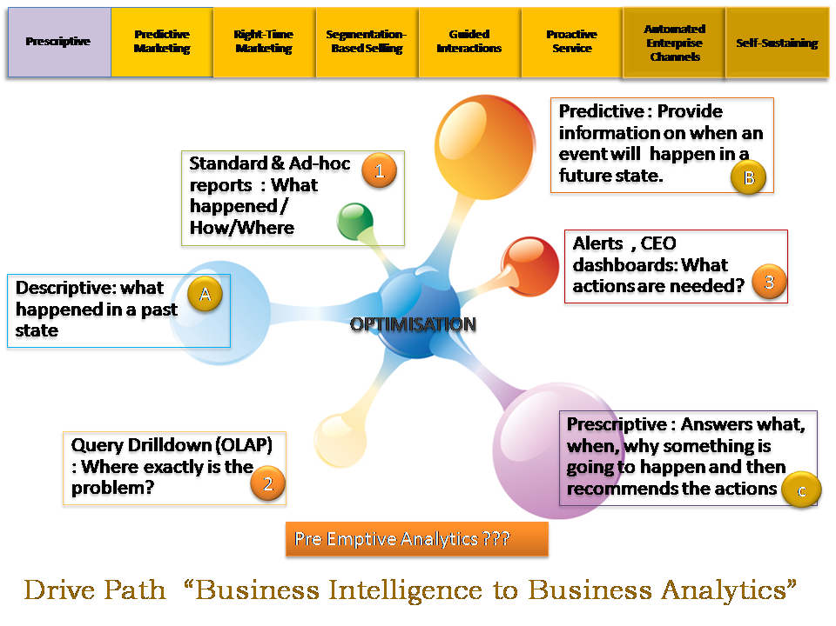
Data journey

Slide 8
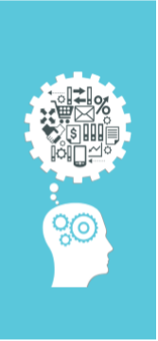
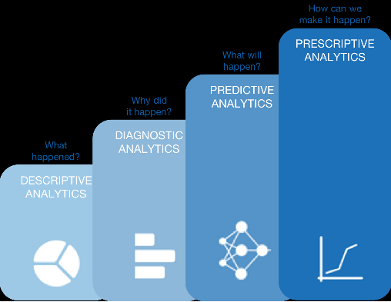
Types of Business Analytics

Slide 9
Data Strategy is Fundamental for Digital Transformation
Need to develop a robust data strategy before delving into the digital transformation process. Strong, actionable data sets the base for technology engines to work smarter and provide actionable insights.

Slide 10
What is driving the adoption of analytics in government?
Harnessing data and integrating it into the public departments will enable the government to build analytical frameworks and design citizen-centric policies and services, thus digitally transforming the entire nation.

Slide 11
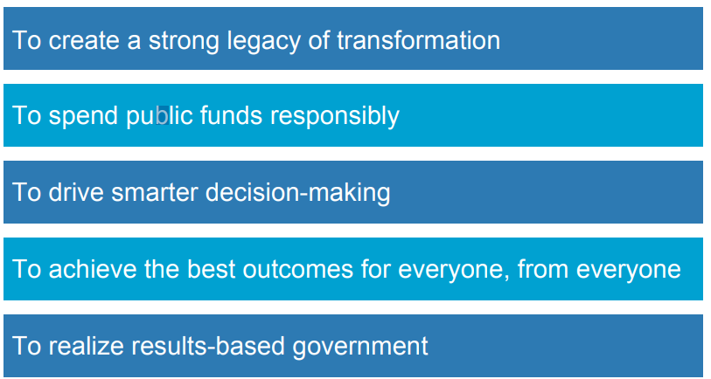
What is driving the adoption of analytics in government?

Slide 12
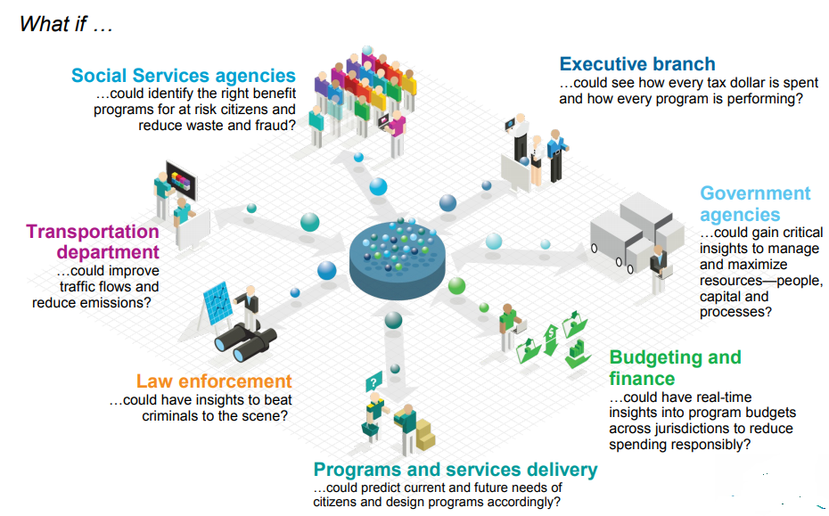
Governments are turning to analytics to deliver better results

Slide 13
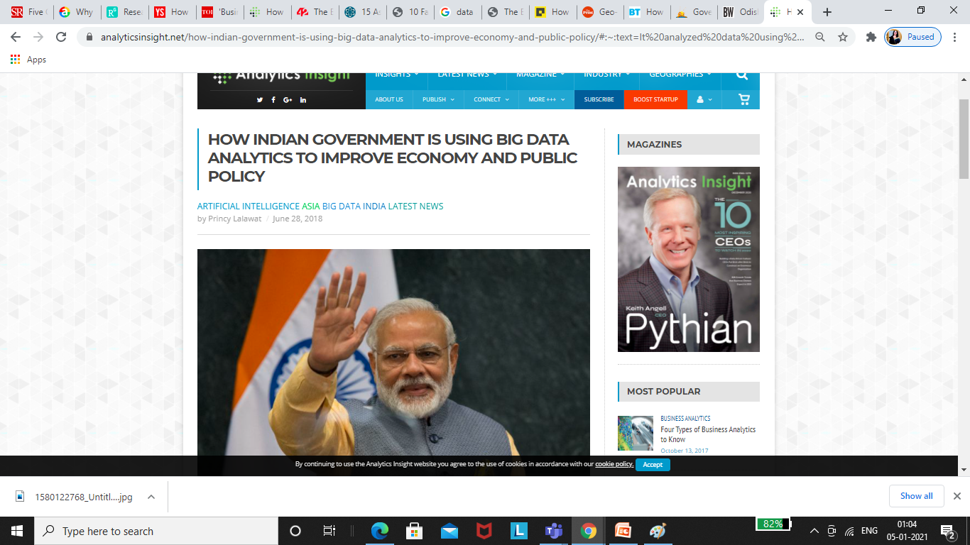
It is very surprising to note that over 90% of the world's data today has been created merely in the last two years.
The India data center market size is projected to reach USD 1.5 billion by 2022 from USD 1.0 billion in 2018, growing CAGR of 11.4% during the forecast period (2018-2022).
2017 will always be remembered as a year that kick-started this big data journey
Demonetization or introduction of GST is all data-driven policies
The Indian Government launched a project called Project insight in 2017, to catch tax evaders.
Kerala Government is utilizing data analytics to analyze, monitor, and manage water distribution in the capital city,
Odisha Government is banking on it to enable true penetration of Government Welfare Schemes, thereby ensuring access to food and other facilities to the least served areas.
Telangana Government's Aarogyasri Health Care Trust has developed and deployed a data analytics model to monitor and identify disease trends, along with fund management,
Facts

Slide 14
Major Initiatives such as-
Digital India, 100 smart cities mission, Aadhaar, and MyGov have been imagined to form a citizen-centric platform which enables citizens to connect with the government and contribute towards good governance.

Slide 15
Data-driven governance involves using data to drive
policy decisions,
set goals and
increase transparency

Slide 16
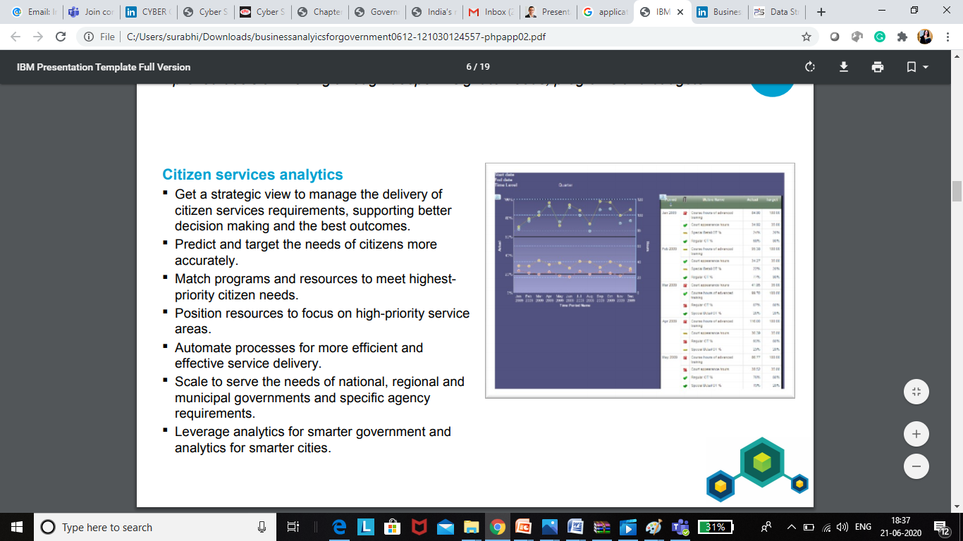
Analytics for improving citizen and organization services Improved decision making through deeper insight to needs, programs and budgets

Slide 17

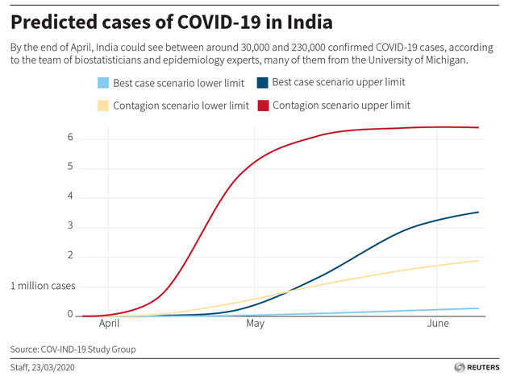
Case Study
5. Data Analytics and Policy Making
6. Business Intelligence and Governance
7. Key performance Indicators / Enablers

Slide 18
How data analytics can help transform the face of Digital India for a better, smarter, and brighter tomorrow.

Slide 19
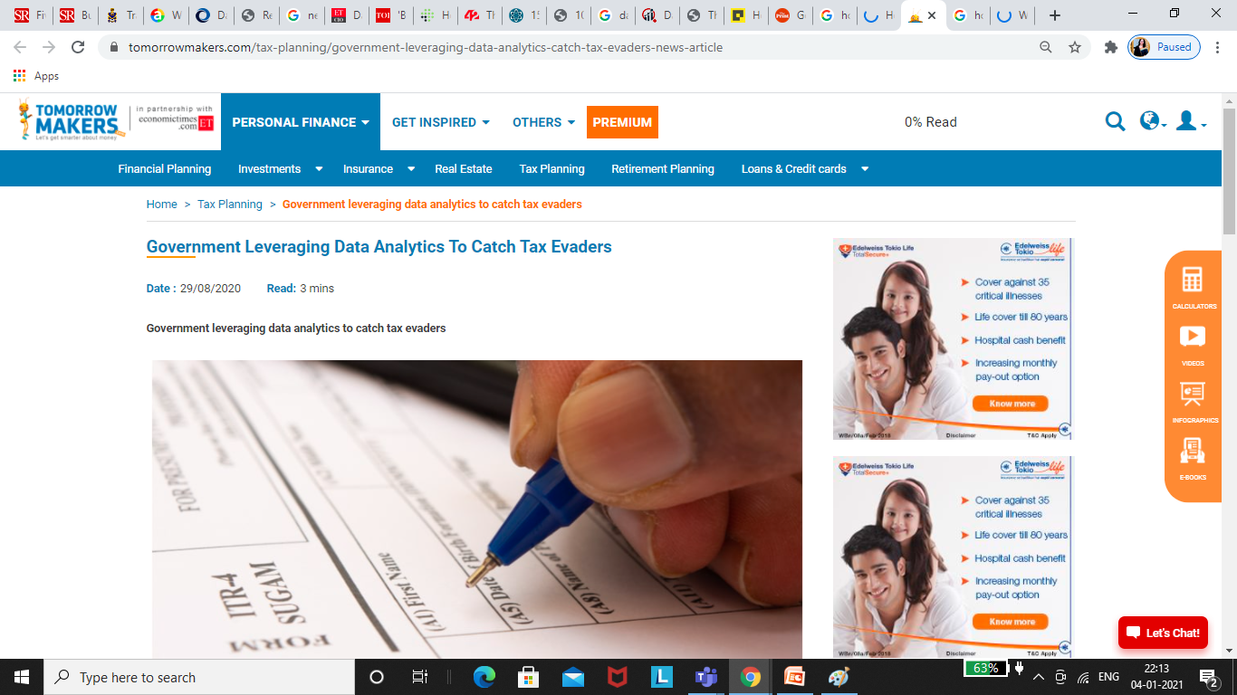
Use case 2:Leveraging Data Analytics to catch tax Evaders
For example, by analyzing historical data about the reaction of taxpayers on receiving tax notices can be summed up to predict their next move. Predictive analytics can also develop sophisticated risk profiles, analyze trends, flag potential audit issues and identify higher-risk cases for deeper investigation - potentially cutting off avenues for fraud even before they take place.

Slide 20
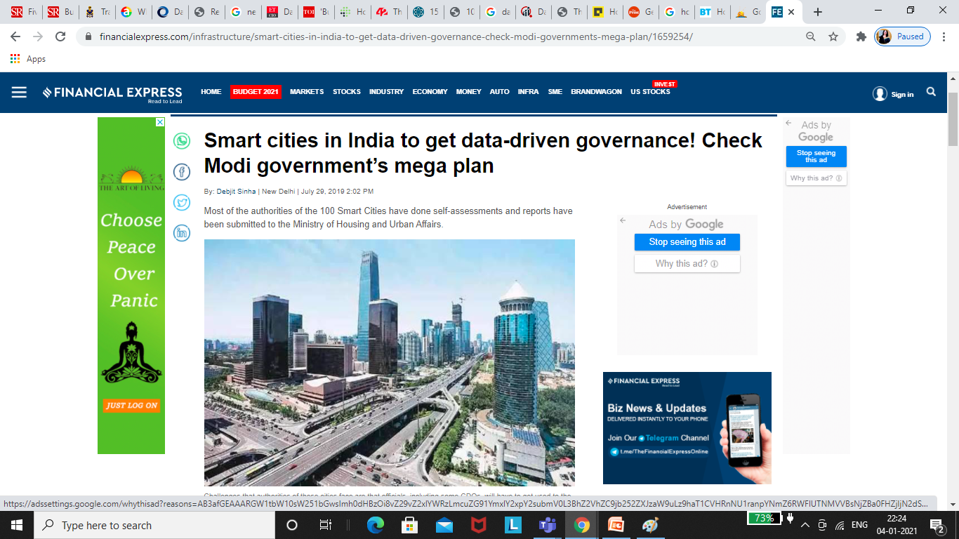
Use Case 3: 100 Smart Cities
The Ministry of Housing and Urban Affairs, that is nodal authority for ‘Smart Cities Mission’, has asked each municipality of 100 smart cities to appoint departmental “data champions”, and push for “data alliances”. This is part of Smart Cities Mission’s “Data Maturity Assessment Framework”. The central government has taken this step to understand data and patterns at the city level, these projects will derive 2,000 to 6,000 terabytes (TB) of data from traffic systems, CCTV cameras, water flow sensors, and among others.

Slide 21
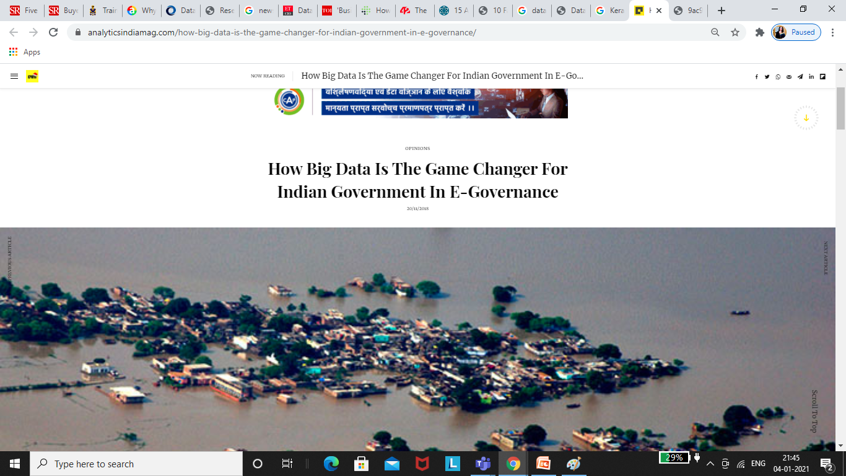
Use Case 1: The Kerala Water Authority (KWA)
The Kerala Water Authority (KWA) of the Government of Kerala is using IBM’s Analytics and Mobility solutions to analyse, monitor and manage water distribution in its capital – Thiruvananthapuram.

Slide 22
Use Case 1: The Kerala Water Authority (KWA)
The Kerala Water Authority (KWA) of the Government of Kerala is using IBM’s Analytics and Mobility solutions to analyse, monitor and manage water distribution in its capital – Thiruvananthapuram.
Providing equitable water supply to all the households is a challenging task and due to various reasons such as bad pipelines and unauthorised use of water, water supply is not easily accessible to the city. With the help of the Big Data analytics system, the data monitored by IBM,
KWA is tracking the water meters across the city. It resulted in improved revenue collection. With the Big Data solutions, KWA aims to achieve 100% success inequitable water supply with the ability to monitor and flag irregularities in water usage using sensors and intelligent meters.

Slide 23
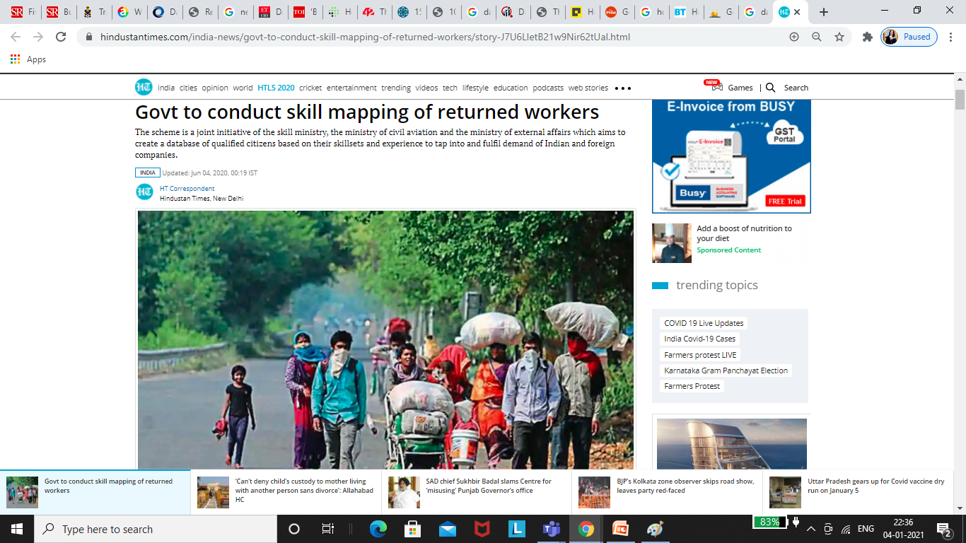
Use case 4:Govt to conduct skill mapping of returned workers
With millions of migrant workers returning home, from other parts of India and from other countries, the union cabinet approved a scheme, SWADES or Skilled Workers Arrival Database for Employment Support to conduct a skill mapping exercise of these workers .

Slide 24
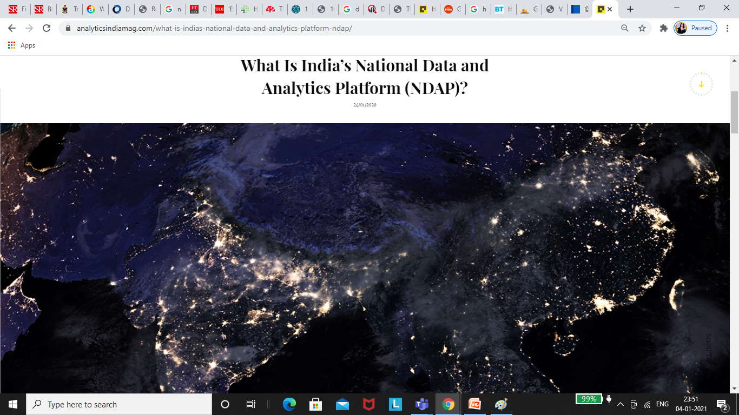
India’s think think-tank Niti Aayog will create a national data and analytics platform to all government data available to stakeholders in an easy format.

Slide 25
Mission of NADP
Standardize data across multiple government sources.
Provide flexible analytics and make it easily accessible in formats.
Conducive for research, innovation, policy making and public consumption.

Slide 26
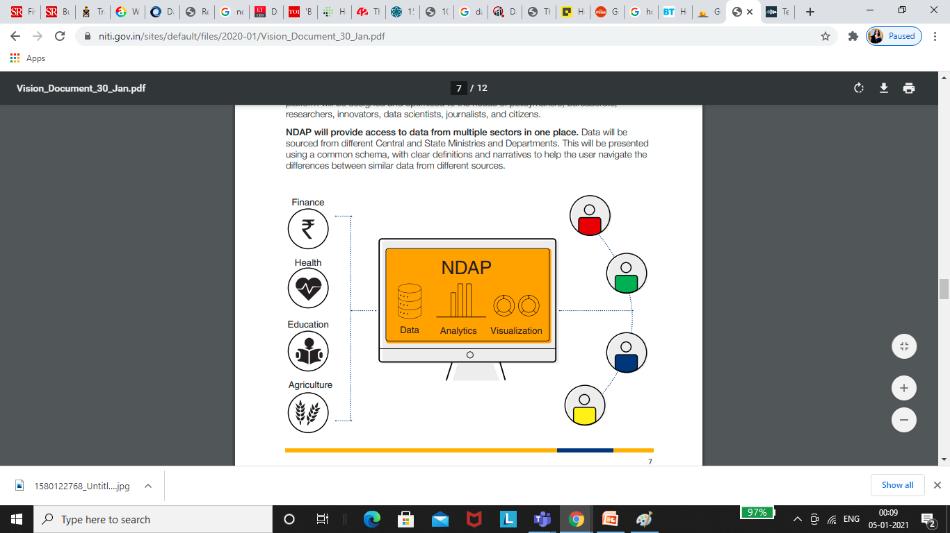
NDAP will provide access to data from multiple sectors in one place
Data will be sourced from different Central and State Ministries and Departments. This will be presented using a common schema, with clear definitions and narratives to help the user navigate the differences between similar data from different sources.

Slide 27
National Data And Analytics Platform
On 23rd January, 2020, NITI Aayog released its vision for the National Data and Analytics Platform (NDAP), with an aim to democratize access to public Government data through a world-class user experience.
The first version of National Data and Analytics Platform is proposed to be released in 2021.

Slide 28
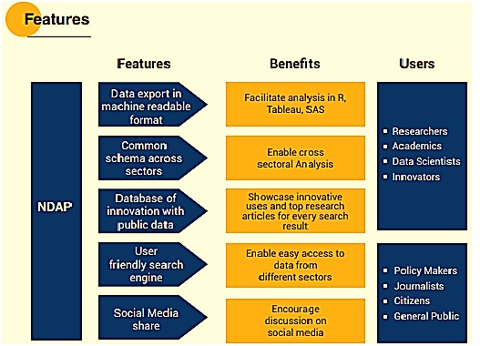
Key Features

Slide 29
Imp Links
https://www.worldometers.info/about/
https://www.internetlivestats.com/
https://datausa.io/
https://data.gov.sg/group/technology
https://www.indiastat.com/
https://data.gov.in/

Slide 30
Conclusion
Indian Government has always shown a keen interest in adopting new technologies, especially big data and AI, in its functioning and states like Karnataka, Odisha, Andhra Pradesh and Telangana have entrenched data analytics policies in. With this collaboration, it aims to bring about better transparency, while efficiently delivering services to the citizens.
Data is an important asset to the government. The roadmap to build analytical frameworks to integrate data in public departments is quite promising and will transform the entire nation digitally. This would require the government to develop a strategy which merges industry and academia to build successful data and analytics capabilities.

Slide 31
Reading Materials
Data Strategy: How To Profit From A World Of Big Data, Analytics And The Internet Of Things” by Bernard Marr
“Big Data Demystified: How To Use Big Data, Data Science And AI To Make Better Business Decisions And Gain Competitive Advantage” by David Stephenson
“The Wall Street Journal Guide To Information Graphics: The Dos And Don’ts of Presenting Data, Facts, And Figures” by Dona M. Wong
“Too Big To Ignore: The Business Case For Big Data” by Phil Simon
“Successful Business Intelligence, Second Edition: Unlock The Value Of BI & Big Data” by Cindi Howson
“Business Intelligence Guidebook: From Data Integration To Analytics” by Rick Sherman
https://economictimes.indiatimes.com/news/economy/policy/niti-aayog-plans-national-data-analytics-platform/articleshow/63651581.cms
Report of Task Force on Artificial Intelligence
https://www.telangana.gov.in/PDFDocuments/Telangana-Data-Analytics-Policy.PDF

