Slide 1
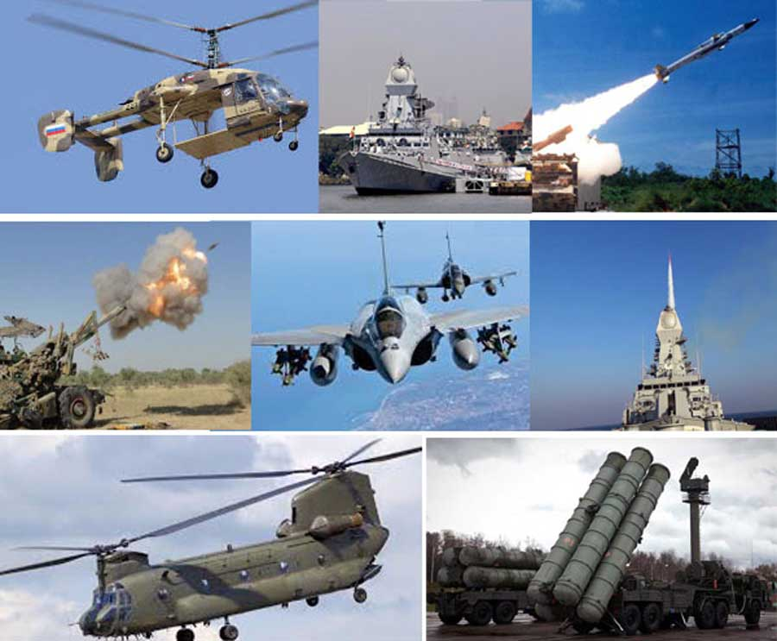

Offset Clause under Defence Procurement
Dr. Surabhi Pandey
Indian Institute of Public Administration

Slide 2
Offset Clause under Defence Procurement

Slide 3
Offset Clause under Defence Procurement
A defence offset policy was promulgated under the Defence Procurement Procedure (DPP-2005) and the first offset contract was signed in 2007
Definition: Under the offset clause, a foreign company that wins a defence deal is supposed to invest a part of the contract value in the country, thus developing skills and bringing in technology, while also generating employment.
An offset provision in a contract makes it obligatory on the supplier to either “reverse purchase, execute export orders or invest in local industry or in research and development” in the buyer’s domestic industry
Valuation for Offset: Under the DPP 2006, the offset value was fixed at 30% of defence deals above ₹300 crore, which was revised to ₹2,000 crore in DPP 2016 for full-import deals.

Slide 4
Offset Clause under Defence Procurement
Defence Ministry has removed the offset clause requirement in inter-governmental agreements (IGA) and has introduced a new category for leasing of military equipment

Slide 5
What are the objectives of Offset clauses?
Comptroller and Auditor General (CAG) Defined offsets as a “mechanism generally established with the triple objectives of:
a) partially compensating for a significant outflow of a buyer country’s resources in a large purchase of foreign goods
(b) facilitating induction of technology and
(c) adding capacities and capabilities of domestic industry”.

Slide 6
The working of Offset Clause?
Target: Till December 2018, ₹19,223 crore worth of offsets should have been discharged.
Actual Implementation: The vendors have claimed discharge of only ₹11,396 crore, 59%, of the offsets. But the Defence Ministry has accepted only ₹5,457 crore of these offset claims, while the rest were pending or rejected due to various deficiencies
Pending: The remaining offset commitments of about ₹55,000 crore would be due for completion by 2024, but the rate of the offset discharge has been about ₹1,300 crore per year.
Ineffective: At other times, international vendors reportedly discharged offsets that didn’t necessarily contribute to India’s defence manufacturing prowess, thereby defeating the very purpose of these deals.
)

Slide 7
Defence Procurement Process

Slide 8
Will no defence contracts have offset clauses now?
Only government-to-government agreements (G2G), ab initio single vendor contracts or inter-governmental agreements (IGA) will not have offset clauses anymore.
For example, the deal to buy 36 Rafale fighter jets, signed between the Indian and French governments in 2016, was an IGA.
Ab initio single vendor means that when you start the process you have only one vendor
According to DAP 2020, all other international deals that are competitive, and have multiple vendors vying for it, will continue to have a 30% offset clause.

Slide 9
Why was the clause removed?
To reduce procurement cost: Generally, vendors would “load” extra cost in the contract to balance the costs of offsets, and doing away with the offsets can bring down the costs in such contracts.
To reduce Administrative Costs: There are “administrative costs” involved in discharging offset obligations, which the vendors pay.
Criticism by CAG about Offsets: CAG audit report “found that the foreign vendors made various offset commitments to qualify for the main supply contract but later, were not earnest about fulfilling these commitments”
The CAG had also not found “a single case where the foreign vendor had transferred high technology to the Indian industry”.

Slide 10
What are the other changes announced?
Alternative route: The new rules allow the military to lease equipment from defence companies or foreign governments. This is expected to bring down acquisition time and costs (since leasing is a cheaper alternative to purchasing).
Enhanced Flexibility: Leasing would also give the Air Force, Army and Navy the flexibility of procuring systems at a time of their choosing.
Aligned with Atmanirbhar Bharat: The new rules stipulate that under some categories procurement be reserved for “Indian vendors”, which are defined as companies that are owned and controlled by resident Indian citizens with FDI not more than 49%.

Slide 11
What are the other changes announced?
Defence Procurement Manual(DPM)
Aligned with Make in India: Along similar lines, the minimum indigenous content (IC) requirement for most projects has also been raised to 50%. If a defence platform is manufactured in India, it must have 60% Indian content
A new procurement category called “Buy (Global–Manufacture in India)” has been added. Under this category, manufacturers are encouraged to set up facilities in India for assembly, repair and maintenance of equipment.

Slide 12
Conclusion
Allowing leasing of equipment and liberalising the procurement process seem to be steps in the right direction.
As for offsets, the evidence suggests that they incurred auxiliary costs whilst not equipping local enterprises with any knowledge or expertise. So, it was probably reasonable to have done away with them.

