Slide 1
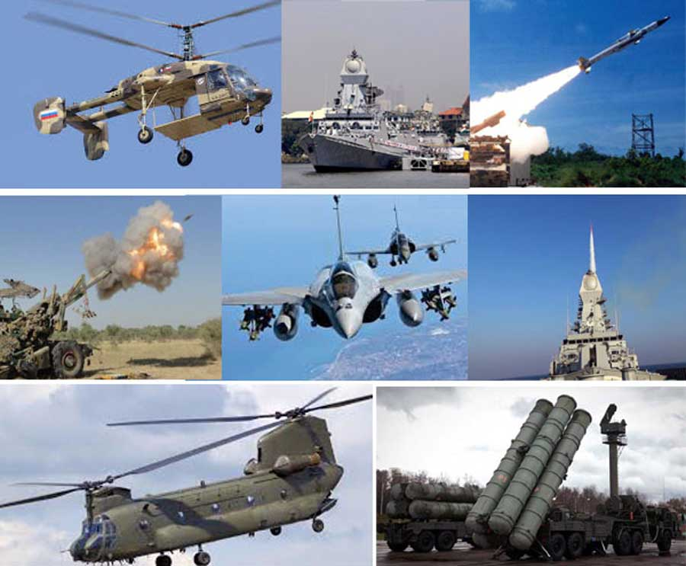

Indian Defense: Procurement Process and Policy
Dr. Surabhi Pandey
Indian Institute of Public Administration

Slide 2
Indian Defence: Industry Overview
In 2020, India with third largest annual defence budget (US$70 b) behind USA (US$732 b) and China (US$261 b),
Second largest defence imports behind Saudi Arabia making up 9.2% of global arms import,
Domestic defence industry has 80% government owned public sector including DRDO and its 50 labs, 4 defence shipyards, defence PSUs and ordnance factories.

Slide 3
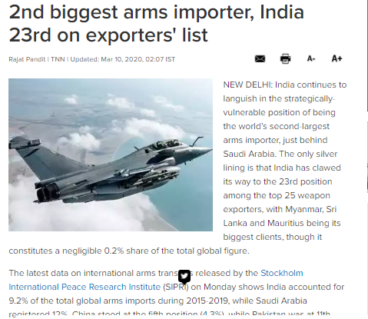
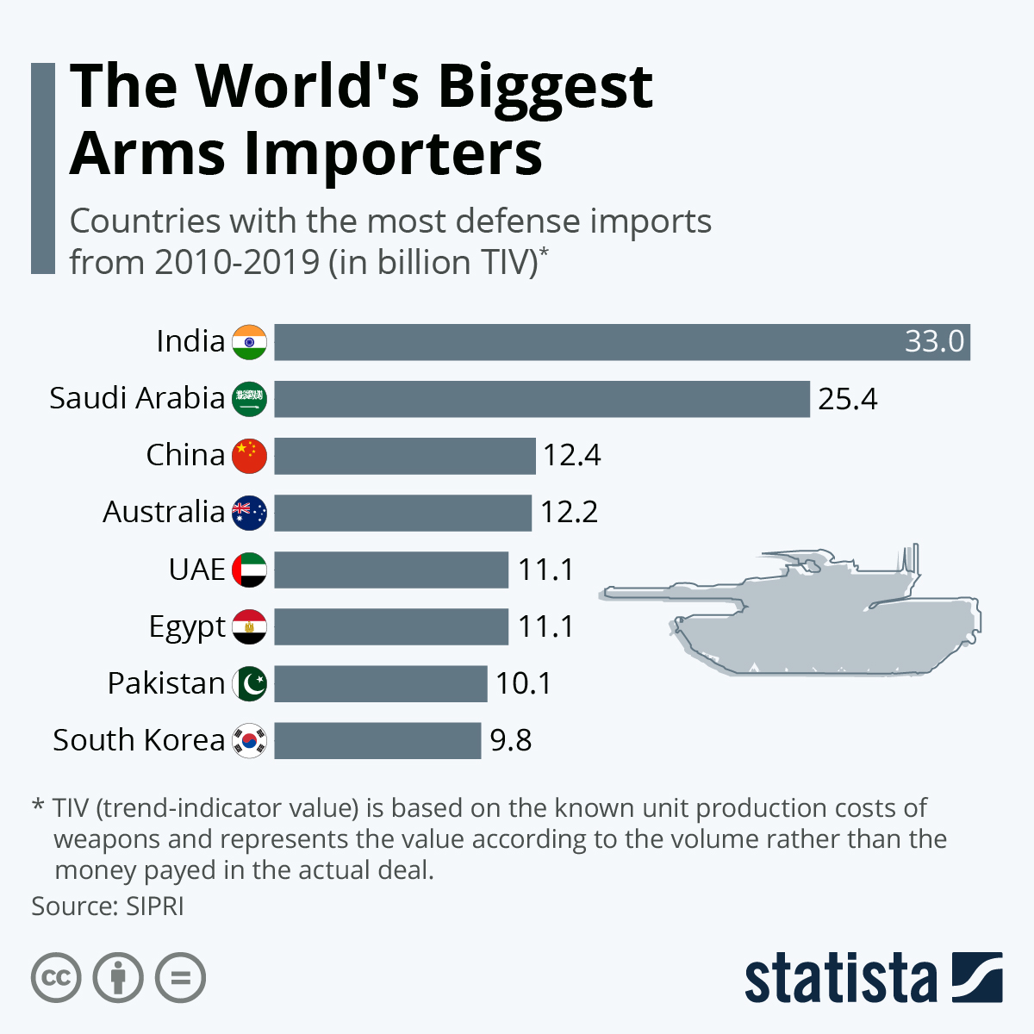
Indian Defense Procurement

Slide 4
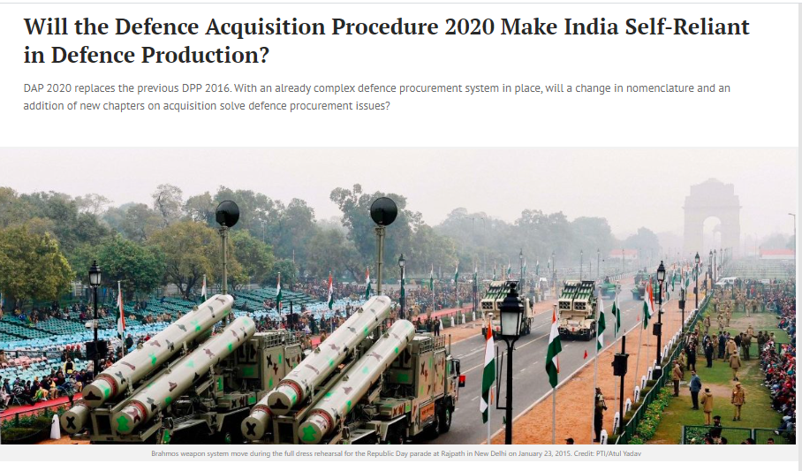

Slide 5
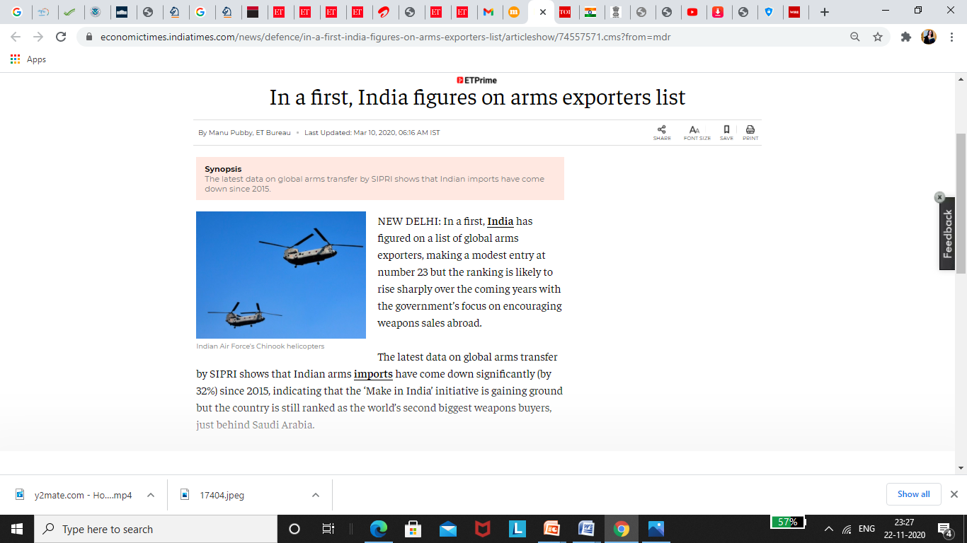
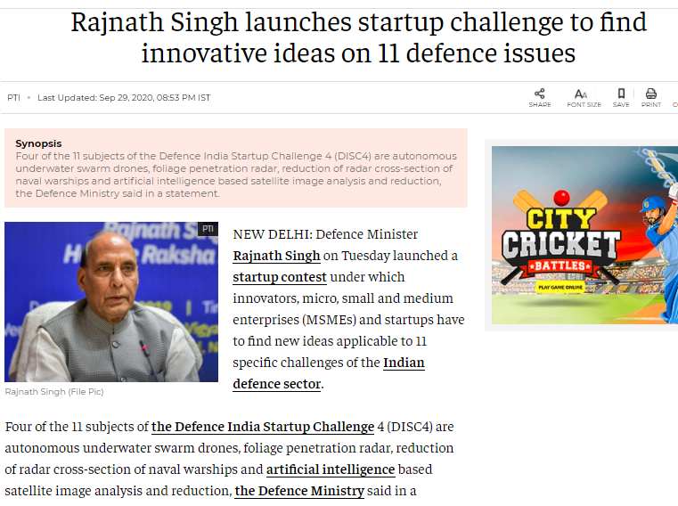
Indian Defense Procurement

Slide 6
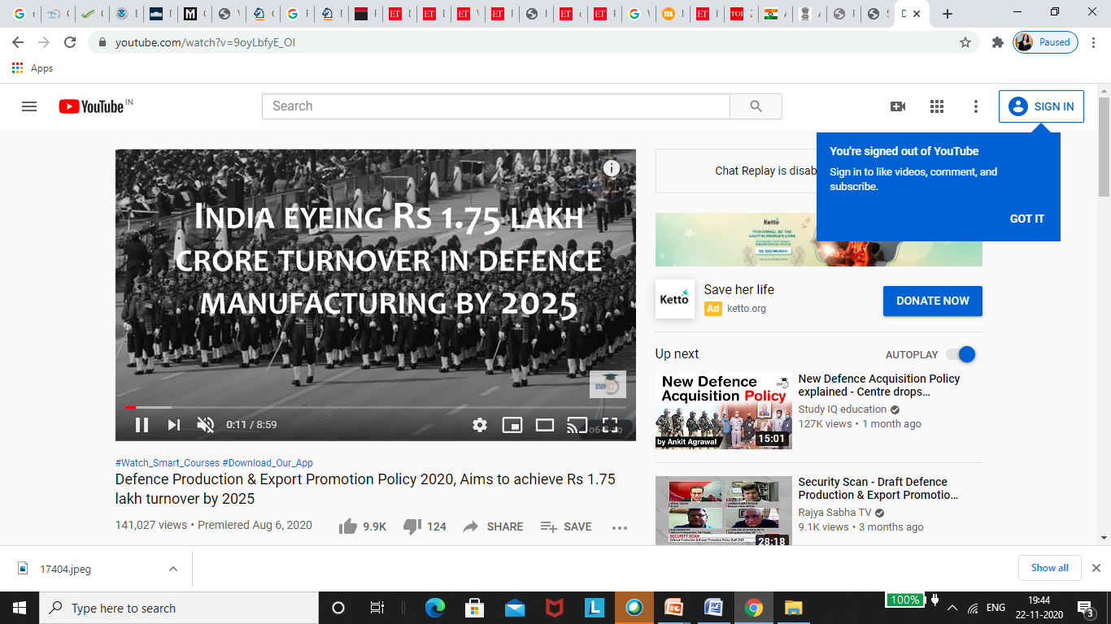
Indian Defense Procurement

Slide 7
T he DAP 2020 is aimed at increasing indigenous manufacturing and reducing timelines for the procurement of defence equipment

Slide 8
Objective:
Turning India into a global manufacturing hub.
Aligned with the vision of the Government of Atmanirbhar Bharat and empowering Indian domestic industry through Make in India initiative.

Slide 9
What does the new DAP talks about?
Turning India into a global manufacturing hub of military platforms through ‘Make in India’
Reducing timelines for the procurement of defence equipment and
Allowing the purchase of essential items by the three armed forces through capital budget under a simplified mechanism

Slide 10
New procurement categories introduced:
Buy (Global - Manufacture in India): Purchase of equipment from the overseas manufacturer, with 50% of the manufacturing being undertaken by a subsidiary in India.
Leasing category: Leasing with periodic rental payments from either an Indian or foreign manufacturer. Likely to be preferred where there are time constraints for procurement, smaller quantity required, operational necessity, asset is required for a limited time etc.

Slide 11
To promote Make in India and Atmanirbhar Bharat initiatives
Reservation in Categories for Indian Vendors: Some categories like Buy (Indian Indigenously Designed Developed and Manufactured -IDDM), Production Agency in Design & Development etc. will be exclusively reserved for Indian Vendors and FDI of more than 49% is not allowed.
Ban on Import of Certain Items: With a view to promote domestic and indigenous industry, the MoD will notify a list of weapons/platforms banned for import.

Slide 12
To promote Make in India and Atmanirbhar Bharat initiatives
Indigenisation of Imported Spares: Steps to promote manufacturing of parts in India have been taken. This includes establishment of co-production facilities through Intergovernmental Agreements (IGA) achieving ‘Import Substitution’ and reducing Life Cycle Cost.
To Develop India into Global Manufacturing Hub:
(FDI in Defence Manufacturing) Provisions have been incorporated like a new category ‘Buy (Global – Manufacture in India)’, to encourage foreign companies to set up manufacturing through its subsidiary in India.

Slide 13
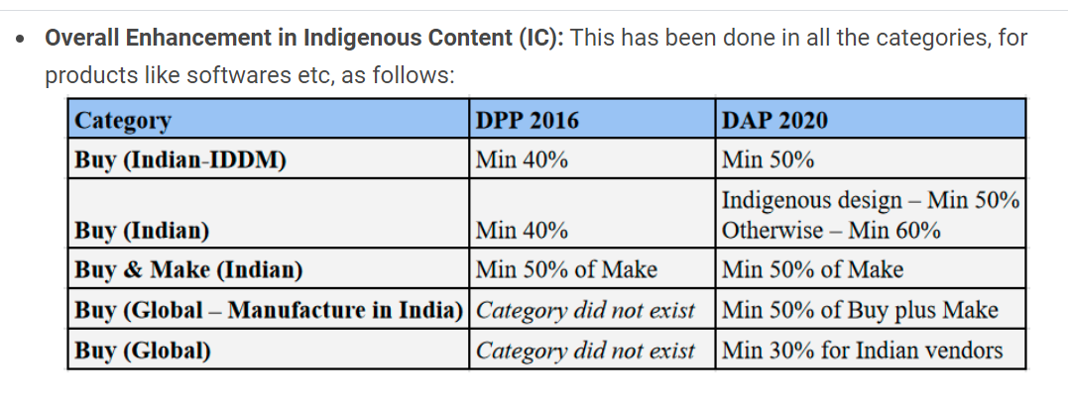
Overall Enhancement in Indigenous Content (IC)

Slide 14
For Ease of Doing Business:
Time Bound Defence Procurement Process and Faster Decision Making: By setting up a Project Management Unit to support contract management and to streamline the Acquisition process.

Slide 15
Revised Offset Guidelines:
There will be no offset clause in …
Government-to-government,
Single vendor and
Intergovernmental Agreements (IGA).
The offset policy for defence deals was adopted in 2005 for all defence capital imports above Rs. 300 crore under which the foreign vendor is required to invest at least 30% of the value of the contract in India.
Offset clause was hindering the transfer of technology, according to a recent CAG report.

Slide 16
A new change in the form of doing away with the offset clause….
India has done away with offset requirements for government-to-government defence deals and single-vendor contracts under a new policy for the procurement of arms and military platforms for the armed forces
With the change in defence procurement policy, the focus is on indigenously designed, developed and manufactured weapon systems in line with the Aatmanirbhar Bharat
The old defence policy faced flak with several issues like lack of transparency (leading to Rafale Scam), inconvenient offset regulations etc.

Slide 17
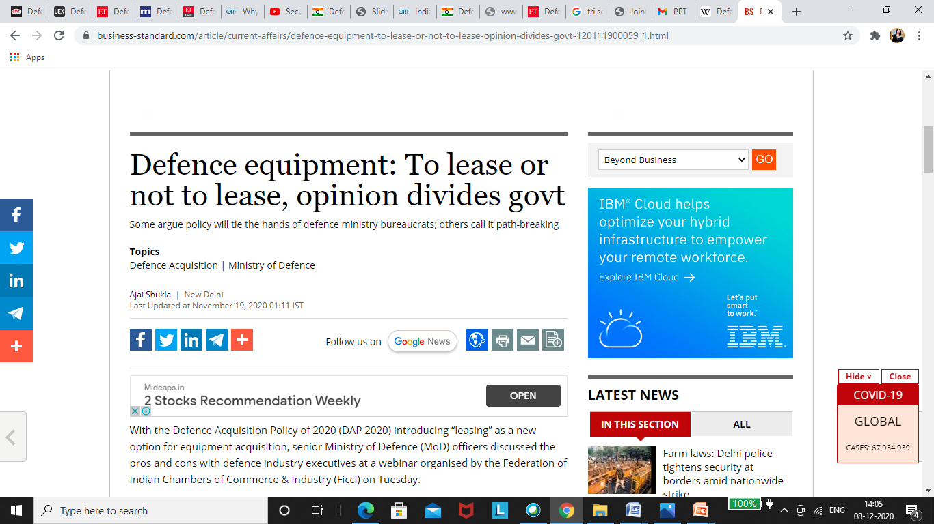
To lease or Not ... Opinion
DAP 2020 Introduced leasing as a new option for equipment acquisition , we discussed
pros and cons .
“Leasing as a means to possess and operate ( a military) assets without owing the assets and says it provides a useful way to substitute huge capital outlays with periodical rental payments “

Slide 18
Other related Initiatives
Draft Defence Production and Export Promotion Policy 2020 (DPEPP 2020).
Innovations for Defence Excellence (iDEX) has been operationalised to provide necessary incubation and infrastructure support to the startups in the defence area.iDEX would be further scaled up to engage with 300 more startups and develop 60 new technologies/products during the next five years.
Mission Raksha Gyan Shakti was launched to promote a greater culture of innovation and technology development and file a higher number of patents in Defence Public Sector Undertakings (DPSUs), Ordnance Factory Board (OFB).

Slide 19
Way Forward
Self-reliance in defence manufacturing is a crucial component of effective defence capability and to maintain national sovereignty and achieve military superiority.
The DAP 2020 not only protects the interests of domestic manufacturers by indigenization of technology, but also provides impetus to foreign investment in the country.
Given the key geostrategic challenges, emanating from the threat of two-front war (against China and Pakistan combinedly), India needs to carry out much-needed defence reforms .

Slide 20
Discussion Points
To lease or Not......opinion.
Tri- services Logistics Integration
Joint Logistics nodes in run up to theatre commands.
Fresh Suggested Defence procurement acquisition Procurement process which will meet the need of future .

Slide 21
Link on defence statistics
https://www.investindia.gov.in/sector/defence-manufacturing

Slide 22
Viewpoint
United states the preferred partner/vendor when it comes to defence procurement
The overall defence procurement expected to increase
The defence procurement process is long drawn and time-consuming
Need to be registered vendor to deal with defence, but once registered you can deal with agencies
Local presence important to deal with the defence agencies in India,
Most preferred form of local presence would be through a ‘Local Partner’
Thelocalpartnercanrepresentthecompanyanddotheneedfulpaperworkandmeetingsforthe‘Vendorregistration’
The association with the partner can be short term, just to enter to India and post which can be extended if required

Slide 23
Major Procurements by Service
Indian Army
Indian Air Force
Indian Navy
Major Procurements those are at various stages worth $ 3.56 billion are:
Assault Rifles for Infantry
Modern Artillery Ammunition
Light Utility Helicopters
Tank Ammunition
Bullet Proof Jackets/Helmets
Tactical Communication System(TCS)
Major Procurements those are at various stages worth $ 7.71 billion are
Medium Multi Role Combat Aircraft (MMRCA)
Pilatus Basic Trainer Aircraft
Light Utility Helicopters
Instalment for upgrade of Mirage2000, C 130J, C17
Attack Helicopters
Heavy Lift Helicopters
Major Procurements those are at various
stages worth$ 4.68billionare
Multi Role Maritime Helicopters(MRH)
Mine Counter Measure Vessels (MCMV)
Light Utility Helicopters
Project 75 Submarines
Instalments for Indigenous Aircraft Carrier (IAC)
Instalment for Advance Technology Vessels (ATV)

