Slide 1


Cyber Disarmament,National Security and Defence Procurement
Dr. Surabhi Pandey
Assistant Professor
(ICT & e- Governance)
Indian Institute of Public Administration,New Delhi

Slide 2
Learning Approach
Learning path
Goal
Strategy
Vision
NATION PREPAREDNESS AND BETTER DEFENSIVE CPABILTIES .
ENHANCING KNOWLEDGE ON ECONOMIC WELL BEING TO NATIONAL SECURITY
UP SKILLING FROM BASIC TO ADVANCE CONCEPT
CASE STUDIES

Slide 3
Learning outcomes:
Overview of Cyber Disarmament
Cyber Diplomacy and Warfare
Nation Preparedness and Cyber Strategy
Strategies and Structures for National Security
Indian Defence: Procurement Process and Policy
New Procurement Policy to Boost India’s Self-reliance in Arms

Slide 4

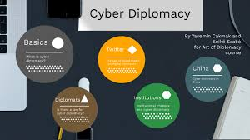
Session 2: Cyber Diplomacy and Warfare
Need of Cyber Diplomacy
Evolution of cyber-warfare and cyber-conflict.
Future trends in cyber security and cyber diplomacy

Slide 5
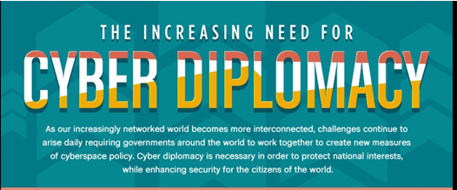
The Increasing Need for Cyber Diplomacy

Slide 6
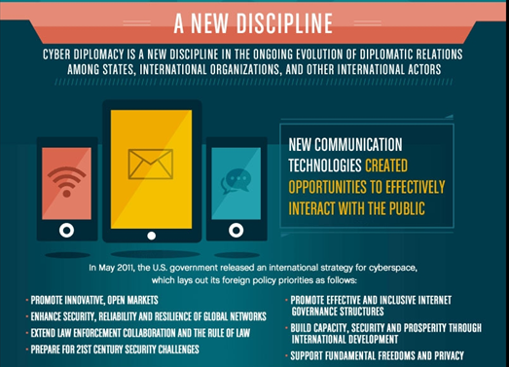

Slide 7
The Increasing Need for Cyber Diplomacy
The world is becoming more networked and interconnected. This has created challenges such as cyber security, cyber espionage, privacy and Internet freedom.
To protect national interests and enhance the security of Internet users, there is need for continued cyber diplomacy between countries.
Each nation has a role to play towards international cyber stability. U.S. encourages countries to facilitate transnational cyber cooperation and promote international cyber stability.
The way nations relate diplomatically is evolving

Slide 8
The Increasing Need for Cyber Diplomacy
Can cyber diplomacy replace the role of traditional diplomats
What do diplomats do?
01
02
They do public diplomacy, of which cyber diplomacy is a newer version,
03
04
To create goodwill and shape the international political and social environment.

Slide 9
The Increasing Need for Cyber Diplomacy
cyber diplomacy that is changing how diplomats interact with their peers, the way governments communicate to the public, and is introducing a new plethora of issues ranging from cyber espionage to internet governance.
cyber diplomacy that is changing how diplomats interact with their peers, the way governments communicate to the public, and is introducing a new plethora of issues ranging from cyber espionage to internet governance.
Cyber diplomacy is changing how diplomats interact with their peers, the way governments communicate to the public, and is introducing a new plethora of issues ranging from cyber espionage to internet governance.
Social networks like Twitter are fuelling the growth of cyber diplomacy. More than 70% of the world’s head of states are on TwitterThe public can now get a better view of diplomatic interactions by reading the retweets, replies and mentions of popular diplomats on Twitter.

Slide 10
The Increasing Need for Cyber Diplomacy
In the last decade, dozens of foreign ministries have been creating offices exclusively dedicated to cyberspace and appointing “cyber diplomats” in order to respond to the growing politicization of cyberspace and broader techno-geopolitical dynamics.
This move has concentrated more international cyber policy activities in foreign affairs ministries, elevating the issue in government hierarchies and increasing the level of international activity of each state in cyberspace.
They do network building for information gathering and create country specific knowledge to advance trade and economic interests.

Slide 11

Americans face Increasing Risks from state and non state actors that conduct malicious cyber activity , including stealing trade secrets or personal information for commercial or financial gain
The U.S recognises that states do have a well established and important role to play with regard to facilitating and transitional cooperation and preventing and promoting international stability

Slide 12
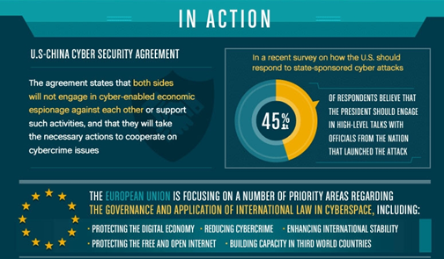

Slide 13
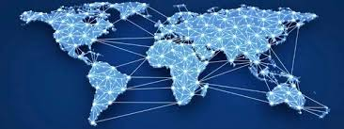
In a world in which more countries are acquiring offensive cyber capabilities, cyber diplomacy is needed to prevent escalation or wrongful attribution of cyber attacks by maintaining a constant dialogue between peers and ensuring channels of communication remain open, even in times of crisis. It also is necessary for developing binding and non-binding norms of responsible state behavior in cyberspace and addressing the most acute divergences between stakeholders in this area.

Slide 14

Cyber warfare
The nature of warfare has shifted from physical to online, seeing a deluge of state-sponsored cyber assaults on the West. The issue was put under the global spotlight last month (April), when the UK and US made an unprecedented joint statement blaming Russia for cyber-attacks on businesses and consumers.
Attacks targeting Government, nuclear, water, energy, aviation and defence . These are achieved by sending spear-phishing emails to employees or infecting websites in what is called a ‘waterhole attack’,” independent counter-disinformation and hybrid warfare consultant.

Slide 15
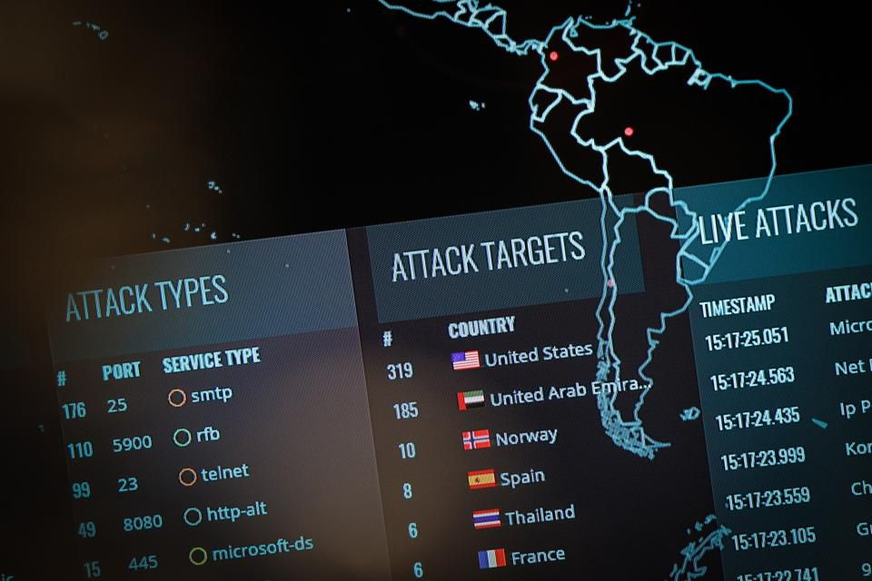
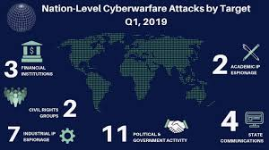
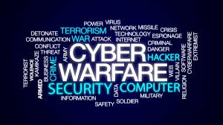
Cyber Warfare: The Threat From Nation States
Nation-states need flexible and dynamic cyber security strategies to react to the cyber threats in a constantly changing and emerging environment such as cyberspace. Although cyberspace has no physical boundaries, countries often formulate cyber security strategy independently based on their own ideas and own security perceptions only. This causes very different cyber security strategies to be found in different countries. This is true although many international agencies offer suggestions to formulate the main aspects and elements of national cyber security strategy.

Slide 16
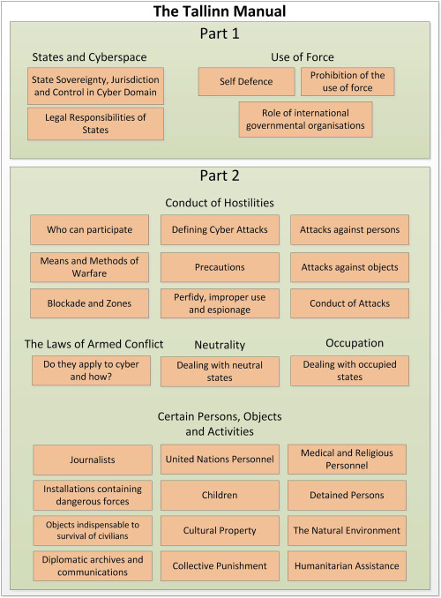

Slide 17
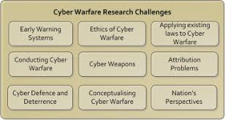

Slide 18
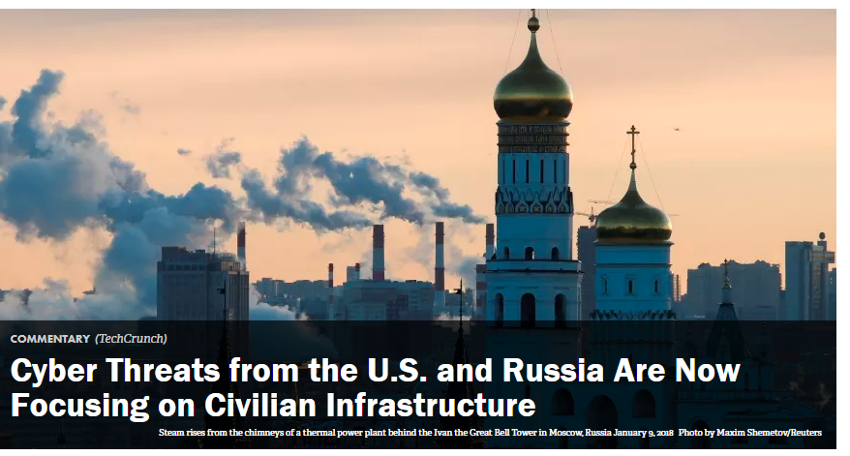
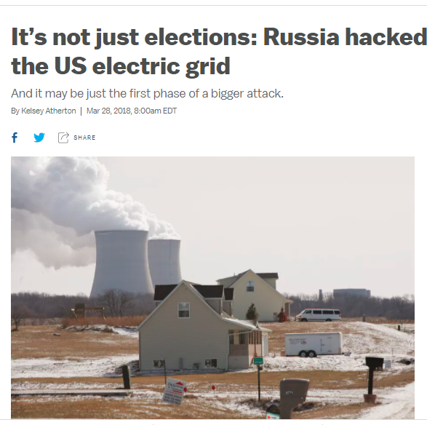
Virtual conflict, real damage
According to an alert from the United States Computer Emergency Readiness Team yesterday, Russia has hacked into many of our government entities and domestic companies in the energy, nuclear, commercial facilities, water, aviation and critical manufacturing sectors – essentially most of what makes our country go.

Slide 19
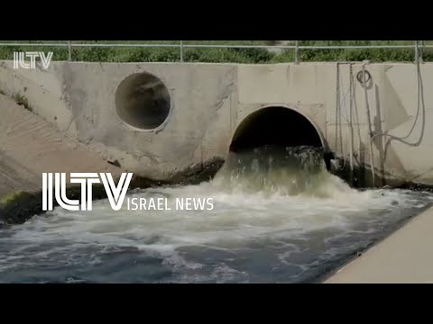

Iran attempted cyber attack on Israeli water and sewage facilities
Water Authority and Israel National Cyber Directorate confirmed the “attempted cyber breach on water command and control systems.”
there was no harm to the water supply and it operated, and continues to operate, without interruption,”

Slide 20
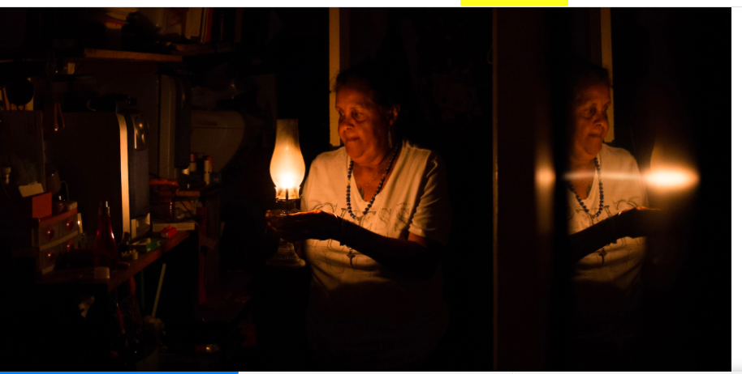
Venezuela is blaming a crippling 5-day blackout on US cyber warfare -
Venezuela is entering the fifth day of a nationwide blackout that has plunged even critical infrastructure like hospitals into darkness.

Slide 21
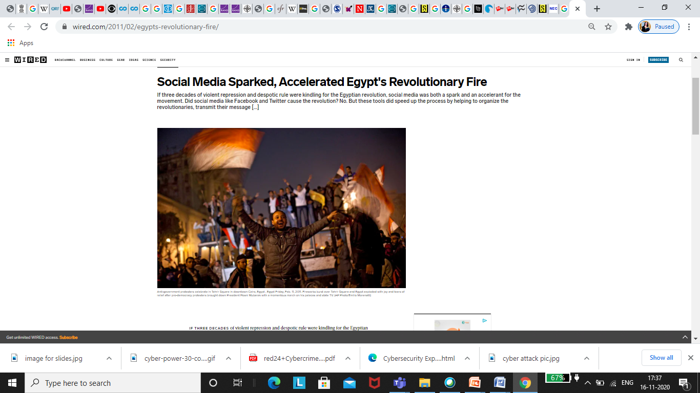
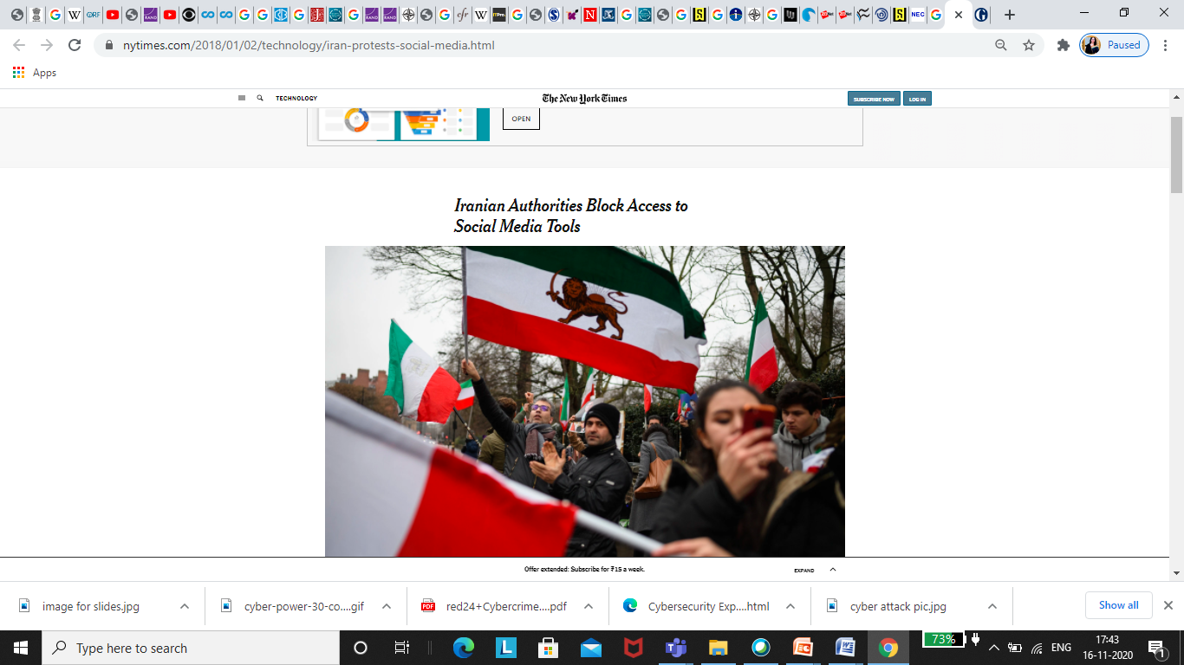
Social Media platform used for propaganda

Slide 22
Stuxnet Worm Attack on Iranian Nuclear Facilities
Stuxnet, the world's first military-grade cyber weapon that can destroy pipelines and cause explosions at power plants and factories, as well as manipulate machinery. It is the first worm that corrupts industrial equipment and is also the first worm to include a PCL (programmable logic controller), software designed to hide its existence and progress. In August, security software company Symantec states that 60% of the computers infected with Stuxnet are in Iran.

Slide 23
Discussion
Can cyber diplomacy replace traditional diplomats and help us get a handle on the world’s most complicated problems?
Capstone

