Slide 1


Conceptualizing the ideas of LIBERTY, EQUALITY and FRATERNITY in New India
C.Sheela Reddy

Slide 2
Article I of Universal Declaration of Human Rights States that …….
“All human beings are born free and equal in dignity and rights. They are endowed with reason and conscience and should act towards one another in a spirit of brotherhood.”

Slide 3
Defining Concepts…….
LIBERTY - “It is a the power to do or enjoy something that is worth doing or enjoying in common with others. Liberty is the eager maintenance of that atmosphere in which men have the opportunity to be their best selves.”-T.H. Green
“Your right to swing your fist ends where my nose begins.”

Slide 4
EQUALITY
Fundamentally a leveling process.
It means that no man shall be placed in society that he can overreach his neighbor to the extent which constitutes a denial of latter’s citizenship.”- Harold Laski

Slide 5
What is Fraternity ?
Fraternity means a sense of common brotherhood of all Indians being one people. It is the principle which gives unity and solidarity to social life………
……….Without fraternity, equality and liberty will be no deeper than coats of paint.”
-Dr.B.R.Ambedkar

Slide 6
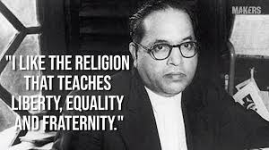
Ambedkar’s view on Liberty, Equality, & Fraternity in Indian Society
A heritage of Buddhism.
He refers to these three principles as foundations of an ideal society, an ideal democracy, and an ideal religion.

Slide 7
LIBERTY, EQUALITY, FRATERNITY - form a union of trinity
Without equality, liberty would produce the supremacy of the few over the many.
Equality without liberty would kill individual initiative.
Without fraternity, liberty and equality could not become a natural course of things.

Slide 8
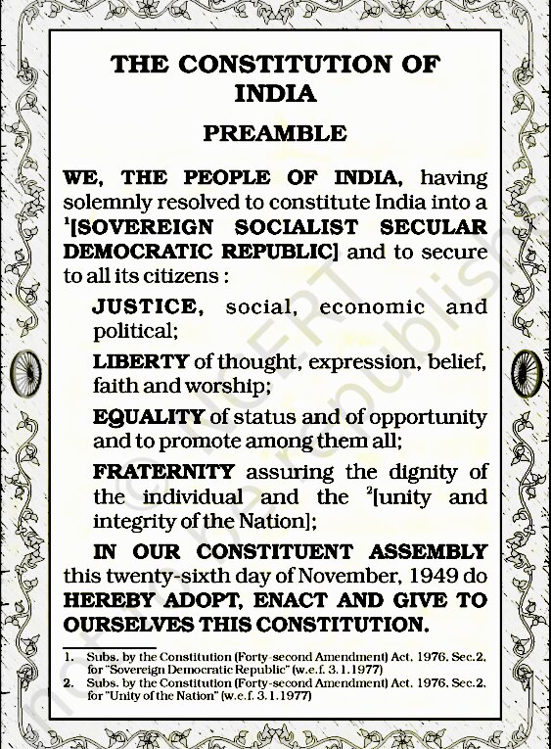
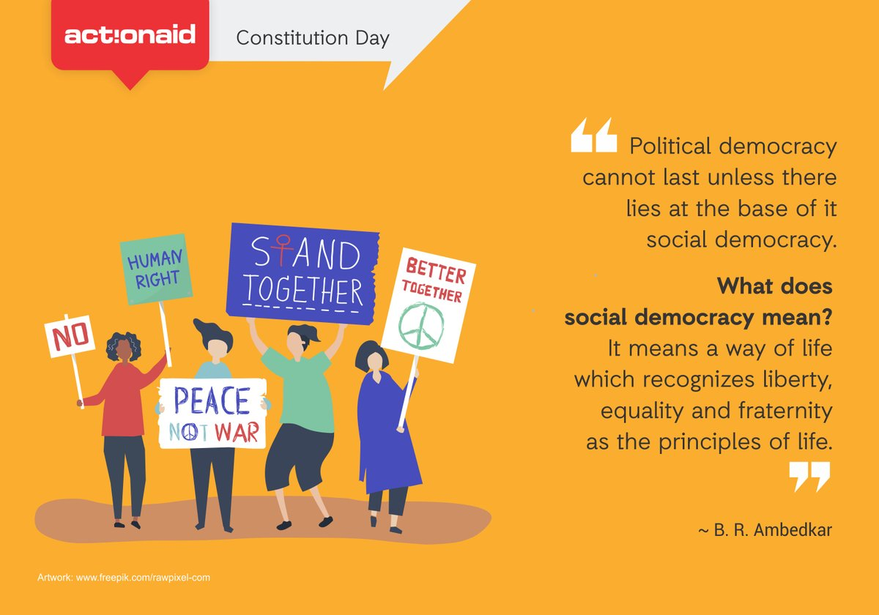

Slide 9
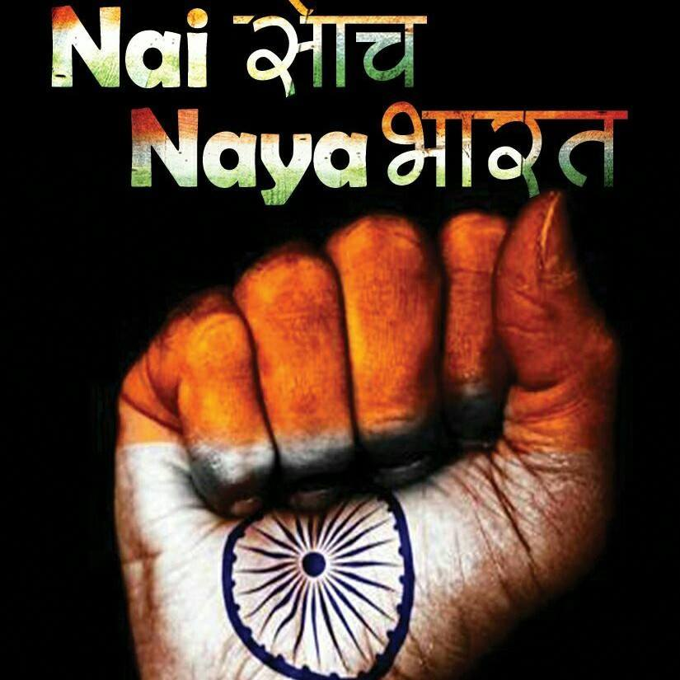
The Story of New India …
What can shape ‘New India?
  Resurgent India,
  Digital India,
  Inclusive India,
  Incorruptible India,
  Investor-friendly India,
  Transformational India,
  Clean India, Skill India,
  Transparent India,
  Transforming India,
  Emerging India,
  Caring India, and
  Communicating India

Slide 10
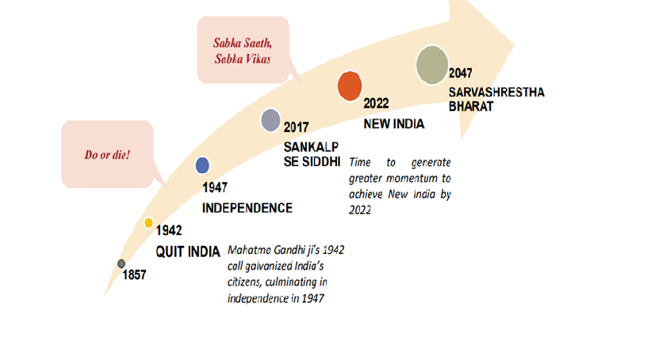
DEVELOPMENT AS MASS MOVEMENT

Slide 11
NEW INDIA @ 2022 –
‘New India – A Resurgent nation: From Sankalp to Siddhi
NEW INDIA @ 2022 –‘Young India, New India – A Resurgent Nation: From Sankalp to Siddhi' (Promise to Execution)
Sankalp(Pledge) se Siddhi(Achievement): Make Efforts so that India emerges as:
Swachh
Swastha (Kuposhan Mukt Bharat)
Shikshit
Sampann
Saksham
Surakshit
2017-2022: Making development a mass movement
Bharat by 2022
To mark the 125th anniversary of Swami Vivekananda's Chicago address at the World’s Parliament of Religion and Pandit Deendayal Upadhyaya's centenary celebrations, on 11th September 2017.

Slide 12
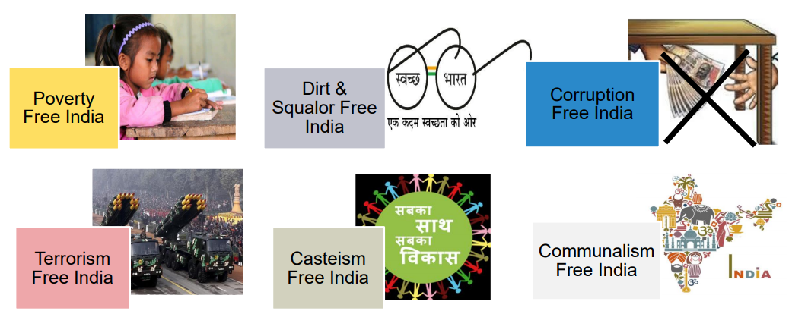
By 2022- The Resolve is to free India

Slide 13
1. POVERTY FREE INDIA - (Antyodaya- “rise of the last person”)
SOCIAL DEVELOPMENT -
  Health and Nutrition - Kuposhan Mukt Bharat
  Skill Development - Pade India Bade India
  Gender Equity - Beti Bachao Beti Padhao
INFRASTRUCTURE & CONNECTIVITY-
  Redevelopment of 100 railway stations; bullet train by 2022
  High-Speed Railway Quadrilateral
  Connect all villages with habitations over 500 (250 in Special Areas) with all-weather roads by 2019 under PMGSY
  Sagarmala, Inland Waterways, Inter-Linking of Rivers
  UDAN scheme for regional connectivity
  2.5 lakh Gram Panchayats with broadband under BharatNet
GROWTH ENABLERS –
  Housing
  Energy – DUGJY –Electrification of Villages, Saubhagya scheme – Households
  Financial Inclusion – JAM Trinity - Jan Dhan-Aadhaar-Mobile

Slide 14
2. DIRT AND SQUALOR FREE INDIA
Swachh Bharat - ODF status
Clean Rivers - Namami Gange - effective abatement of pollution, conservation and rejuvenation of National River Ganga.
Clean Energy - enhance renewable energy capacity

Slide 15
3.CORRUPTION FREE INDIA
Demonetization –
  56 lakh new taxpayers added
  Undisclosed income of Rs. 29,123 crore detected & admitted
  3 lakh shell companies uncovered & 2.1 lakh shell companies deregistered
Goods & Services Tax - One of the biggest tax reforms that is helping formalize Indian businesses
Direct Benefit Transfer -Aapka Adhikar, Apne Dwar
E-Governance - Aadhaar - largest biometric identification system in the world
Benami Act - Unprecedented surge in detections after the amendment in 2016 - people caught with 'benami' properties could serve up to seven years of rigorous imprisonment

Slide 16
4.TERRORISM FREE INDIA
Umbrella scheme of "Modernization of Police Forces"; 2/5th funding dedicated to LWE, J&K & North East
Dedicated program on 100 backward districts to boost internal & cross-border security

Slide 17
5. CASTE FREE INDIA
Pradhan Mantri Adarsh Gram Yojana (PMAGY) - rural development programme launched for the development of villages having a higher ratio (over 50%) of people belonging to the scheduled castes through convergence of central and state schemes and allocating financial funding on a per village basis.
All villages selected under PMAGY should attain model village status by 2022.
National SC/ST Hub - supports existing SC/ST entrepreneurs and enterprises in technological upgradation and capacity building.
Upgradation of Merit of Students

Slide 18
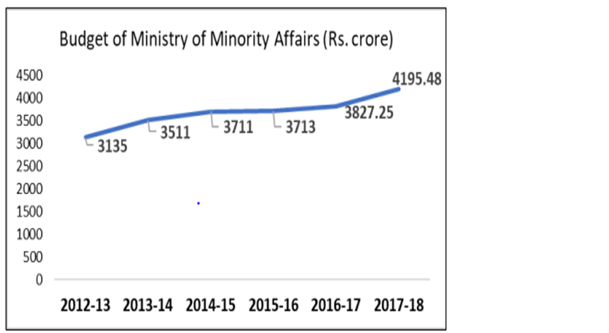
6.COMMUNALISM FREE INDIA
India is about Shanti, Ekta & Sadbhavana
Empowerment vs Entitlement without appeasement

Slide 19
Niti Aayog ‘Strategy for New India @ 75’
Development must become a mass movement (Jan Andolan), in which every Indian recognizes her role and also experiences the tangible benefits accruing to her in the form of better ease of living.
Embracing new technologies, fostering innovation and upskilling - mainstreaming of regions such as the North East, hilly states and the 115 Aspirational Districts - improved regional and inter-personal equity
Putting in place a ‘development state’ in place of the ‘soft state’ - efficient delivery of public services, rooting out corruption and black economy, formalizing the economy and expanding the tax base, stopping leakages through direct benefit transfers
Economic transformation cannot happen without public participation.

Slide 20
New wave of Development in the Aspirational Districts
Chatra in Jharkhand – ‘Arogya Kunji’ improved the outreach and efficacy of timely medical aid and healthcare services in rural areas
Nandurbar in Maharashtra – ‘Centralised Kitchen’ to provide hot and nutritious meals to children in residential schools
Rajnandgaon in Chhattisgarh - ‘Hamar Swasthya’ App to make people’s health cards available to the doctors and health workers
Shrawasti and Bahraich in Uttar Pradesh – ‘Bal Sansad’ a platform to young students to express their views on various issues like family, school, society, good values among other things.

Slide 21
Democratic Report 2020 (V-Dem institute - independent research institute)
Quality of democracy decreased alarmingly in India.
The change is depicted through the Liberal Democracy Index (LDI). The index combines measures of the quality of elections, suffrage, freedom of expression and the media, freedom of association and civil society, checks on the executive, and the rule of law.

Slide 22
Change in four Crucial Indicators………
Academic Freedom : The right of academics to freely teach, discuss, research, publish, and express opinions without constriction by prescribed doctrine.
Civil Liberties : Absence of physical violence by government agents and absence of constraints on private liberties and political liberties by the government.
Rule of Law: To what extent are laws transparently, independently, predictably, impartially and equally enforced, and to what extent do the actions of government officials comply with the law.
Freedom of expression: To what extent does government respects press and media freedom, the freedom of ordinary people to discuss political matters at home and in the public sphere, as well as the freedom of academic and cultural expression.

Slide 23
India slipped 26 places to 105 among 162 countries and territories on the index of global economic freedom, according to the Economic Freedom of the World: 2020 report released by the Fraser Institute in Canada.
India slipped 10 places to 51st position in the 2019 Democracy Index's global ranking, according to The Economist Intelligence Unit(UK Based), which cited "erosion of civil liberties" in the country as the primary cause for the downtrend.

Slide 24
The Freedom in the World 2020 report
A yearly survey and report by the U.S.-based and partially US Government funded Non-Governmental Organisation - Freedom House
Ranks India at the 83rd position, along with Timor-Leste and Senegal - It covers 195 countries, awarding scores based on two indicators
  Political rights indicators: cover the electoral process, political pluralism and participation and government functioning.
  Civil liberties indicators are related to freedom of expression and belief, associational and organizational rights, the rule of law and personal autonomy and individual rights.

Slide 25
‘Indian income inequality, 1922-2015: From British Raj to Billionaire Raj’ - Thomas Piketty and Lucas Chancel
Over the 1980-2015 period, the top 0.1% of earners captured a higher share of total growth than the bottom 50%.
while the top 1% received a higher share of total growth than the middle 40%.

Slide 26
India in 2020 ranked 102 among 117 countries in Global Hunger Index .This further shows how economic and social justice is being denied to a majority of the population.
According to OXFAM(confederation of 20 independent charitable organisations focusing on the alleviation of of global poverty) 2020 report India has been ranked 129 among 158 countries on ‘Commitment to Reducing Inequality (CRI) Index.’
India's richest 1 per cent hold more than four-times the wealth held by 953 million people who make up for the bottom 70 per cent of the country‘s population.

Slide 27
Some questions?
How to bring change without conflict?
Did we lose on fraternity?
Do social and cultural prejudices persist due to gap between public and private?
What are the other forms of intervention required other than the state?
Are we fairly accommodative in public sphere but private sphere untouched?(being secular in public and not in private)

Slide 28
Fraternity remains the least understood, least discussed, and doubtlessly the least practiced of the four pillars of constitutional morality spelt out in the preamble of India’s Constitution: justice, liberty, equality, and fraternity.
It is lost even in our public and social life, in which the aggressive use of oppositional identities continues, as it is the most reliable instrument to harvest votes for most political parties.
Democracy is all about equality and freedom. The case of democratic idea is the belief that every person within the community is equally entitled to life with dignity and self-respect.

Slide 29
Fulfill Swami Vivekanand’s vision……
"If there is any land on this earth that can lay claim to be the blessed Punya Bhumi; to be the land.. where humanity has attained its highest towards gentleness, towards generosity, towards purity, towards calmness, above all, the land of introspection and of spirituality - it is India”
“…to set in motion a machinery which will bring the noblest ideas to the doorstep of even the poorest and meanest.”
“Follow the rule and India will rule”

Slide 30
Humane Approach …….
With the foundation of ethics established, it is possible to build a society that is bonded together through its work. Most of us miss the Constitutional meaning of our work. The Constitutional meaning of our work is not that I and my family make enough money to survive (or perhaps get rich). The purpose of work is this: the practical, everyday expression of how I love and serve my neighbor, and thereby build the unity and integrity of the nation………………
…………….Or as the Constitution’s Fundamental Duties prescribe: the purpose of work is “to strive towards excellence… so that the nation constantly rises to higher levels of endeavor and achievement.”
Dr. A.P.J Abdul Kalam

Slide 31


