Slide 1

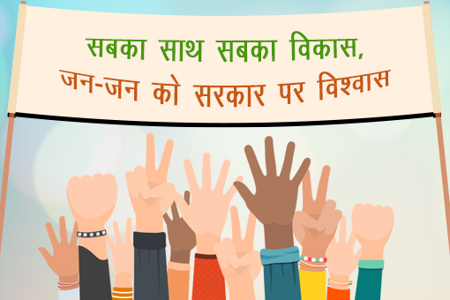
The Agenda of ‘Sabka Saath, Sabka Vikas, Sabka Vishwas’
(Major government policies for Equity and Harmony)
C.Sheela Reddy

Slide 2
“Sabka Saath, Sabka Vikas, Sabka Vishwas(SSSVSV)”
(together with all, for the development of all and with the trust of all)
Prime Minister Shri Narendra Modi coined the slogan after he registered a landslide victory in 2019 Lok Sabha elections.
Slogan is an extension of his earlier poll pitch - 'Sabka Saath, Sabka Vikas'.

Slide 3
What is at the base of Sabka Saath, Sabka Vikas, Sabka Vishwas,”?
“It is the responsibility of the government that every
person is benefitted and every person gets justice.
Mantra of governance -
“Reform, Perform and Transform”.

Slide 4
What Adversely Affects an Inclusive Agenda?
Situations that result in the overstatement of communal thoughts,
Abuses emanating from socio-religious intolerance,
Misuse of political power at the grassroots level,
Neglect of poor, women, destitute, minorities etc.

Slide 5
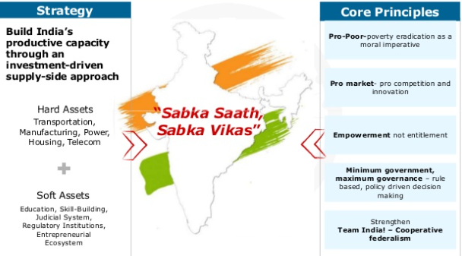
Development for all Framework

Slide 6
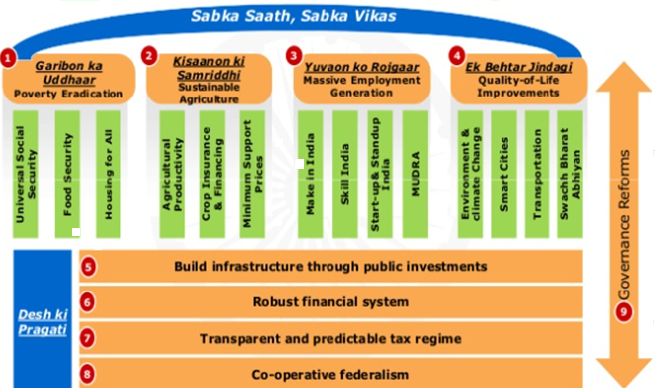
Transforming Governance Architecture for India

Slide 7
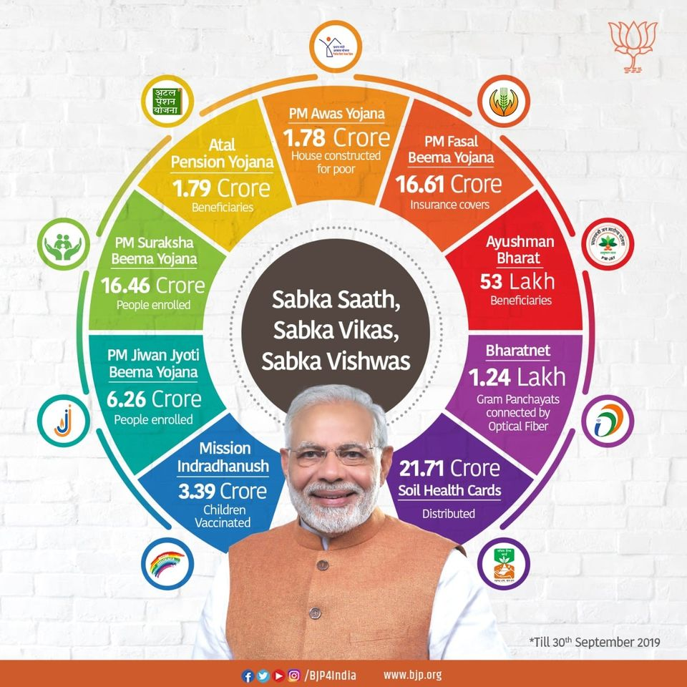

Slide 8

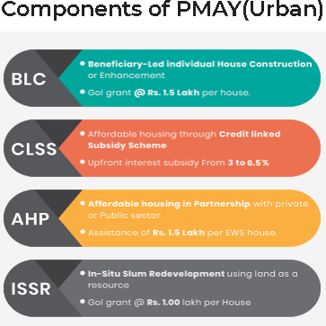
Pradhan Mantri Awas Yojana (Urban)-PMAY (U) - ‘Housing for all programme by 2022 -Ministry of Housing & Urban Poverty Alleviation
Urban beneficiaries -three components,
Economically Weaker Section (EWS),
Low-income Group (LIG) and
Middle Income Group (MIG).
In addition, slum dwellers in the urban areas can also apply for the Pradhan Mantri Awas Yojana.
10.28 lakh houses under the Pradhan Mantri Awas Yojana (Urban) has been sanctioned by the governement until August 2020, taking the total number of houses sanctioned so far under the scheme to 1.06 crore, (Economic Times, Aug 07, 2020)
Made a mandatory provision for the female head of the family to be the owner or co-owner of the house under this Mission

Slide 9
Central government has decided to give ownership rights to 40 lakh people living in national capital Delhi’s unauthorised colonies.
The Union Cabinet has approved a proposal to grant ownership rights to people living in 1,797 unauthorised colonies in Delhi,
The ownership rights will be given to inhabitants of houses in these colonies irrespective of whether the houses were built on private or government land.
Owning a house is the greatest wish of the middle class, the move comes in support of the government in implementing Pradhan Mantri Unauthorised Colonies AwasYojna(PMUDAY) in Delhi. (November 8, 2019, Business Standard)

Slide 10
PM FASAL BEEMA YOJANA - insurance service for farmers for their yields - administered by Ministry of Agriculture
Launched on 18th February 2016
Ensures protection of crop loss for entire cropping cycle
Covers all Food & Oilseeds crops and Annual Commercial/Horticultural Crops
Implemented by empanelled general insurance companies.
Comprehensive risk coverage against unforseen events
Encouraging farmers to adopt innovative and modern agricultural practices
Ensuring flow of credit to the agriculture sector which will contribute to food security, crop diversification and enhancing growth and competitiveness of agriculture sector besides protecting farmers from production risks.
*Beset by a number of problems for the farmers with unpaid dues in thousands of crores while insurance companies have pocketed the money

Slide 11
Pradhan Mantri Suraksha Bima Yojana(PMSBY)
Available to people in the age group 18 to 70 years with a bank account who give their consent to join / enable auto-debit on or before 31st May for the coverage period 1st June to 31st May on an annual renewal basis.
Aadhar would be the primary KYC for the bank account.
Risk coverage under the scheme isRs.2 lakh for accidental death and full disability and Rs. 1 lakh for partial disability.
Premium of Rs. 12 per annum is to be deducted from the account holder’s bank account through ‘auto-debit’ facility in one installment.
Scheme is being offered by Public Sector General Insurance Companies or any other General Insurance Company who are willing to offer the product on similar terms with necessary approvals and tie up with banks for this purpose.

Slide 12
ATAL PENSION YOJANA - Social Security Scheme
Launched on 9th May 2015,
With the aim of delivering old age income security particularly to the workers in the unorganized sector, and
Steady stream of income after the age of 60 to all citizens of India.
Under APY the subscribers have a choice to get Fixed monthly Pension amount from Rs. 1000/-, Rs.2000/-, Rs. 3000/-, Rs. 4000/- and Rs. 5000/- by paying monthly subscription
Age of Entry | Years of Contribution | Monthly pension of Rs1000 | Monthly pension of Rs 2000 | Monthly pension of Rs 3000 | Monthly pension of Rs 4000 | Monthly pension of Rs 5000
18 | 42 | 42 | 84 | 126 | 168 | 210
19 | 41 | 46 | 92 | 138 | 183 | 228

Slide 13
PRADHAN MANTRI JEEVAN JYOTI BEEMA YOJANA(PMJJBY)
Available to people in the age group of 18 to 50 years having a bank account who give their consent to join / enable auto-debit.
Aadhar would be the primary KYC for the bank account.
Life cover of Rs. 2 lakhs shall be for the one year period stretching from 1st June to 31st May and will be renewable.
Risk coverage under this scheme is for Rs. 2 Lakh in case of death of the insured, due to any reason.
Premium is Rs. 330 per annum which is to be auto-debited in one installment f rom the subscriber’s bank account as per the option given by him on or before 31st May of each annual coverage period under the scheme.
Scheme is being offered by Life Insurance Corporation and all other life insurers who are willing to offer the product on similar terms with necessary approvals and tie up with banks for this purpose.

Slide 14
AYUSHMAN BHARAT – Ministry of Health and Family Welfare
Launched as recommended by the National Health Policy 2017, to achieve the vision of Universal Health Coverage (UHC),
An attempt to move from sectoral and segmented approach of health service delivery to a comprehensive need-based health care service.
Aims to undertake path breaking interventions to holistically address the healthcare system (covering prevention, promotion and ambulatory care) at the primary, secondary and tertiary level.

Slide 15
Adopts a continuum of care approach - expanding Access, Universality and Equity
(comprising of two inter-related components)
Health and Wellness Centres (HWCs) –
  cover both, maternal and child health services and non-communicable diseases, including free essential drugs and diagnostic services.
  empowering individuals and communities to choose healthy behaviours and make changes that reduce the risk of developing chronic diseases and morbidities.
Pradhan Mantri Jan Arogya Yojana (PM-JAY) - National Health Authority (NHA) is the apex body for Implementing -
  Launched on 23rd September, 2018, largest health assurance scheme in the world which aims at
  Providing a health cover of Rs. 5 lakhs per family per year for secondary and tertiary care hospitalization to over 10.74 crores poor and vulnerable families (approximately 50 crore beneficiaries) that form the bottom 40% of the Indian population.
  Households included are based on the deprivation and occupational criteria of Socio-Economic Caste Census 2011(SECC 2011) for rural and urban areas respectively.

Slide 16

Intensified Mission Indradhanush 2.0 - December 2, 2019 - ‘Reach the Unreached’
Ministry of Health and Family Welfare
Aim to reach out to partially vaccinated and unvaccinated children with all the available vaccines under Universal Immunization Program (UIP) across 381 districts in 29 States/UTs.
Key objective behind the launch of the intensified immunization drive was to ensure that no child suffers from any vaccine-preventable diseases.
Cover the low performing areas in the selected districts (high priority districts) and urban areas with special focus on the unserved and low coverage pockets in urban slums with a migratory population.
Programme focused on improving immunization coverage in select districts and cities to ensure 90 percent coverage

Slide 17

BharatNet - Bharat Broadband Network Limited - Telecom Infrastructure Provider
World's largest rural broadband connectivity program,
It is built under the Make In India initiative with no involvement of foreign companies.
BharatNet will provide more employment opportunities, improved service delivery (online e-gram panchayat services, e-governance, e-education, e-health, e-medicine, e-grievances, e-agriculture, e-citizen, etc.) to the rural India
impetus to the Make In India, Digital India and Start Up India initiatives.

Slide 18

Department of Agriculture & Co-operation under the Ministry of Agriculture and Farmers Welfare
"Swasth Dharaa. Khet Haraa." - Healthy Earth. Green Farm.
Assess the current status of soil health and, when used over time, to
Determine changes in soil health that are affected by land management.
Implemented through the Department of Agriculture of all the State and Union Territory Governments.
Types of crops to grow to get maximum yield.

Slide 19
Series of Social Welfare Initiatives for Social Justice and Empowerment
Guiding Principles……
Ekatmakta,
Samata and
Samajik Samrasta

Slide 20
Rashtriya Ekta Diwas or National Unity Day is observed every year on October 31 since 2014
"will provide an opportunity to re-affirm the inherent strength and resilience of our nation to withstand the actual and potential threats to the unity, integrity and security of our country.” – Ministry of Home Affairs
“By common endeavour, we can raise the country to a new greatness, while lack of unity will expose us to fresh calamities”
- SardarVallabhaiPatel

Slide 21
"Rashtriya Samrasata Diwas"
Government notification 2015
14th April every year - with the aim to bring about a feeling of Samrasta amongst all the citizens of the Country as an appropriate tribute to Dr. Ambedkar

Slide 22
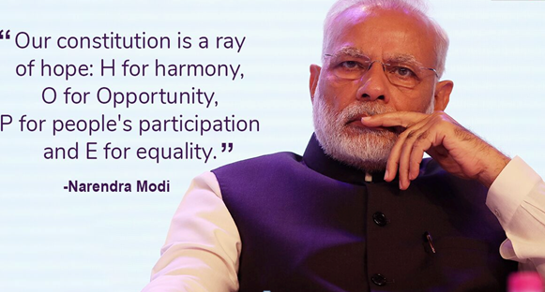
Constitution – A Ray of Hope

Slide 23
Strengthening the Spirit of ‘SSSVSV’
Reinforcing democratic and secular principles to protect the heterogeneous nature of the country for unity and harmony.
Ensuring socio-religious and sub-regional harmony by taking into confidence the belief of the multi-cultural and religious groups residing in India .
A behavioral change is required through a mass social movement. The citizenry in the long term need to be empowered to reject anything that is detrimental to social harmony and national growth.
Mainstream public opinion towards national development through proper channelling of opinions and constructive criticism.
Striving towards social exclusion by focusing on equity and equality to ensure inclusion.

Slide 24
Social Justice: Equity and Harmony
Social Justice: Basic Premise
Ambedkar’s ideas on Constitution building.
Equity and Equality: Critical Dilemmas
How to Bring Justice and Harmony in a Deeply Diverse Society?
Stigma and Exclusion
Social Exclusion and Its Consequences
Accessible India Campaign
Social Inclusion: A Perspective
Contextualizing the Ideas of Liberty, Equality and Fraternity in New India.
The Agenda of Sab Ka Saath, Sab Ka Vikas and Sab Ka Vishwas: Major Government Policies for Equity and Harmony

Slide 25
Individual Assignment
Share your thoughts/perspectives on any of the topic discussed in 1000 words.

Slide 26


