Slide 1
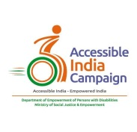
Accessible India Campaign
(Sugamya Bharat Abhiyan)
C.Sheela Reddy

Slide 2

What Constitutes a Disability?
A disability - condition of the body or mind (impairment) that makes it more difficult for the person with the condition to do certain activities (activity limitation) and interact with the world around them (participation restrictions).
“Disability” is a matter of perception

Slide 3
Who is a person with disability?
MoSPI - Disabled Persons in India: A Statistical Profile 2016
Disability is not a homogeneous concept –varies from person to person.
Seen through a microscopic lens, one person will always be more or less disabled than the other, in terms of their relative physical capabilities.
No universal definition of what constitutes a disability or of who should be considered as having a disability.
A disability is a result of the interaction between a person with a condition (health or mind) and a particular environmental context.

Slide 4
MoSPI Report….
As per 2011 population census, 20% of persons with disabilities in India have a disability in movement,
19% have a disability in seeing,
19% have a disability in hearing and
8% have multiple disabilities.
Number of persons with disabilities is highest in the age group 10-19 years (46.2 lakh people).

Slide 5
Disability in India
Population with disabilities is around 26.8 million, constituting 2.21% of India’s total population, (2011 population census) .
World Bank data on the total number of persons with disabilities in India suggests the number is between 40 and 80 million.
Persons with disabilities constitute a significant part of the Indian population.
India has one of the highest numbers of people with disabilities globally.

Slide 6
The World report on Disability 2011- WHO
Extensive global picture of the situation of people with disabilities, their needs, and the barriers they face to participating fully in their societies
“Disability is complex, dynamic, multidimensional, and contested”.
“Disability need not be an obstacle to success. I have had motor neurone disease for practically all my adult life. Yet it has not prevented me from having a prominent career in astrophysics and a happy family life”
- Professor Stephen W Hawking

Slide 7
Disability - Two types
Person is born with a disability - often the lack of good and accessible medical facilities - various medical complications for both the pregnant mother and the unborn child, often leading to a disability for the child
Person acquires a disability during his/her life - various reasons including accidents, disasters, wars, violence and other factors. All these are “controllable” (except natural disasters)

Slide 8
What is Accessibility( PwDs) ?
Set of norms and standards designed to provide safe and independent use of varied environments such as transportation, roads, buildings and communication
Universal design is a commitment for designing products and environments for the broadest population possible,
Equal opportunity to Persons with Disabilities by way of providing ACCESS to schools, work places, temples, parks, banks etc. all facilities
Provisions such as ramps etc. are visible objects to create awareness in society for inclusive thinking and barrier free society.

Slide 9
Global Initiative
The United Nations Convention on the Rights of Persons with Disabilities (UNCRPD) was adopted on 13 December 2006
Opened for signature on 30 March 2007 which came into effect on 03 May 2008 with 163 signatories and India is a signatory to this.
Article 9 of the Convention casts obligations on the Governments for ensuring to Persons with Disabilities easy accessibility.

Slide 10
Indian Context - Spirit Behind the Campaign
Universal Accessibility - critical for enabling Persons with Disabilities’ (PwDs) to gain access to equal opportunity and live independently and participate fully in all aspects of life.
Persons with Disabilities (Equal Opportunities, Protection of Rights and Full Participation) Act, 1995 under sections 44, 45 land 46 categorically provides for non-discrimination in transport, non-discrimination on the road and non-discrimination in built environment respectively.

Slide 11
Department of Empowerment of Persons with Disabilities (Divyangjan)
“Accessible India Campaign” (Sugamya Bharat Abhiyan) -lofty aim of ensuring universal accessibility to civic infrastructure, both physical and digital.
Launched by the Prime Minister of India on International Day of Persons with Disabilities on 3rd December 2015 – First time Indian government embraced the cause of PwDs visibly.
The Rights of Persons with Disabilities Act was passed in 2016 (17 chapters with 102 sections) - mandates incorporation of Universal Design principles while designing new infrastructure, electronic and digital media, consumer goods and services.

Slide 12
The Rights of Persons with Disabilities Act
“barrier” means any factor including communicational, cultural, economic, environmental, institutional, political, social, attitudinal or structural factors which hampers the full and effective participation of persons with disabilities in society;
“person with benchmark disability” means a person with not less than forty per cent. of a specified disability where specified disability has not been defined in measurable terms and includes a person with disability where specified disability has been defined in measurable terms, as certified by the certifying authority;

Slide 13
Components of the Campaign - “Leave No One Behind”
Build Environment Accessibility - accessible physical environment for everyone.
Transportation System Accessibility - equal right to travel and use public and private transportation infrastructure with dignity and independence.
Information and Communication Eco-System Accessibility - measures to curb all societal barriers of infrastructure, and inaccessible formats that stand in the way of obtaining and utilizing information in daily life.

Slide 14
What are the Targets entailed under the three components ???
Making 50% of all the government buildings of National Capital and all the State capitals fully accessible by December 2018.
Completing accessibility audit of 50% of government buildings and making them fully accessible in 10 most important cities/towns of States by December 2019.
Ensuring that 50% of railway stations in the country are converted into fully accessible railway stations by March 2018.

Slide 15
Contd…
Ensuring that 25% of Government owned public transport carriers in the country are converted into fully accessible carriers by March 2018.
Conducting accessibility audit of 50% of all government (both Central and State Governments) websites and converting them into fully accessible websites by March 2017.
Ensuring that at least 50% of all public documents issued by the Central Government and the State Governments meet accessibility standards (March 2018)

Slide 16
Some Facts…..
In 2016, India’s first accessibility audit of buildings and public places failed to find a single disabled-friendly building across the country.
90% of the buildings audited in India did not have a toilet for the disabled.
Of the 5% which did have special toilets, 75% were in a sorry state (a study by Samarthyam, which runs the National Centre for Accessible Environments) - Accessibility Awareness and Implementation Strategies.

Slide 17
Supportive Directions/Actions……
Union (of India), States and UTs must ensure government buses are disabled-friendly in accordance with the harmonised guidelines and they are duty-bound to see private buses also become disabled friendly
- Supreme Court,2017
In 2014, the Reserve Bank of India had made it mandatory for banks to install talking ATMs with Braille keypads. But very few ATMs today have the promised ramp or Braille key boards on the cash machines.

Slide 18
Uniqueness of the Campaign
Campaign is considered as a ‘game changer’ as it provides a framework for defining the rights to equality and a life with dignity for the 2.68 crore PwDs in India -
Focus of the disability movement has always been on shifting the welfare approach to a rights-based approach.
Campaign in a way tries to work on unique solutions that do not interfere with the self-belief and confidence of the disabled.
Enactment of the campaign by the Government of India was, aligned with the demands of the differently able community .

Slide 19
Intentions and Expectations………
Moreover, the campaign associates itself with the main theme of the Indian Constitution – JUSTICE & EQUALITY.
Promoting social inclusiveness will be an essential aspect of the campaign. This initiative aims to ease the pain and make the lives of the differently-abled worthwhile.
It will not only boost their confidence but also be of great help towards the development of our country.

Slide 20
Accessible India campaign is based on the premise - ‘Nothing about us without us’
Involving persons with disabilities and organizations, representing them in the policy-design of the strategy has contributed to the positive results of the campaign, notably in making sure that issues that really matter to them were high on the Indian governments agenda.
The government through ICT has been trying to create awareness on the issues and problems faced by the differently-abled and also expecting the citizens to contribute innovative and creative ideas, which will help in creating a simple life for the differently-abled.

Slide 21
Some concerns????
Yardsticks for measuring disability
Stringent punitive measures for non-compliance
How to make them(PwDs) as a part of the campaign so as to make it truly inclusive ?

Slide 22
UNDESA-UN Habitat Forum on Disability Inclusion and Accessible Urban Development 28-30 October, 2015
A city that is well designed is well designed for all.
Accessibility, as a collective good that benefits all, should be considered a central component of good policy to achieve inclusive and sustainable urban development.
By 2050, it is expected that about 6.25 billion people, 15% of whom are persons with disabilities, will be living in busy urban centres

Slide 23
Is Accessibility a cross-cutting theme??
Unprecedented developmental activity in the country under the various missions such as the Smart Cities Mission and Digital India.
Disability is not an isolated issue. It is cross-cutting and can impact everyone irrespective of caste, gender, age and nationality.
Ensuring a disability-sensitive development agenda across all ministries, sectors and causes becomes critical if growth has to be truly inclusive.
‘Nothing about us without us’ assumes even greater significance in the current context.

Slide 24
What is required???
Representation of persons with disabilities in all ministries and key missions, commissions and committees to advise and ensure inclusion in all policies, programmes and developments.
Synergy between various arms of the government.
The Smart Cities Mission focusses on comprehensive development leading to the convergence of other ongoing government programmes such as Make In India, Digital India, Atal Mission for Rejuvenation and Urban Transformation (AMRUT), Pradhan Mantri Awas Yojana, National Heritage City Development and Augmentation Yojana (HRIDAY), etc.
Does the Accessible India Campaign find a mention??

Slide 25


.
Accessible India Campaign is a great start indicating the intent to do great things for the disabled community.
However, its eventual success will depend on the level of engagement of all stakeholders in moving this campaign forward.
Need to ‘Walk the Talk’
“I can’t change the direction of the wind, but I can adjust my sails to always reach my destination.” –Jimmy Dean

Slide 26
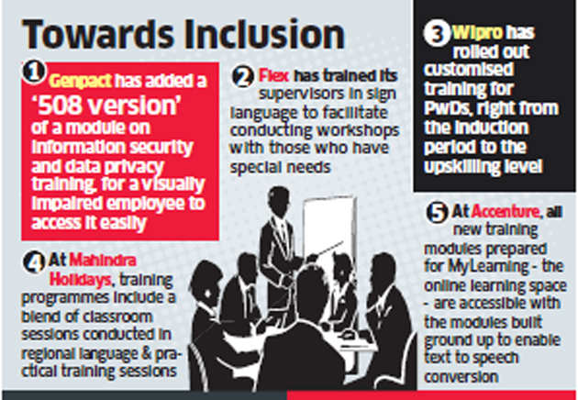
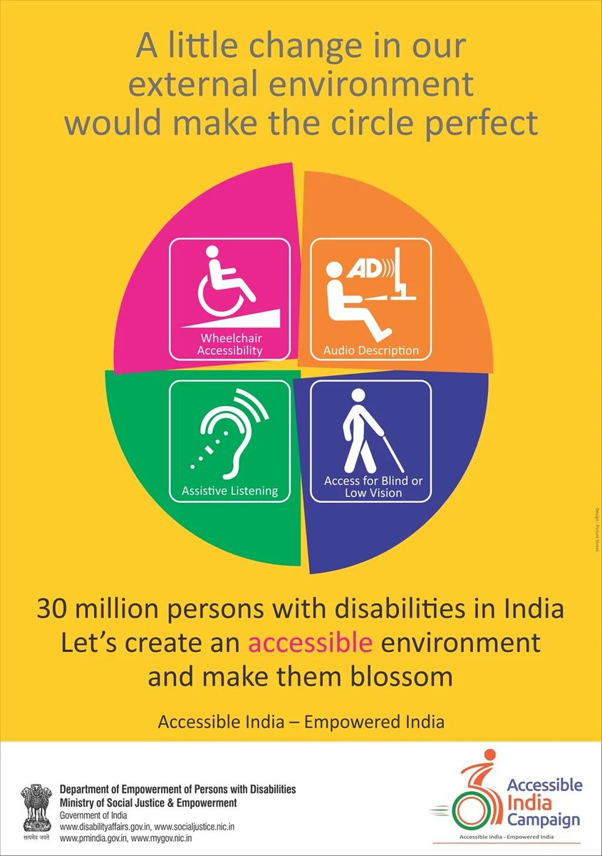
Collaborative endeavor

Slide 27


THANK YOU
Notes:
27

