Slide 1
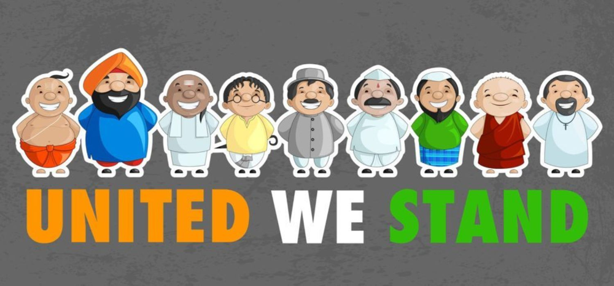
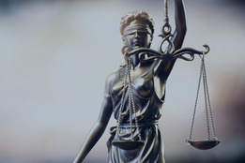
Justice and Harmony in Diverse society

Slide 2
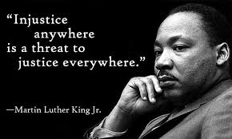
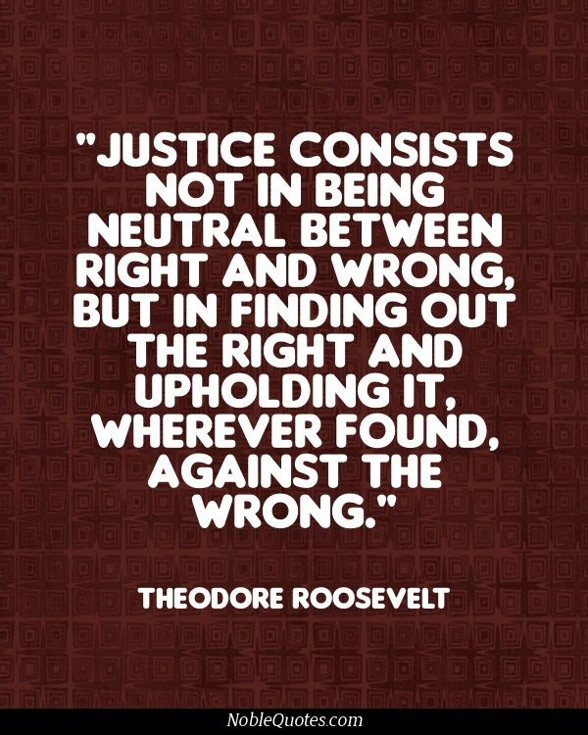

Slide 3
Defining Social Justice In Terms of Harmony…….
Greek philosopher Socrates – “justice was a condition for harmony in which each part of soul or each part of group in the city took care of its own business so that the whole society functioned according to proper order”.
While Socrates gave a definition of justice directly in terms of harmony, in modern times the concept of justice and harmony have largely gone their separate ways.

Slide 4
Theoretically, in order to establish the principles and norms of justice and harmony one must realize the present causes of injustice and disharmony.
All human beings suffer from interpersonal and societal conflicts.
These conflicts have resulted in unjust, unfair and disharmonious conditions, and led to social isolation, social turmoil, and diminished security of people’s lives.

Slide 5
Understanding Social Justice and Harmony….
Social Justice - fair and equitable distribution of power, resources, and obligations, in society to all the people, regardless of their race and ethnicity, age, gender, ability status, sexual orientation and religious or spiritual background.

Slide 6
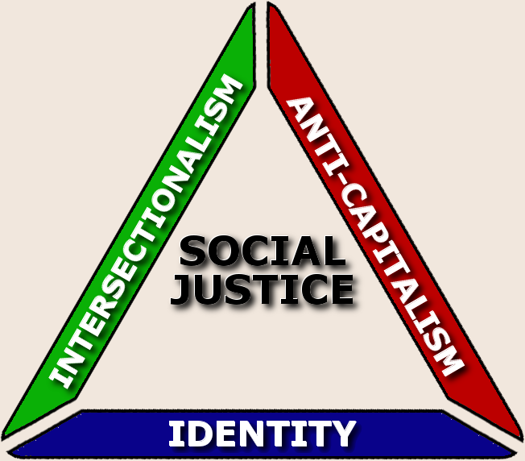
Fundamental Principles Underlying Social Justice :
Inclusion
Collaboration
Cooperation
Equal access
Equal opportunity

Slide 7
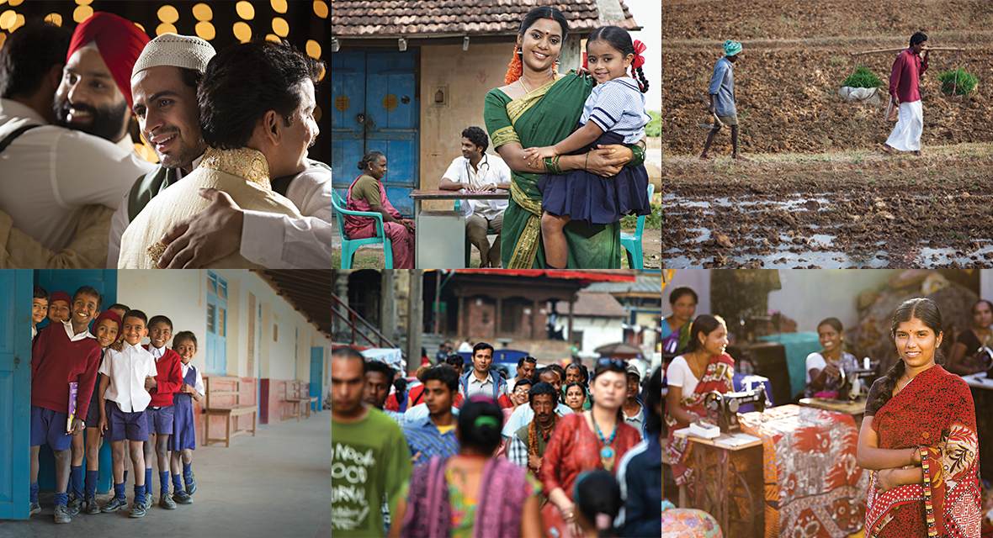
Contd…..
Social Harmony - encourages trust, admiration, peace, respect, generosity and equity among people in a society irrespective of caste, class and gender etc……

Slide 8
Ambedkar’s View on Social Justice and Harmony
To Ambedkar Justice can be dispensed by establishing :
a society where individual becomes the means of all social purposes
society based on equality, liberty and fraternity
democracy- political, economic and social.
democracy through constitutional measures and
democracy by breaking monopoly of upper strata
on political power

Slide 9
How is Preferential Treatment Justified????
To Dr. Ambedkar, the concept of social justice sometimes requires ‘unequal 'or ‘preferential treatment’ for certain sections of the population, which have been deprived of certain values for ages.
This is with a view to bring them on an equal footing with other sections of the population.

Slide 10
Modern Notion of Justice and Harmony in Society
Rawl’s theory of social justice - “……….the fundamental issue in distributive justice is equality; a more equal or at least a less unequal distribution of the benefits and of social co-operation”…
…..Any attempt to promote distributive justice must begin with a consideration of the existing inequalities in society.
……..It is essential to keep in sight both inequalities between individuals and disparities………”.

Slide 11
Social Justice – A Relative Concept
In terms of culture-specificity, the term social justice has a different meaning in Indian society.
It means dispensing justice to those to whom it has been systematically denied in the past because of an established social structure.
Feeling of social justice is a form of relative concept which is changeable by the time, circumstances, culture, and ambitions of the people .
Inclusion of the word “Socialist” in the Preamble by the 42nd Amendment Act has strengthened the democratic ethos of social and economic justice.

Slide 12
Manifestations of Disharmony
Political and social developments or issues that receive prime importance in national discourse do not arouse similar interest in some states.
Geographical distance and remoteness from the events at the center exhibit in creation of disharmony between different identities and communities.
India’s caste system, which splits up Hindus into different societal groups according to their work and birth has been the major cause of creating disharmony and injustices to individuals belonging to various communities.

Slide 13
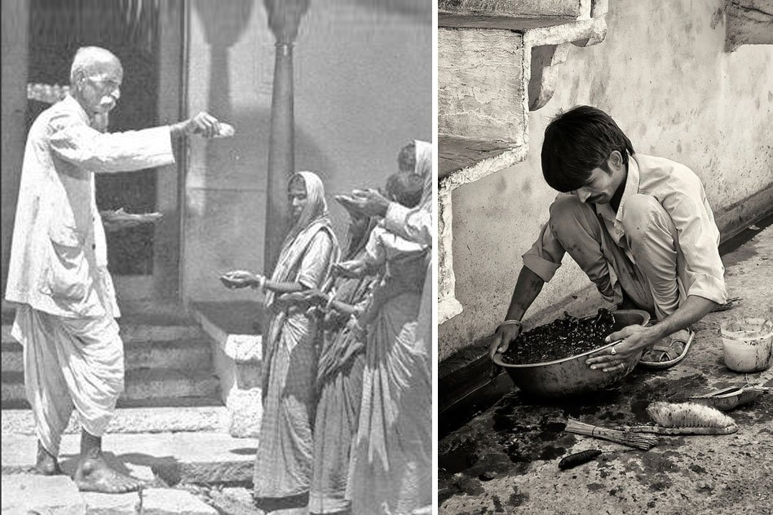
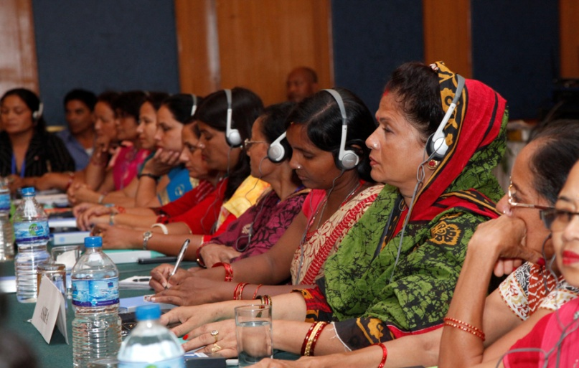
Injustice Breeds Exclusion……??
Female suppression has been widespread and pervasive over the span of the history of India.
Although women’s status has also been subject to many changes, women are still discriminated against and excluded from decision-making processes, despite the constitutional and legal provisions that not only grant equality to women, but also empower them.

Slide 14
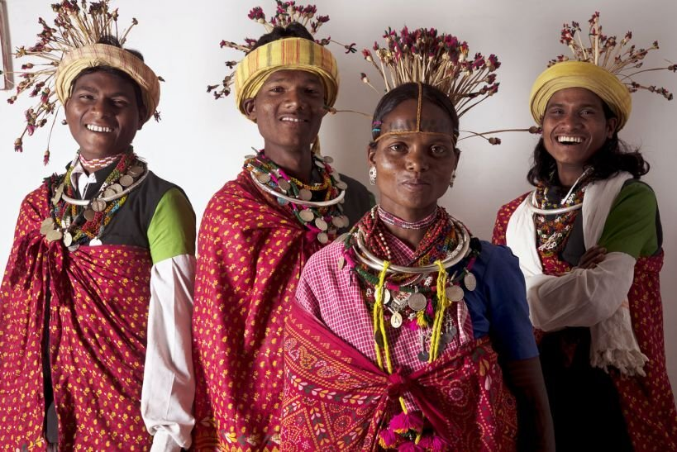
CASE STUDY: INJUSTICE TO THE BAIGA COMMUNITY IN CHHATTISGARH, INDIA
Chhattisgarh state recognises five PVTGs, namely, the Baigas, Pahari Korwas, Birhors, Kawars and Abujhmarias. As a strategy to curtail their decreasing population, the Government of India in 1979 restricted their access to permanent contraceptive methods (sterilization).
This order is still being enforced in many states, including in Chhattisgarh, The other rationale underlying the order was that the population of PVTGs was dwindling and their numbers had to be increased.

Slide 15
Contd…
However, the government failed to acknowledge and act on the real reasons for the dwindling population that included starvation, chronic malnutrition, and lack of access to adequate health services, which in turn resulted in high mortality rates among these communities.
The National Population Policy, 2000 of India commits to “voluntary and informed choice and consent of citizens while availing of reproductive health care services” and states that special efforts should be made to provide these services to tribal communities (Adivasis) as per their needs.

Slide 16
There is extremely high malnutrition levels among Baiga children and both Baiga women and men.
Among Baiga children under five years of age, 55.5% were underweight, 55.5% stunted and 15.6% wasted, the high malnutrition levels among children that continue into adulthood.
Baigas have been demanding the right to contraceptive services. Denying contraceptive services is a violation of reproductive and human rights and the right to self-determination and bodily autonomy.
    Is the government order justified?
    What is the basis of conflict?
    How to strive for harmony in exceptional situations?
    What is just and what is unjust?

Slide 17
Consequences of Disharmony
Threat to minority: Rise in intolerance and communal disharmony lead to majoritarianism suppressing minorities and hindering their rights.
Mob-violence: Targeting of religious minorities has led to a rise in mob-violence impacting the psyche of minorities
Threat to Rule of law: With rise in incidence of mob justice, lynchings, there is a threat to rule of law.
Freedom of speech: Disharmony and intolerance has led to excessive scrutiny of speech and expression preventing many to speak freely due to fear of life.

Slide 18
Violation of human rights: The Human Development Index of the society is adversely affected by conflict, unrest impacting the basic right to freedom of people. (India ranks 131 among 189 countries in – HDI, 2020)
Regionalism: Anti-national elements instigate regional feelings and create an atmosphere to break the cohesiveness of our society.
Lawlessness: Lawlessness accruing out of communal disharmony is exploited by the divisive forces operating in the country because of which internal security risks gets heightens.
Damage social fabric: The social fabric of the society gets irreparably damaged and the conditions of mistrust serve as a catalyst for future conflicts on flimsy grounds.

Slide 19
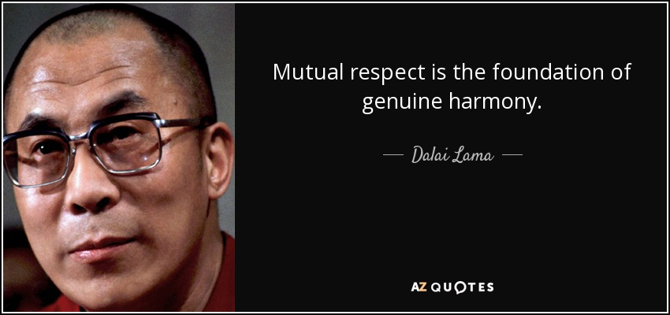
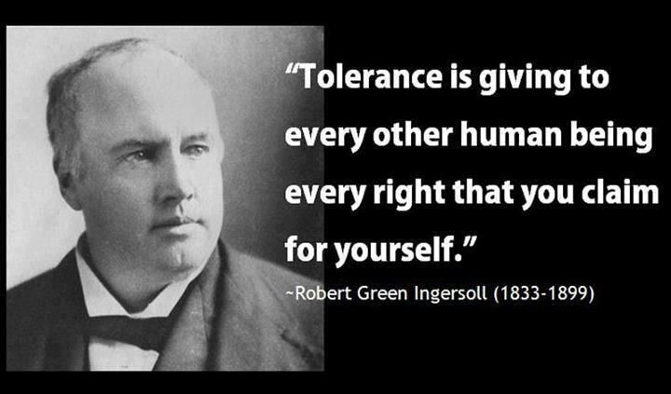

Slide 20
REFERENCES
Dr. Rajkumar Singh, Rajkumar, Status of Social Justice in India, South Asia Jounal.
http://southasiajournal.net/status-of-social-justice-in-india/
Social Justice Theory
https://www.researchgate.net/publication/310769309_Social_Justice_Theory#:~:text=Social%20justice%20is%20generally%20de%EF%AC%81ned,%2C%20sexual%20orientation%2C%20and%20reli%2D
Basabi Khan and Georg Stöber, George, Living in Harmony? "Casteism", Communalism, and Regionalism in Indian Social Science Textbooks. Journal of Educational Media, Memory & Society.Vol. 6, No. 2, Special Issue, Published by: Berghaln Books.
https://www.jstor.org/stable/44320034?Search=yes&resultItemClick=true&searchText=justice+and+harmony+in+India&searchUri=%2Faction%2FdoBasicSearch%3FQuery%3Djustice%2Band%2Bharmony%2Bin%2BIndia%26acc%3Don%26wc%3Don%26fc%3Doff%26group%3Dnone&ab_segments=0%2Fbasic_SYC-5187_SYC-5188%2Ftest&refreqid=fastly-default%3A65c2c4d85d24f7d9e8d3be69152f549d&seq=5#metadata_info_tab_contents
Case Study:
https://www.tandfonline.com/doi/full/10.1080/09688080.2018.1542912

