Slide 1
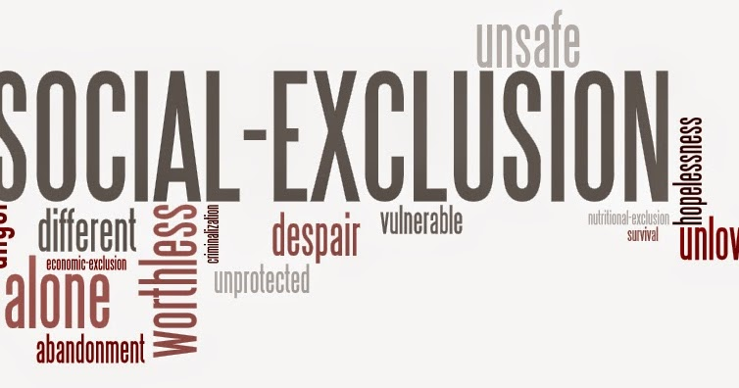
STIGMA & EXCLUSION
C.Sheela Reddy

Slide 2
What is Stigma ?
What leads to Stigma?
SOME QUESTIONS
Does Stigma lead to discrimination?
How does discrimination result in Social Exclusion ?

Slide 3
Stigma????
Today
Origin
Stigma is a Greek word and refers to the physical mark made by fire or with knives on individuals considered outsiders or inferiors.
Tattoo that was cut or burned into the skin of criminals, slaves, or traitors in order to visibly identify them as blemished or morally polluted persons
The physical marks have gone but stigma remains based on one or more factors such as age, class, colour, ethnicity, religion and sex.
Individuals who are stigmatized usually feel different and devalued by others.

Slide 4
What is Stigma?
A mark of shame or discredit; an identifying mark or characteristic, a scar, stain or brand
– (Merriam Webester)
French sociologist Emile Durkheim was the first to explore stigma as a social phenomenon in 1895

Slide 5
Stigma - an attribute that is deeply discrediting…
  ‘Stigma is the situation of the individual who is disqualified from full social acceptance………..
  The stigmatised individual is reduced in our minds from a whole and usual person to a tainted, discounted one’
(Sociologist- Erving Goffman, 1963)

Slide 6
What does Stigma involve?
Stigma involves people making unfair moral judgements about other people often based on:
Stereotypes and Misinformation
Stigma - about the social interactions between stigmatised and normal persons in the society’
Goffman defined stigma as a special kind of gap between virtual social identity and actual social identity

Slide 7
Goffman - divides the individual's relation to a stigma into three categories - the stigmatized, the normal, and the wise
the stigmatized are those who bear the stigma;
the normals are those who do not bear the stigma; and
the wise are those among the normals who are accepted by the stigmatized as "wise" to their condition

Slide 8
What does Stigmatisation consist of ?
Marked recognition of the differentiating mark
Subsequent devaluation of a person

Slide 9
Instances……
Someone isn’t “schizophrenic.” He/she is a person living with schizophrenia.
Always opt for language that’s “people-first,” and that centers an individual, rather than their symptoms.
“You are the smartest one I have ever known in your caste!” (How many people have you ever met?)
“Oh not you, you are different and not like other people of your caste”.

Slide 10
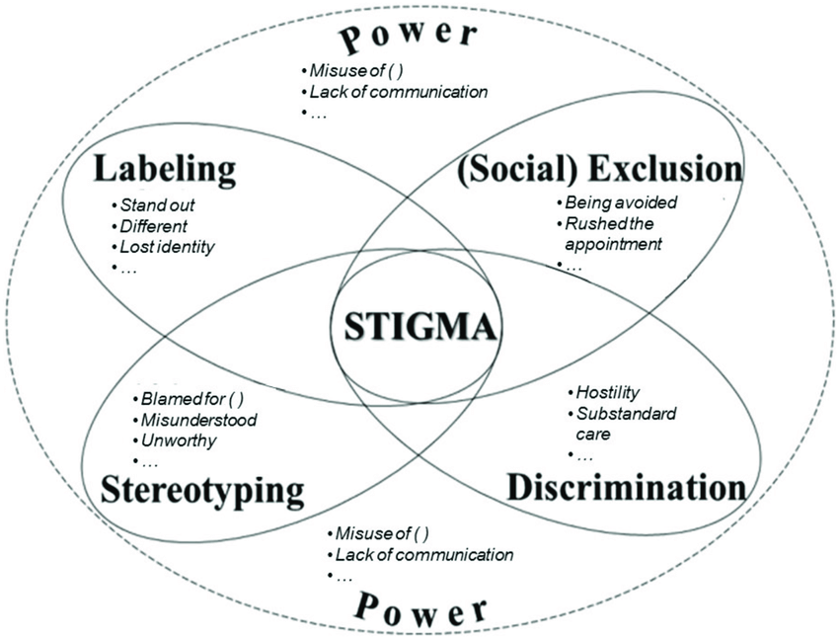
Stigma – Interpretations..
Reaction of others – (labelling, Stereotyping, Judgement, Prejudice)
To an undesirable attribute –
(eg. Race, obesity, addiction, disability)
Context –specific – (varies by culture, gender, time period etc)
Spoiled identity – ( from a ‘normal’ to a ‘tainted identity’)
Become ‘them’ rather than ‘us’

Slide 11
Stigma -Types
Structural stigma is the “societal-level conditions, cultural norms, and institutional practices that constrain the opportunities, resources, and wellbeing for stigmatized populations”
Perceived Stigma – Beliefs about how others view something as negative .
Anticipatory Stigma – Anticipating Negative behavior, discrimination, prejudice based on association with difference/disorder.
Treatment Stigma – Stigma associated with getting treatment for mental illness, or treatment itself.
Experienced Stigma- The actual experience of negative behavior based on association with difference/disorder.
Internalized Stigma- Holding negative views about oneself based on negative association difference/disorder.

Slide 12
Social Stigma
Social stigma refers to supporting stereotypes about individuals with a mental illness.
For example, “I remember as a student telling one of my professors that I had bipolar disorder. She subsequently began talking to me more slowly and even subtly questioned my ability to complete a graduate degree. In essence, she was endorsing a common stigmatizing misconception: that having a mental illness makes an individual less intelligent or less capable”.

Slide 13
How is stigma related to deviance?
Stigma occurs when an individual is identified as deviant, linked with negative stereotypes that engender prejudiced attitudes, which are acted upon in discriminatory behavior.
Who is a deviant? -
Gerhard Falk expounds upon Goffman's work by redefining deviant as "others who deviate from the expectations of a group" and by categorizing deviance into two types –
Societal deviance
Situational deviance

Slide 14
Societal and Situational Deviance
Societal deviance refers to a condition widely perceived, in advance and in general, as being deviant and hence stigma and stigmatized.
Situational deviance refers to a deviant act that is labeled as deviant in a specific situation, and may not be labeled deviant by society

Slide 15
Why Stigma exists and how it is maintained?
History of misunderstanding and mistreatment
Myths and misconceptions
The Media
Prejudice and Discrimination
Negative Judgements and Labels
Stigmatising Phrases

Slide 16
Impact of Stigma
Isolation – manifested in lack of Social Capital
Rejection – resulting in reduced life opportunities
Hostility – resorting to even violence
Marginalised – face discrimination and exclusion

Slide 17
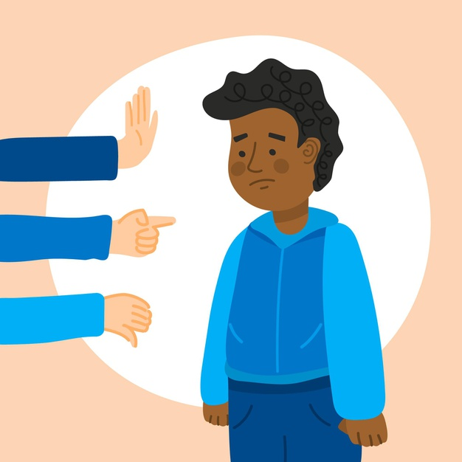
Stigma restricts a person's ability to……
Develop their potential and impacts negatively upon
Relationships
Housing
Health
Employment
Insurance
Education
Travel

Slide 18
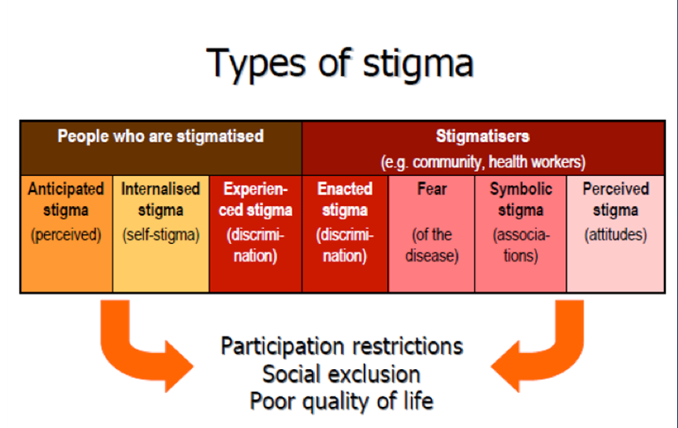
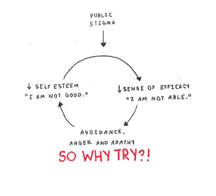
Stigmatization

Slide 19
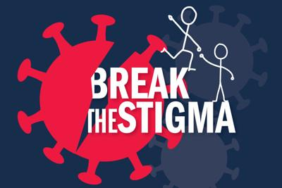
Understanding Stigma and Exclusion
Combination of problems of knowledge (ignorance)-lack of awareness about issues
Attitudes (prejudice) and
Behavior (discrimination), against an identifiable group of people, a place, or a nation.

Slide 20
How Stigma can be challenged?
Stigma, though powerful and enduring, is not inevitable, and can be challenged.Two important aspects :
  Challenging the stigmatization on the part of stigmatizers
  Challenging the internalized stigma of the stigmatized.

Slide 21
Approaches to challenge stigmatization, (Campbell et al. 2005)
Educate individuals about non-stigmatising facts and why they should not stigmatize.
Efforts to legislate against discrimination.
Efforts to mobilize the participation of community members in anti-stigma efforts, to maximize the likelihood that the anti-stigma messages have relevance and effectiveness, according to local contexts.

Slide 22
Does Stigma lead to Discrimination??
Groups who experience stigma may also experience discrimination. This discrimination can take the form of:
Other people avoiding or rejecting them;
Getting denied healthcare, education, housing, or employment;
Verbal abuse; or
Physical violence

Slide 23
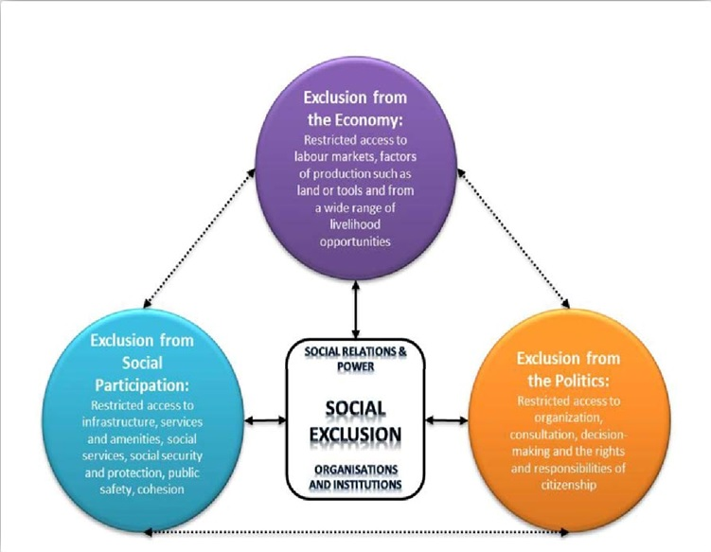
Discrimination Manifests in Exclusion

Slide 24


THANK YOU
Notes:
24

