Slide 1


Equity and Equality: Critical Dilemmas
C. Sheela Reddy

Slide 2
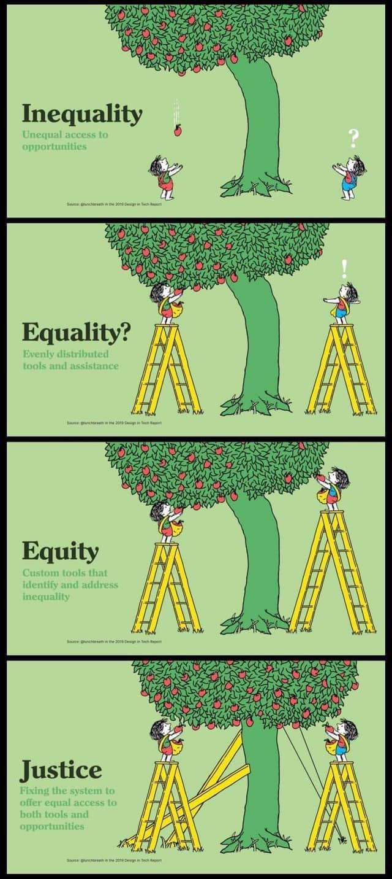
Major Societal Concerns
Unequal access to opportunities
Equally distributed tools and assistance
Custom tools that identify and address inequality
Fixing the system to offer equal access to both tools and opportunities

Slide 3
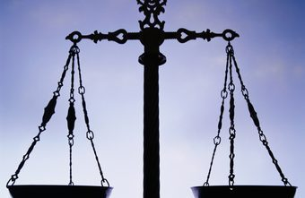
SOME QUESTIONS
Why are Equity and Equality Important ?
Are Equality and Equity the same?
What is the relationship between Equity and Equality ?
What are the provisions of Equality in Indian Constitution and how equity could be ensured?

Slide 4
Understanding Equality and Equity
Equality refers to everyone having the same rights, being offered the same opportunities and the same levels of support for all segments of society.
Equity involves ensuring individuals have what they need to enjoy those rights - offering varying levels of support depending upon need to achieve greater fairness of outcomes.

Slide 5
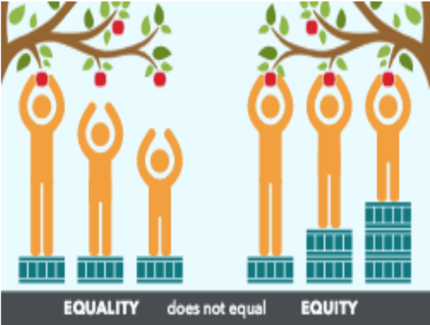
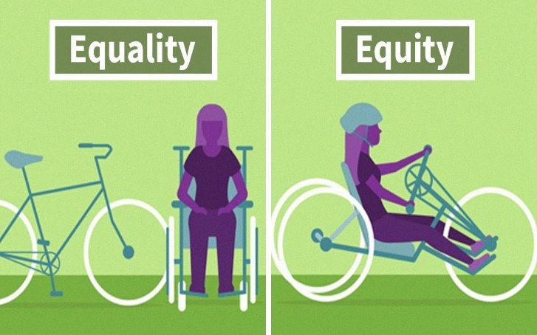
BASIS FOR COMPARISON | EQUITY | EQUALITY
Meaning | Equity is the virtue of being just and even handed | Equality is described as a state where everybody is at the same level
What is it ? | Means | Ends
Distribution | Fair | Even
Recognizes | Differences, and attempts to counteract unequal individual opportunities. | Sameness and treats everyone equal.
Ensures | People have what they need. | Providing everyone the same things.

Slide 6
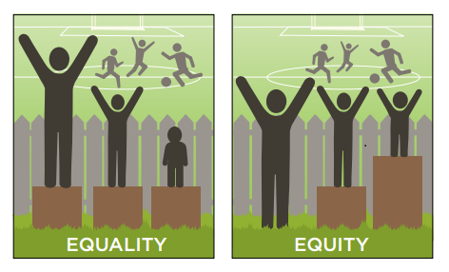
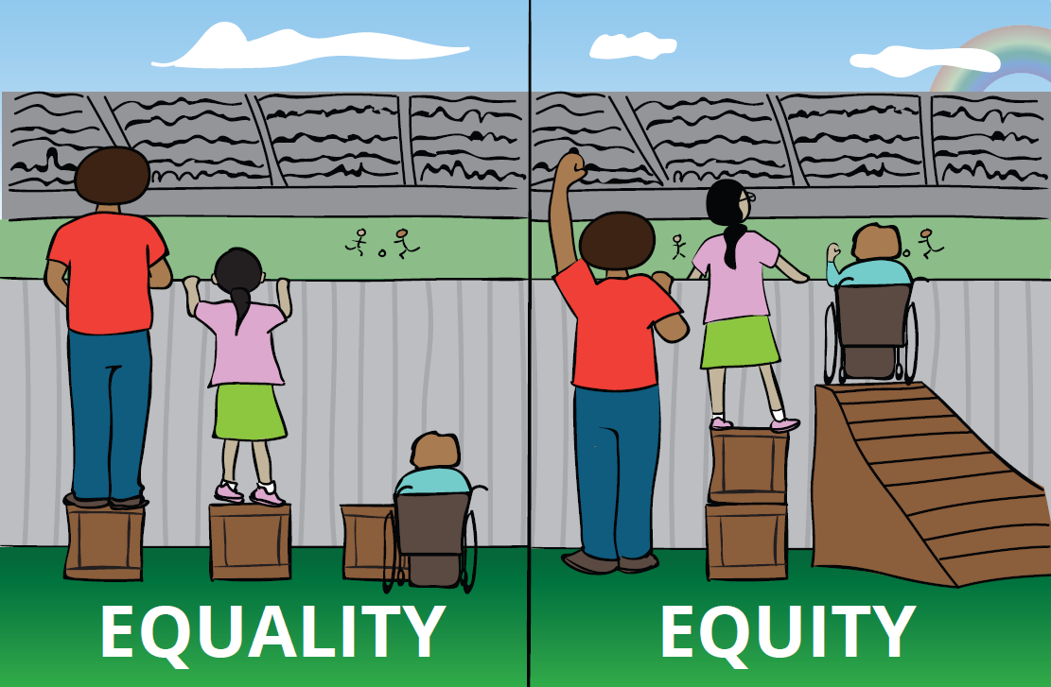
Equality Vs Equity

Slide 7
Equity Vs. Equality
Equity represents impartiality, i.e. the distribution is made in such a way to even opportunities for all people, | Conversely equality indicates uniformity, where everything is evenly distributed among people.
Equity is the idea of “leveling the playing field” so that fairness is ensured. | Equality treats everyone the same without paying attention to the natural differences between people in terms of race, sex, social class etc.
Equality is giving everyone a shoe, Equity is giving everyone a shoe that fits.

Slide 8
Constitutional Provisions
Articles 14 to 18 of the Constitution - civic equality,
Articles 325 and 326 - political equality, and
Article 39 under the Directive Principles of State Policy - economic equality.
Equality of opportunity means to give equal chance to every individual for the development of his capacity.

Slide 9
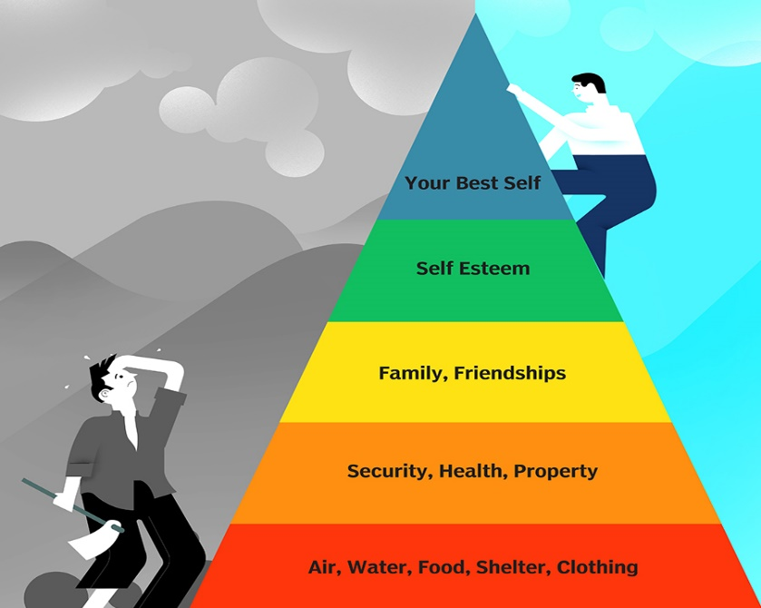
Principle of Equity
Not the uniformity of treatment to all in all respects.
All persons similarly circumstanced shall be treated alike both in the privileges conferred and liabilities imposed by the laws.
Equal law should be applied to all in the same situation, and there should be no discrimination between one person and another.

Slide 10
Equity-Means to Equality
Equality is undermined when equity is not given due consideration and when a person or group’s needs are not taken into account.
Equality and equity may be inherently different but are also bound together. In order to create true equality of opportunity, equity is needed to ensure that everyone has the same chance of getting there.

Slide 11


