Slide 1
A.III.9 Social Justice: Equity & Harmony
C. Sheela Reddy

Slide 2
Objectives
To understand the nature and dynamics of discrimination and exclusion - An Ambedkar’s perspective.
To examine current strategies for ensuring social justice and inclusion in the Indian context.
To explore ways and means for building a fair, just and harmonious society.

Slide 3
CONTENTS
Social Justice :Basic Premises
Equity and Equality : Critical Dilemmas
Stigma and Exclusion
Consequences of Exclusion
How to Bring Justice and Harmony in a Deeply Diverse Society?
Accessible India Campaign (Sugamya Bharat Abhiyan)
Social Inclusion: Ambedkar’s Perspective
Social Justice: Equity and Harmony
Contextualizing the Ideas of Liberty, Equality and Fraternity in New India
The Agenda of Sab Ka Saath, Sab Ka Vikas and Sab Ka Vishwas (together with all, development for all, the trust of all)

Slide 4
Social Justice :Basic Premise

Slide 5
Ideas about
Justice as well as
Social Justice are complex and indeterminate

Slide 6
Some related concepts……
Exclusion
Inclusion
Inclusive Governance
Inclusive Development
Growth Vs Equity & Harmony
Affirmative action

Slide 7
Justice
Set of universal principles which guide people in judging what is right and what is wrong, no matter what culture and society they live in.

Slide 8
Basic Premise of Social Justice
Emancipation of the underprivileged, exploited, and oppressed sections of society.
Liberate mankind from traditional bondages of social and economic exploitation and discrimination.
It postulates a social order which can guarantee freedom and equal rights to all sections of society.

Slide 9
Opening words of the Preamble of the Indian Constitution
“WE, THE PEOPLE OF INDIA, having solemnly resolved to constitute India into a SOVEREIGN SOCIALIST SECULAR DEMOCRATIC REPUBLIC and to secure to all its citizens: JUSTICE, social, economic and political;
LIBERTY of thought, expression, belief, faith and worship;
EQUALITY of status and of opportunity; and to promote among them all
FRATERNITY assuring the dignity of the individual and the unity and integrity of the Nation;
IN OUR CONSTITUENT ASSEMBLY this twenty-sixth day of November, 1949, do HEREBY ADOPT, ENACT AND GIVE TO OURSELVES THIS CONSTITUTION

Slide 10
Fundamental Constitutional values
Sovereignty
Socialism
Secularism
Democracy
Republican Character
Justice
Liberty
Equality
Fraternity
Dignity of the Individual
Unity and Integrity of the nation.

Slide 11
Ambedkar’s Views….
Democracy not just a political arrangement but essentially form of inclusive society and a mode of associated living.
Achieve social justice and social democracy in terms of one man-one value.
Consider social justice as true basis for patriotism and nationalism
Citizenship requires a sense of belongingness without which worst kinds of socio-political detachment take place.

Slide 12
Social Justice through Social Inclusion - ??
The development of capacity and opportunity to play a full role, not only in economic terms, but also in social, psychological and political terms.

Slide 13
People First - Sen’s approach
Development - Expansion of people’s capabilities
Human well being - multidimensional phenomenon
Quality of life that individuals are able to achieve
People are both means and end of development
Purpose of development is to enrich human lives, not richness of economy
Many factors influence human capabilities
GDP - to compare countries, not straight forward relation with quality of life

Slide 14
Poverty - deprivation of basic capabilities
Inequality and social exclusion - two common side effects of current economic growth model
Poverty a multidimensional process necessitating a multi - faceted development approach
Emphasis on good social outcomes
It is not enough to keep development as the goal….. Development should be at the socially desirable level

Slide 15
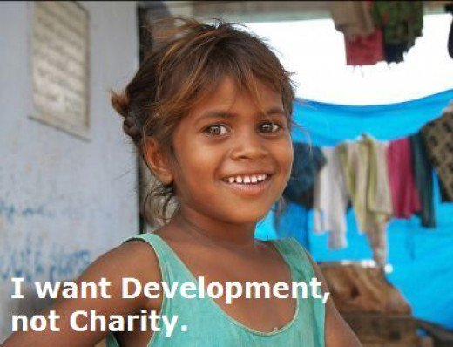

Slide 16
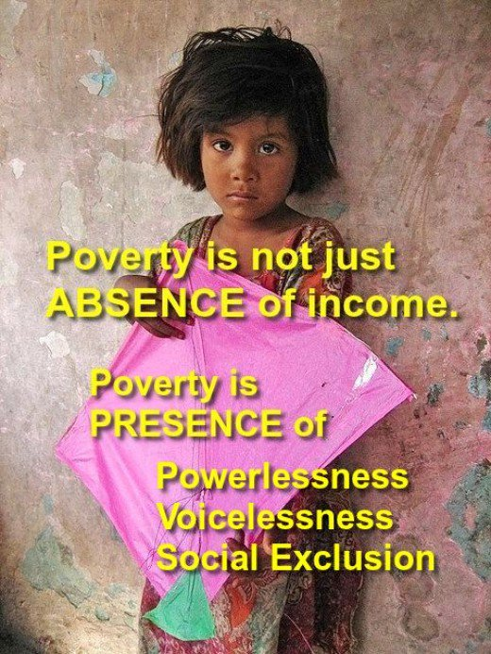

Slide 17
The United Nations Definition : Inclusive society
based on respect for :
Human rights and fundamental freedoms,
Cultural and religious diversity,
Social justice and the special needs of vulnerable and disadvantaged groups,
Democratic participation and the rule of law.

Slide 18
Social justice (is realized)
When equal opportunities for people from different walks of life are provided.
When equal individual and social rights and freedom are achieved.
In a developing country like India, social justice can be related to distributive justice. The main problem in India is not the scarcity of resources, but the unjust distribution of resources among the people.

Slide 19
Dr. B. R. Ambedkar - who tried to turn the Wheel of the Law toward social justice for all……
“If you ask me, my ideal would be the society based on liberty, equality and fraternity. An ideal society should be mobile and full of channels conveying a change taking place in one part to other parts”.

Slide 20
AMBEDKAR BELIEVED
EDUCATION
which is a panacea for the
social evils and injustice
The road to social justice is to be led by

Slide 21
Fought against caste and injustice
Believed that a democratic form of government presupposes a democratic form of society
Struggled hard to secure human rights for all
Ambedkar
Ultimate aim was to establish real social democracy
Wanted to vitalize conscience of the people
Mobilized the masses in India to fight injustice

Slide 22
Four principles of social justice:
The foundation of a free society - equal worth of all citizens.
Everyone is entitled, as a right of citizenship, to be able to meet his/her basic needs.
The right to self-respect and personal autonomy demands the widest possible spread of opportunities.
Not all inequalities are unjust, but unjust inequalities should be reduced and where possible eliminated.

Slide 23
….Whatever the Constitution may or may not provide, the welfare of the country will depend upon the way in which the country is administered. That will depend upon the men who administer it………
After all, a constitution like a machine is a lifeless thing. It acquires life because of the men who control it and operate it, and India needs today nothing more than a set of honest men who will have the interests of the country before them…….
– Dr. Rajendra Prasad

Slide 24
Granville Austin
The constitution can be summarized as having three strands:
Protecting and enhancing national unity and integrity
Establishing the institutions and spirit of democracy
Fostering a social revolution to better the lot of Indians.
Maintaining harmony between the three strands has presented a great challenge to the Indian State…..

Slide 25
“Until the great mass of the people shall be filled with the sense of responsibility for each other’s welfare, social justice can never be attained” - Helen Keller (American author, political activist, and lecturer, the first deaf-blind person to earn a bachelor of arts degree)

Slide 26
Honor the Legacy of Dr.Ambedkar……….
April 14(Birth Anniversary)
November 26, Constitution Day (Samvidhan Divas)
December 06, Mahaparinirvan Divas
The permanent mission of India to the U.N. organized a special event to commemorate Ambedkar’s 125th Birth Anniversary.

Slide 27
Panchteerth
Union Government - 5 places “Panchteerth” in honor of Babasaheb Dr. B. R. Ambedkar.
His birthplace (Janma Bhoomi) in Mhow, Madhya Pradesh
Dr. Ambedkar Memorial in London where he stayed while studying in U.K.
‘Deeksha Bhoomi’ in Nagpur (converted to Buddhism with approximately 6,00,000 followers on 14 October 1956)
‘Mahaparinirvan Sthal’ in Delhi (26, Alipur Road, Delhi) - Dr Ambedkar National Memorial
‘Chaitya Bhoomi’ in Dadar, Mumbai, Maharashtra (cremated after his death on 6 December 1956)

Slide 28
Reference Links
1. Allan C. Ornstein - Social Justice: History, Purpose and Meaning, Social Science and Public Policy, Soc (2017) 54:541–548 https://doi.org/10.1007/s12115-017-0188-8
https://link.springer.com/article/10.1007/s12115-017- 0188-8
2. Soli J. Sorabjee, Ambedkar’s ideas of social justice still haunt country’s constitutional apparatus. How much have we achieved?, The Indian Express, April 18, 2019, Accessed on November 22, 2020
https://www.google.com/amp/s/indianexpress.com /article/opinion/columns/b-r-ambedkar-social-justice-indian-constitution-5681094/li te/

Slide 29


