Slide 1

Work-Life Balance
How can we get it !

Slide 2
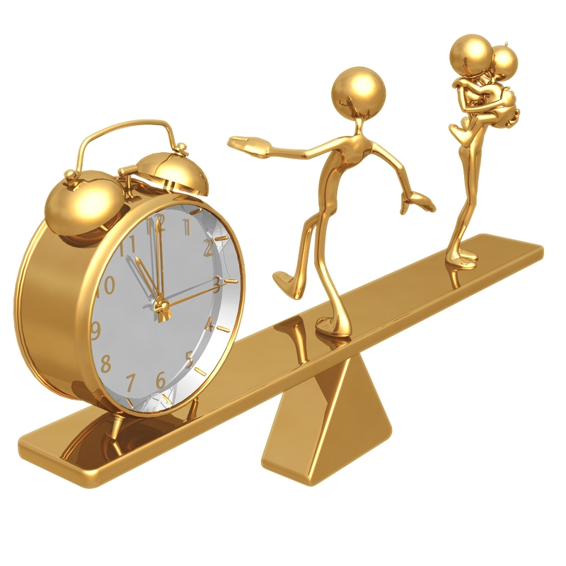
Work Life Balance
“An individual’s ability to fulfill his work and lifestyle responsibilities with minimal conflict and maximum contentment.”
Achieving work-life balance means:
Being aware of different demands
of your time and energy.
Having the ability to make choices
in the allocation of time and energy
and making conscious choices.

Slide 3
Work-Life balance - What is it all about?
Work-life balance" was coined to address the unhealthy life choices that many people were making; they were choosing to neglect other important areas of their lives such as family, friends, and hobbies in favor of work-related chores and goals
Notes:
Work-Life Balance does not mean an equal balance. Trying to schedule an equal number of hours for each of your various work and personal activities is usually unrewarding and unrealistic. Life is and should be more fluid than that.
Your best individual work-life balance will vary over time, often on a daily basis. The right balance for you today will probably be different for you tomorrow. The right balance for you when you are single will be different when you marry, or if you have children; when you start a new career versus when you are nearing retirement.
There is no perfect, one-size fits all, balance you should be striving for. The best work-life balance is different for each of us because we all have different priorities and different lives.

Slide 4

Defining Work-Life
Balance?
Life will deliver the value and balance we desire ...when we achieve and enjoy something every single day...in all the important areas that make up our lives.
Hence, a good working definition of Work-Life Balance is:
Meaningful daily Achievement and Enjoyment in each of the four life quadrants:

Slide 5
Work Life Triangle
Work ( what we do, careers, housework, chores, etc)
Relationships (personal, friendships, partners, spouses, children
Self-Care (spiritual, physical, intellectual, emotional, health, wellness, exercise)
Work
Self-Care
Relationships

Slide 6
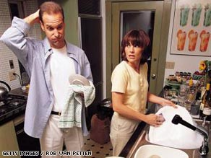

Meaning of the 3 words
WORK
              ???
It relates to the time and energy people expend to
a third party in return for a definite award.

Slide 7
What it is not…….
It is not equal balance
The best WLB for you will vary
The best work life balance varies for all
Notes:
It is a choice to be made by every individual.And good or bad he or she has to live with the results of those choices.

Slide 8
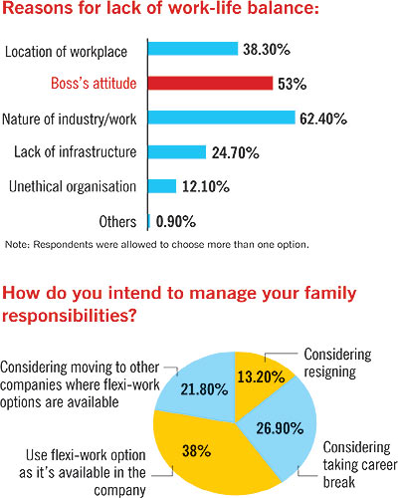

Slide 9
FACTORS AT HOME LEADING TO
IMPROPER WORK-LIFE BALANCE
Work-to-family interference
Role overload
Caregiver strain
@Home
Fatigue
Family &Friends
Expectations

Slide 10
FACORS AT WORK LEADING TO
IMPROPER WORK-LIFE BALANCE
Global economy
International business
Longer hours
@Work
Changes in family roles
Advanced communication technology

Slide 11

Why has Balance
become more difficult?
Technological change
Changes in time spent in work
Downsizing, Restructuring and Decline in Job Security
Women in the work force and changing family patterns

Slide 12

Technological Breakthroughs

Slide 13
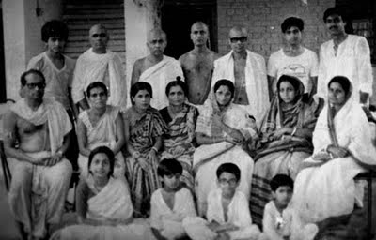

Shifts in Societal Patterns

Slide 14

New Horizon of Expectations

Slide 15

NEED FOR MAINTAINING

Slide 16
BENEFITS OF IMPROVED WLB

Slide 17
Relationship Between Work-Life balance and Productivity

Slide 18
COMPANIES REAP THE BENEFITS
Evidence speaks loud and clear
30% of managers believed that flexible work arrangements had increased employees’ ability to meet deadlines.
Royal Bank Financial Group, Toronto estimates that its flexible work arrangements , which include flexitime, compressed workweeks, and work-at-home arrangements, added $130 million to its bottomline in 1997. 37% of its managers in said that employee efficiency had increased.
Tennesee Bank found that branch offices where employees rated supervisors as supportive of work/ family balance retained employees twice as long and kept 7% more retail customers.

Slide 19
72% of managers felt that employee stress levels were lower.
36% of the Royal Bank employees said they would leave if flexible work arrangements were not available.
In a study,AON Canada @ work 2000, 29% respondents ranked work life balance as the most important factor while considering a job.
In the Price WaterhouseCoopers 1999,International Student survey, 57% of the students mentioned work- life balance as their primary goal.
Companies are fast recognising these challenging needs of employees and work-life programmes are becoming popular tools to recruit and retain top talent.

Slide 20

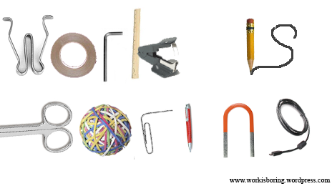
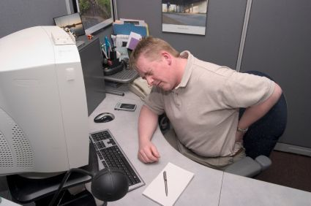
Impact of Imbalance:
Problems in the life
Problems related to
Employee health
Monotony at work place
Declining levels of
productivity and
efficiency.

Slide 21



Negative impact in the personal life of working people-
Increasing number of divorces.
Infertility due high stress levels.
Advent of nuclear families.

Slide 22
IMPLEMENTATION OF WLB
2 legs of the company’s work life balance ladder
What the company does for the employee?
What the individual does for himself?

Slide 23

At the Individual level
Keep a log
Learn to say NO
Leave work at work
Manage your time
Communicate clearly
Fight the guilt
Nurture yourself
Get enough sleep
Set aside one night each week for recreation
Seek professional help
Negotiate a Change with Your Current Employer
Take advantage of your options
Plan Fun and Relaxation

Slide 24
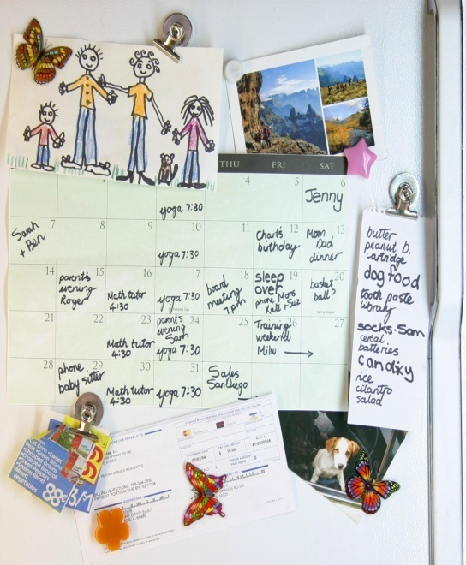
Figure Out What Really Matters to You in Life
Children
Spouse
Satisfying career
Health
Religion

Slide 25
At Organisational level
Flexible working arrangements
  Part-time working, Flexitime, Job sharing, etc.
Help with childcare arrangements
  Paternity leave, Time off work when child is sick
Better resources and work environment
  More training, Lighten workload, More time together with family (family days, off on Birthdays,anniversaries More breaks during the day, )etc.

Slide 26
..For the employer
Devote more resources to improving “people management” practices
Provide employees with increased control and flexibility regarding when and where they work
Give employees the explicit right to refuse overtime work
Conceirge Services:

Slide 27


Providing Managerial Support
Creating Institutional Support Mechanisms
Time expectations
Co-Worker Support
Sustain It!!!

Slide 28


