Slide 1
A Great Place to Work
Dr. Neetu Jain

Slide 2
A Great Place to work …defined
One where you trust the people you work for, have pride in what you do and enjoy the people you work with.
Highlights 3 key relationships that exists in workplace between employees and : 1. Their managers 2. Their jobs 3. Their colleagues

Slide 3
A Great Place to Work ….dimensions
• CREDIBILITY : Employees perceive management to be credible, believable and trustworthy mainly by its open and accessible communication channels and its exhibited integrity and commitment to organisational vision.
• RESPECT : Employees feel respected by management due to actions like support to their professional development, appreciation shown, collaboration with them on relevant decisions and caring for them as individuals.
• FAIRNESS : Employees perceive management as fair due to management practices like ensuring equitable and impartial treatment to all, absence of favoritism and forums to redress grievances.

Slide 4
• PRIDE : Employees take pride in the work they do, in the results produced by their teams and organisation as a whole and the organisations social stature in terms of its products, services and its social activities.
• CAMARADERIE : Employees perceive their workplace to have friendly and welcoming atmosphere where they feel a sense of family or team and find high quality of hospitality, companionship and friendliness

Slide 5
CREDIBILITY
Credibility means managers regularly communicate with employees about the company's direction and plans - and solicit their ideas.
It involves coordinating people and resources efficiently and effectively, so that employees know how their work relates to the company's goals. It's the integrity management brings to the business. To be credible, words must be followed by action

Slide 6
RESPECT
Respect involves providing employees with the equipment, resources, and training they need to do their job. It means appreciating good work and extra effort.
It includes reaching out to employees and making them partners in the company's activities, fostering a spirit of collaboration across departments and creating a work environment that's safe and healthy. Respect means that work/life balance is a practice, not a slogan.

Slide 7
FAIRNESS
At an organization that's fair, economic success is shared equitably through compensation and benefit programs. Everybody receives equitable opportunity for recognition.
Decisions on hiring and promotions are made impartially, and the workplace seeks to free itself of discrimination, with clear processes for appealing and adjudicating disputes. To be fair, you must be just.

Slide 8
PRIDE
Pride means the feeling of pride that the employees have towards their jobs, their teams/work groups and the company as a whole

Slide 9
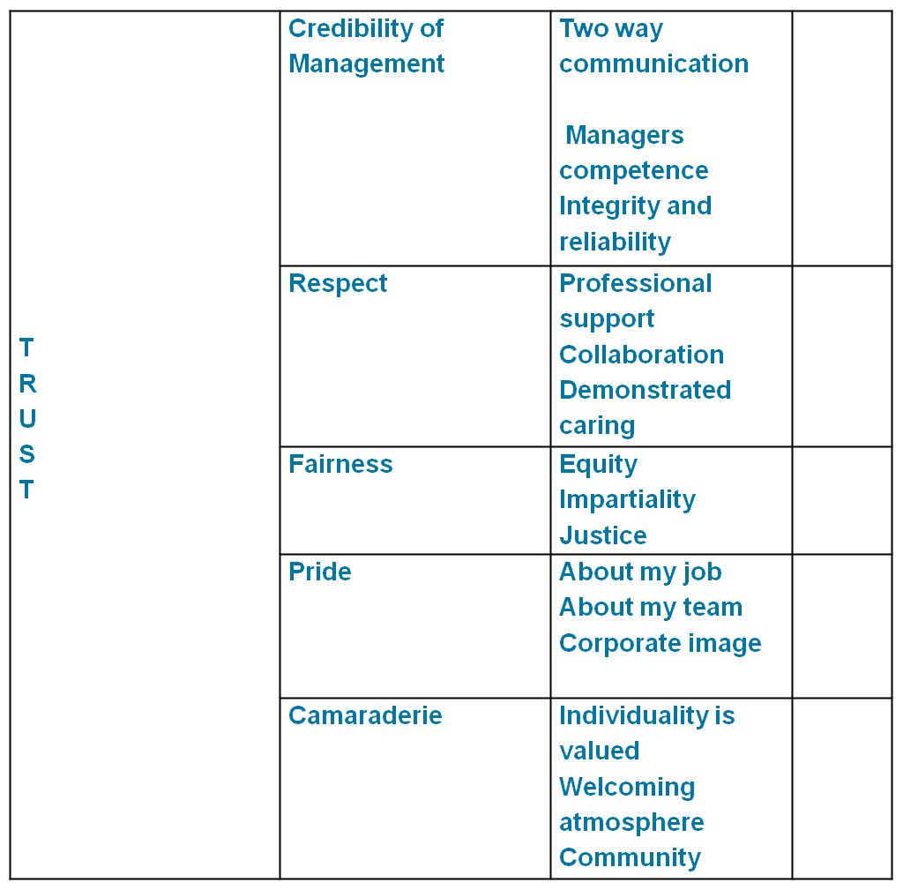
Components of Trust Index

Slide 10
Benefits of being a Great place to work
Available research indicates that companies that are recognized as best workplaces as per the Great Place To Work® framework have:
Positive correlation with the stock market returns provided to shareholders.
Higher profitability
Congenial working environment (with high degree of motivation and fun)
Higher job satisfaction
Low employee turnover
High retention rate

Slide 11
Five fold framework
Five fold framework focuses on five aspects or levels or dimensions of a human being i.e. Physical, Intellectual, Social, Emotional and Spiritual where he or she may have needs corresponding to that level. Organizations need to design various programmes to address employees’ needs at these five dimensions in order to get their best. For making an organization a healthy and desired place to work, focus should be on five aspects of an employee.
HB (Human Being) = PQ *SoQ* EQ * IQ * SQ
PQ = Physical Quotient
IQ = Intellectual Quotient
SoQ = Social Quotient
EQ = Emotional Quotient
SQ = Spiritual Quotient.

Slide 12
Five phrases that define a great place to work
• “A friendly place”
• “There isn’t much politics around here”
• “You get a fair Shake”
• “More than a Job”
• “Its just like a family”

Slide 13
A friendly place to work”
• People enjoy each other’s company
• Schmoozing – informal chatting with others – is an accepted part of everyday work life.
• Superiors are approachable and take interest in personal well being of subordinates.

Slide 14
There isn’t much politics around here”
• Atmosphere of mutual respect for each other
• Absence of favoritism and discrimination
• Employees are not concerned about being backstabbed.
• Employees aren’t constantly jockeying for position, trying to curry favor with higher-ups, worrying about the impact of their actions on their chances for moving up in the company, or looking over their shoulders to make sure someone else isn’t setting them up to destroy their career.

Slide 15
“You get a fair Shake”
• Standards of fairness are maintained
• Employee complaints are heard impartially and fully and are resolved in timely manner
• There is a sense of justice
• There is job security
• There is no fear of victimization when a point of view or disagreement is expressed.
• “They treat us fairly here” , “The company does not take advantage of you”

Slide 16
“More than a Job”
• Work brings meaning to life, social status
• “You can have impact on things here”, ”Work here has meaning”
• Your work is your work.You are responsible for it.
• Greater level of responsibility – control over one’s work
• Employees have role in defining their own job, determining priorities and deadlines, and criticizing actions made by others(including supervisors and top management) without fear of retribution.
• Feeling of their job making valuable contribution to society.
• Company stands for something more than business that makes profit from selling certain products
• Employees internalize company’s approach and commitment to producing a quality product
• Feeling proud of what you do and who you do it with.

Slide 17
“It’s just like Family”
• A caring and nurturing environment
• Supervisors take interest in employees’ personal lives and they feel valued as individuals – your personal concerns are important to others in the organization
• Employees feel they have made a lifelong career commitment to the organization and employers recognize and appreciate this commitment
• “We are all in it together” – every one can play a distinct and valuable role – pool our resources to sustain one another and the organization.

Slide 18
Great Place to Work .…a few more thoughts
• You are paid a lot of money
• You are treated like a human being
• You do interesting work
• You get good benefits
• You are not fired at slightest downturn
• You have a clean and safe environment to work
• You have all the tools to do the job right
• You are able to make suggestions or complaints without fear of reprisal.

Slide 19
What makes some workplaces so good
• “People are our most important assets”
• “This company values you as a person”
• “You can rely on us to look after your best interests because we care about you”
• “People first, products and profits will follow” – Advanced Micro Devices
• “Respect for individual is first tenet of our business” – IBM
• “People make the difference” – Publix Super Markets
• “Mean What you say”

Slide 20
A Stake in Success
• Sharing Rewards :
• More than half of the 100 Best Companies to Work for in America have explicit profit sharing plans – rationale – employees should participate in success they made possible.
• Performance linked rewards and incentives
• Sharing ownership : Employee stock options
• Sharing Recognition :
• Recognition can build or destroy trust in workplace
• Unless the trust is reciprocated by recognition of extra efforts, employees feel hurt, even betrayed and retreat to minimum performance levels – robotic attitude.
• Acknowledgement of good work creates a ‘climate of approval’
• ‘You have Done Good Award’ – any employee sends it to any other employee.

Slide 21
Basic Terms of Employment
1.Fair Pay and benefits Compare well with similar employers. Square with company’s ability to pay
2. Commitment to job security
3. Commitment to safe and attractive working environment. The Job Maximizes individual responsibility for how the job is done, Flexibility about working hours, Opportunities for growth: Promotes from within, Provides training, Recognizes mistakes a part of learning.

Slide 22
Terms of Employment
•Employee gives time, productive energy and commitment – EXCHANGE – Employers give equitable and fair compensation. - A good work place makes an honest attempt to give a fair deal.
• 1/3rd of the 100 best companies have no-layoff policy – Job Security
• Makes a powerful statement on trust levels
• Shows genuine interest in long term relationship
• Implies company is willing to take additional burden for the relationship
• It communicates that everyone is considered important in the company

Slide 23
The Job
• How jobs are to be done
• Provide ways for people to assume an increasing share of responsibility for their own work
• “Person doing the job knows more about it than anybody else” – communicates that company believes employees have important contribution to offer
• Participative management techniques
• Increased responsibility implies increased risk – company must be willing to accept honest mistakes
• trusting implies risk

Slide 24
The Job….contd.
• When work is to be done
• Flexi time gives employees choices about their working schedules
• Makes an important statement on trust – ‘the company trusts you to determine when to do the job’.
• Employees perceive that company acknowledges a genuine problem many of them face
• Who does the job
• One of the ways of allowing employees to assume more responsibility is to provide them with opportunities to grow with company - Hidden talent may be uncovered
• Provide recognition for job well done, recognize mistakes as learning process
• Strong in-house training programs – communicates that the company considers that the employees’ growth is basis for company’s growth

Slide 25
Workplace Rules
Reduces social and economic distinctions between management and other employees.
Right to due process, Right to information Right to free speech, Right to confront those in authority, Stake in success, Shares rewards from productivity, Shares profits, Shares ownership, Shares recognition.

Slide 26
Workplace Rules
• Every workplace has policies and practices – written and unwritten which determine how employees are treated by those in authority and by fellow employees.
• Good workplaces go at length to provide safeguards to assure fairness.
• Right to due process : Right to appeal against decisions which the employee considers unfair.
• Right to full and accurate information : Right to company related information
• A policy of no secrets does much to build trust - helps stop rumors that erode peoples’ confidence in each other
• Elaborate communication systems that provide ongoing information about all aspects of the company

Slide 27
Workplace Rules…contd
Right to free speech : Right to have their own opinions on work issues and and right to obtain answers on anything of concern from anyone in the company
Sessions of information sharing and question-answer with top executives
Right to confront those in authority :
Open door policy – employees unhappy with treatment by their supervisor can appeal to higher-ups without fear of retribution.
Communicates to the employees that the company cares whether they are treated fairly, even if they are lower down in hierarchy.
Communicates to employees that everyone in workplace can be held accountable to his fellow employees for his actions.

Slide 28
Innovative HR Practices
Creation of diff clubs for employees involvement and enjoyment,
Initiating innovative schemes for rewarding emps…
Open house discussions and feedback mechanism
Flexi benefits and rewards
Shared work and shared leaves
Cud be providing them psychic income & X factor,
360 Degree performance management feedback system
Performance linked bonuses
Open book management style
Knowledge sharing
Fair evaluation system

Slide 29
THANK YOU

