Slide 1
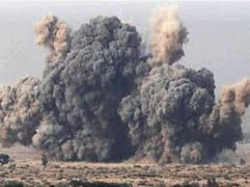
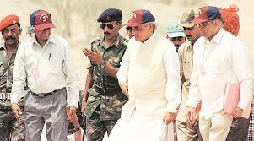

Disarmament INDIAN tangle: A detailed Dekko
Dr. Manan Dwivedi, Faculty, International Relations and International Organizations

Slide 2

Dear Supes ET AL…….

Slide 3
The Historical Nuke Credentials:
US amalgamated as “ Strategic –Allyhood” since the Rejection by Soviet Union and its changing fences with India…….
India is a party to the Partial Test Ban Treaty and not a patchy party to the Conference on Disarmament, Comprehensive Test Ban Treaty and the Nuclear Non Proliferation Treaty ( NNPA)…….

Slide 4
Ad Nauseum…..
The centrality of the Hyde Act and the US Atomic Energy Act of 1951…
How the 123 Nuclear Energy Cooperation was inked in 2006 between New delhi and Washington……
How India stands vis a vis the Nuclear Supplier Group…..

Slide 5
…
The details of the India’s Nuclear Doctrine:
1.) No First Use ( NFU)
2.) Credible Minimum Deterrence
3.) The Sea based, land based and Air based Triad of Delivery Vehicles……
4.) The nature of the Indian Stockpile…
Thanks for a Patient Hearing!!!!!!!!!!!!!!!!!!!

Slide 6
The American Dream:
Et Al…….
Supes Imagery, and the narrative of the Flick Independence Day, with the Alien , GWOT ( Global War on Terror…..
The liberal American Order…….
And, South Asia on a Short Fuse…………
Indian and American response to Covid and the Ushering in of a New World Order with the ascendance of America and the strategic scuttling out of PRC, the Neighborhood talons of the Dragon…

Slide 7
The Stodgy culmination…..
Thanks for a patient Hearing!!!!!!!!!!!!!!!!!!!

