Slide 1
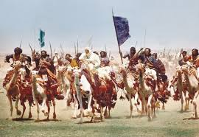
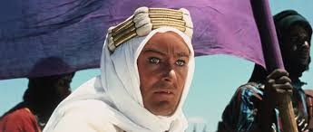
The Concept of the West Asian World Order….
Definitions, Theories and Contemporary Perspectives

Slide 2
Definitions of West Asia and Middle East….
How the Twin aspects of West Asia and Middle converge and diverge in a cumulative definitional Idiom…..
The Israel Palestine Conundrum and the attendant disturbances in the Region….
The US Policy in the context of West Asia and its ally-hood with Israel in the context of the Jew connexion…..

Slide 3
The Indian Perception and Oil….
Security Dilemma in West Asia and the Rise and fall from grace of the Islamic brotherhood and the Islamic State…..
The Rise of Erdrogan’s Turkey……… and the Turkic Empire Ad Impera……
The Great Power Interventions in the Region…..
West Asia, OPEC and the various induced and natural Oil Gluts….

Slide 4
Thanks for a Patient Hearing!!!!!!!!

Slide 5
Alternative Interpretations of Development (Mabogunje)
Development as Economic Growth- too often commodity output as opposed to people is emphasized-measures of growth in GNP. Note here the persistence of a dual economy where the export sector contains small number of workers but draws technology as opposed to traditional sector where most people work and is dominated by inefficient technology

Slide 6
Alternative Interpretations of Development
Development as Modernization- emphasizes process of social change which is required to produce economic advancement; examines changes in social, psychological and political processes;
How to develop wealth oriented behavior and values in individuals; profit seeking rather than subsistence and self sufficiency
Shift from commodity to human approach with investment in education and skill training

Slide 7
Alternative Interpretations of Development
Development as Distributive Justice- view development as improving basic needs
Interest in social justice which has raised three issues:
1.Nature of goods and services provided by governments
2. Matter of access of these public goods to different social classes
3. How burden of development can be shared among these classes
Target groups include small farmers, landless, urban under-employed and unemployed

Slide 8
Alternative Interpretations of Development
Development as Distributive Justice- view development as improving basic needs
Interest in social justice which has raised three issues:
1.Nature of goods and services provided by governments
2. Matter of access of these public goods to different social classes
3. How burden of development can be shared among these classes
Target groups include small farmers, landless, urban under-employed and unemployed

Slide 9
Marxist View of Development
Emphasizes Mode of Production - elements and activities necessary to produce and reproduce real, material life
Capitalist (market economy) mode depends on wage labor whose labor power produces a surplus which is accumulated and appropriated by the employer-result is often class conflict in capitalist societies

Slide 10
Neocolonial Dependence Model
Outgrowth of Marxist thinking-Dos Santos
Existence of underdevelopment due to historical evolution of an unequal international capitalist system of rich country-poor country relations
Sets up center (developed countries) versus periphery (developing countries) contrast
Attempts to become self-reliant and progressive are surpressed by this relationship
Moreover certain elites in the developing world (e.g landlords, entrepreneurs, merchants) enjoy high incomes, social status and political power and thus perpetuate inequality and conformity and are rewarded
They serve international power groups such as multi-national firms, assistance agencies (World Bank) and other agents

Slide 11
Sustainable Development
Defined as development that is likely to achieve lasting satisfaction of human needs and improvement of the quality of life and encompasses:
Help for the very poorest who are left with no option but to destroy their environment to survive
Idea of self-reliant development with natural resource constraints
Cost effective development using different economic criteria to the traditional –i.e. development should not degrade environment
Important issues of health control, appropriate technologies, food self-reliance, clean water and shelter for all
People centered activities are necessary- human beings are the resources in the concept

Slide 12
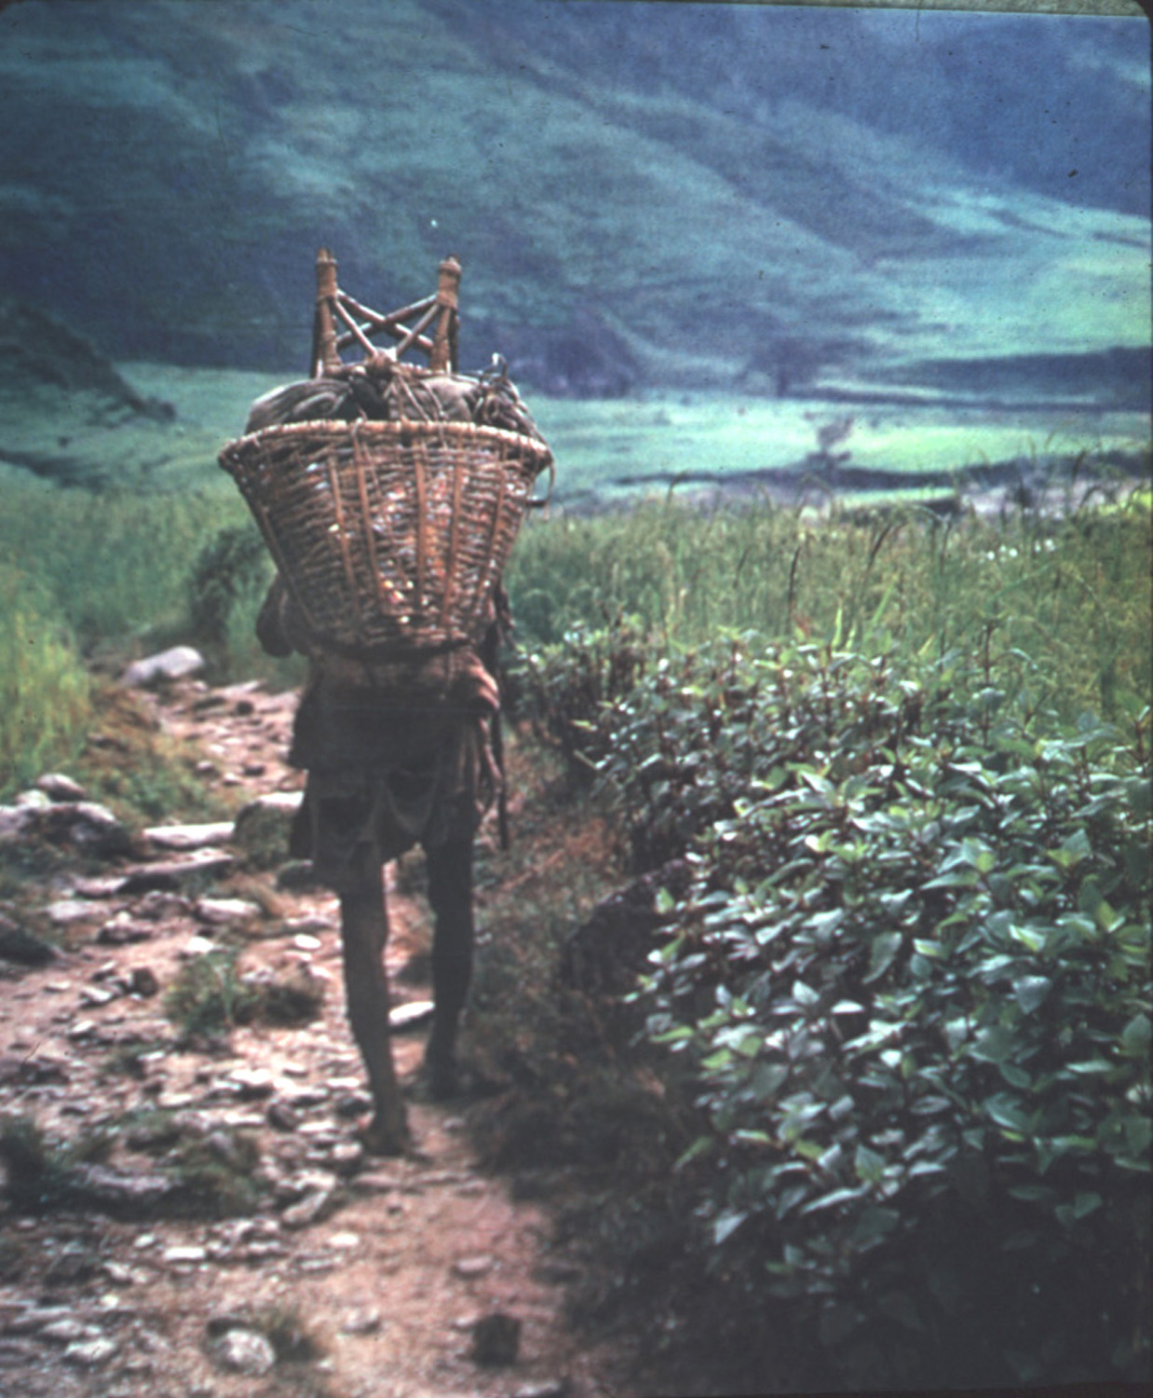

Slide 13
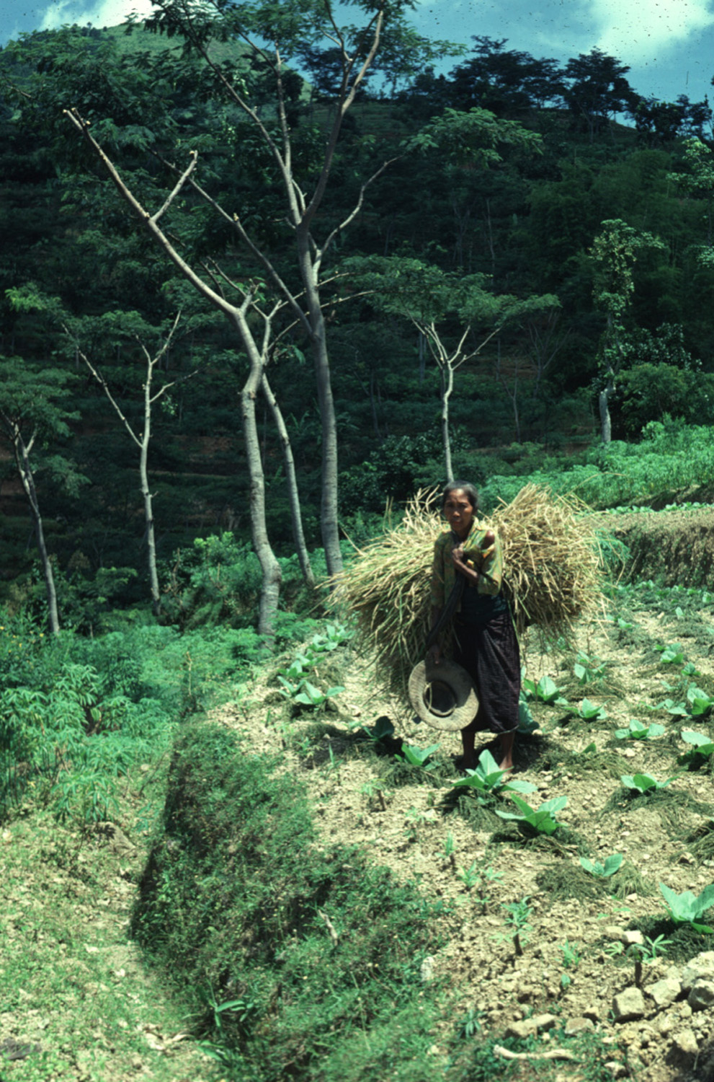

Slide 14
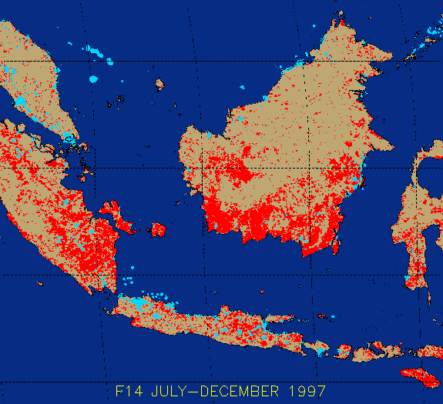

Slide 15
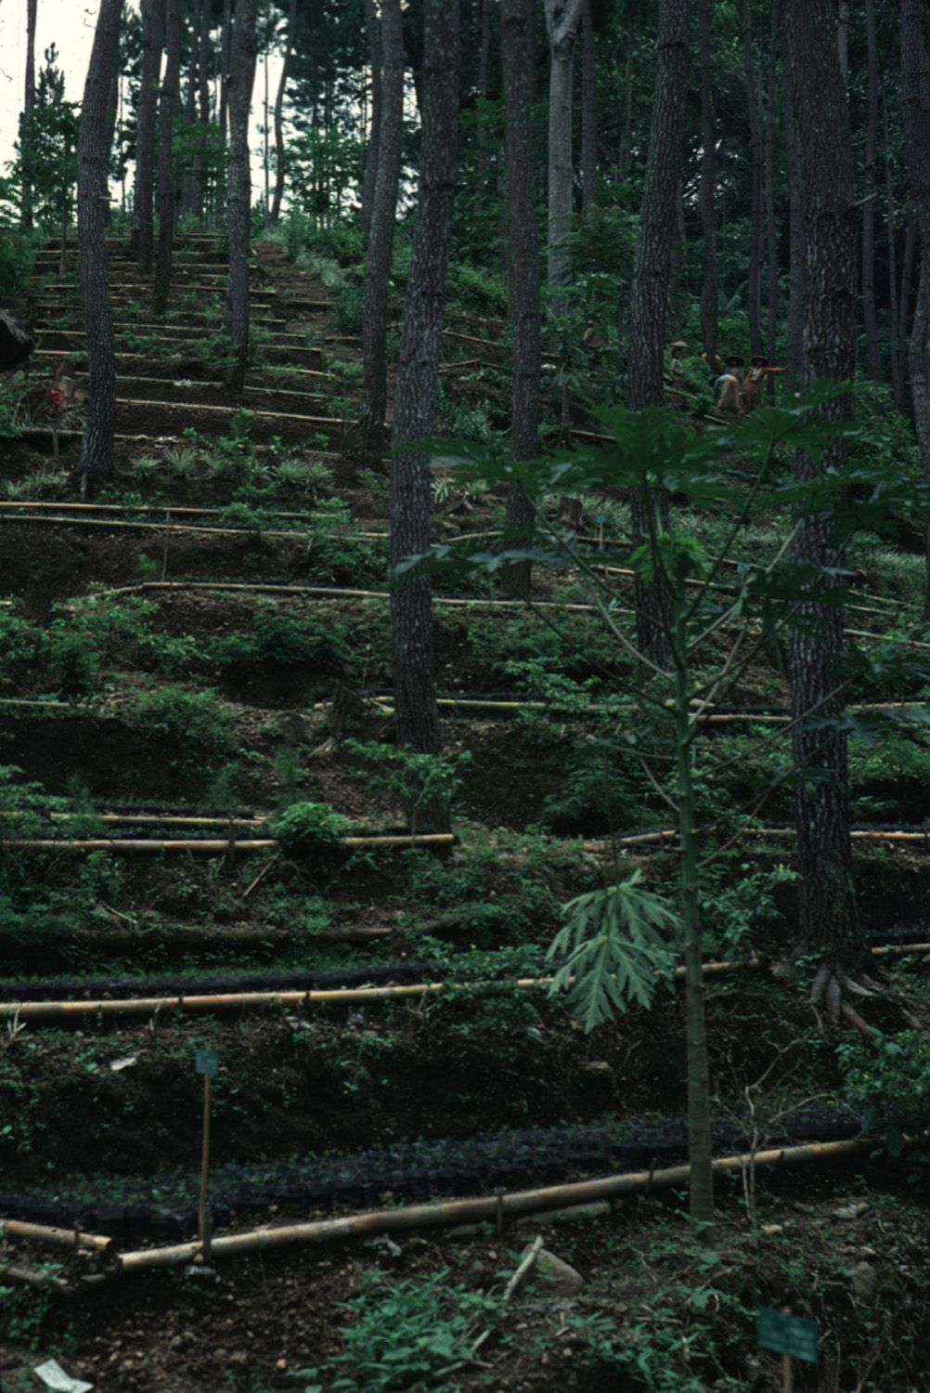

Slide 16
Theories of Development
1940-50s- Keynesian growth theory -process of capital of formation is determined by savings and investment
Domestic savings are chanelled to productive investments such as manufacturing which result –usually-in high productivity
Growth is market driven as income levels rise, savings rises and frees capital for alternative investment

Slide 17
Theories of Development
Modernization Theory -as noted previously this theory suggests that economic dimension alone is insufficient and adds theories on institutional and social change
Incorporates non-economic elements such as social practices, beliefs, values and customs (McClelland, Achieving Society)
Diffusion and speed of change is critical as is removal of various cultural and social barriers
Backward internal structures-rather than external factors-cause underdevelopment

Slide 18
Theories of Development
NeoLiberal Development Theory- grew in the 1970s and designed to counteract impact of Keynesianism
New emphasis on supply side factors in development- private initiatives and market led growth
Move away from demand stimulation (interest rate manipulation), import substitution, state intervention and centralized planning
Gradual industrialization with ‘trickle down’ of benefits to all social classes

Slide 19
Theories of Development
Popular Development- what is it?
Avoids ‘grand theories’ and emphasizes solutions viewed in context of development which is part of historical process
Context of development is constantly changing in scale and time
Accommodates geographical and historical diversity
Theory of little use to practitioners of development
Stresses local diversity, human creativity, process of social change through pragmatism, flexibility and context
Not extent of state intervention but comparative advantages of public and private sectors and their complementarity

Slide 20
Popular Development and Environment
Recognizes high “opportunity costs” associated with irreversible environmental damage
Dealing with environmental problems requires solutions sensitive to local social and ecological conditions
Society and nature relations are affected by variations in class, gender and ethnicity
“Reproductive squeeze” forces peasants to intensify production in fragile environments

Slide 21
Popular Development, Space and Place
Bottom up approaches (as opposed to top-down) to peoples’ participation are important in this view
How are various social groups and classes affected by rural-urban, core-periphery and other spatial interactions?
Growing importance of “decentralization” of decision-making and authority from center to periphery

Slide 22
Popular Development and Power
How does the power structure affect development?
Examine sources of empowerment, inequality and discrimination
Need to devise more people centered approaches which stress empowerment and participation
Empowerment as participatory development seeks to engender self-help and self-reliance but also effective collective decision-making

Slide 23
What causes underdevelopment?
Very easy to focus on characteristics of development
For example we know that underdevelopment is usually characterized by: low per capita incomes, low literacy and educational attainment, lack of basic services- water and power
But how do we EXPLAIN underdevelopment?

Slide 24
Some Common ‘Theories”
Old view that absence of development caused by certain physical environments, particular cultural traditions and value systems-environmental and cultural determinism
Lack of natural resources certainly impediment to development but not impossible- example of Japan
Why has Japan succeeded?

Slide 25
Reasons for Japanese Success
Strong cooperation between government and business
Able to adapt to spatial-physical situation and acquire a maritime prowess
Early development (Meiji restoration) of transport and banking systems
Highly literate population
Niche development- technology driven

Slide 26
Other Common Explanations of Underdevelopment
Instability and other adverse internal situations- political factors
Some truth to this as extended periods of turbulence are not conducive to development- central African nations with tribal rivalries and ethnic cleansing
Poor physical environment- lack of rainfall, poor soils also may pose barriers to development

Slide 27
Vicious Circles- Gunnar Myrdal
Complex web of interlocking vicious circles each of which constitutes a chain of cause and effect relationships where one unfavorable circumstance leads to another and produces downward spiral
High Birth Rate> Large Families>Low PCI> Poverty> Low Output Per Worker>
Low PCI> Low Productivity> Poor Health>Inadequate Housing
Remedy > Downward spiral not reversible without massive aid

Slide 28
Remedy for Vicious Circle
Aid would stimulate growth in modern sector and reduce size of ‘informal’ or traditional sector
Thus eliminate dualism and the major causes of unequal distribution of wealth
Foreign aid would allow countries to increase low levels of productivity

Slide 29
Another Common Explanation
Colonialism As Scapegoat
Attacking vicious circle proponents-do not explain how these magic circles come into existence
Need to view development in historical perspective as sequence of dynamic events-explore roots
Colonialism viewed as the cause of disintegration and decline- how?

Slide 30
Indigenous population exploited
Traditional way of life and self sufficient mode of production have been destroyed
Forced to pay taxes and conscripted labor practices
Social differentiation increased- disintegrating force
Fatal effects on secondary (manufacturing) and tertiary (service) sectors- import of cheap goods forced indigenous artisans out of work
Discouraged modern industrialization

Slide 31
Colonialism as Scapegoat cont’d
Thus what occurred in these situations was dependent not autonomous development
Colonial powers extracted wealth for home country-Netherlands, France, Great Britain
International division of labor (IDL) and western dominated trading structure was created to take advantage of colonial authority
IDL=allocation of tasks among laborers such that each one engages in tasks that he performs most efficiently and this promotes worker specialization and productivity

Slide 32
What to Do With Development Theory ?
Several theories have been advanced have been criticized and some also discredited—to be replaced by other theories
Third World is very heterogeneous-dissimilar in terms of population, resources, climates, culture , economic structure and location
Unlikely that one theory will be powerful enough to explain underdevelopment everywhere

Slide 33
What to Say About Development Theory ?
Underdevelopment must be seen as a product of an array of complex and continuously changing interactions between:
1. Past and Present
2. Natural and Human Environments
3. External and Internal Conditions
Multitude of obstacles to development vary with place and time
Critical to remember that the above theoretical ideas aid us in asking pertinent questions

