Slide 1
Stream Name
Policy and Regulatory Framework for GovTech
Session Number: 05
Session Topic:
Privacy Protection & Data Protection
CHARRU MALHOTRA, Ph.D. (IIT-D)
COORDINATOR ( Centre of e-Governance)
Associate Professor (e-Governance and ICT)
Indian Institute of Public Administration
charrumalhotra [at]gmail.com

Slide 2

Agenda
01
Type of Data
02
Data Privacy
03
Personal Data Protection Bill 2019
04
Puttaswamy case
05
Understanding GDPR
06
Concluding Remark
07
Way Forward

Slide 3
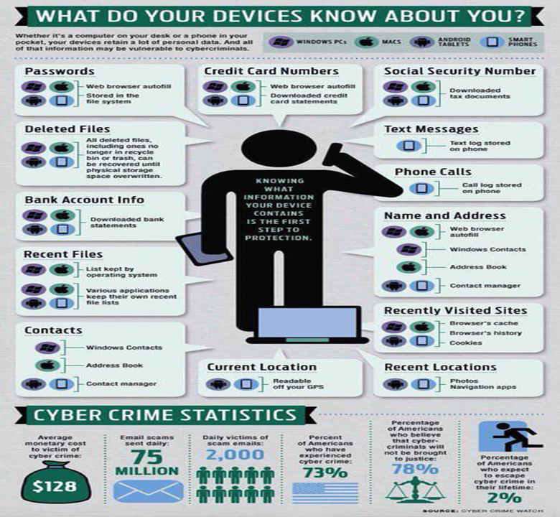
USE OF MOBILE

Slide 4




GAMING
DATING
USE OF SOCIAL MEDIA
SOCIAL CONNECT
INFORMATION – National, Global & Individual

Slide 5
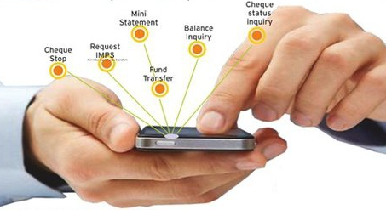
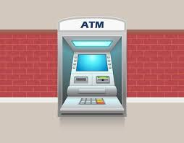
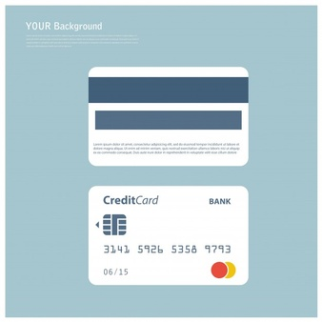
USE OF CASHLESS TRANSACTION

Slide 6
Types of Data & DataPoints
Includes all personal data that is given out during online interactions i.e. official identifier, email & other identifying data, login details etc.
Online
Financial
Financial data including, card details, online transaction data, Net banking etc.
Medical
Medical treatment & history, health data, sex life, sexual orientation, biometric data, genetic data, intersex status etc.
Geographic
Sharing of address/GPS location online can be risky and needs protection from unauthorized access.
Political
caste or tribe, religious or political belief or affiliation
Data Point

Slide 7
Data :
Monetisation v/s Individual Rights ?
Privacy is the right of an individual to be free from undesirable profiling, uninvited surveillance.
Data is one of the most important assets a company has. INNOVATION STEMS FROM DATA ANALYTICS
04
01
03
With the rise of the data economy, companies find enormous value in collecting, sharing and using data.
Companies such as Google, Facebook, and Amazon have all built empires atop the data economy.
02

Slide 8
Data Protection is the Force Behind Our Right to Privacy
Only 66 per cent of the nations of the world safeguard people's data and privacy, despite an 11 percentage point increase in the adoption of data protection and privacy legislation in the period between 2015 and 2020. It can have adverse effects on FDI as well due to different legislative policies in different countries.

Slide 9
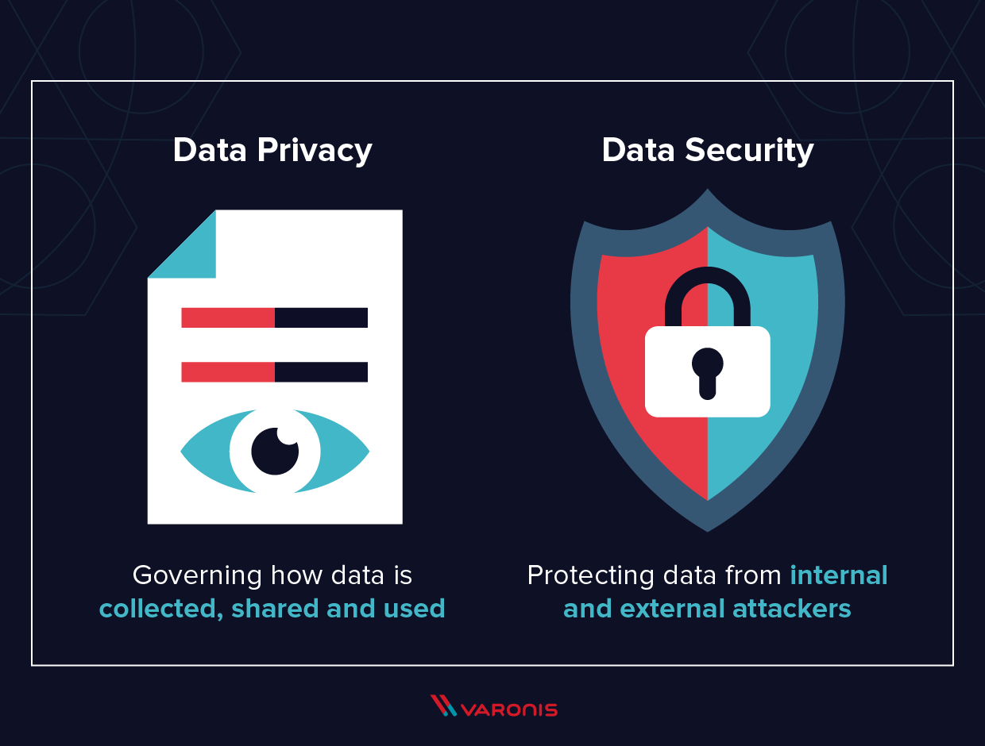
Data Privacy Vs Data Security
Data Privacy focuses on the rights of individuals, the purpose of data collection and processing, privacy preferences, and the way organizations govern personal data of data subjects.
Data Security regards to the means of protection that an organization is taking in order to prevent any third party from unauthorized access to digital data.

Slide 10
Current scenario of Data Privacy and Data Protection law in India
At the moment, India does not have a specific legislation enacted primarily for data protection.
India’s regulatory mechanism for data protection and privacy is the Information Technology Act, 2000 and its corresponding Information Technology (Reasonable Security Practices and Procedures and Sensitive Personal Data or Information) Rules, 2011 (“the IT Rules”).
In addition to this, personal data is also protected under Article 21 of the Indian Constitution which guarantees to every citizen, the Right to Privacy as a fundamental right

Slide 11
Relevant Sections of the IT Act
1. Section 43A : This section creates a liability on a body corporate
Body corporate includes a firm, sole proprietorship or other association of individuals engaged in commercial or professional activities
The body corporate that possesses, deals or handles any sensitive personal data or information in a computer resource that it owns, controls or operate is liable to pay damages by way of compensation, to the person affected if there is any wrongful loss,
This loss could be because of the negligence in implementing and maintaining reasonable security practices and procedures to protect the information of the person affected
2. Section 72 A : Any person (including an intermediary) who, while providing services under the terms of a lawful contract, has secured access to any material containing personal information about another person.
If the person providing services discloses the information, without the consent(of the person using service ), shall be punished with imprisonment for a term which may extend to three years, or with fine which may extend to five lakh rupees, or with both

Slide 12
Limitations of the Present Provisions
The IT Act was not enacted with the primary intent of providing data protection
The scope and applicability of the provisions of the IT Act on Data Protection is very narrow
The IT Act does not lay out any penalties for data breach except Section 72 A
The IT Rules do not apply to the government/ state and are only applicable to body corporates
To overcome, these limitations, a committee under the leadership of Retd. Justice B N Srikrishna was constituted to propose a draft statute on data protection.
The Government of India has issued the Personal Data Protection Bill 2019 (“the Bill”) based on the recommendations of the committee.
This Bill, if converted into ‘law’, then it will be India’s first legislation on the protection of personal data

Slide 13
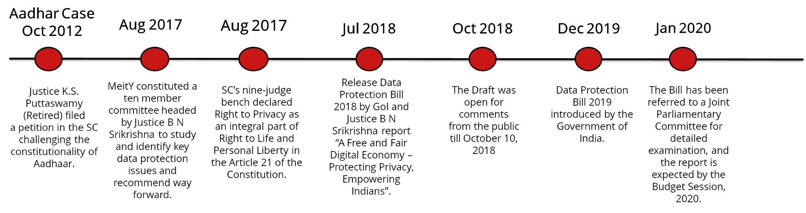
Timeline of Data Privacy

Slide 14
Background of Data Privacy: Puttaswamy case
Oct 2012 : K.S. Puttaswamy (Former Karnataka HC Judge ) filed PIL agnst Union of India.
(In this PIL, Aadhar scheme was challenged saying it violates fundamental rights to privacy and equality & that the collection of biometric data by Govt. agencies without any suitable legislation are contravention to privacy).
11 Aug 2015 : The case by a 3 judge Bench of the Court who ordered that the matter should be referred to a larger Bench of the Court.
18 July 2017: 5 judge Constitution Bench ordered the matter to be heard by a 9 judge Bench.
an interim order restricting compulsory linking of Aadhaar for benefits delivery
& Right to Privacy recognised as a fundamental right : as an integral part of the right to life and personal liberty guaranteed in Article 21 of the Constitution.

Slide 15
An interim order restricting compulsory linking of Aadhar for benefits delivery passed:
Nagappan, while hearing a clutch of petitions challenging the Aadhaar scheme as a violation of privacy, clarifies that demands made by officials for Aadhaar card is in clear violation of the Supreme Court's interim order of September 23, 2013.
Source: https://www.businesstoday.in/current/economy-politics/aadhaar-linking-deadline-supreme-court-timeline-pan-card-bank-account/story/266066.html#:~:text=Nagappan%2C%20while%20hearing%20a%20clutch,order%20of%20September%2023%2C%202013.

Slide 16

Background of Data Privacy: Puttaswamy case (Contd)
To make this right meaningful, it is the duty of the state to put in place a data protection f/w which, while protecting citizens from dangers to informational privacy originating from state and non-state actors, serves the common good.
It is the understanding of the state’s duty that the PDP Committee must work with while creating a data protection framework.
Source: https://cic.gov.in/sites/default/files/Right%20to%20Privacy%20and%20RTI%20by%20Aditya%20Verma%20%20%281%29%20%281%29.pdf

Slide 17
Some Basic Terms
Privacy by Design : Privacy already integrated in the technology when created
Data Subject/ Principal : the natural person ( or community) to whom the personal data relates to.
Data Fiduciary is a person or business ( the service provider such as FB ) who determines the purpose and manner of data processing with an obligation to act in a trustworthy manner in the interest of another
Data Protection officer : DF must appoint DPO to to ensure that her organisation processes the personal data of its staff, customers, providers or any other individuals (also referred to as data subjects) in compliance with the applicable data protection rules.
Data Processor : who would process the data ( Cambridge Analytica)
Rights of Data Principal : Rights to strength an individual's inf. privacy, providing them with autonomy and control
(the right to obtain a summary of their personal data held with the fiduciary, (ii) the right to seek correction of inaccurate personal data, and (iii) the right 'to be forgotten', which allows the data principal to restrict or prevent data misuse)
DPA: India does not have a national regulatory authority for protection of personal data. MeitY is responsible for administering the IT Act and issuing the rules and other clarifications under the IT Act.

Slide 18
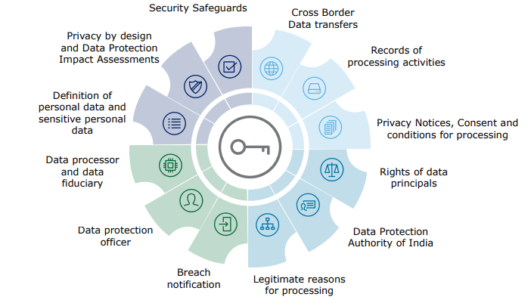
Key Features of PDP 2019
Source: Deloitte Report (2020) on Draft Personal Data Protection Bill, 2019

Slide 19
Personal Data Protection Bill 2019
Rights of Individual
Grounds for processing personal data
Social media intermediaries
Obligations of Data Fiduciary
Applicability
Transparency
& accountability measures:
(i) implementing security safeguards (such as data
encryption and preventing misuse of data)
(ii) instituting grievance redressal mechanisms to address complaints of individuals.
(i) obtain confirmation from the fiduciary on processing of personal data
(ii) Seek correction of inaccurate, incomplete, or out-of-date personal data,
(iii) have personal data Transferred to any other data fiduciary in certain circumstances, (iv) restrict continuing
disclosure of their personal data by a fiduciary, if no longer necessary
The Bill governs the processing of personal data by:
(i) govt
(ii) companies incorporated in India
(iii) foreign
companies dealing with personal data of individuals in India.
Include intermediaries which enable
online interaction between users and allow for sharing of information.
Intermediaries with above a notified threshold, and
whose actions can impact electoral democracy or
public order, have certain obligations, which include providing a voluntary user verification mechanism for users in India.
The Bill allows processing of data by fiduciaries only
if consent is provided by the individual.
Exceptions:
(i) if required by the State for providing
benefits to the individual, (ii) legal proceedings,
(iii) to respond to a medical emergency.

Slide 20
Features of Personal Data Protection Bill 2019
Data Protection Authority
Data Protection Officer
Transfer of Data outside India
Exemptions
Offences
(i) processing or transferring personal data in violation of the Bill - fine of Rs 15 crore or 4% of the annual turnover of the fiduciary, whichever is higher
(ii) failure to
conduct a data audit- five crore rupees or 2% of the annual turnover of the fiduciary, whichever is higher.
Re-identification & processing of de-identified personal data without consent is punishable with
imprisonment of up to three years, or fine, or
both.
Sensitive personal data may be transferred outside India for processing if explicitly consented to by the individual, and subject to certain additional conditions.
Certain personal data notified as critical personal data by the government can only be processed in
India.
(i) in interest of security of state, public order, sovereignty and integrity of India and
friendly relations with foreign states, (ii) for preventing incitement to commission of any
cognisable offence relating to the above matters.
Other: (i) prevention, investigation, or prosecution of any
offence, or (ii) personal, domestic, or (iii) journalistic purposes.
(i) take steps to protect the interests of individuals
(ii)prevent misuse of personal data, (iii) ensure compliance with the Bill.
Orders of the
Authority can be appealed to an Appellate Tribunal. Appeals from the Tribunal will go to
the Supreme Court.
Providing
information/advice to the data fiduciary on matters / obligations under the act. Monitoring
personal data activities. Providing advice to carry
out data protection impact etc. Also includes maintenance of inventory of records to be maintained under data fiduciaries.

Slide 21
Features of Personal Data Protection Bill 2019
Sharing of non-personal data with
government
Amendments to other laws
The central government may direct data fiduciaries to provide it with any: (i) non-personal data
(ii) anonymised personal data
(where it is not possible to identify data principal) for better targeting of services.
The Bill amends
the Information Technology Act, 2000 to delete
the provisions related to compensation payable
by companies for failure to protect personal data.

Slide 22

California passed a major privacy law that will make it harder for Facebook and Google to track people and gather data
Source: https://www.businessinsider.com/prop-24-privacy-california-data-tracking-facebook-google-2020-11

Slide 23
Understanding GDPR
It was implemented in May in the year 2018. GDPR is a regulation which requires businesses to protect the personal data and privacy of EU citizens for transactions that occur within EU member states.
Tougher standards were introduced to ensure companies are transparent about these various practices and now have to gain permission to capture individual’s data.
And failure to do so can result in huge fines, such as companies who continue to misuse data will be fined up to 20 million euros or 4% of the company’s annual turnover.
KEY FEATURES INCLUDE:
Specific Permission: Unless or until you give permission to an app or website to use your details in a specific way, they can’t use it for any other purpose or sell it to third parties.
Privacy by Design: According to this feature when you sign up for a service, you should not be asked for data that is not directly needed or relevant for the purposes of using that app or service.
Data Portability: Here you get the right to ask for any data that a company has about you in a readable format so that you can reuse it.
Right to be Forgotten: two exceptions are: a) It will not apply to information that there is a legal requirement to keep, such as medical records and; b) it is also a personal right to forget, distinct from the third party Right to be Forgotten, where individuals can request that outdated or undesirable information about them be removed from search engines.
Definitive Consent: When the legislation was announced, the Parliament had clearly said that “silence, pre-ticked boxes or inactivity will thus not constitute consent. In future, it should also be as easy for a person to withdraw consent as to give it.”

Slide 24
Comparing
PDP 2019
and
GDPR

Slide 25
Sno Definitions: | PARAMETERS | PDP (2019) | General Data Protection Regulation (GDPR) of European Union (May, 2018)
a. | Personal Data | Yes | Yes
b. | Sensitive Data | Yes | Yes (special categorizations)
c. | Data Controller or Fiduciaries | Yes | Yes (Data Controller)
2. | Right to Erasure | Yes | Yes
3. | Reasonable Purpose for Processing | Yes | Yes
4. | Data Localization | Yes (with exemptions but GoI can still request) | Yes (but with exemptions)
5. | Responsibility of Social Media Intermediaries | Yes | No
6. | Anonymized Data | Yes | Yes
7. | Committee | Yes (Independent body selected by GoI) | Yes (under a commission for assistance)
8. | Data Protection Officer | Yes | No
9. | Exemptions of Government | Yes | No
10. | Penalties | Yes | Yes
11. | Breach Notification | Yes (Limited Requirements) | Yes (Two-step verification)

Slide 26



The Jio- Facebook Deal
Certain Mergers and acquisitions escape notice as thresholds are not defined properly.
Recent deal opens ways for Facebook and jio to exchange info. and data. Facebook under the scanner of the Competition commission of India as the possibility using the large cluster of data for analysis can be an unfair advantage which might not comply with localization norms.
Whatsapp Payments Compliance
The messaging platform recently declared that it is fully compliant with data localization norms of RBI, in light of its new payments feature trying to enter the Indian market.

Slide 27
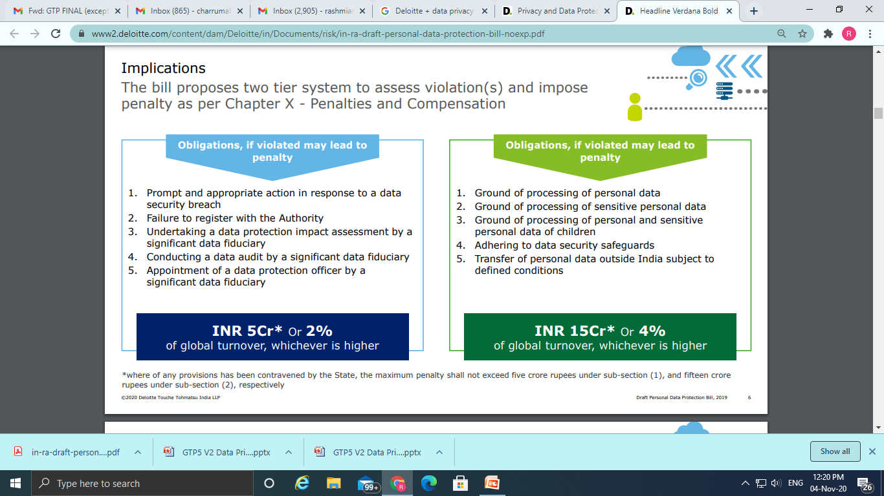
Implications of PDP
The bill proposes two tier system to assess violations and penalty as per Chapter X –Penalties and Compensation

Slide 28
Current Status of Data Privacy in India
Personal Data Protection Bill 2019 : As of March, 2020 the Bill is being analyzed by a Joint Parliamentary Committee in consultation with experts and stakeholders.
Non Personal Data Protection Bill :
A government committee headed by Infosys co-founder Kris Gopalakrishnan has suggested that non-personal data generated in the country be allowed to be harnessed by various domestic companies and entities.
      The nine-member committee, while releasing the draft report, has kept time till August 13 for the public to send suggestions. It has also suggested setting up of a new authority which would be empowered to monitor the use and mining of such non-personal data.

Slide 29
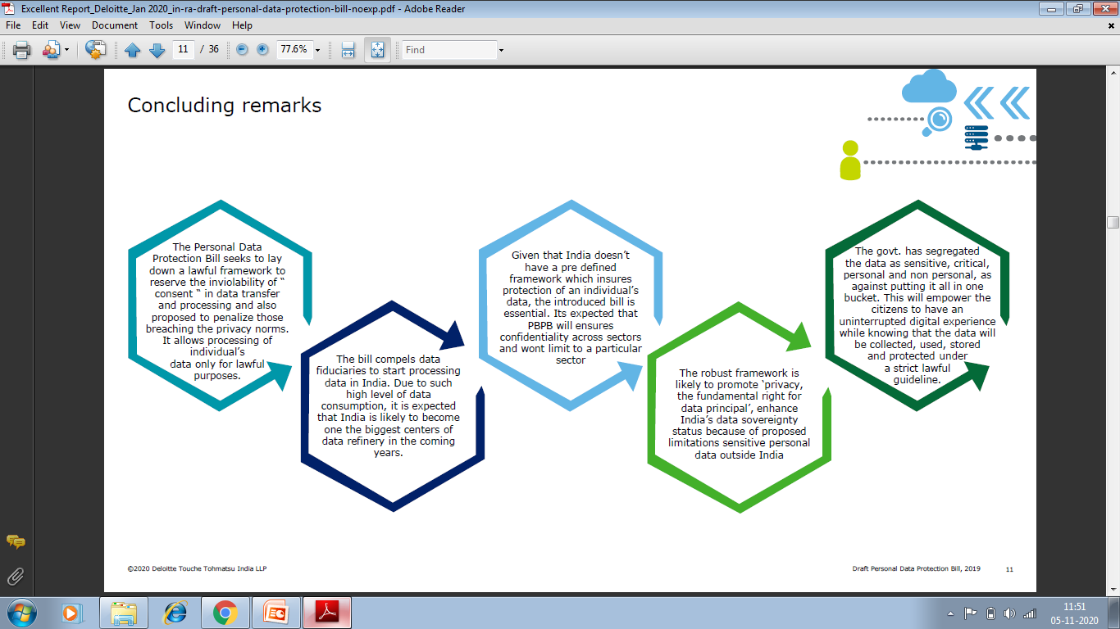
Concluding Remarks
Source: Deloitte Report (2020) on Draft Personal Data Protection Bill, 2019

Slide 30
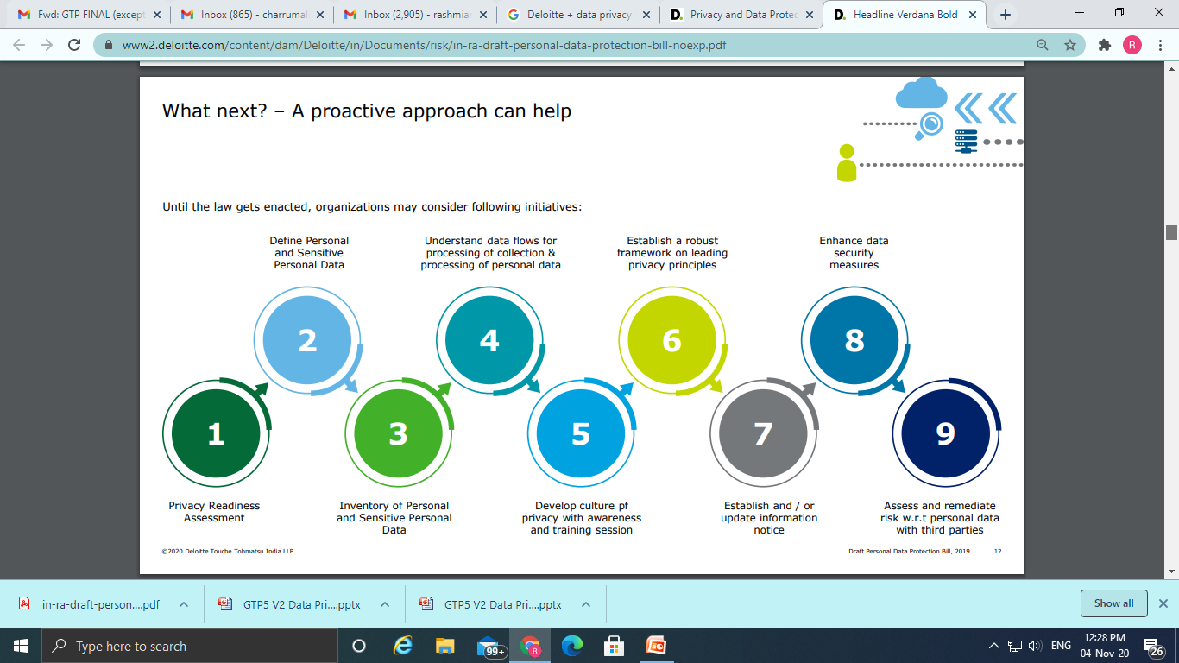
Recommendations: Need of Proactive approach
Source: Deloitte Report (2020) on Draft Personal Data Protection Bill, 2019

Slide 31
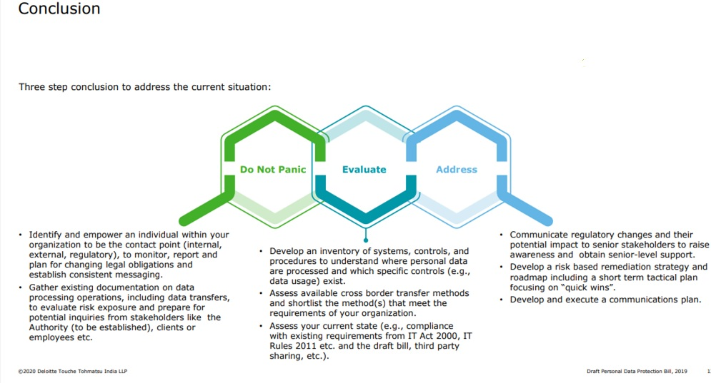
Way Forward

Slide 32
References
The Future of Your Personal Data - Privacy vs Monetization | Stuart Lacey | TEDxBermuda - https://www.youtube.com/watch?v=JIo-V0beaBw
Soliman, K. S., Affisco, J. F., Belanger, F., & Hiller, J. S. (2006). A framework for e‐government: privacy implications. Business process management journal.
Malhotra, C., Anand, R., & Singh, S. (2018). Applying Big Data Analytics in Governance to Achieve Sustainable Development Goals (SDGs) in India. In Data Science Landscape (pp. 273-291). Springer, Singapore.
Gruschka, Nils & Mavroeidis, Vasileios & Vishi, Kamer & Jensen, Meiko. (2018). Privacy Issues and Data Protection in Big Data: A Case Study Analysis under GDPR.
https://www.businessinsider.in/slideshows/miscellaneous/this-is-how-facebook-learns-what-you-buy-at-physical-stores-in-order-to-show-you-relevant-ads-and-how-to-opt-out/slidelist/72482647.cms#slideid=72482649

Slide 33

Our next session would be on :
Policy Debates on AI and Related Issues
Any questions?
You can find me at:
charrumalhotra[dot]iipa[at]gov[dot]in

