Slide 1
Stream Name
Policy and Regulatory Framework for GovTech
Session Number: 01
Session Topic:
Agile Policy Making to
Catalyze GovTech
CHARRU MALHOTRA, Ph.D. (IIT-D)
COORDINATOR ( Centre of e-Governance)
Associate Professor (e-Governance and ICT)
Indian Institute of Public Administration
charrumalhotra [at]gmail.com
charrumalhotra[dot]iipa[at]gov[dot]in

Slide 2

Agenda
01
Why Agile? & Methods for Agile Policy
02
Anticipated Concerns
03
Levels of Implementing & Process of Agile Policy Making
04
Tools for Agile Policy
05
Global Best Practices

Slide 3
Concerns Confronting Policy Making
Lack of
Co-Creation
Policy after event
Policy wise Silo Approach
Diluted emphasis of resources
Diversity
Vertical and Horizontal Fragmented ecosystem

Slide 4
Rapidly contextualize and personalize to meet diverse needs of the citizenry
Maximize the chances of deliverables ass per rapidly evolving ecosystem
WHY AGILE?
Minimize quickly the risk of failure

Slide 5
Methods for Agile Policy
Think Holistically to embrace & leverage constantly changing environment
Robust Feedback loop
Consider Eco Systems & not Systems
Net impact of one policy component on another
‘The Whole is greater than the Sum of its parts’
Systems Thinking
Design Thinking
Co-Creation for socially meaningful & targeted ideas
‘Inform, Consult, Involve, Collaborate and Empower’ (IAP2)

Slide 6
Tools for Agile Policy
Policy labs
Reserved spaces to design public services using data analytics
Regulatory sandboxes
Safe spaces to test products/services without regulations & financial hurdles
Collaboration b/w regulators & innovators
Innovation deals to shorten time to market
Public- Private data sharing using AI/ Big Data Analytics
Open data to benefit society

Slide 7
Policy Labs
To assess how a policy will fare once implemented the governments allot certain areas to the policy makers to experiment with new ways of developing policies called policy labs.
Bring new techniques
Allow using frontier technology
Design better public services

Slide 8
Policy Labs
Case Study for Policy Lab (European Union)
  The UK policy lab has introduced a policy lab toolkit, which follows the open policy making principles i.e., to be open to new techniques, new experts and new evidences.
  The Govlab Austria is yet another example that works on the principle of developing policies by providing a framework and space to policy makers which is open and transparent to the citizens

Slide 9

Regulatory Sandbox
Framework set up by a regulator that allows FinTech startups & other innovators to conduct live experiments in a controlled environment under a regulator's supervision.

Slide 10
Regulatory Sandbox
Case Study for Regulatory Sandboxes (Australia)
  Australia’s ASIC allows for testing of specific new products or services without acquiring a license for a period of upto 12 months. It provides relief from certain requirements of the law and comprises of three options:
  relying on existing statutory exemptions
  relying on fintech’s certain products/services licensing exemptions
  relying on individual relief for other services

Slide 11
Collaboration between Regulators and Innovators
Forming a collaboration between innovators and governments can allow them to use new technologies in a shorter time span by reducing the time taken to alter existing policy structures that may hinder the same from happening.

Slide 12
Collaboration between Regulators and Innovators
Case Study of Promoting Collaborations with innovators and regulators
  The Innovators Deal by the European Commission – innovations can be made use of soon after they are made.
  Avoiding technology from getting outdated which may happen due to:
  delay in conception of idea to bringing the innovation to the market,
  specifically in the context of governance services, these kind of collaborations can prove to be efficient in delivering services to the citizens.

Slide 13
Private/Public Data Sharing using AI/Big Data Analytics
Exchange of data between private firms and governments can allow for collaborations.
Whereby stakeholders from different sectors can come together and provide each other better real time data.

Slide 14
Private/Public Data Sharing using AI/Big Data Analytics
  The Waze connected citizens programme (USA) has been made to do the same, where data is exchanged from private firms to citizens to provide a better traffic monitoring system thereby leading to lesser congested and better managed roads.
  Uber partnered with New York city, allowing its drivers to run in exchange for real- time geo-localized data on their journeys.

Slide 15
Levels of Implementing Agile Policy
Global Level: Multilateralism- Need for Uniform Policy Framework with multi-national collaboration:
Eg. : World Bank, ITU , for organizing international events and interventions
National Level:
National Regulatory F/ws with possibilities of institutionalisation
Eg.: Sweden used Regulatory Sandbox tool to test AV w/o altering EU Laws
1
2
Local Level:
Pilot/ Use cases of Govtech-
Global Standards , Local Flavours
Drones supply blood, medicines in rural areas (Nagpur, India)
Data Analytics to identify high fire risk area (Philadelphia, USA)
3

Slide 16
Implementing Through CoE
Co-design & pilot new policies to accelerate benefits of frontier technologies
Policy making & technology governance as a multi-stakeholder endeavour
1
3
Establishing
CoE for Agile Policy
4
2
Collaborations with startups and innovators
Focus on :AI, blockchain, IoT, drones, autonomous vehicles, robotics etc.

Slide 17
Process of Agile Policy Making
  Setting ethical standards to ensure consumption and composition across multiple systems.
  Public-private (includes citizen) collaborative governance
Collaborate
Formulate
Monitor & Control + Feedback Loop
Intervene
  Industry self- regulators, & trust in technology innovation
  New Sources of authority to govern new technologies- Super Regulators

Slide 18
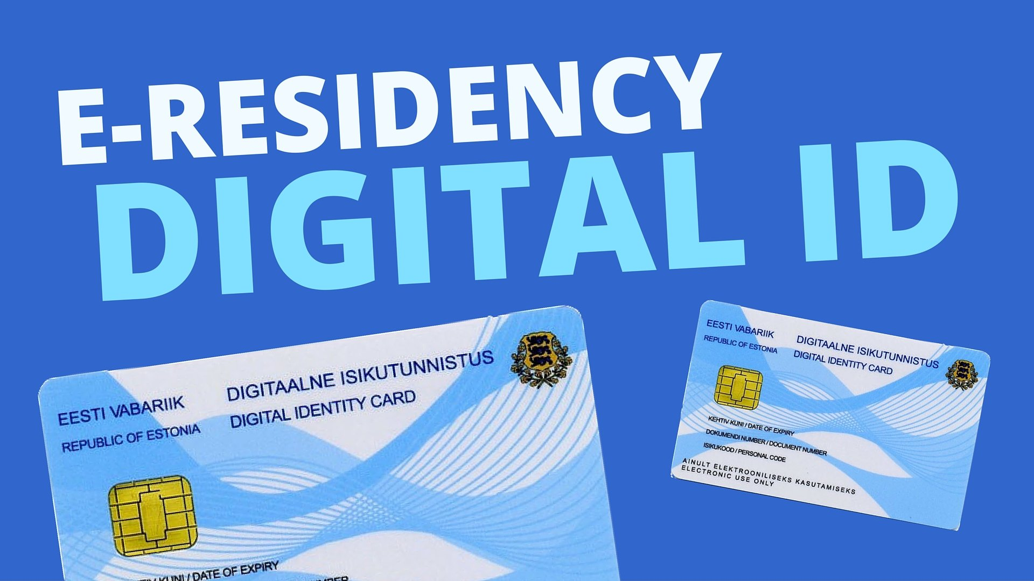

Global Best Practices
e-Estonia (Finland) initiative about digital citizenship, security, Virtual business and education
Rwanda’s (Africa) medical drone initiative awarded 2017 Index Award

Slide 19
How GovTech Policy should be made?
One National Policy Framework
Bridging Digital Divide
Zero Data Loss
Privacy by Design / Electronic Consent Framework
Interop ability
UPI / Demonetization
Local Solutions
Agility
Adaptability
Responsiveness to India’s diversity

Slide 20
References/further reading
Parcell, J., & Holden, S. H. (2013, June). Agile policy development for digital government: an exploratory case study. In Proceedings of the 14th annual international conference on digital government research (pp. 11-17).
Room, G. (2011). Complexity, institutions and public policy: Agile decision-making in a turbulent world. Edward Elgar Publishing.
Raisina 2019 | Bits and Bytes: Creating an Agile Governance Framework for the Future : https://www.youtube.com/watch?v=CW9-jrDA8W0

Slide 21

Our next session would be on :
Drone Policy of India
Any questions?
You can find me at:
Charrumalhotra[dot]iipa[at]gov[dot]in

