Slide 1
CLIMATE CHANGE AND DISASTER RISK REDUCTION (DRR)
Prof Vinod K. Sharma
Indian Institute of Public Administration, New Delhi

Slide 2
Origin and Effects of Global Warming
Use of fossil fuels (oil, coal, gas)
Rising concentrations of greenhouse gas
Rising concentrations of greenhouse gas
Changes in local average climate
Changes in local weather extremes
Notes:
Anthropogenic/ human induced global warming results in changes to local average climate systems and in local weather conditions. In the second part of this presentation we will further look at these local changes. We will demonstrate this with graphs that show changes in temperature.

Slide 3
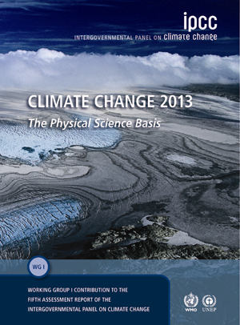
The Global climate change debate
Main findings on climate change
IPCC
It’s already happening and will continue
The rate of change is alarming
Each decade successively warmer since 1850
Northern hemisphere witnessed warmest 30 yr period 1983-2012(medium level of confidence) of last 1400 years
Notes:
The Intergovernmental Panel on Climate Change (IPCC) is a UN agency consisting of more than 2000 climate scientist from all over the world that review all scientific data on climate change. A closelook at the publication of the IPCC reports to be well informed of the current international scientific consensus on climate change.
The latest report was launched in 2007 and this report was an eye-opener to the larger public. Its statements were clear and alarming: climate change is now unequivocal, it is bound to continue at an alarming rate unless substantial measures are taken to reduce greenhouse gas emissions and it already is and will continue to bring the world more extreme weather events.

Slide 4
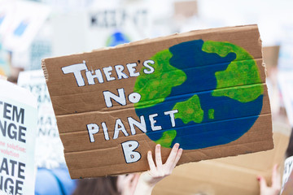
Climate Change is an “unequivocal” fact and “very likely” due to human activity.

Slide 5
Temperature
Global temperatures will continue to rise over the next century.
Different scenarios show different expectations, between +1.8°C and +4.0°C
Temperature trends (expected)
+6.0
+5.0
+4.0
high scenario (A1FI)
+4.0°C
+3.0
+2.0
low scenario (B1)
+1.8°C
global surface warming (°C)
+1.0
0.0
-1.0
1900
2000
2100
Notes:
THIS LAST PART OF THE GRAPH SHOWS THE TEMPERATURE PROJECTIONS MADE BY THE IPCC. SCENARIOS BASED ON ENERGY EMISSIONS, KEEPING IN MIND FACTORS AS ECONOMIC GROWTH, POPULATION GROWTH ETC.
EVEN IN THE MOST OPTIMISTIC SCENARIO AN INCREASE OF 1,8 DEGREES IS PROJECTED. THIS IS UNPRECEDENTED IN MODERN CIVILIZATION. Many people believe a rise of 2 degrees C is a tipping point for disastrous and irreversible impacts, like on the melting of arctic ice, Greenland and melting of permafrost which would produce more GHG’s. Even if GHG are reduced substantially world wide, some scientists state we still only have a 50% chance of reaching a limitation of 2 degrees rise.
Background info:
First of all, we don’t know what future greenhouse gas concentrations will be - in practice, scientists use various scenarios that are all equally plausible. This is particularly problematic if we want to know what is going to happen in say, 2100, less for the coming two decades, where climate change is mostly determined by greenhouse gases emitted already.
Secondly, the computer models are not perfect. They contain approximations, and there are many aspects of the climate system that we do not fully understand. While they are pretty reliable in terms of simulating large-scale patterns in the atmosphere, they do not provide perfect results for each aspect of the weather and for every place on earth.
A third problem is scale. As mentioned, the horizontal resolution of the models is typically of the order of several hundred kilometres. This means that they will average the weather over areas that in reality will have very different local conditions. What the model tells you for the whole area still needs to be translated to what will happen in a particular location. There are options to alleviate some of these problems, for instance by using regional climate models at higher resolution, or so-called statistical downscaling, but they require special attention.
Finally, a key limitation relates to generating information on extremes. First of all, the coarse scale means that the models do not represent small-scale weather phenomena, such as storms. Therefore, they don’t directly provide reliable estimates of how such events will change into the future. They are better at predicting changes to average temperature and to a lesser extent rainfall. But even more large-scale extremes such as heat waves present difficulties. Of course the climate model’s output (the simulated weather) can also be examined to look at the frequency and intensity of particular extreme weather event. How often does the temperature in a particular area exceed a particular value -- i.e. how often can we expect a heat wave there? However, as in the real observations, the more extreme an event is, the more difficult it becomes to generate reliable statistics. If the average temperature in particular month in a particular place is 24 degrees Celsius, it is pretty straightforward to find out how frequently we will find a day where the temperature is more than 28 degrees. However, if we want to know how often the temperature exceeds 40 degrees, or is above 30 degrees for over a week, which might occur, say, once every 100 years, we would have to run the model for an awfully long time to generate reliable statistics.
Note: highest and lowest ranges of scenario are not visble in this graph: 1.1 - 6.4 °C. In this scenario all uncertainties are included.

Slide 6

Climate change will continue…

Slide 7
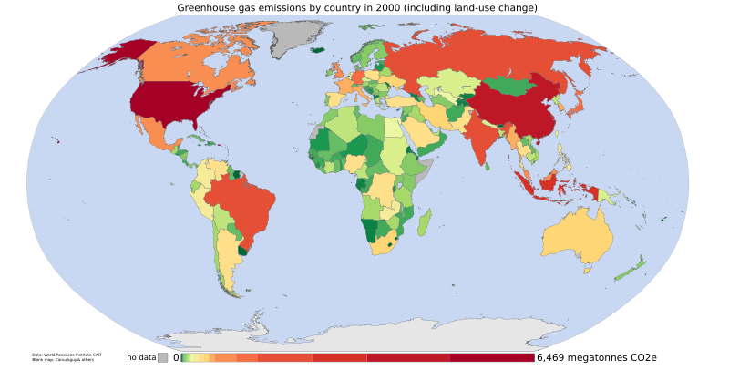
Who’s emitting most? And who is paying the highest price?
Greenhouse gas emissions
Notes:
ALTHOUGH CLIMATE CHANGE IS A GLOBAL PROBLEM, POOR COUNTRIES WILL BE AFFECTED UNEQUALLY HARD. This slide shows who is relatively seen mostly responsible for emitting large amounts of GHGs in the atmosphere. Of concern to us is the fact that the poorest countries are hit the hardest, but have the least means and capacity to cope. Western countries are investing billions in their own protection. Eg the Netherlands has a very highly developed dyke system worth billions of Euros to protect its low lying landscape (blown in new life by the commission Veerman), which is below sealevel for a large part. Who is paying the adaptation bill for the developing countries?

Slide 8
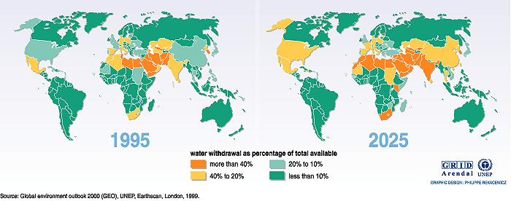
Freshwater Stress
Billions at risk

Slide 9
Changing disaster patterns
Weather related disasters doubled over the past 2 decades
Increase small- and medium-scale disasters
More uncertainties
Disaster trends
400
300
200
Number of disasters
100
0
‘90
‘91
‘92
‘93
‘94
‘95
‘96
‘97
‘98
‘99
‘00
‘01
‘02
‘03
‘04
‘05
‘06
geo-
physical
epidemics,
insect infestations
hydro-
meteorological
Source: CRED
Notes:
An increase in the number of weather related natural disasters
According to the IFRC World Disasters Report 2006 the last ten years saw an increase of reported natural disasters. Until 1997 this number was around 200 per year. Since that year the average number went to more than 300 a year, reaching almost 400 per year in 2006?. This increase is due to the rising number of weather related disasters, such as floods and storms. The increase is particularly in small- and medium-scale disasters, sometimes referred to as ‘forgotten disasters’.
Occurrence of geophysical disasters (such as earthquakes, volcano eruptions and tsunamis) have remained more or less the same.

Slide 10
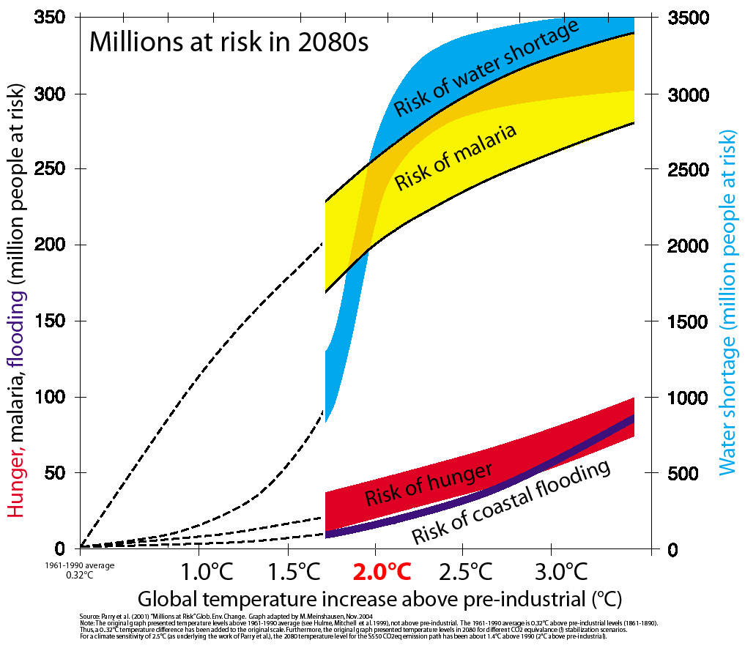
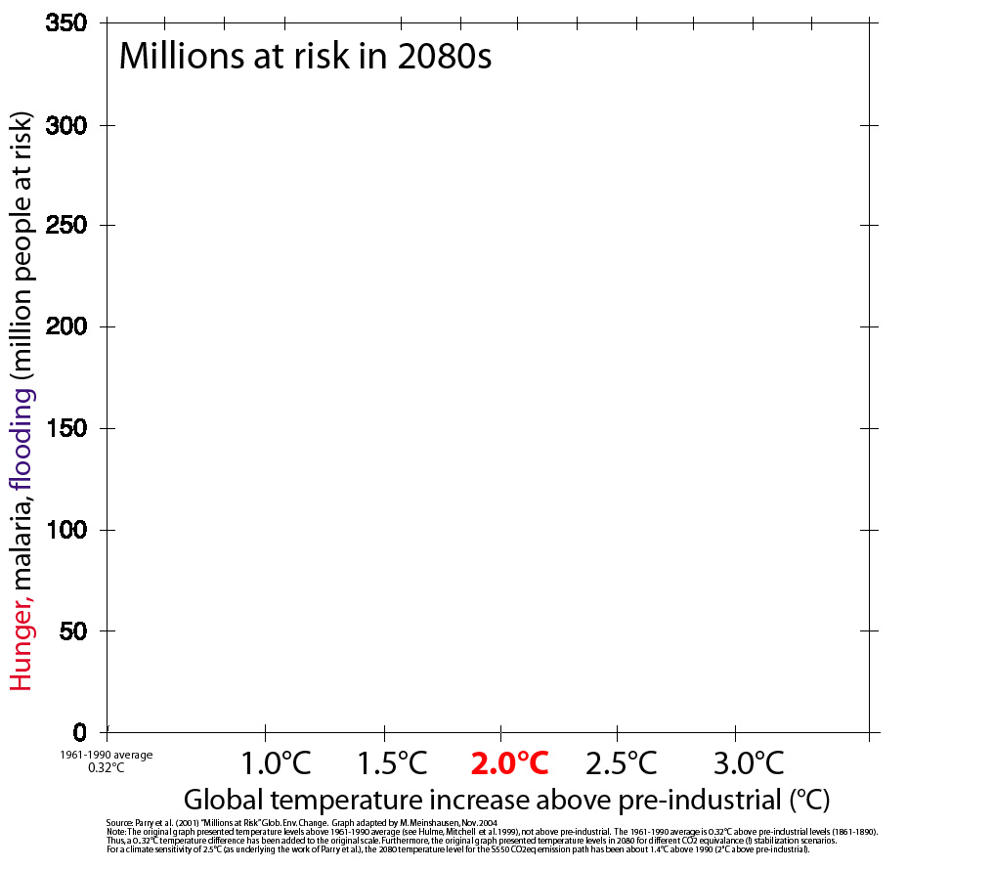
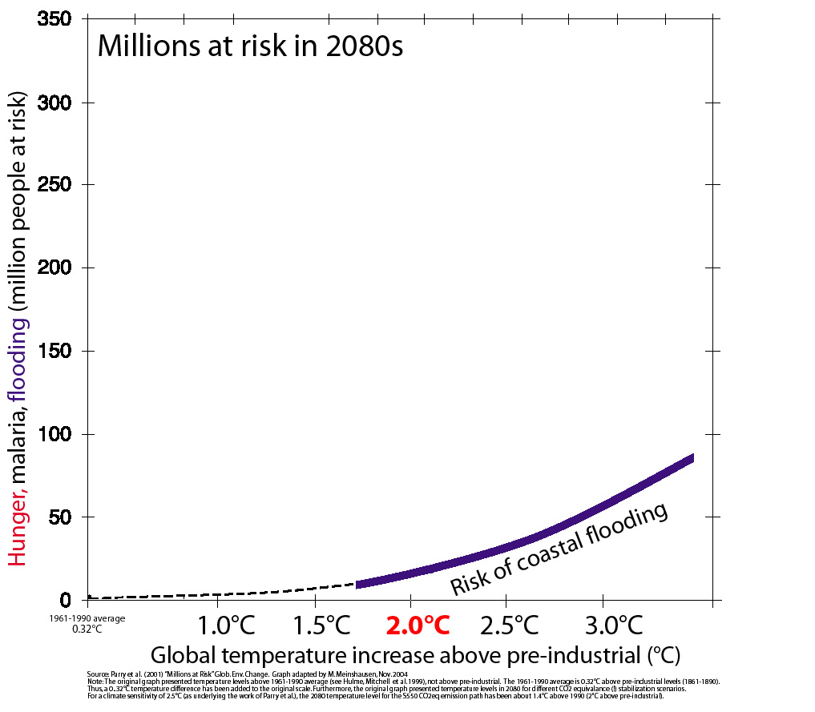
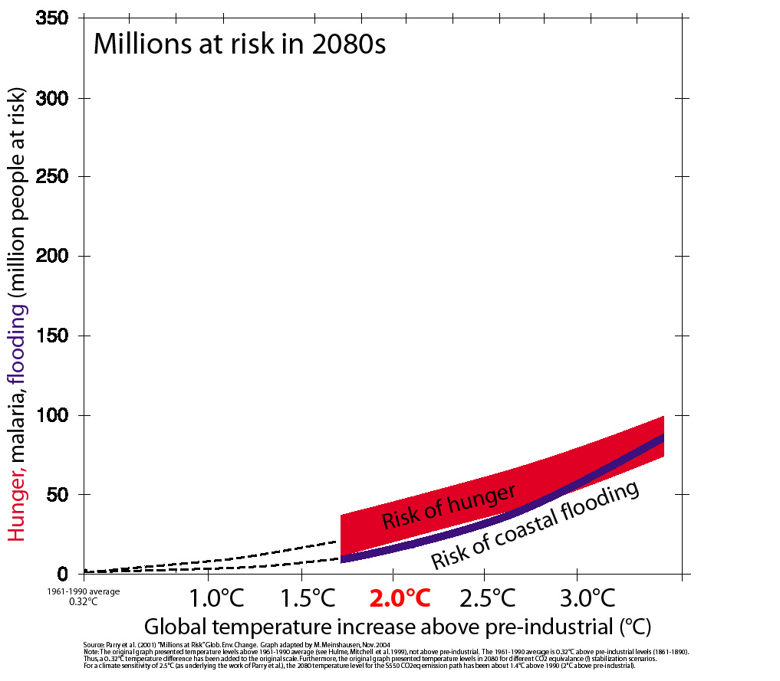
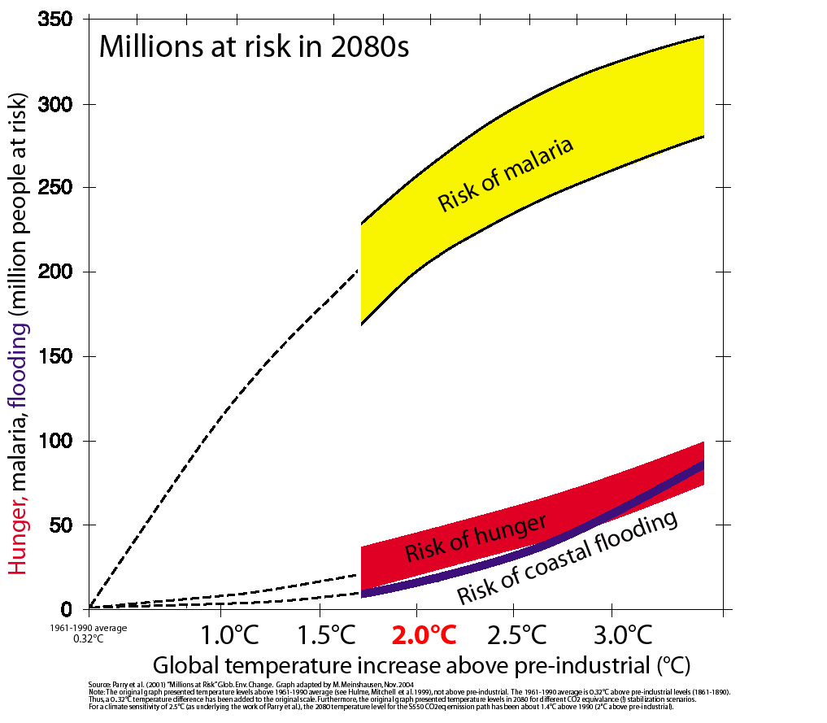
Millions at Risk (Parry et al., 2001)

Slide 11
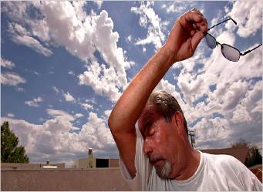
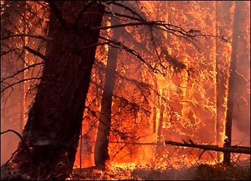
More warm days and more heat waves
Higher death toll amongst the elderly and disabled
Increasing risk of forest fires
Notes:
In more detail we will discuss these negative consequences and their impacts on human vulnerability
We can expect an increase of both number of hot days and nights and more heatwaves world wide.
This is causing a higher death rate amongst the elderly and the disabled. Especially if the nights are not cooling of during heatwaves the human body can not cool itself enough, resulting in heat stress/ heat stroke or drying out – maybe too much detail??.
A major heatwave in Western Europe in 2003 caused a death toll of 35000 people. In cities, the dominant features are heat-absorbing roofs and pavements, leading to heat islands.
The heatwaves also cause an increasing risk of forest fires. In 2006 and 2007 Europe was hit hard by forest fires and in particular Greece.

Slide 12
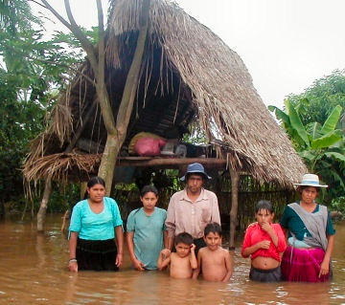
More intense rainfall
More floods, landslides
Pollution of water
Destroyed harvests
Notes:
ANOTHER CONSEQUENCE OF CLIMATE CHANGE IS MORE RAINFALL THAT WILL LEAD TO MORE INUNDATION, THREATEN FOOD SECURITY AND PEOPLE’S HEALTH. FLOODS CAN LEAD TO MIGRATION OF PEOPLE LIVING IN FLOOD PRONE AREAS. The drought/flood sequence is troubling for many regions for example a heavy rain after a period of severe drought can cause devastating floods.

Slide 13
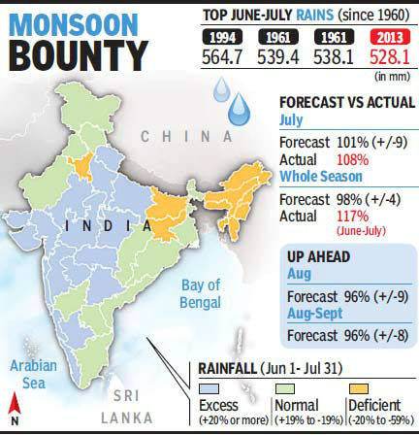
Monsoon Bounty

Slide 14
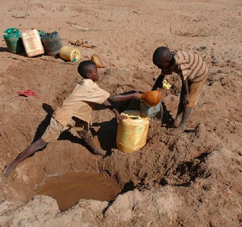
Increased frequency & intensity of droughts
Too little drinking water
Food security threatened
Potential impact on conflict and migration
Notes:
CLIMATE CHANGE CAN ALSO LEAD TO MORE DROUGHTS IN OTHER AREAS. NO NEED TO EXPLAIN WHAT THIS MEANS FOR FOOD SECURITY AND HEALTH.

Slide 15
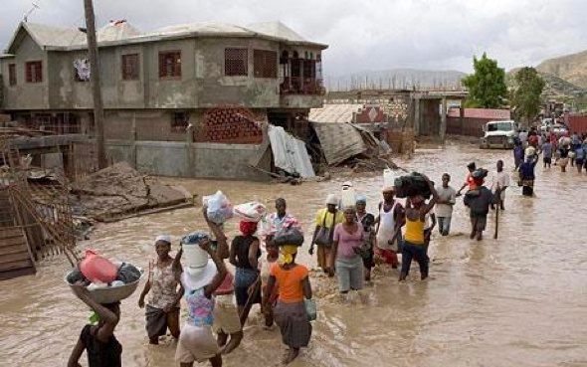
More intense tropical storms:
Higher wind speed and more rainfall
Notes:
An increase in the number of strong hurricanes has been observed.
Higher sea surface temperatures increase strength and duration of hurricanes.
The average number of hurricanes remains more or less the same over time. Especially the increase of rainfall during tropical storms has disastrous impacts.
only 11% of all hurricanes occur in the Atlantic, the rest are in the Pacific and Indian Oceans.
There has been a large upswing in the frequency of Atlantic hurricanes, beginning in 1995. This corresponds to an upswing in tropical North Atlantic sea surface temperature, which is very likely a response to increasing anthropogenic greenhouse gases.

Slide 16
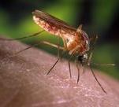
Health and climate change
Shift of diseases to new areas
Increase of water borne diseases after floods
Increase of diseases due to higher temperatures, humidity or drought
Notes:
CLIMATE CHANGE WILL LEAD TO A SHIFT OF VECTOR BORNE (or insect carried) DISEASES such as
MALARIA,
DENGUE,
WEST NILE VIRUS,
LEISHMANIASIS ( IS A PARASITE – CAUSES WOUNDS/ INFECTIONS AND MISFORMING OF HEAD AND LIMBS, FEVER, CUF
LYME
SCHISTOSOMIASIS (EGGS: INFECTIOUS DESEASE – STOMACH AND INTESTINES INFLICTION, LEADING TO FEVER, ILLNES, CUF ETC.)
MOSQUITOS CARRYING THESE VIRUSES SHIFT TO NEW TERRITORIES AND SURVIVE IN MORE PLACES WHERE THEY NEVER OCCURRED BEFORE BECAUSE OF THE LARGER AREAS WITH HIGHER TEMPERATURES.
IPCC also describes an increase of diseases due to higher temperatures, humidity or drought: diarrheal disease, cholera, meningitis, skin disease, food poisoning

Slide 17
CLIMATE RELATED HAZARDS ARE INCREASING
-Mumbai Floods 2005
-Chennai Floods 2016
-Kerala Floods 2019
-Floods and Droughts every year
-Tropical Cyclones increasing -Amphan and Nisarg 2020

Slide 18
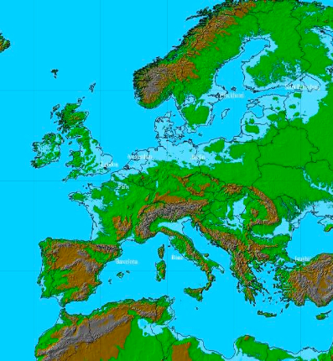
Sea level rise
Sea level rise will bring large coastal areas at risk
Salt water intrusion threatens water supply and food security
Impacts already being felt particularly during storm surge
Notes:
Increases in the number of high sea level events are being recorded. SEA LEVEL RISE CAUSES STRESS FOR PEOPLE LIVING IN COASTAL AREAS ALL AROUND THE WORLD and is exacerbated by phenomenon such as storm surges and king tides.
FURTHERMORE IT´S A THREAT TO WATER RESOURCES BECAUSE OF THE SALINATION OF GROUND WATER AFTER INUNDATIONS.
IT OBVIOUSLY HAS CONSEQUENCES FOR FOOD SECURITY AS WELL BECAUSE INUNDATIONS LEAD TO DESTRUCTION OF LAND AND FOOD SUPPLIES.
This could force people to seek living space elsewhere.
The impacts of sea level rise can be exacerbated by environmental degradation such as sand mining and dense coastal living.
NOTE: sea level rise is predicted to be 80cm if you include ice dynamics as published by science in 2008!!!! IPCC recognizes that ice dynamics are not included in their predictions; Ice dynamics is a complex phenomenon of the growing and melt off variability of ice sheets (statement doesn’t make sense), including the possible break offs of ice sheets.

Slide 19
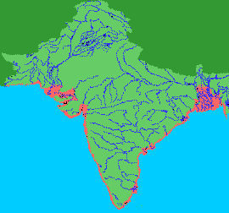
Sea Level Rise Indian subcontinent
Bangladesh
Displace 13 million
16% of national rice production lost
India
Displace 7 million, estimated cost $Bn 230
Inundate 1700 km² agricultural land
Necessitate 4000 km of dykes and sea walls
Submerge 576 km² total land & 4200 km of roads

Slide 20
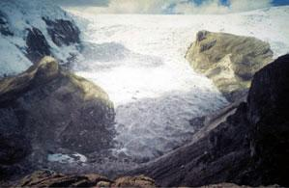
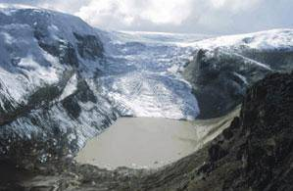
Melting ice
Qori Kalis Glacier, Quelccaya Ice Cap, Peru
1978
Reduction in water supplies
Glacial lake outburst floods
2002
Notes:
Cities such as Peru are completely dependent on water supplies offered by glaciers. A constant melt during the dry season is of utmost importance to continue water supply. Glaciers are then usually ‘recharged’ with more snowfall during the wet season. If the rate of melting is greater than the rate of replenishment, the glaciers will eventually disappear, having long term implications for water security.
Glacial melt can also cause a build of water in lakes, sometimes causing ‘glacial lake outburst’ floods in places such as Nepal.

Slide 21
Agriculture and Climate Change
Indian Agriculture
GDP from agriculture: 34% , 1994
13.7%, 2013
Dependent population: 70%
Average farm size: 1 to 5 ha
Landless dependent on others
2.5º to 4.9ºC increase with -20% drop in precipitation
Rice yield - 15% to - 42%
Wheat yield - 25% to - 55%
2-3.5°C increase in temperature in India could reduce farm net revenues by 9 – 25%
Source: Parikh J and Kavi Kumar
Source: TERI, 2002

Slide 22
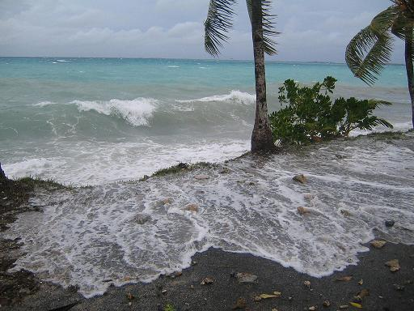
Paradise lost?
Existential threat for nations
Sea ingression in Odisha

Slide 23
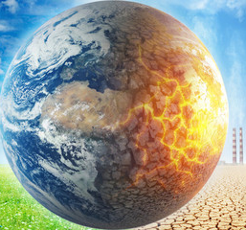
We have to change

Slide 24
Adapting to Climate Change Impacts in Developing Countries

Slide 25
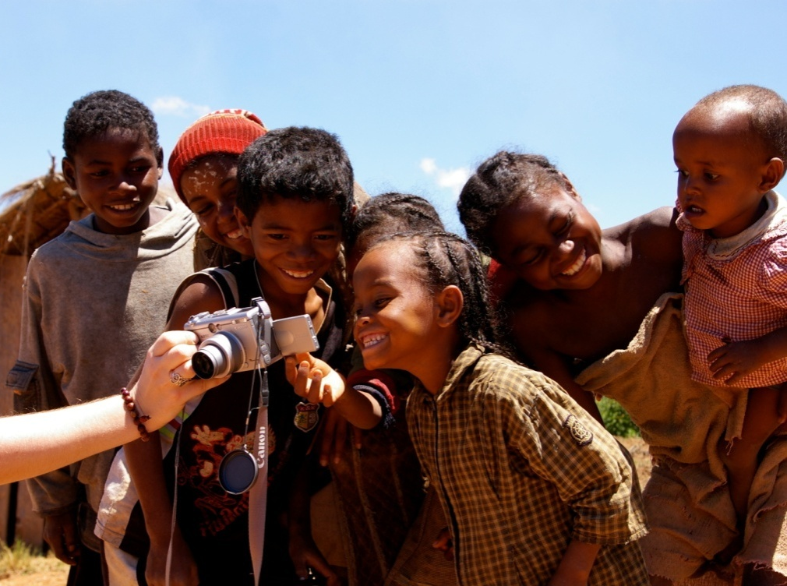
Challenges to Adaptation in Developing Countries
Underlying development challenges
  Education
  Governance
  Health
  Infrastructure
Poor historical records
Poor current weather data
GCM uncertainty
Poorly adapted to current conditions
Numerous pressing needs

Slide 26
Climate Service Partnership

Slide 27
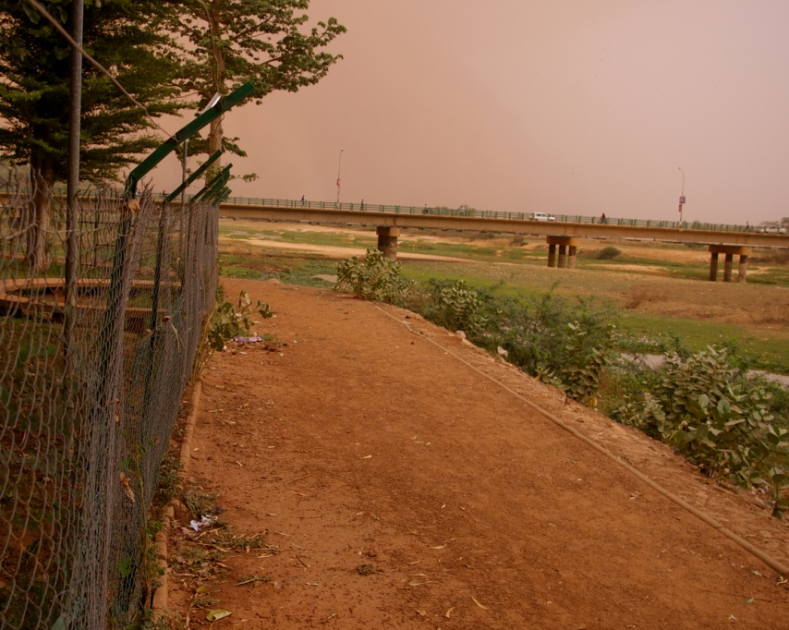
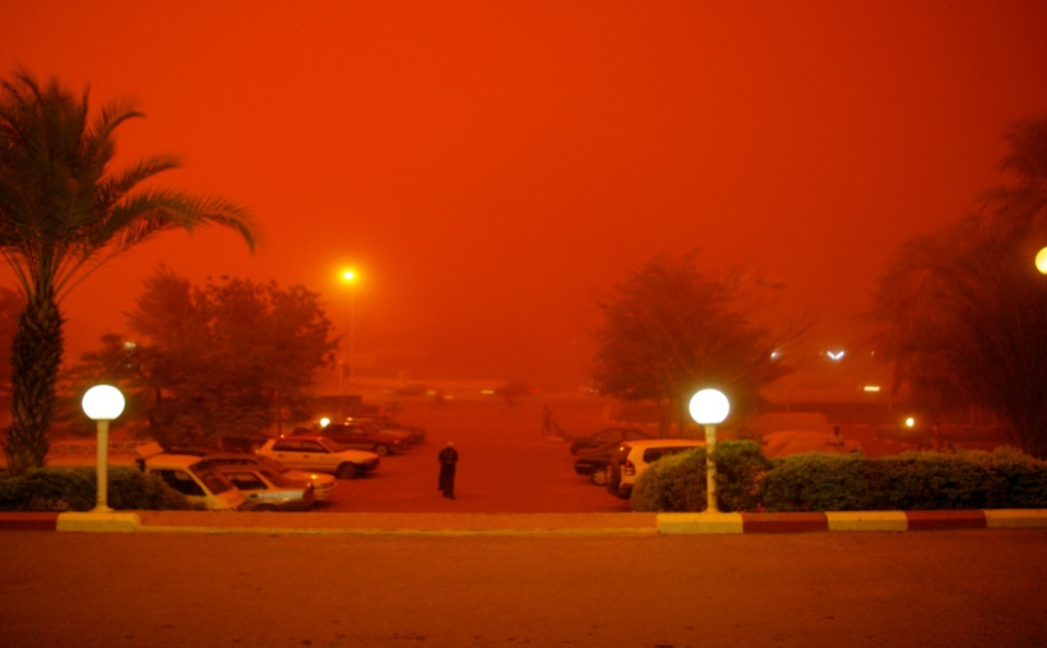
Climate Service Partnership
Growing consensus that providing climate information can help decision making
International Conference on Climate Services:
  NOAA, UK Met, German Climate Service, WMO, Global Framework for Climate Services, World Bank, USAID
Principles:
  Tailored to decision needs
  Focus on key development sectors
  Open access to data
USAID/West Africa:
  Climate Adaptation Support Service for regional development

Slide 28
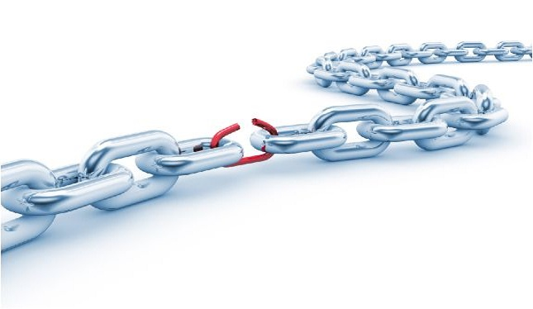
Value Chain of Climate Information
Identify User Needs
Translate Information for users
Deliver Information
Apply Information for decision making
Robust Decisions

Slide 29
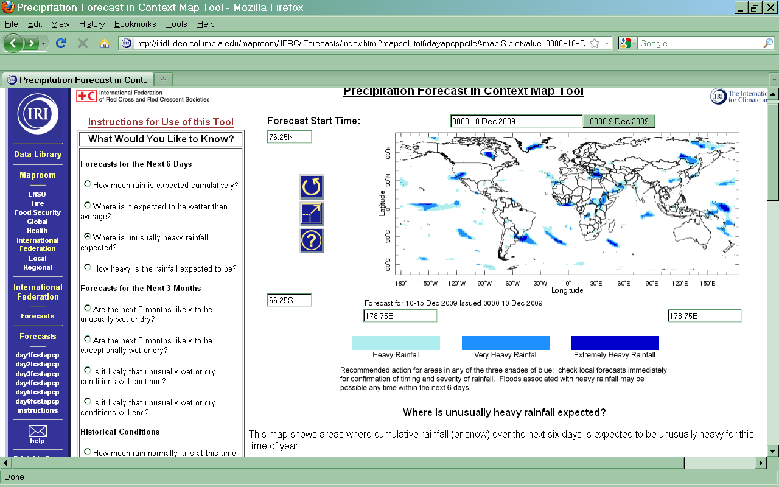
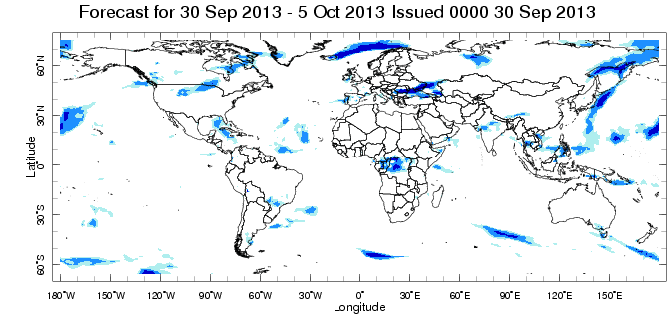
IRI - IFRC Map Room
http://iridl.ldeo.columbia.edu/maproom/.IFRC/.Forecasts/
Notes:
As an example, the IRI Map Rooms attempt to translate information into understandable language tailored for specific user communities. These new products may not be at all useful for other communities, but the point of services is to provide what the users require rather than what the suppliers want to distribute.

Slide 30
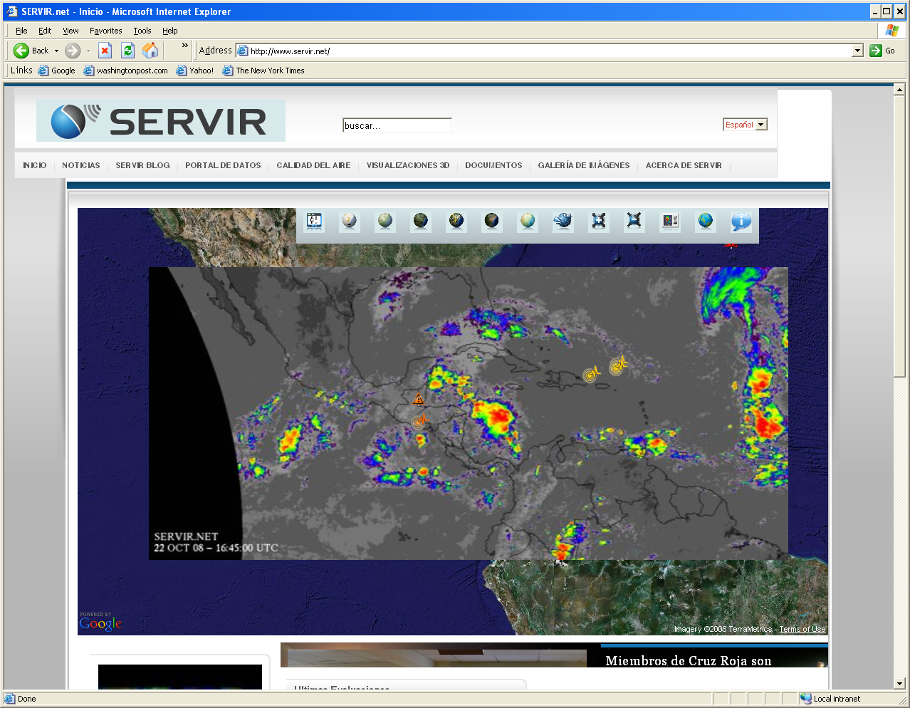
SERVIR:
Tools to Assist Development
Notes:
SERVIR is the parent tool of the Climate Mapper. SERVIR is a regional visualization tool for environmental and meteorological data and information. It was created for Central America to help monitor land use change in the Mayan Biosphere Reserve using satellite data from NASA. It has grown to offer real time weather forecasts, tropical storm track red tide alerts, fire alerts.

Slide 31
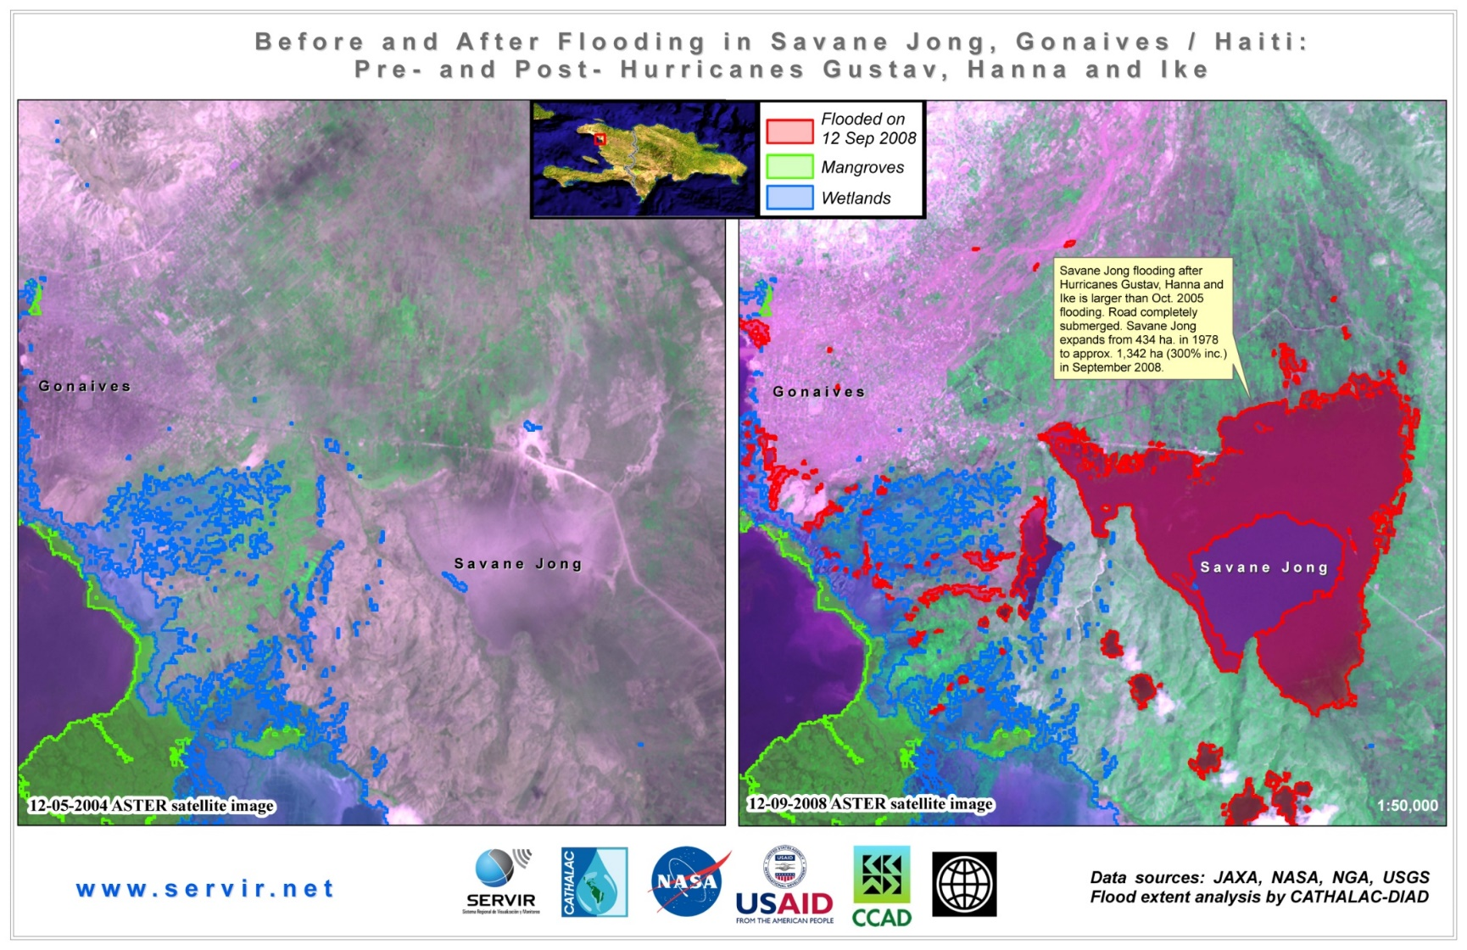
SERVIR:
Disaster Response
Notes:
This pair of images shows the area outside Gonaive, Haiti, known as Savane Jong. The left hand image is from 2004, but shows typical conditions, inlcuding a large, dry lowland area with a road through it. The image on the right shows the same area during the 2008 hurricane season. The area in red is flooded, including the Savane Jong. The road is now under water. So in planning relief efforts, it’s important to know that this road is submerged.

Slide 32
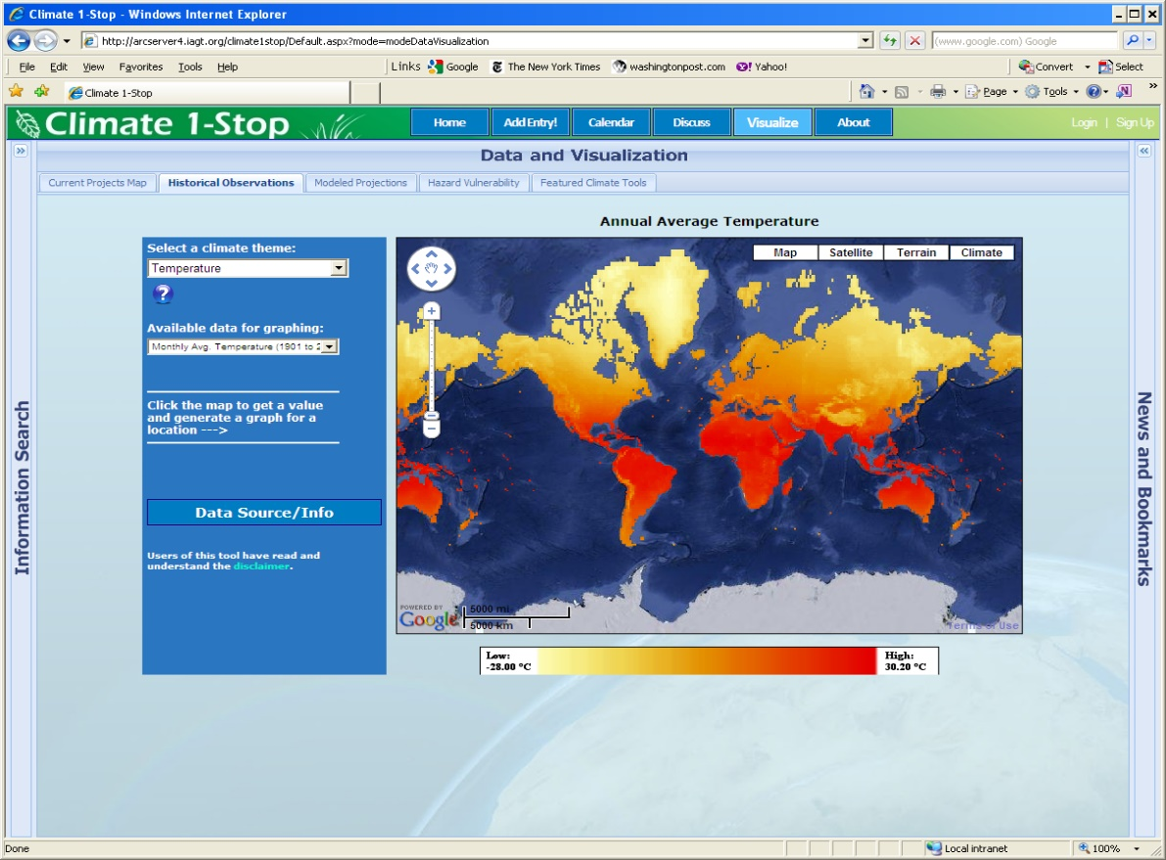
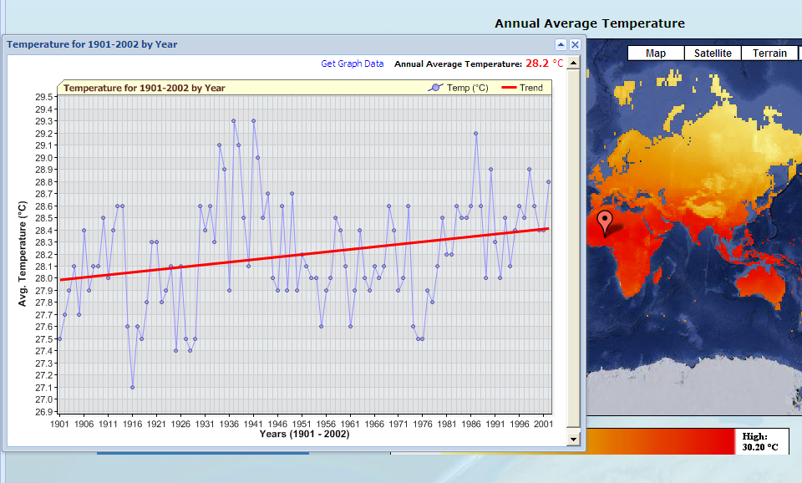
Climate Mapper Tool

Slide 33
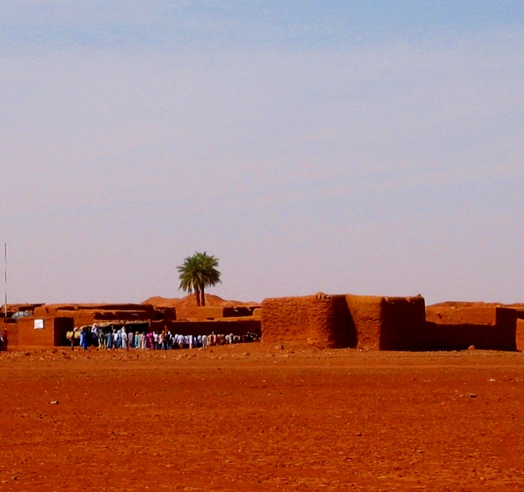
Rural Radio: RANET

Slide 34
Four main “buckets” for Risk Management
Risk Reduction
Frequent, less severe events
Risk Retention
Post disaster assistance
Risk Transfer
Rare, very severe events
Notes:
Need to target each kind of risk management tool at the risks that it can best – and most cost-effectively – address.
Insurance is not a stand-alone solution. Not all climate risks are insurable, or most cost-effectively addressed through insurance. (But, for events of a certain frequency and severity, insurance can be more cost-effective than risk reduction)
Target residual risks: For example, target late season risk, when it’s too late for farmers to use other coping mechanisms like planting a second crop. Consider these risk reduction activities when designing the insurance
Insurance can be a useful tool for adaptation. It can increase adaptive capacity, and also provide a price signal for investments in risk reduction measures or transitions to more resilient crops or livelihoods.
Properly set insurance premiums can, in principle, send appropriate signals to policy holders to undertake adaptation measures to reduce exposure to various risks, including those posed by climate change.
Sustainability and accurate price signals necessitate private sector involvement.

Slide 35
Irrigation
Irrigation
Water use efficiency
Drought resistant varieties
Training on climate change
Access to forecasts
Reforestation
Community monitoring systems
Grain storage, seed banks
Probability
Losses
Risk reduction
Retained
Insurance
Aid/Relief
Notes:
Target each kind of risk management tool at the risks that it can best – and most cost-effectively – address.
There are different innovations under development to deal with the catastrophic losses on the right hand side.

Slide 36
Further Readings
https://www.undp.org./content/dam/india/docs/undp_climate_change.pdf
www.ecowatch.com/india-climate-crisis-2645524391.html
https://www.downtoearth.org.in/climate-change

Slide 37


