Slide 1
National Policy for Disaster Management 2009
Prof. Vinod K. Sharma
Indian Institute of Public Administration, New Delhi-110002

Slide 2
Why National Policy ?
National Statement on the subject
Vision, Mission, Approach
Legal document approved by Union Cabinet
Strengthen DM Act 2005
Paradigm Shift in Disaster Management

Slide 3
Disaster Risks in India
Earthquake- 58.6 % prone area
Floods-12 % land (40 million ha land)
Cyclones- 7516 Km east coast and 5700 Km west coast vulnerable
Droughts- 68 % of cultivable land is prone
Forest Fire-Entire Himalayan states
GLOF-Himalayan States
Landslides- 12 states
CBRN-Chemical, Biological, Radiological, Nuclear

Slide 4
VISION
To built a safe and DISASTER RESILIENT INDIA by developing a holistic, proactive, multi-Disaster oriented and technology driven strategy through-
  CULTURE OF PREVENTION
  CULTURE OF MITIGATION
  CULTURE OF PREPAREDNESS
  CULTURE OF QUICK RESPONSE

Slide 5
Institutional Framework under the Act –DM 2005
National Disaster Management Authority (NDMA)
State Disaster Management Authority (SDMA)
District Disaster Management Authority (DDMA)
National Institute of Disaster Management (NIDM)
National Disaster Response Force (NDRF)
National Executive Committee (NEC)
State Executive Committee (SEC)
National Crisis Management Committee (NCMC)

Slide 6
Financial Arrangements
DM to be in-built in Development Plans
National Disaster Response Fund
  State Disaster Response Fund
National Disaster Mitigation Fund
  State Disaster Mitigation Fund
Responsibilities of Central Ministries and Departments
  State and District level arrangements
  Mitigation Projects

Slide 7
Disaster Prevention, Mitigation and Preparedness
Disaster Prevention and Migation
Risk Assessment and Vulnerability Mapping
Urban Risk
Climate Change Adaptation
Critical Infrastructure
Environmentally Sustainable Development
Preparedness
  -role of various stake holders
  -Plans
  -Early Warning

Slide 8
Partnership in Mitigation and Preparedness
Community Based Disaster Preparedness
Stakeholders’ Participation
Corporate Social Responsibility (CSR) and Public Private Partnership (PPP)
Media Partnership
Mock drills

Slide 9
Techno-Legal Regime
Revision of Municipal Regulations
  -Building Bylaws
  -Land use planning
Safe Construction Practices
Compliance regime
Enforcement

Slide 10
RESPONSE
Role of National Executive Committee
Role of State, District and Local Authorities
Standard Operating Procedures (SOPs)
Incident Command System (ICS)
Medical Response
Animal Care
Information and Media Partnership

Slide 11
Relief and Rehabilitation
Temporary Relief Camps
Management of Relief Supplies
Review of Statndards of Relief
Temporary Livelihood Options and socio-Economic Rehabilitation
Provision of Intermediate Shelters
Rehabilitation issues

Slide 12
Reconstruction and Recovery
Owner driven reconstruction
Speedy reconstruction
Recovery and safe Development
Livelihood Restoration

Slide 13
Reconstruction before and after the National Policy
Uttar Kashi Earthquake 1991
Lature Earthquake 1993
Gujarat Earthquake 2001
Odisha Super-Cyclone 1999
Sikkim Earthquake 2011

Slide 14
Sikkim Reconstruction
Owner Driven, Participatory Approach
In-situ, No environmental damage
Reconstruction as public awareness exercise
With no compromise on disaster resistant features
Timely
Capacity Building exercise
Culture of safe construction
No dispute or court case

Slide 15
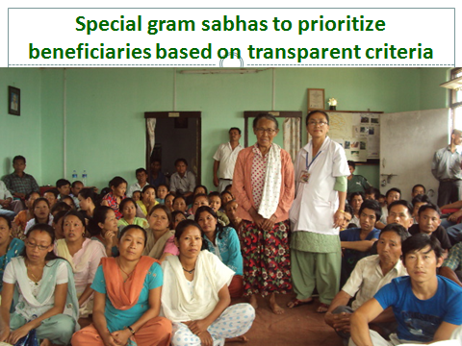

Slide 16
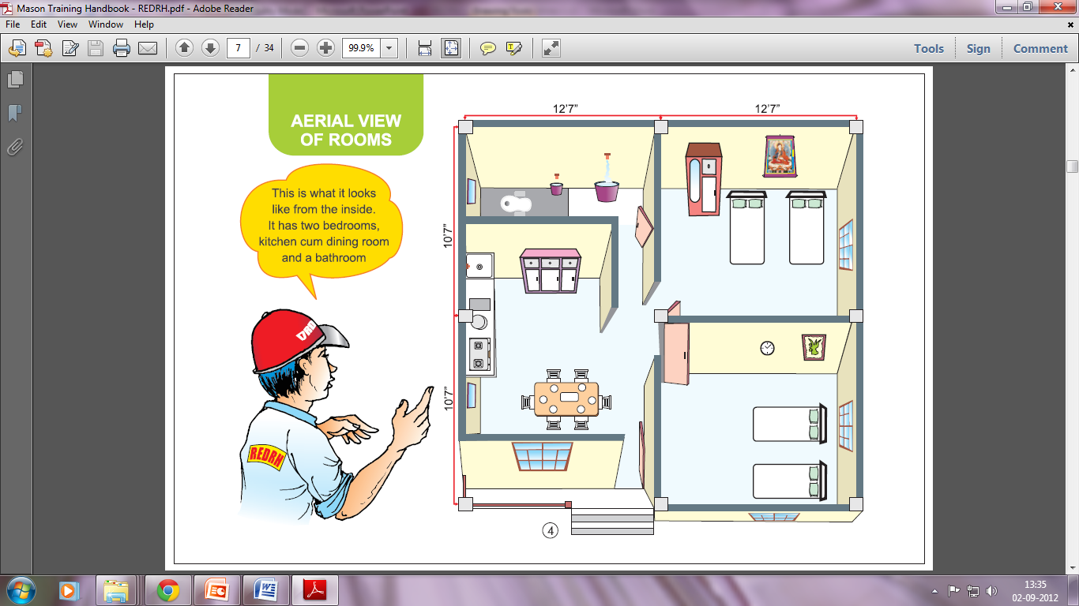
Top view of house
4 Rooms including two bedrooms, one dining –cum- kitchen and one bathroom (605 square feet plinth area)

Slide 17
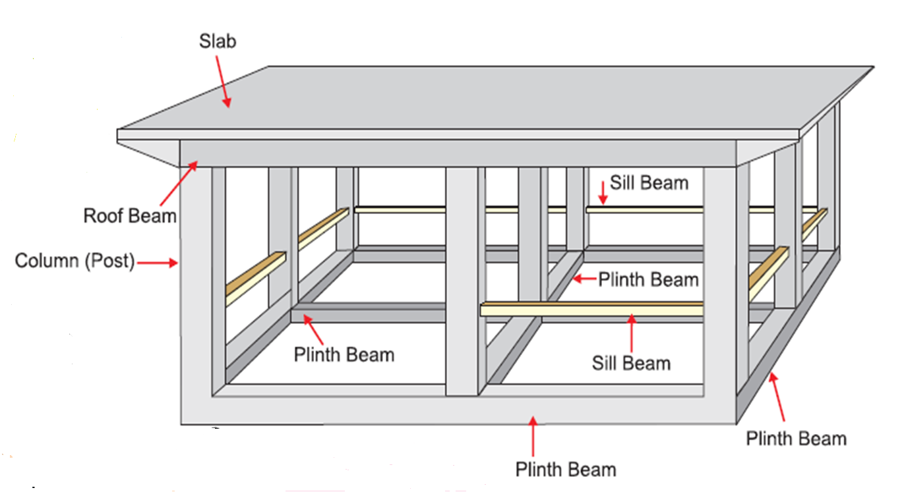
Super-structure of house

Slide 18
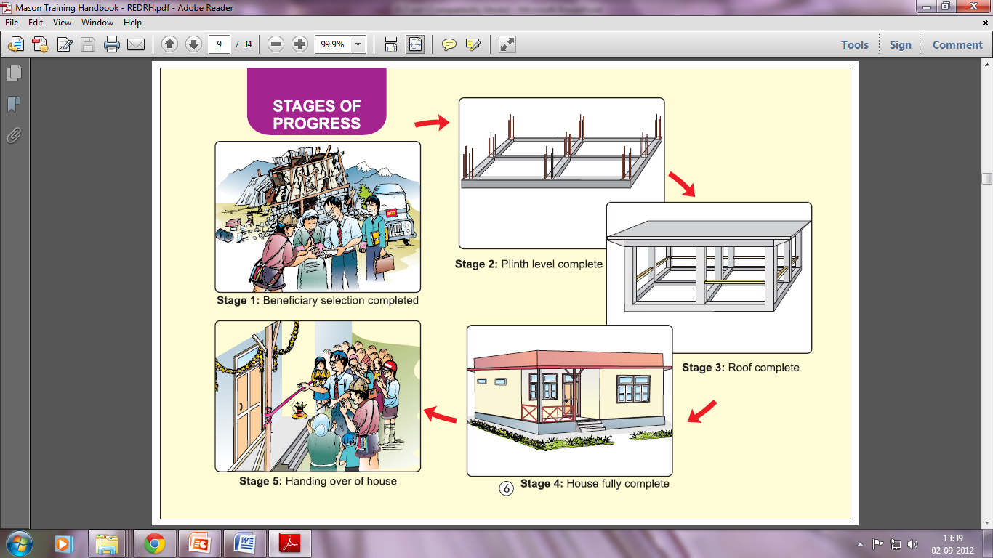
Stages of progress

Slide 19
Capacity Development
Public Awareness and education
Training to all stakeholders
Mock drills
Update the state and district plans

Slide 20
Knowledge Management
Science and Technology
Earth Sciences, Mining, Geology
Environment and Climate Change
Meteorology
Innovation

Slide 21
Research and Development
Early warning
Forecasting
Prediction of Hazard
Use of ICT
Use of artificial intelligence
Use of GIS and GPS

Slide 22
Road Ahead
Policy is more than 10 years old, needs revision on recent developments-
  -Sendai Framework
  -Sustainable Development Goals
  -Paris Agreement
  - Prime Minister’s 10 point program
  -Recent disasters
  -Covid 19

Slide 23
Linkage with other policies
National Training Policy 2013
National Science, Technology and Innovation Policy 2013/2020
National Water Policy 2012
National Agriculture Policy 2000

Slide 24
Further Readings
https://ndma.gov.in/images/national-dm-policy2009,pdf
https://www.indiawaterportal.org
https://mowr.gov.in.policies.national-water-policy

Slide 25
THANK YOU

