Slide 1
Natural Disasters in India
PROF VINOD K.SHARMA
INDIAN INSTITUTE OF PUBLIC ADMINISTRATION, NEW DELHI

Slide 2
India
Agro-based Economy
70% people depend on Agriculture
Demand for water-Water Scarcity
Health Issues
Social Issues
Political Issues
Governance

Slide 3
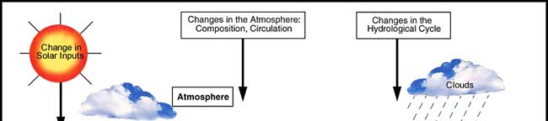
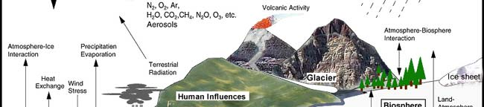
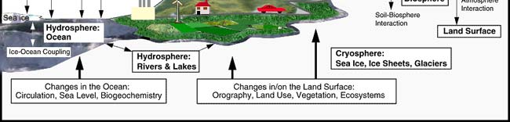
The components of the global climate system - A schematic view (Source: IPCC 2001)

Slide 4
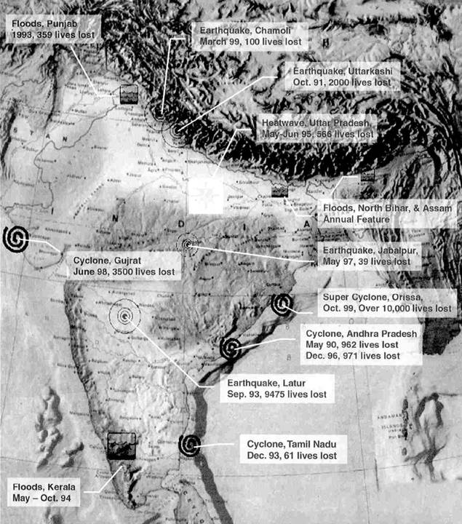
Major Natural Disasters : 1990 - 2020
Earthquakes
Uttarkashi 1991
Latur (Killari) 1993
Jabalpur 1997
Chamoli 1999
Kutchchh, Gujarat 2001
J&K 2005
Sikkim 2011
Cyclones
East & West Godavari 1992&
dist.of Andhra Pradesh 1996
Kutchchh, Gujarat 1998
Orissa 1999
Feni 2019
Vayu 2019
Amphan 2020
Floods
Punjab 1993
Kerala 1994
Punjab & Haryana 1996
Mumbai 2005
Chennai 2017
Kerala 2018
Tsunami
Andaman & Nicobar
Islands & coastal areas 2004
Pandemic 2020
Earthquake, J&K
Oct.8, 2005
Earthquake, Gujarat
January 26, 2001
Tsunami
Dec.26, 2004

Slide 5
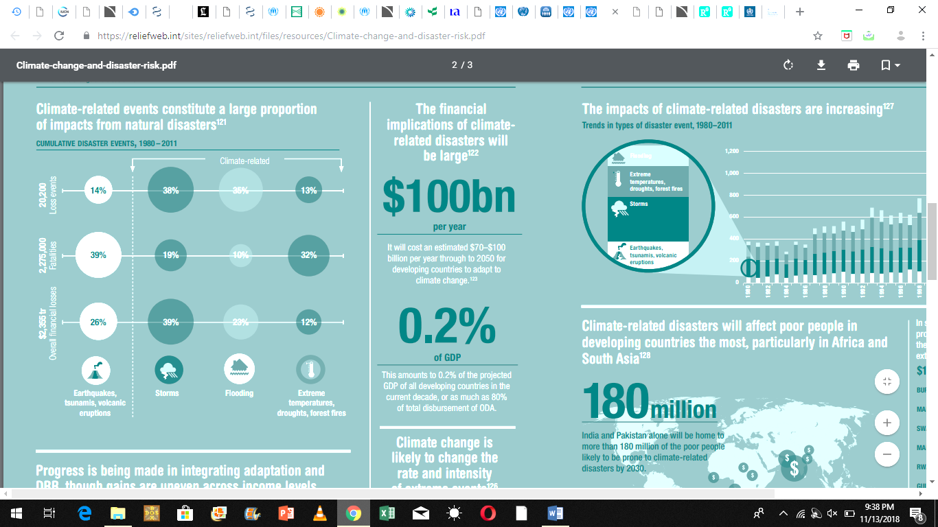
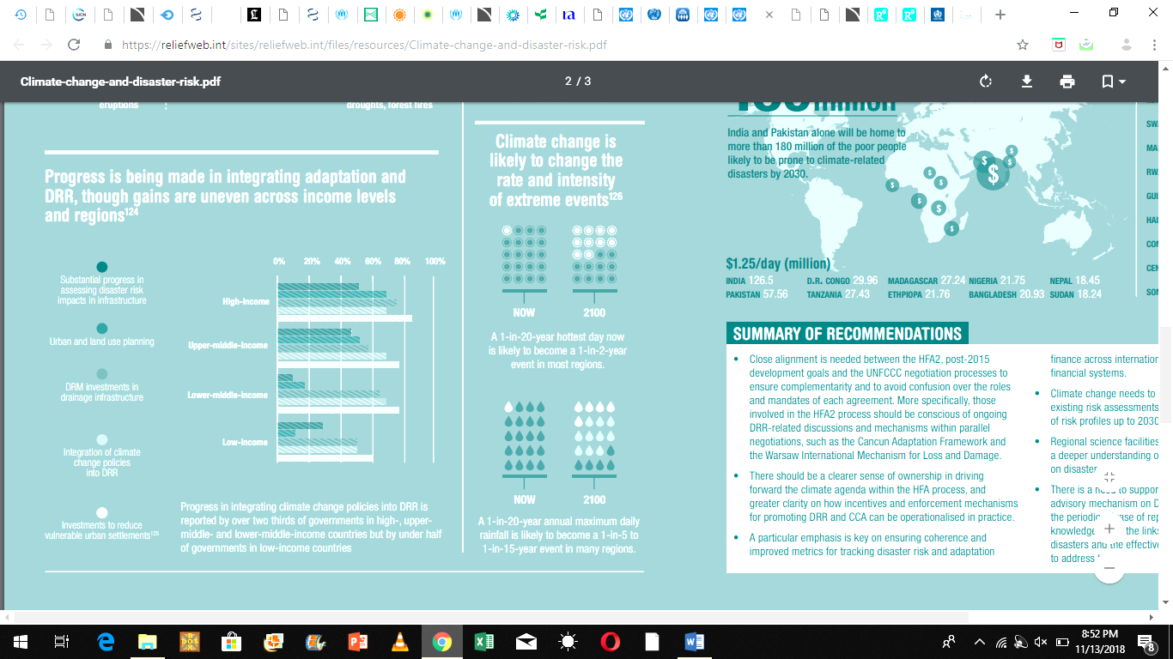

Slide 6
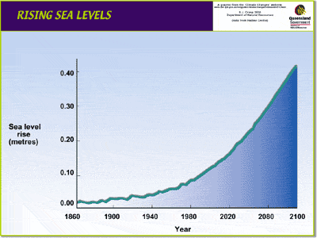

Slide 7
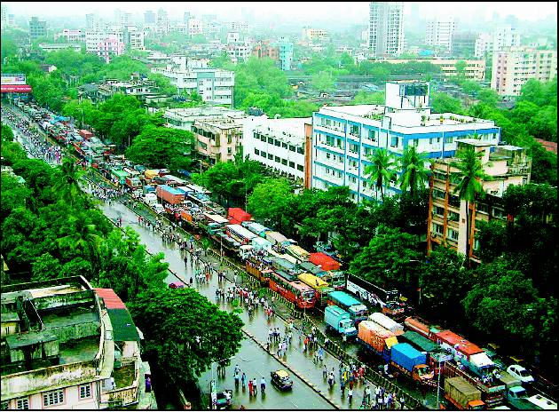
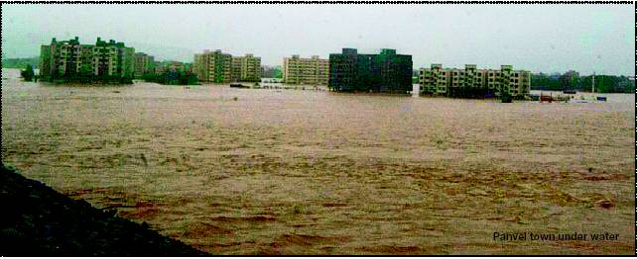
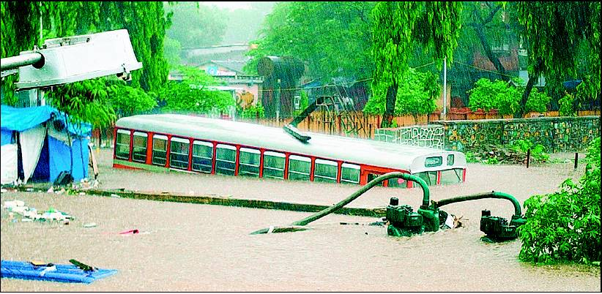
Urban Flooding

Slide 8
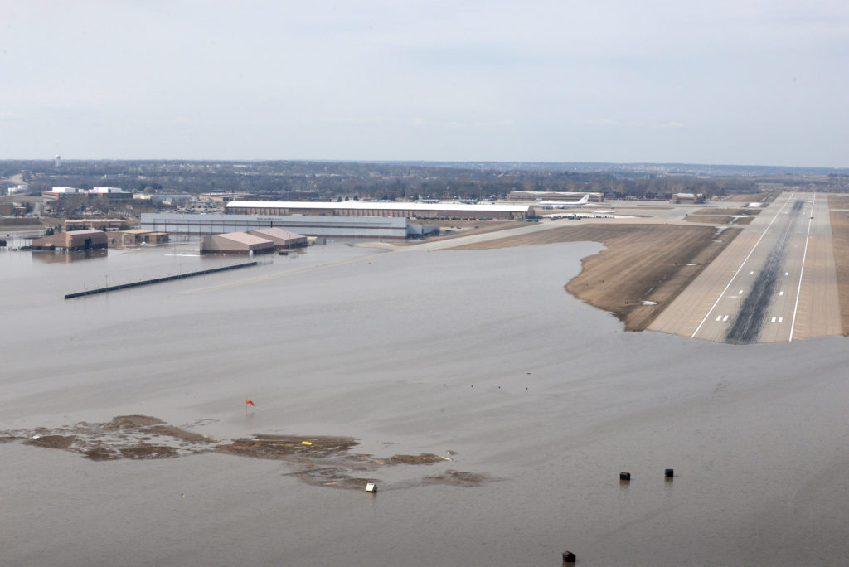
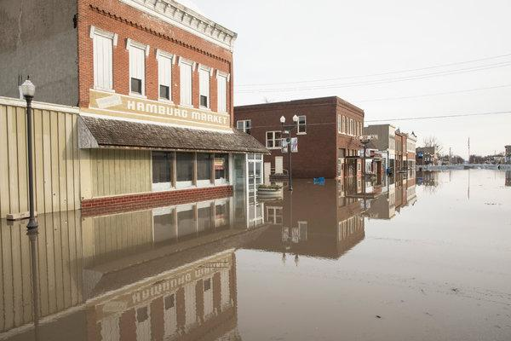

Slide 9
Sea Ingress

Slide 10
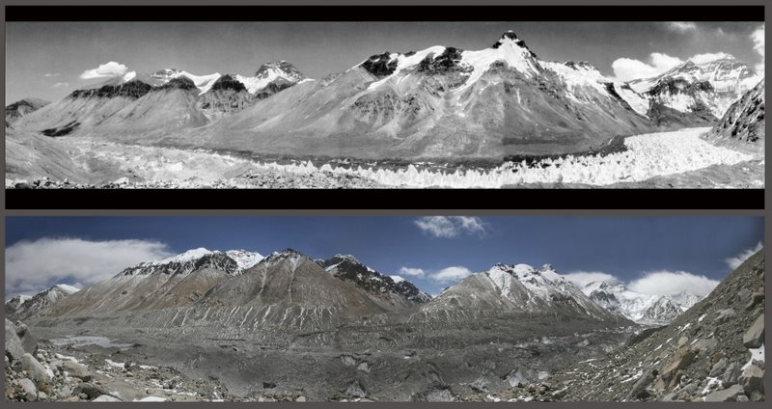
1968
2007
Glaciers Of Himalayas

Slide 11
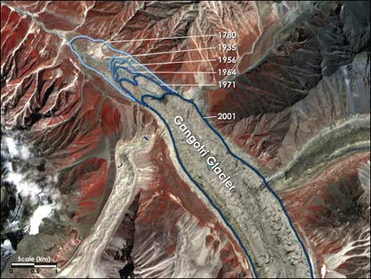

Slide 12
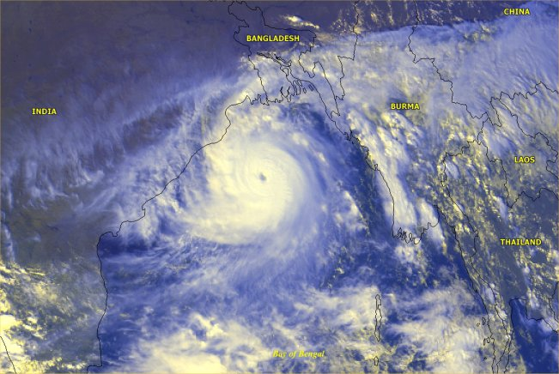
Tropical Cyclone
28th October, 1999
Bay of Bengal
Super cyclone of 20th Century

Slide 13
According to IFRC World Disaster Reports
In last 10 years very significant increase in natural disasters
Floods and cyclones are increasing hydromet disasters
Drought and health stresses are creeping disasters
Earthquakes, tsunamis and landslides are still not fully understood
Expected Extra People at Risk From Future Climate Change
50 m 2020
132 m 2030
266 m 2080

Slide 14
Direct Impact on All Areas
Increased frequency, increased severity, and less predictability of :
  Cyclones and Storms
  Floods
  Flash floods
  Cloud bursts
  Snow fall
  Heat waves

Slide 15
Examples of negative effects
Drought
  Recent increases in drought are due at least in part to man-made greenhouse gases
  Widespread increases in drought are predicted
Moderate drought
  Coverage has increased from 15% to 25% of the world’s surface
  Coverage is projected to double to 50% by 2100
Regional effects
  Drought may increase in frequency, and include stress on urban areas
  Likely to put stress on plants and water resources

Slide 16
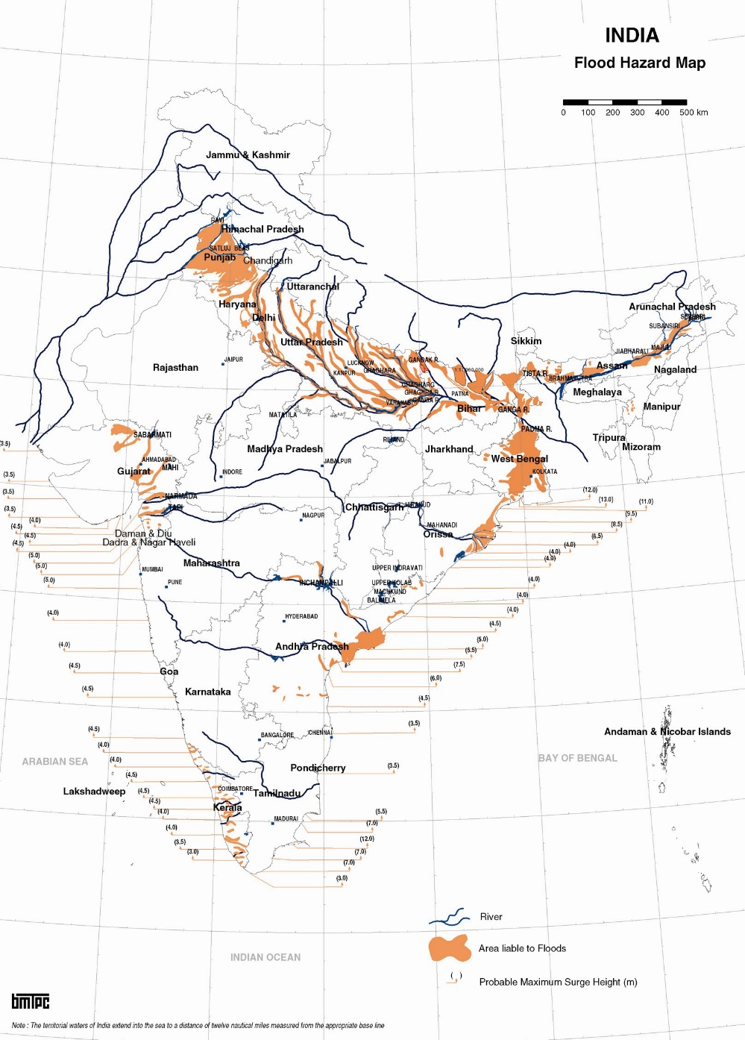
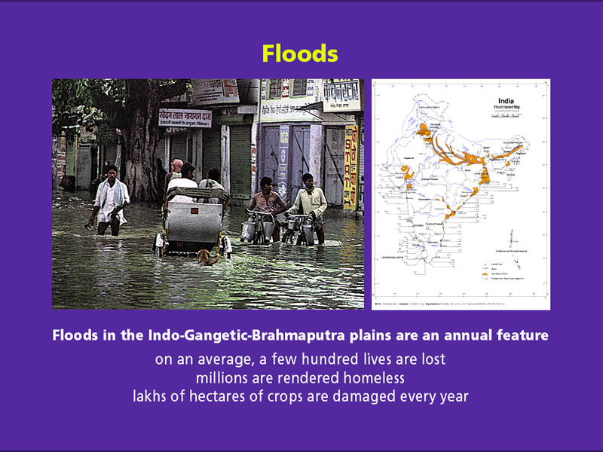
Floods
Floods in the Indo-Gangetic-Brahmaputra plains are an annual feature, Uttarakhand, Kerala floods
On an average, a few hundred lives are lost
Millions are rendered homeless
Lakhs of hectares of crops are damaged every year

Slide 17
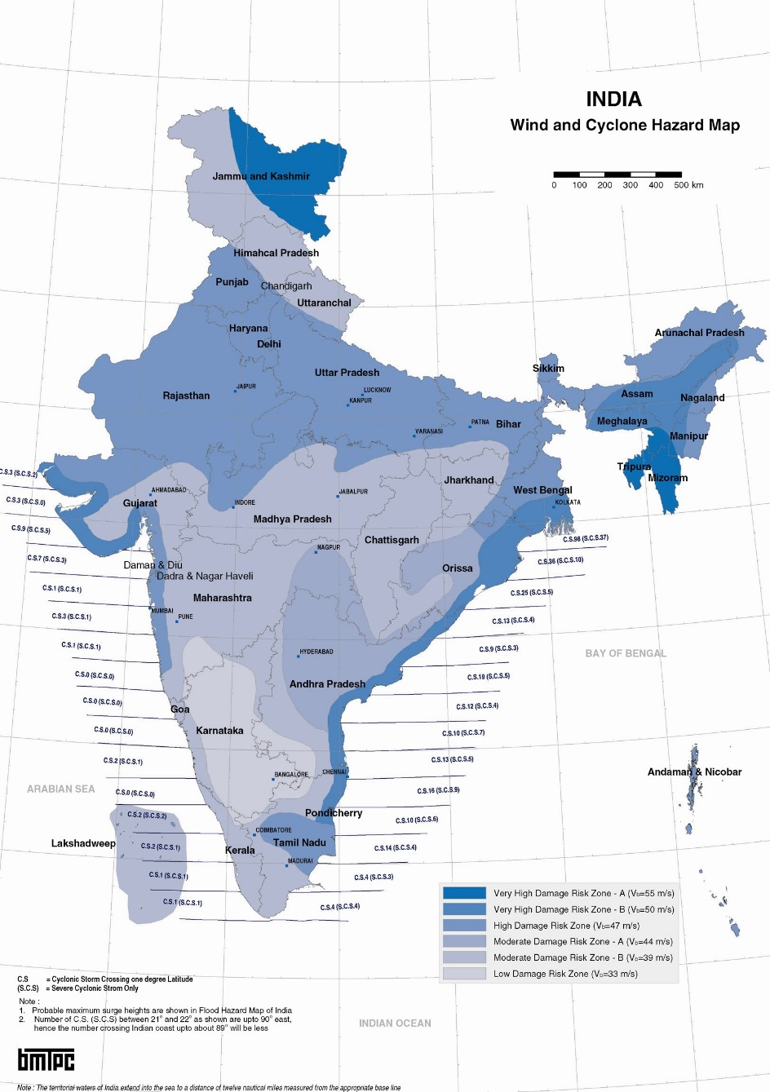
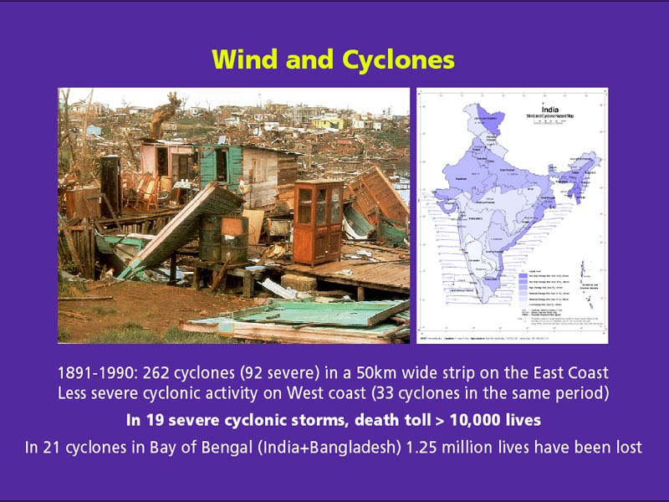
Wind and Cyclones
During the Period 1877-2005 in a 50 km wide strip following cyclonic activity have taken place:
283 cyclones (106 severe) on the East Coast
35 cyclones (19 severe) on West Coast
In the 19 severe cyclonic storms, death toll > 10,000 lives
In 21 cyclones in Bay of Bengal
(India and Bangladesh) 1.25 million lives have been lost

Slide 18
Why cyclones are getting worse?
Sea level rise will make more land area susceptible to storm surges, as its elevation will be reduced
Temperature variations will result in increased wind speeds
Due to lowered crop yield in inland areas, the population concentration will have increased more in coastal towns for work, resulting in more population at risk
8% stronger with every passing decade

Slide 19
Who is at Risk?
Particularly the poor
Inhabitants of coastal towns and villages, fishermen hamlets, islanders
Farming communities dependent on rainfed agriculture
Hill communities dependent on natural water sources
Megacities with high water demand

Slide 20
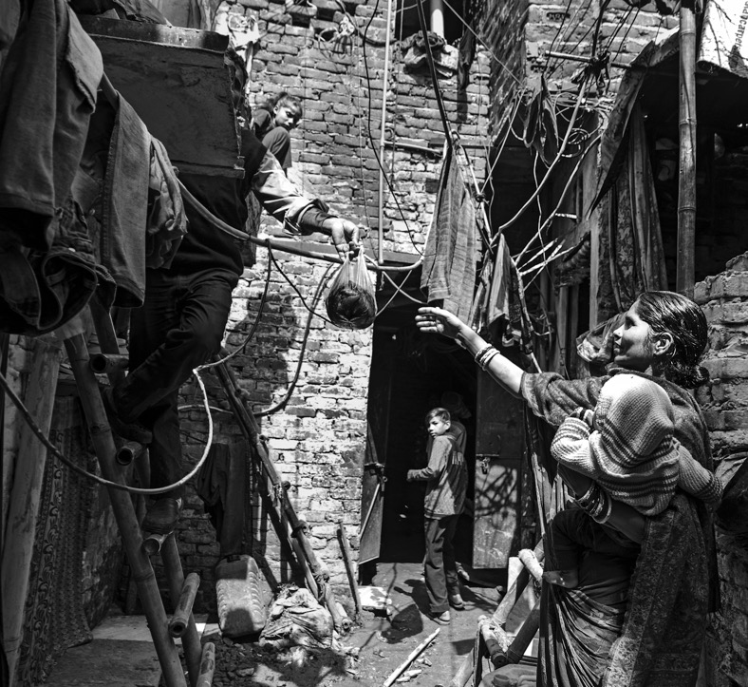
No disaster
Is ‘natural’
Risks lurking under the radar slip through
the cracks because they don’t meet the
idea of a ‘natural disaster’
Notes:
Newer risks are emerging that are serious, and do not fit the natural disaster nomenclature.

Slide 21
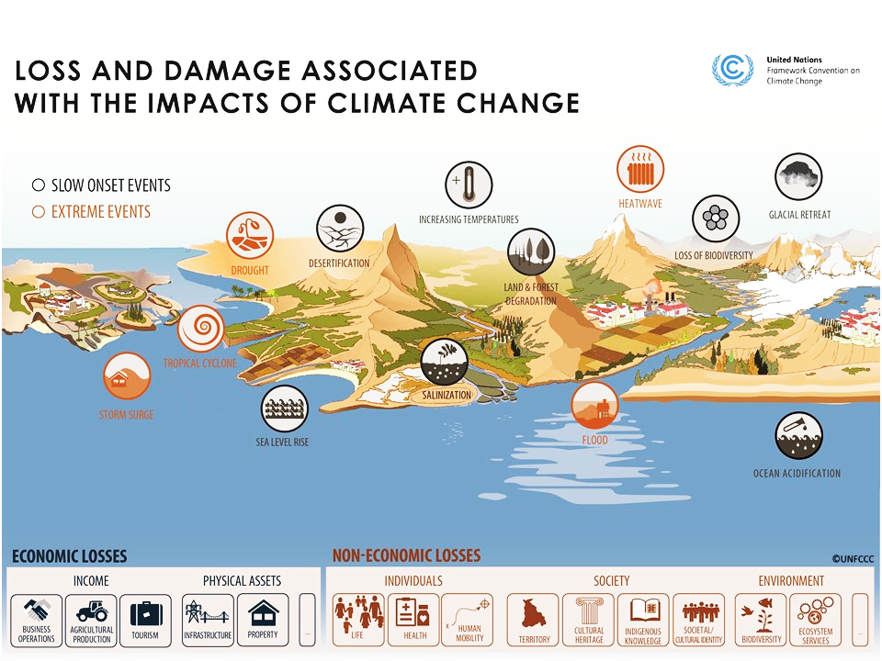

Slide 22
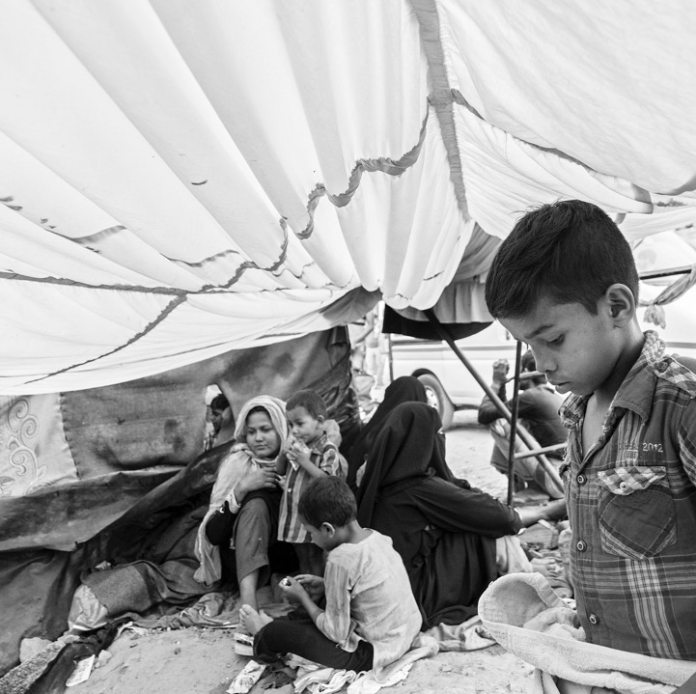
The complexity
of Disaster impact
Beyond ‘damages’, the long-term and
uncaptured impacts have life-changing
consequences for affected communities
Notes:
Disaster impacts last long after the headlines are gone. There are lives that are lost in second wave events, or just because people are more exposed. The hardship continues for years. Multiple types of disasters combining, or coming in chain reactions create very complex situations. More true for climate related disasters.

Slide 23
Contd.
Losses
Economic Losses
Non-Economic Losses
Loss of Territory
Loss of Life
Loss of Culture Heritage
Notes:
Overall, India has begun experiencing the adverse effects of climate change related loss and damage with severe consequences for people’s habitats, health, and livelihoods
Apart from quantifiable losses, there is also the threat of non-economic losses i.e. loss of heritage, culture, and centuries old ways of life

Slide 24
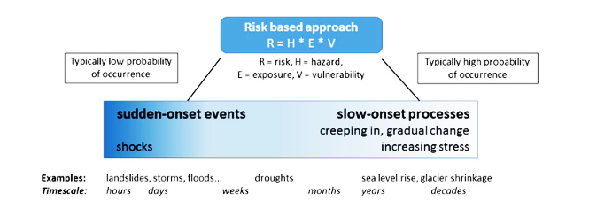
Risk concept : Sudden and slow onset processes
Source: Huggel et al., 2016

Slide 25
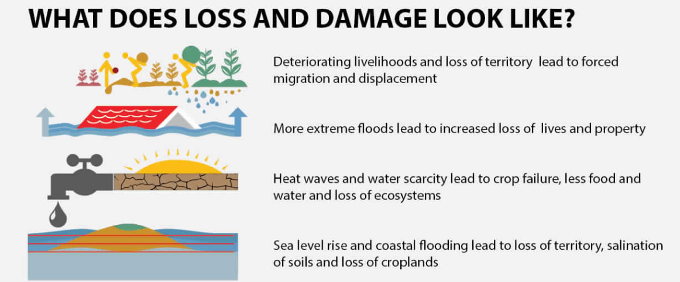

Slide 26
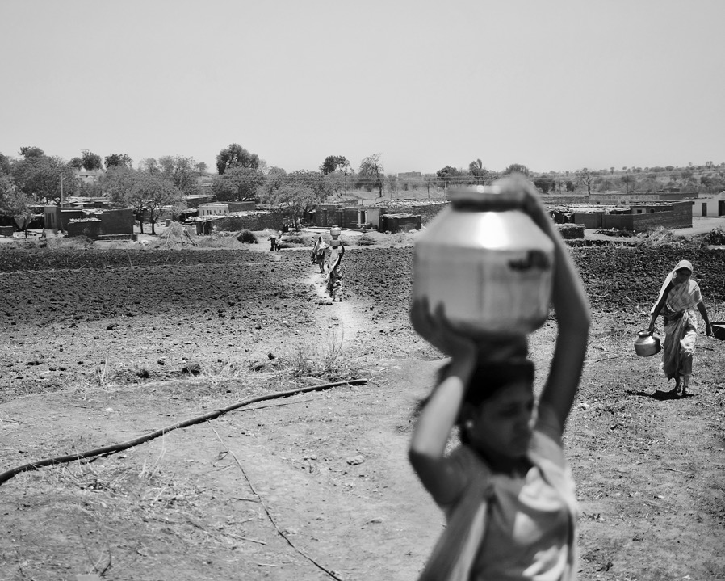
The silent events
The disasters that go unseen leave
those affected at even greater risk.

Slide 27
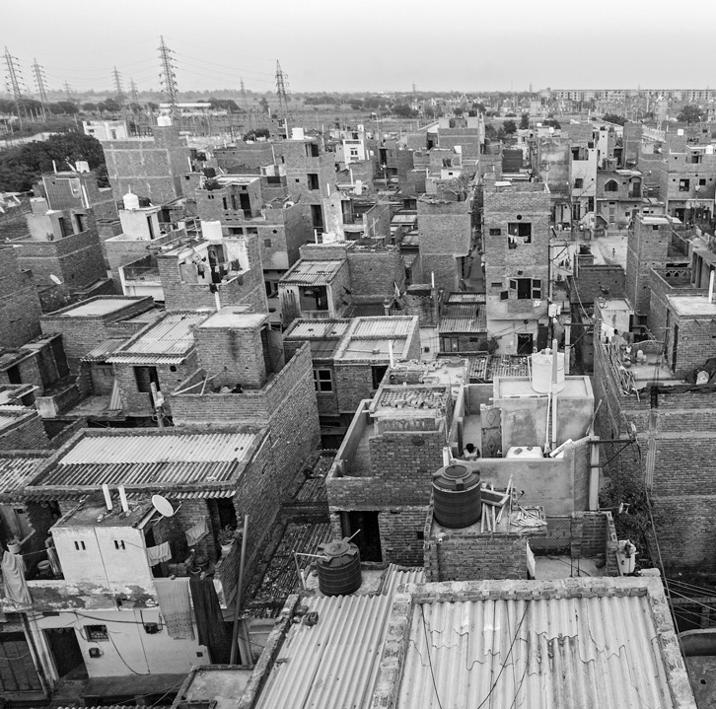
The urban imperative
Risk is rapidly urbanising and will
affect everyone!

Slide 28
What this means for us?
Resilience
The ability to
Anticipate
Absorb
Adapt

Slide 29
Further Readings:
https://m.jagranjosh.com/general-knowledge/list-of-major-natural-disaster-in-the-history -of-india-1590147440-1
https://en.m.wikipedia.org/wiki/Natural_disasters_in_india
https://www.gfdr.org/en/india

Slide 30


