Slide 1
Paradigm shift from relief towards Disaster Preparedness and Mitigation-International Strategy in DRR
Prof. Vinod k. Sharma
Indian institute of public administration, new delhi

Slide 2
International Decade for Disaster Risk Reduction (1990-1999)
Beginning on 1 January 1990, was launched by the United Nations
Intended to reduce, through concerted international action, especially in developing countries, loss of life, property damage and social and economic disruption caused by natural disasters.

Slide 3
Objective
To reduce through concerted international actions, especially in developing countries, loss of life, property damage and economic disruption caused by natural disasters such as earthquakes, windstorms, tsunamis, floods, landslides, volcanic eruptions, wildfires and other calamities of natural origin such as grasshopper and locust infestation

Slide 4
Goals
Improve the capacity of each country to mitigate the effects of natural disasters expeditiously and effectively, paying special attention to assisting developing countries in the assessment of disaster damage potential and in the establishment of early warning systems and disaster-resistant structures when and where needed;
Devise appropriate guidelines and strategies for applying existing scientific and technical knowledge, taking into account the cultural and economic diversity among nations;
Foster scientific and engineering endeavours aimed at closing critical gaps in knowledge in order to reduce loss of life and property;
Develop measures for the assessment, prediction, prevention and mitigation of natural disasters through programmes of technical assistance and technology transfer, demonstration projects, and education and training, tailored to specific disasters and locations, and to evaluate the effectiveness of those programmes.

Slide 5
Plan of Action
By the year 2000, all countries, as part of their plan to achieve sustainable development, should have in place:
comprehensive national assessments of risks from natural hazards, with these assessments taken into account in development plans;
mitigation plans at national and/or local levels, involving long-term prevention and preparedness and community awareness, and
ready access to global, regional, national and local warning systems and broad dissemination of warnings.

Slide 6
Yokohama Conference 1994
I. Principles:
A. Basis for the strategy
B. Assessment of the status of disaster reduction midway into the Decade
C. Strategy for the Year 2000 and beyond

Slide 7
Yokohama Conference 1994
II. Plan of Action
1. Activities at the community and national levels
2. Activities at the regional and sub-regional levels
3. Activities at the international level, in particular through bilateral arrangements and multilateral cooperation

Slide 8
Hyogo Framework 1995-2015
Defines:
Strategic Goals
Priorities for Action
Implementation and Follow- up
Integrates disaster risk reduction into policies, plans and programmes of sustainable development and poverty reduction
Recognize risk reduction as both a humanitarian and development issue- in the context of sustainable development
Focus on national implementation, with bi-lateral, multi-lateral, regional and international cooperation

Slide 9
Strategic Goals
DRR integrated into sustainable development policies and programmes
Strengthened institutional mechanisms to build capacities for resilience to hazard
DRR as part of preparedness, relief and recovery

Slide 10
Priorities of Action
HFA also articulates five priorities for action:
Ensure that disaster risk reduction is a national and a local priority with a strong institutional basis for implementation;
Identify, assess, and monitor disaster risks and enhance early warning;
Use knowledge, innovation, and education to build a culture of safety and resilience at all levels;
Reduce the underlying risk factors;
Strengthen disaster preparedness for effective response at all levels.

Slide 11
Sendai Framework 2015-2030
Scope and Purpose
The present framework will apply to the risk of small-scale and large-scale, frequent and infrequent, sudden and slow-onset disasters, caused by natural or manmade hazards as well as related environmental, technological and biological hazards and risks.
It aims to guide the multi-hazard management of disaster risk in development at all levels as well as within and across all sectors.

Slide 12
Expected Outcome
The substantial reduction of disaster risk and losses in lives, livelihoods and health and in the economic, physical, social, cultural and environmental assets of persons, businesses, communities and countries

Slide 13
Goal
Prevent new and reduce existing disaster risk through the implementation of integrated and inclusive economic, structural, legal, social, health, cultural, educational, environmental, technological, political and institutional measures that prevent and reduce hazard exposure and vulnerability to disaster, increase preparedness for response and recovery, and thus strengthen resilience

Slide 14
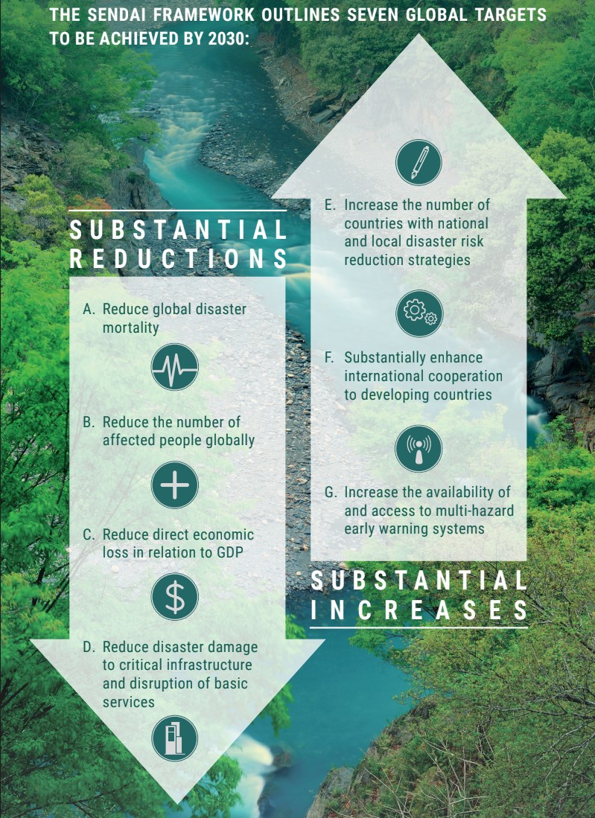
Targets

Slide 15
Targets
A. Substantially reduce global disaster mortality by 2030, aiming to lower average per 100,000 global mortality between 2020-2030 compared to 2005-2015
B. Substantially reduce the number of affected people globally by 2030, aiming to lower the average global figure per 100,000 between 2020-2030 compared to 2005-2015
C. Reduce direct disaster economic loss in relation to global gross domestic product (GDP) by 2030

Slide 16
Targets
D. Substantially reduce disaster damage to critical infrastructure and disruption of basic services, among them health and educational facilities, including through developing their resilience by 2030
E. Substantially increase the number of countries with national and local disaster risk reduction strategies by 2020
F. Substantially enhance international cooperation to developing countries through adequate and sustainable support to complement their national actions for implementation of this framework by 2030
G. Substantially increase the availability of and access to multi-hazard early warning systems and disaster risk information and assessments to people by 2030

Slide 17
Priorities for Action
There is a need for focused action within and across sectors by States at local, national, regional and global levels in the following four priority areas.
Priority 1: Understanding disaster risk
Priority 2: Strengthening disaster risk governance to manage disaster risk
Priority 3: Investing in disaster risk reduction for resilience
Priority 4: Enhancing disaster preparedness for effective response, and to «Build Back Better» in recovery, rehabilitation and reconstruction

Slide 18
Way ahead
Mainstreaming of Disaster Risk Reduction
State charter for Sendai Framework
Agenda should reach up to Panchayats
SDGs/ Sendai Framework/ Paris Agreement and Prime Minister’s 10 point programme should work together at all levels

Slide 19
Bibliography
https://gfmc.online/programmes/un/idndr/idndr2.html
http://www.zaragoza.es/contenidos/medioambiente/onu/868-eng.pdf
https://www.ifrc.org/Docs/idrl/I248EN.pdf
https://www.unisdr.org/files/44983_sendaiframeworksimplifiedchart.pdf
https://www.undrr.org/implementing-sendai-framework/what-sf

Slide 20


