Slide 1
Disaster Management Planning
Vinod Kumar Sharma
IIPA, New Delhi

Slide 2
National Disaster Management Plan 2016/2019
National Disaster Management Plan (NDMP) was first prepared in 2016
  First ever NDMP in India and highly appreciated by DM experts
Revised NDMP in 2019
  Dynamic process
  Many disasters happened from 2016-2019
  Linked with SDMP
  More comprehensive and inclusive approach

Slide 3
VISION:
MAKE INDIA DISASTER RESILIENT

Slide 4
Five Pillars of the Plan
Confirming legal mandate, DM ACT 2005, National Disaster Management Policy 2016
Three International Agreements-
  Sendai Framework 2015-20130
  SDGs 2015-2030
  Paris Agreement 2015
Prime Minister’s 10 point program
Social Inclusion
Mainstreaming Disaster Risk Reduction

Slide 5
How to Build Resilience
Understanding Risk
Interagency coordination
Investing in Disaster Risk Reduction
  Structural Measures
  Non-structural Measures
Capacity Development
Climate Change Risk Management

Slide 6
State Disaster Management Plan
More Practical, not generic, based on theory
Based on Disaster Vulnerability
  Physical
  Economical
  Social
  Political
Linked with National Plan on one side and District Plans on other side
Linked with other development plans
Based on Resource available

Slide 7
Sikkim State Disaster Management Plan-A case Study
Sikkim- a Himalayan State ; Fragile Ecosystem, Environment Friendly state,
Vulnerable for Earthquake, Landslides, Forest Fire, GLOF, Mud flow, flooding
Following Sendai Framework 2015-2030
Linked with National Plan
Linked with State Action Plan for Climate Change
Linked with Development Plans

Slide 8

Sikkim is very fragile ecosystem, State is first organic state, having more than 300 Glacial lakes
http://sikkimforest.gov.in/climate-change-in-sikkim/23-Chapter-CLIMATE%20CHANGE%20IN%20SIKKIM%20A%20SYNTHESIS.pdf

Slide 9
District Disaster Management Plan
Most important among all plans
Should be linked to National and State Plans
Details of Hazard, Vulnerability, Risk Analysis
Well defined Goals, Mission and Mandate as per DM Act 2005
Main components-
  Preparedness Plan
  Mitigation Plan
  Response Plan
  Recovery Plan

Slide 10

Goal
To develop a district disaster management plan that aligns resources, and makes roles and responsibilities clear to all towards effective DRR and response

Slide 11

Mandate
Provisions in the NDM Act, 2005
  Chapter IV, Clause 31(1)
  DDMA (District Authorities) should have a plan for disaster management in the district

Slide 12
Powers and Functions of District Authority During any Disaster (under DM Act, 2005)
District Authority may order any officer, local authorities, departments to take action for prevention, mitigation and effective response & such officer or department shall be bound to carry out such order.
Give order for release / use of resources available with any department / local authority in district.
Control / restrict entry of persons, movement, dispatch in vulnerable or affected area.
Remove debris, conduct Search & Rescue Operations.
Provide shelter, food, drinking water, essential provisions, health care.

Slide 13
Powers and Functions (Contd)
Establishment of Emergency Communication Centre & Control Rooms.
Arrangement – disposal of dead / unclaimed Bodies.
Procure exclusive or preferential use of amenities from any authority or person.
Construction of temporary bridges / structures, demolitions.
Ensure NGOs carry out Response in Equitable / Non-discriminatory Manner.
Direct All Authorities to take necessary Measure.

Slide 14
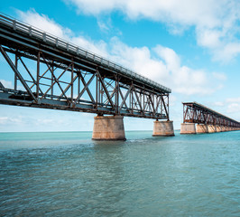
Critical Gap Areas
Lack of comprehensive plan
Lack of SOPs
Lack of ready references
Current plan is largely list of inventory and contacts
Low participation of stakeholders
No ownership in stakeholders and users
Lack of coordinated approach
Plans are rarely used in recent disasters
Absence of model plan

Slide 15

Approach
Analysis of critical gaps
Need to revisit the planning process
Involve all stakeholders
Modify / update the plan

Slide 16
Principles to be Observed During the Process
Inclusiveness
Bottom-up approach
Active participation of all stakeholders at various levels
GO-NGO collaboration, joint planning and action
Focus on vulnerable groups
Sustainability and linkages with development programs

Slide 17

Key Processes and Activities
Identification and analysis of key stakeholders at various levels.
Formation of advisory groups / core groups to guide and support the process.
Stakeholders’ consultations at all levels to get inputs and feedbacks on the process time to time.
Review of existing templates for development of district disaster management plans. Review of existing plans.
Piloting of the model framework at Gram Panchayat / ULB level, Block level and Sub-division levels in district.
Review consultation and piloting exercises conducted at various levels.
Development of draft guideline for development of sub-district disaster management plan.
Development of capacity building materials for key stakeholders involved in the process.
Capacity building workshops at sub-division level on the framework and guideline for DDMP
Forward planning at sub-division level.
Coordination and handholding support to different sub-divisions (including planning at Gram Panchayat level / City and Block level) to complete the process for all GPs, blocks and subdivisions.
Collation of sub-division level plans.
Coordination and collation of departmental plans of various concerned line departments at district levels.

Slide 18
Key Stakeholders
Govt. Line departments
NGOs
Engineers group/association
Doctors group, IMA chapter at district
Women’s organizations
Child focused organizations
Association/group/organization for infants
Association/group/organization for elderly people
Local NGOs, CBOs, youth groups etc.
NCC, NYK, Scout, Guides, NSS, civil defense etc.
Retired officers/ govt. employees
Academic institutions, university, college, schools
PHC, ASHA, ANMs, Anganwadis, PDS and other representatives from such govt. schemes/programs.
PRIs
Traders association
Corporate (CSR)
Religious institutions
Chemists associations

Slide 19
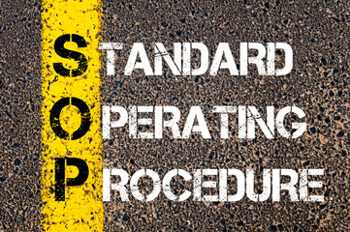
Standard Operating Procedures
The SOPs for each disaster need to be prepared and comes into function as and when a disaster strikes.
Each of the Emergency Support Functionaries has their own SOPs with respect to each disaster.
The sops are divided into three stages:
  Pre- Disaster
  During - Disaster
  Post- Disaster

Slide 20
EOC Information Chart
Incident call received by EOC operator
Give information to Concerned Police station
Inform concerned authority DM/ADM/SDM, DPO,PC & other ESFs
Incident Management as per DDMP + CDMP/VDMP

Slide 21
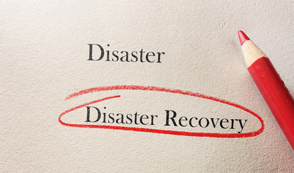
Recovery & Reconstruction Plan
Recovery and Reconstruction Plan should take into account the following components:
Restoration of basic infrastructure
Reconstruction/repair of lifeline buildings/social infrastructure
Reconstruction/repair of damaged buildings
Restoration of livelihoods
Medical Rehabilitation

Slide 22

Linkage with the Developmental Plan
DDMA should regularly involves Civil Defence (CD) & volunteers in all disaster management preparedness and mitigation activities.
The volunteers further pass-on this information to the community wherein they live.
The members of the Self Help Groups are also trained on basic safety measures during disasters.

Slide 23

Business Continuity Planning
Business Continuity Planning is part of Business Continuity Management (BCM), it includes:-
Policies, standards & procedures to ensure continuity
Resumption & recovery of critical business processes
Limiting the impact of the disaster on people, processes and infrastructure (includes IT)
Minimizing the operational, financial, legal, reputational and other material consequences arising from such a disaster

Slide 24

Monitoring and Evaluation
Proper Monitoring and evaluation of the DM Plan.
Post disaster evaluation mechanism.
Regularly updating process.
Periodic uploading of updated plan and resources on India Disaster Knowledge Network (IDKN).
Conducting periodic mock drills.
Checking whether all the personnel involved in execution of DDMP are trained and updated on the latest skills necessary in line with the updated plans.

Slide 25
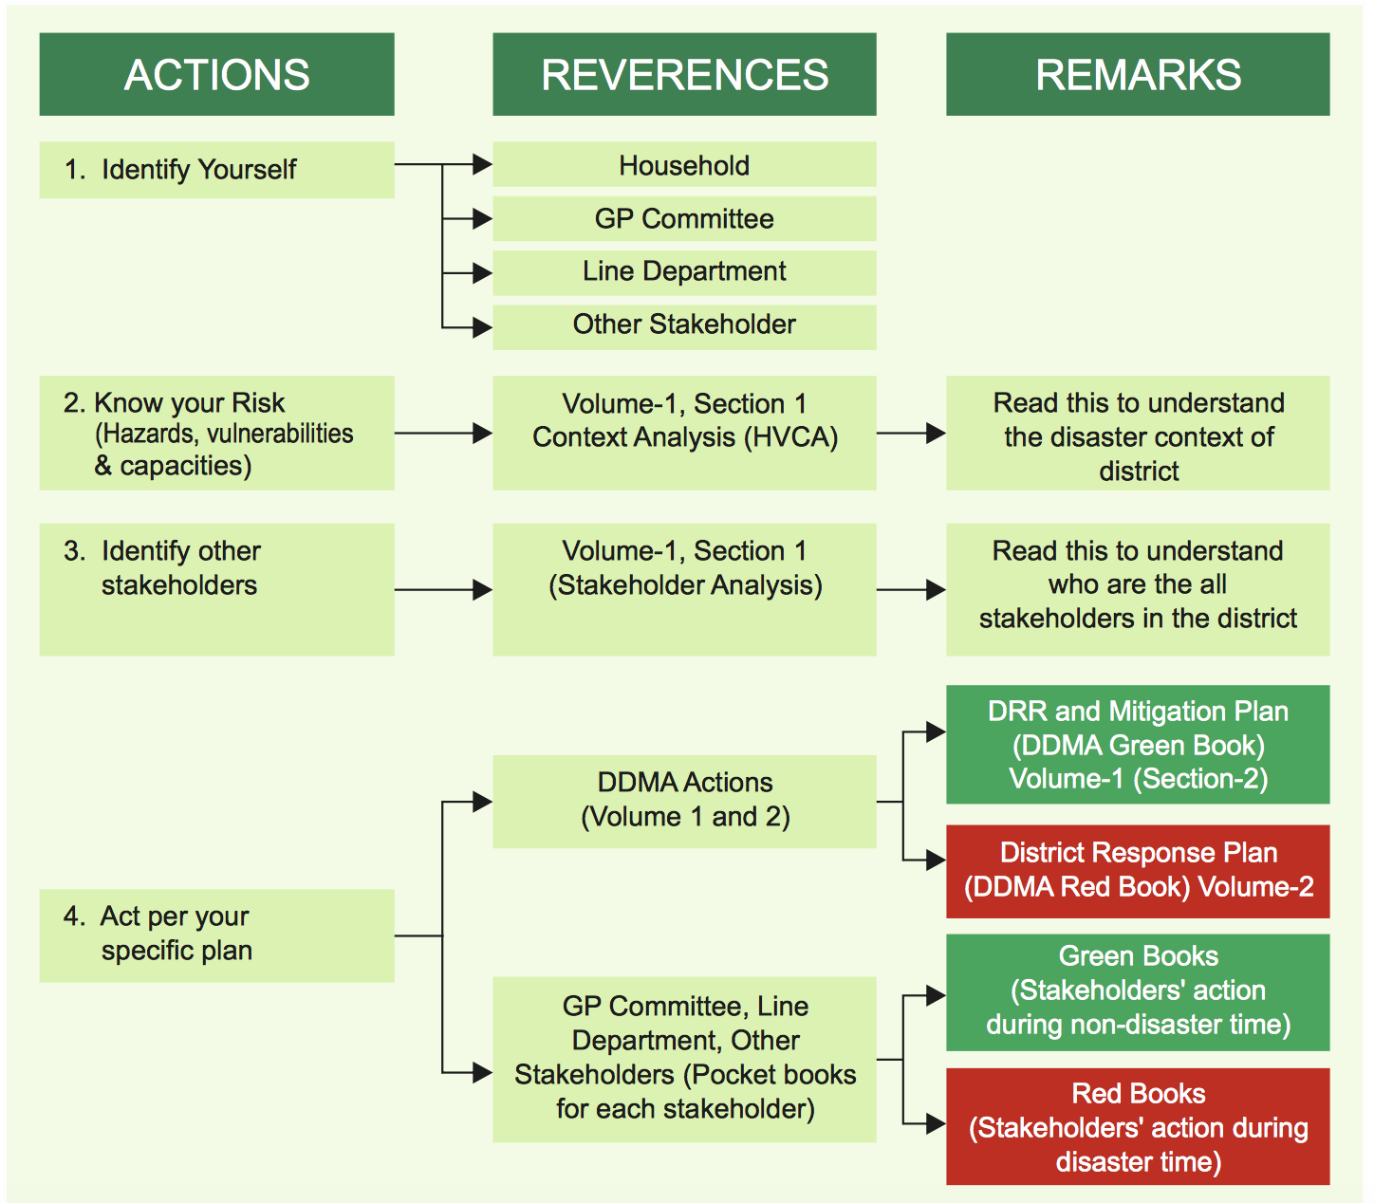
Reference
Model DDMP-Madhubani. www.ndma.gov.in

Slide 26
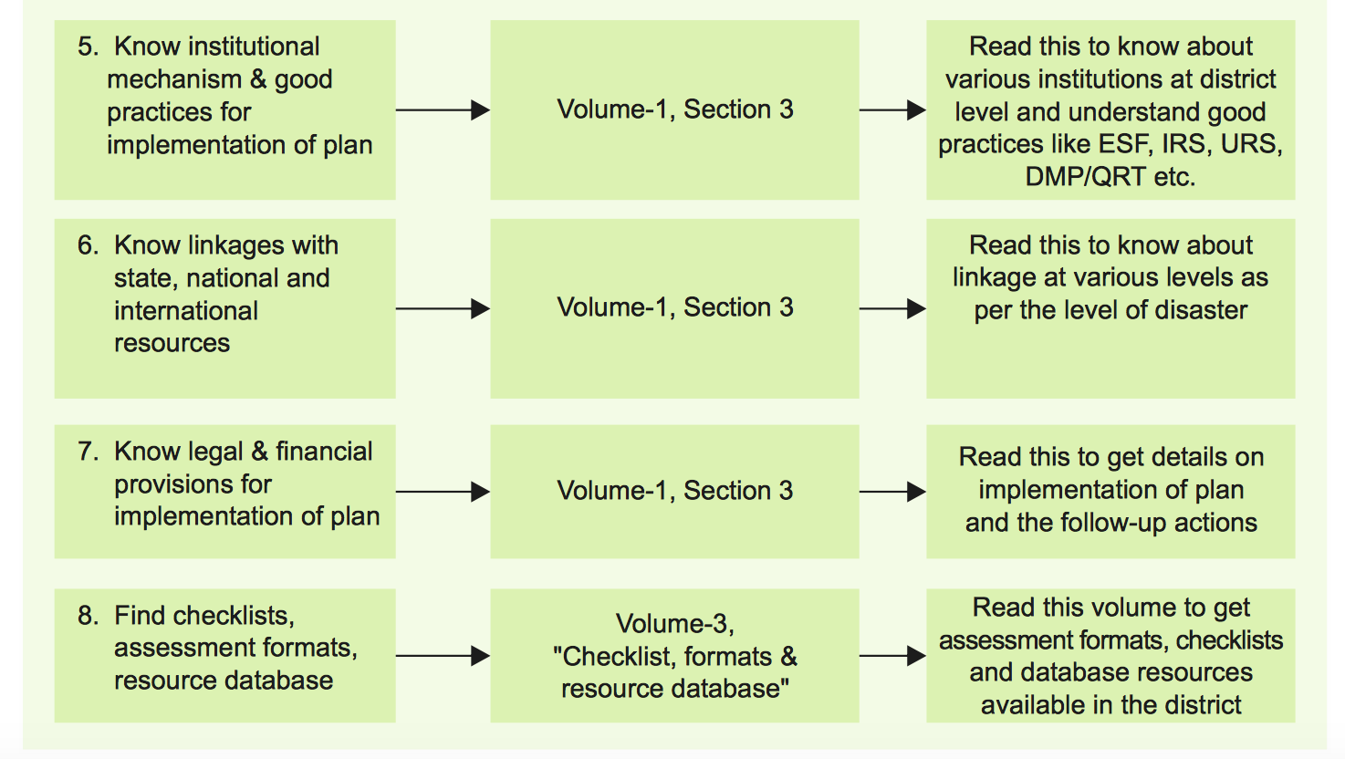
Reference
Model DDMP-Madhubani www.ndma.gov.in

Slide 27
FURTHER READINGS
https://ndma.gov.in/images/policyplan/DDMPExplanatory note
https://nidm.gov.in/PDF/manuals/DDMP_guidelines-Template.pdf
https://kadapa.ap.gov.in/district-disaster-management-plan-2

Slide 28


