Slide 1
BASICS OF DISASTER RISK REDUCTION
Hazard, Vulnerability, Capacity, Risk Assessment
Dr. Vinod K. Sharma
Sr Professor, Indian Institute of Public Administration
Vice Chairman, Sikkim State Disaster Management Authority

Slide 2
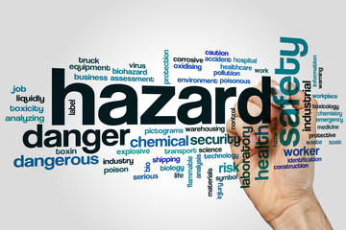
Hazard
Hazard is an event or occurrence that has the potential for causing injuries to life and damaging the property & environment and potential for causing injuries

Slide 3
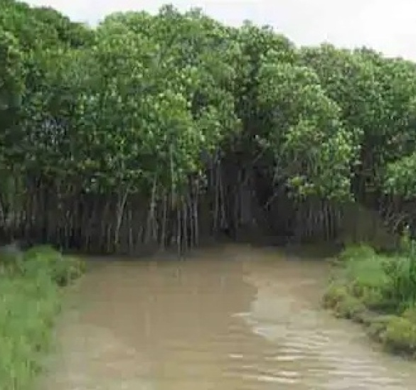
CYCLONE- AMPHAN 2020
Hazard or Disaster ?

Slide 4
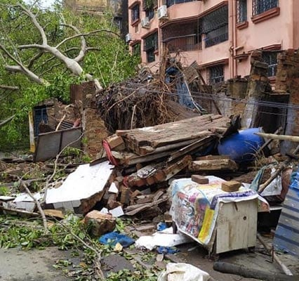
In West Bengal Amphan was a DISASTER

Slide 5
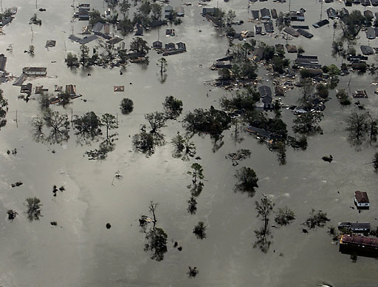
VULNERABILITY
Vulnerability is a set of conditions that reduces people’s ability to prepare for, withstand or respond to a hazard

Slide 6
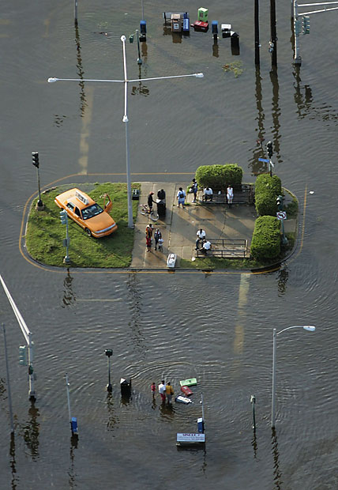
RISK
Risk is the measure of expected losses (deaths, injuries, property damage, crop loss, etc.) due to a hazard on account of nature of construction and proximate to hazardous area.

Slide 7
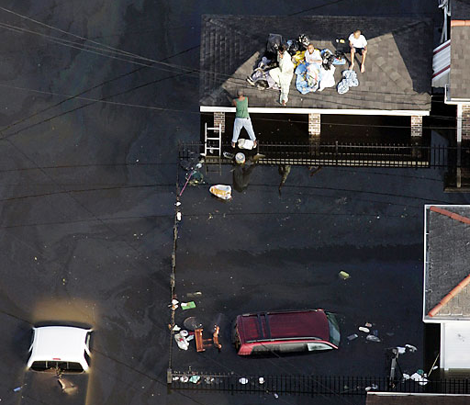
Disaster
MISHAP arising from natural or man made causes
Result in a serious disruption of the functioning of a society,
Cause widespread human, material, or environmental losses
Exceed the ability of the affected society to cope using only its own resources.

Slide 8
Disasters
Disaster
VULNERABILITY
Hazards
Underlying causes
Trigger Events
Earthquake
Tsunami
Flood
Cyclones
Drought
Landslide
War
Pollution
Insufficient
Coping
Capacities
Limited access to resources
Disabilities
Gender & Age
Poverty
Dynamic Pressure
Lack of institution, training & education
Population Expansion
Uncontrolled development
Environmental degradation

Slide 9
THE DISASTER CRUNCH MODEL
VULNERABILITY
HAZARD
Disaster
1
Underlying causes
2
Dynamic
pressures
3
Unsafe
conditions
Trigger events
Earthquake
High winds
Flooding
Volcanic eruption
Landslide
Drought
War, civil conflict
Technological accident
Poverty
Limited access to
- power structures
- resources
Ideologies
Economic systems
General
pre-conditioning
factors
Lack of
- education
- training
- appropriate skills
- local investment
- local markets
- press freedom
Macro-forces
- population expansion
- environmental
degradation
Fragile physical environment
- dangerous locations
- dangerous buildings and
infrastructure
Fragile local economy
- livelihoods at risk
- low income levels
Public actions

Slide 10
Factors Enhancing Vulnerability
Poverty
Population growth
Poor Development Practices
Rapid urbanization
Lack of Awareness
Unplanned development
Poor governance

Slide 11
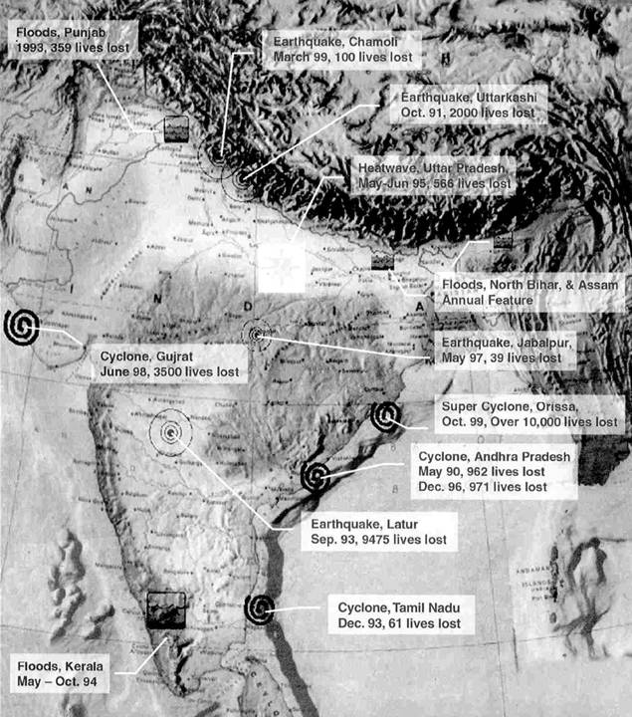
Major Natural Disasters :
1990 - 2020
Earthquake, J&K
Oct.8, 2005
Earthquakes
Uttarkashi 1991
Latur (Killari) 1993
Jabalpur 1997
Chamoli 1999
Kutchchh, Gujarat 2001
J&K 2005
Sikkim. 2011
Cyclones
East & West Godavari 1992&
dist.of Andhra Pradesh 1996
Kutchchh, Gujarat 1998
Orissa 1999
Odissa & W.B -AMPHAN 2020.
Floods
Punjab 1993
Kerala 1994
Punjab & Haryana 1996
Mumbai 2005
Srinagar 2014
Tsunami
Andaman & Nicobar
Islands & coastal areas 2004
Earthquake, Gujarat
January 26, 2001
Tsunami
Dec.26, 2004

Slide 12
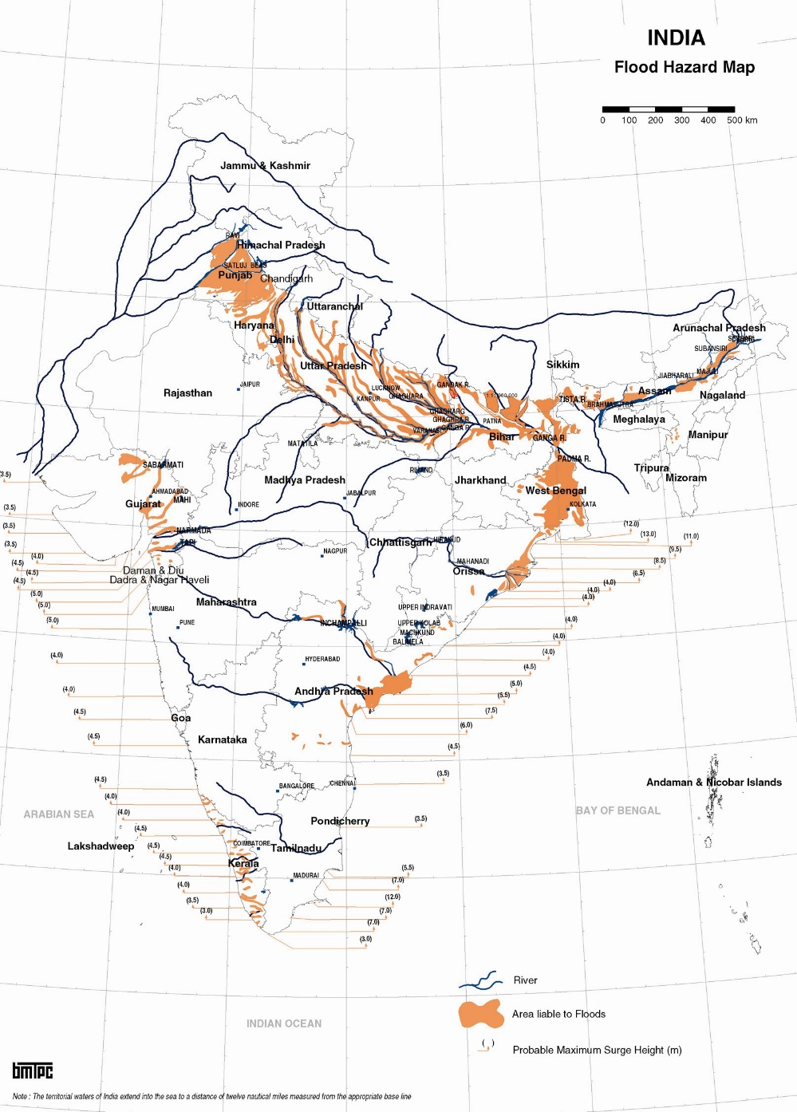
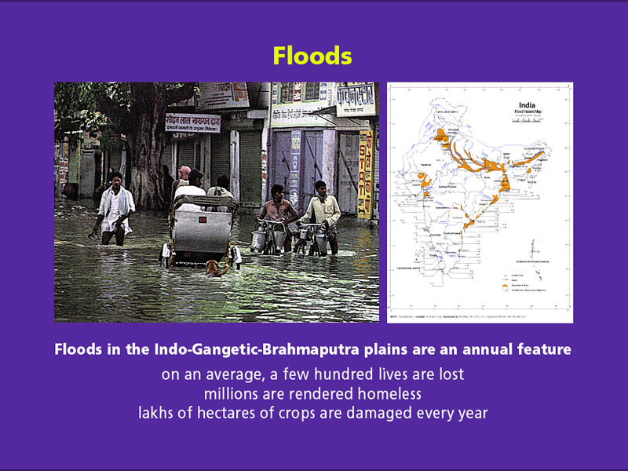
Floods
Floods in the Indo-Gangetic-Brahmaputra plains are an annual feature
On an average, a few hundred lives are lost
Millions are rendered homeless
Lakhs of hectares of crops are damaged every year

Slide 13
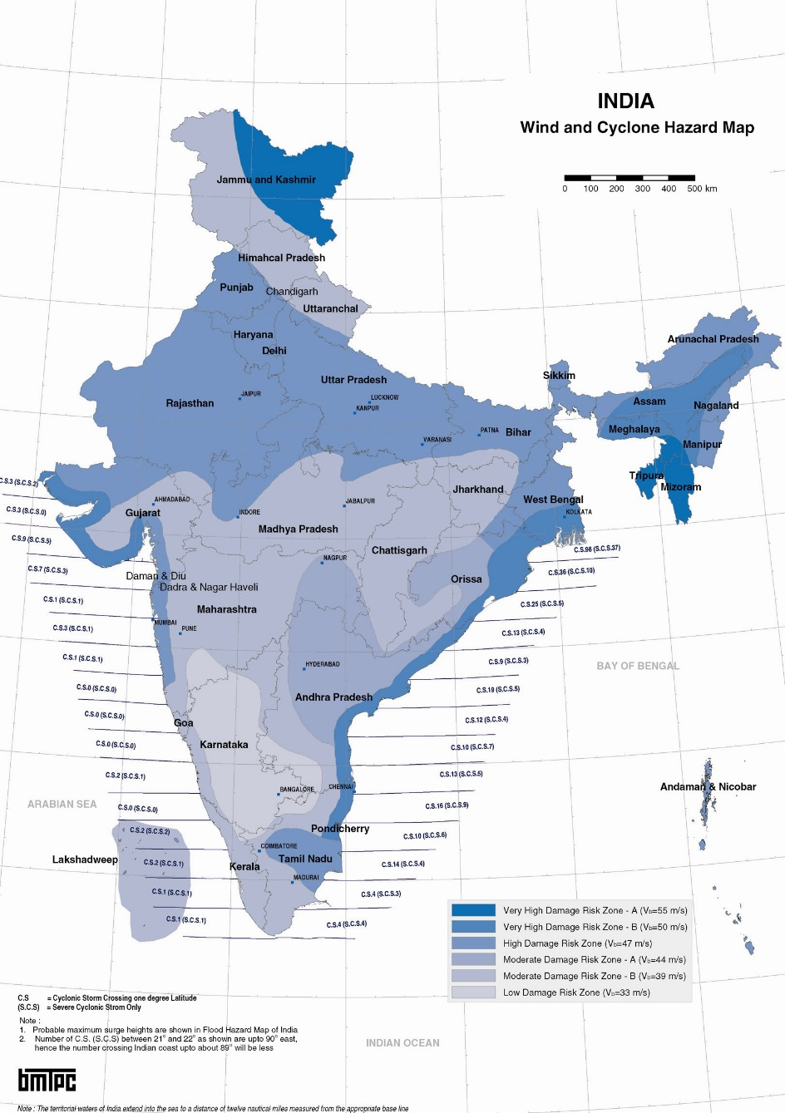
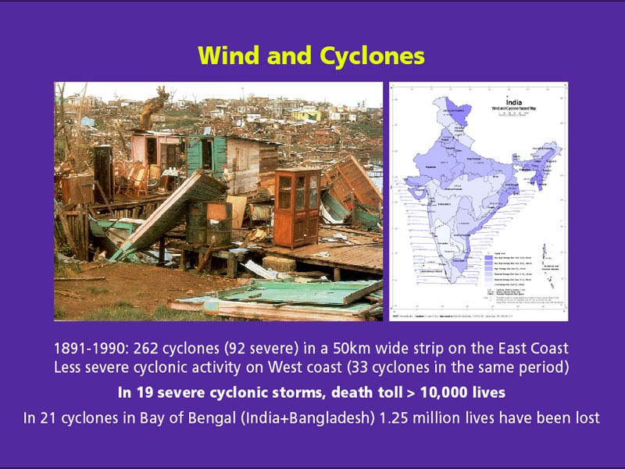
Wind and Cyclones
During the Period 1877-2005 in a 50 km wide strip following cyclonic activity have taken place:
283 cyclones (106 severe) on the East Coast
35 cyclones (19 severe) on West Coast
In the 19 severe cyclonic storms, death toll > 10,000 lives
In 21 cyclones in Bay of Bengal
(India and Bangladesh) 1.25 million lives have been lost

Slide 14
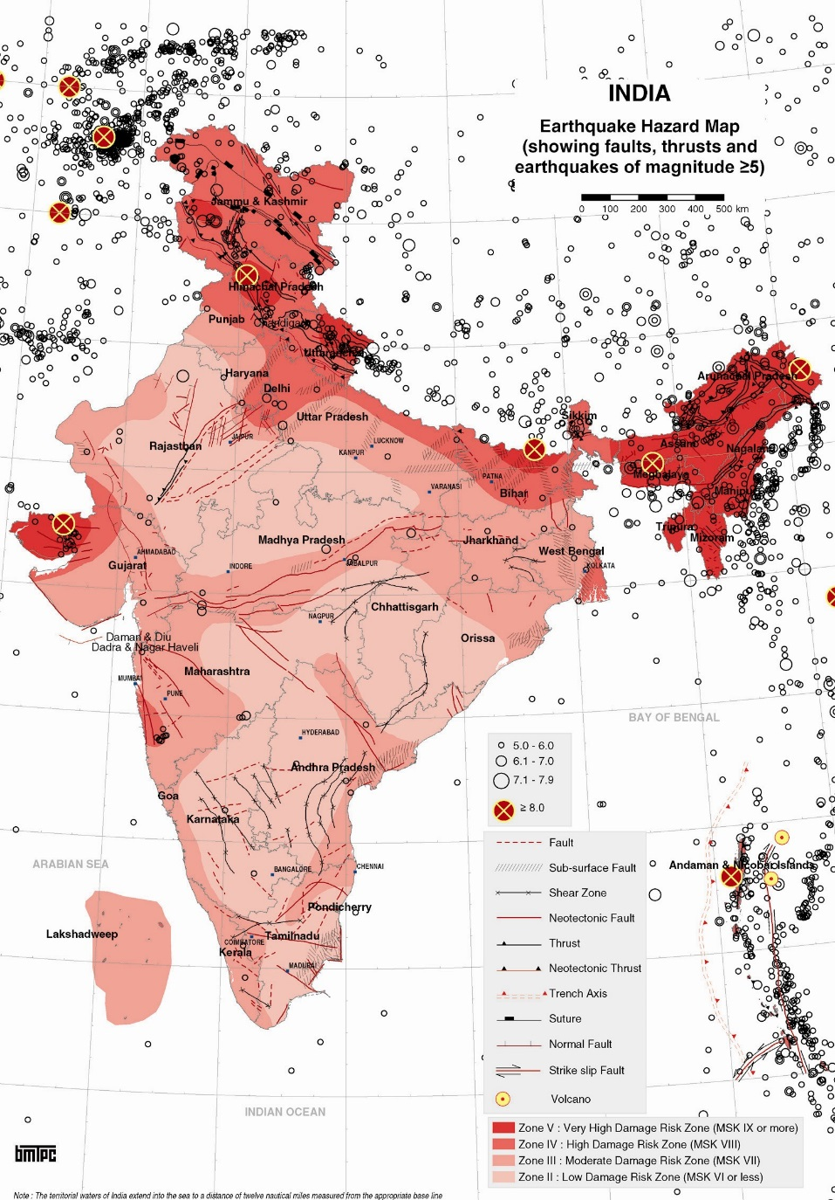
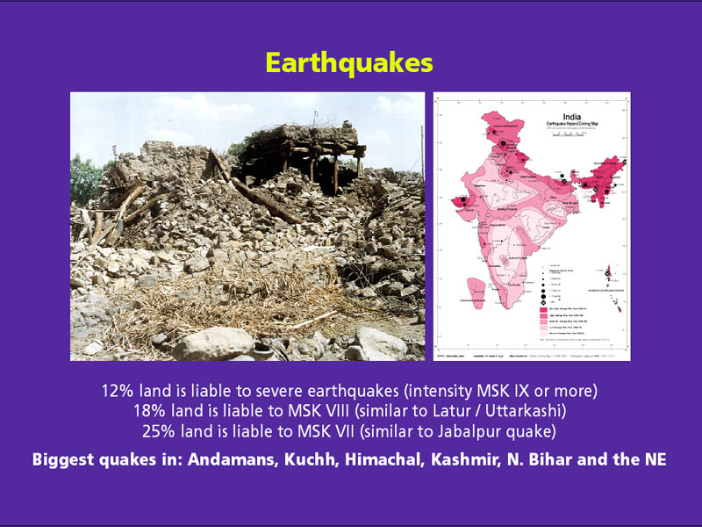
Earthquakes
10.79% land is liable to severe earthquakes (intensity MSK IX or more)
17.49% land is liable to MSK VIII (similar to Latur/Uttarkashi)
30.79% land is liable to MSK VII (similar to Jabalpur earthquake)
Biggest quakes in Andamans, Kuchh, Himachal, Kashmir, Bihar and the North Eastern States)

Slide 15
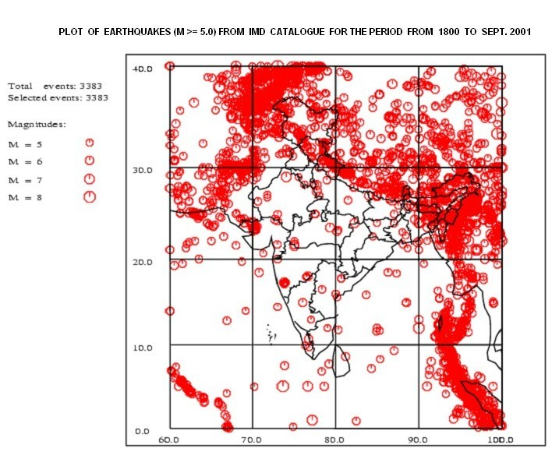
Earthquakes in last 200 years

Slide 16
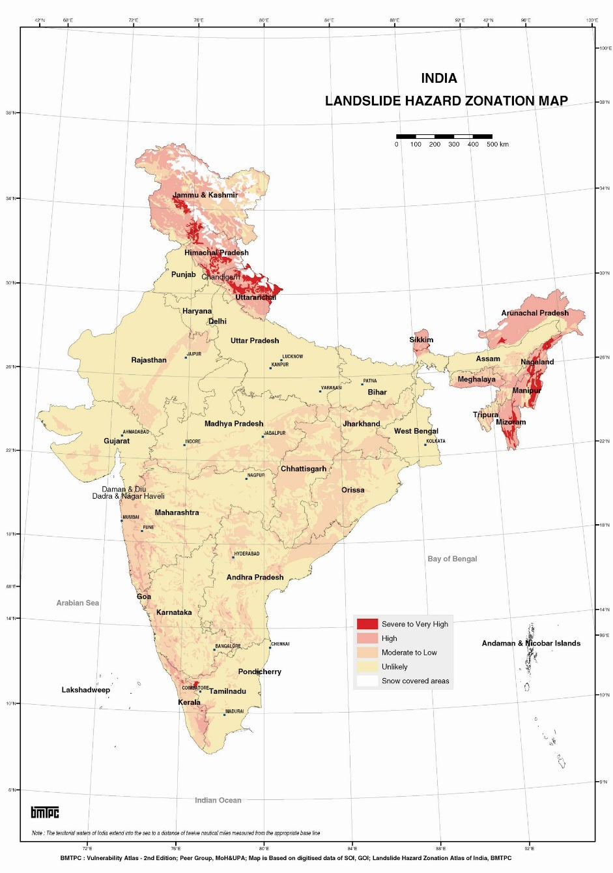
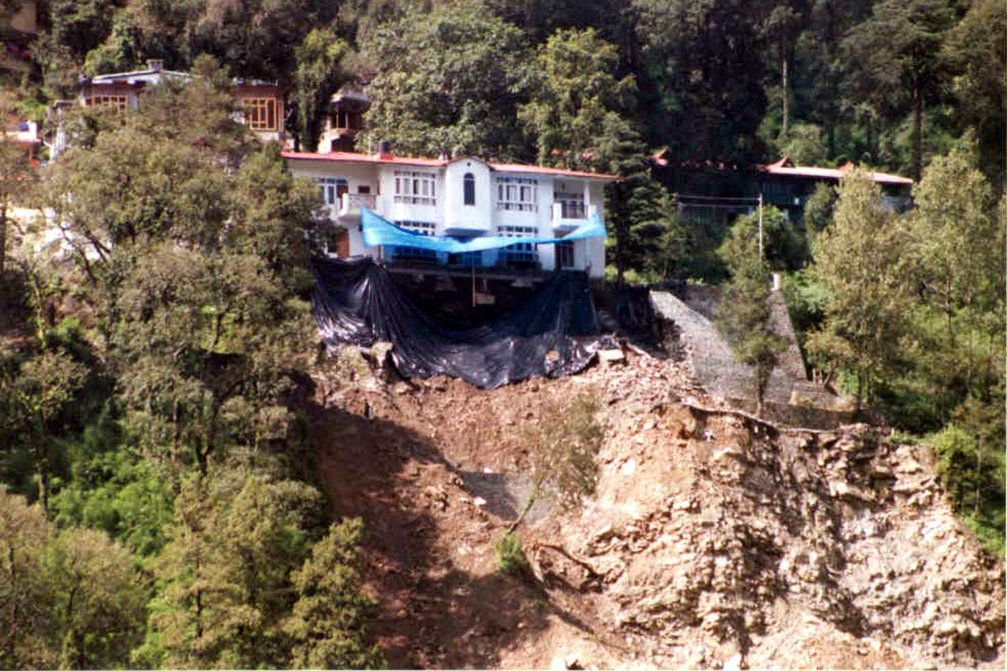
Landslides
The Indian Subcontinent with diverse physiographic, seismotectonic and climatologic conditions is subjected to varying degree of landslide hazards.
The himalayas including Northeastern mountain regions being the worst affected followed by a section of the Western Ghats, Eastern Ghats and Vindhyas.
Accounts for considerable loss of life and damage to communication routes, human settlements, agricultural fields and forest lands.

Slide 17
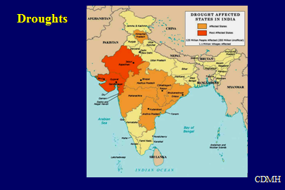

Slide 18
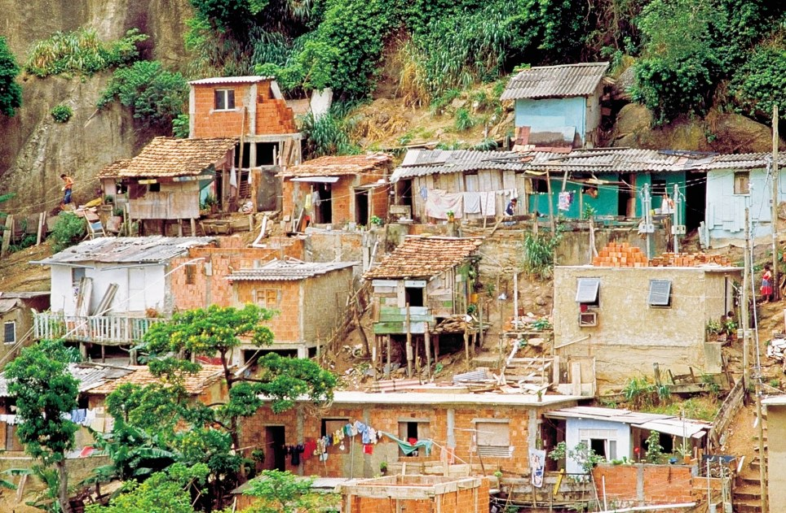

Slide 19
Vulnerability
Capacity to Cope
High
Low
Exposure to Hazard
Low
Vulnerability
High
Vulnerability
High
Very Low
Vulnerability
Low
Vulnerability
Low

Slide 20
DISASTER MANAGEMENT CYCLE
Disaster impact
Pre-disaster risk reduction phase
Disaster
Preparedness
Relief
Mitigation
Rehabilitation
Reconstruction
Post-disaster recovery phase

Slide 21
Types of Disasters
Man-made accidents
Geological
Water & Climate-related
Chemical
Biological

Slide 22
Water & Climate Related Disasters
Storm Surges (Ocean)
Drought
Avalanches
Hurricanes
Hailstorms
Cyclones & Tornadoes
Floods

Slide 23
GEOLOGICAL DISASTERS
Earthquakes
Landslides & Mudflows
Tsunami

Slide 24
Aviation Accidents
Ocean Oil Spills
Rail Accidents
Mine Flooding
Road Accidents
Man-made Disasters
Boat Capsizing
Mine Collapse
Panic Exodus
Forest & Urban Fires
Terrorist activities

Slide 25
Biological Disasters
Bacteria Related
Fungal
Other Pathogens
Virus Related

Slide 26
Chemical Disasters
Toxic Gases & Nuclear Radiation
Food
Contamination
Soil
Contamination & Pesticides
Water
Contamination

Slide 27

AIM OF DISASTER MANAGEMENT
Reduce (avoid, if possible) the potential losses from hazards
Assure prompt and appropriate assistance to victims when necessary
Achieve rapid and durable recovery

Slide 28
LINKING DISASTERS AND DEVELOPMENT
The cause and effect relationship between disasters and development has been ignored
Disasters were seen in the context of emergency response
Development programs were not assessed in the context of disasters
Communities under disaster stress were seen as too turbulent for development initiatives

Slide 29
Disasters versus Development
DEVELOPMENT REALM
Development
can increase
vulnerability
Development
can reduce
vulnerability
NEGATIVE REALM
POSITIVE REALM
Disaster can
set back
development
Disaster
can provide
development
opportunities
DISASTER REALM

Slide 30
Further Readings
www.un.org/sustainabledevelopment/sustainable-development-goals/
https://www.unisdr.org/who-we-are/what-is-drr
The Inter-Agency Library on Disaster Reduction for the ISDR

Slide 31


