Slide 1


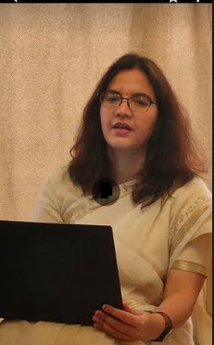
Welcome !
Indian Institute of Public Administration , New Delhi (IIPA)
Cyber Security Strategy
Dr. Surabhi Pandey
Subject Expert

Slide 2



Session 10: New emerging security threats and Global Cyber Security Index
Session 10.1
Emerging Cyber Threats
Discussion on parameters of Global Cyber Security Index (GCSI)
Artificial Intelligence opportunities and challenges.
IoT Threats and use of Block chain in crypto currency
No. of Sessions :1
Activities
Case Discussion
Quiz & FAQ

Slide 3








Learning Objectives
To understand fundamentals of cyber safety
Current Vulnerabilities
Security goals,
Information ethics ,
Functionality and Usability .

Slide 4

INSTRUCTIONS
Course Prerequisite:
Basic knowledge of
computer and a mindset
to ensure safety and
security of organizational data.
Pedagogy:
Mix pedagogy of Blended Interactive sessions , case discussion , panel discussion and lab sessions are planned
Course duration: 10 sessions
Credit : 0.5
Specific modules : 5
Mode of evaluation: Assignment and Practical Lab

Slide 5

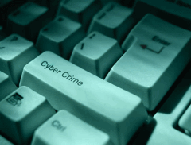

Agenda
Emerging Threats
Artificial Intelligence opportunities and challenges.
IoT Threats
Block chain in crypto currency
Global Cyber Security Index (GCSI)

Slide 6
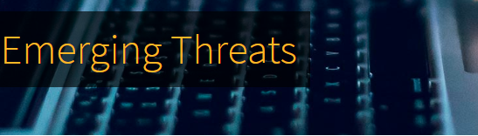
How serious of a problem is cybercrime?
A study by Cyber security Ventures predicts these crimes will cost the world $6 trillion a year by 2021.

Slide 7
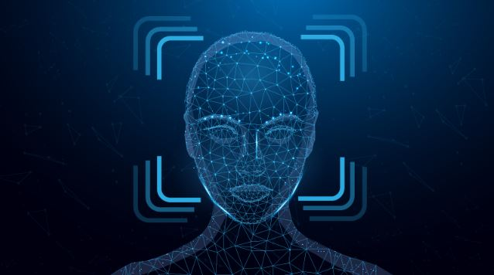
Emerging Cyber Security Threats for 2020
Deep fakes : “Media that is doctored using artificial intelligence-based technology to produce or alter video/image/audio content so that it presents something that didn’t, in fact, occur.”

Slide 8
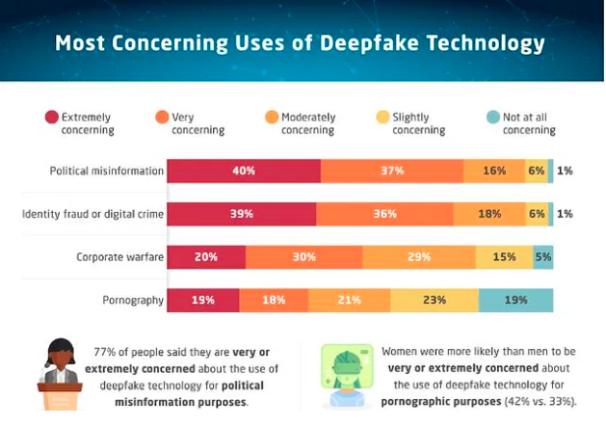
Source :https://www.ameinfo.com/industry/media/proof-threshold-exploring-how-americans-perceive-deepfakes

Slide 9
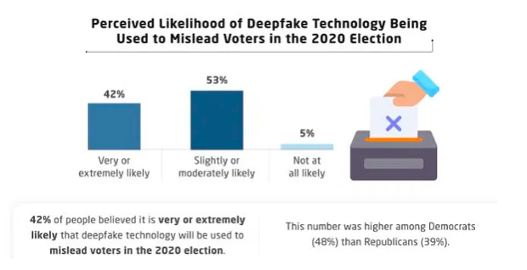
Source :https://www.ameinfo.com/industry/media/proof-threshold-exploring-how-americans-perceive-deepfakes

Slide 10
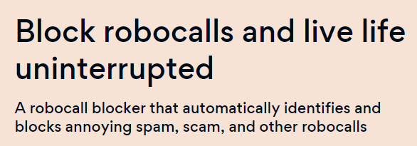


Slide 11
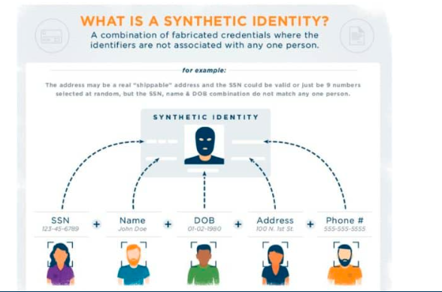
Emerging Threat : Synthetic Identity fraud
A synthetic identity is a combination of fabricated credentials where the implied identity is not associated with a real person. Fraudsters may create synthetic identities using potentially valid social security numbers (SSNs) with accompanying false personally identifiable information (PII).

Slide 12
Emerging Threats :Disinformation in social media
Social disinformation is often spread through social media such as whatsapp ,Face book and Twitter. “Fake news” became a hot topic.
Remember that the creators of disinformation purposely make content that is designed to trigger an emotional response
Is this the original account, article, or piece of content?
Who shared this or created it?
When was this created?
What account is sharing this? When was the account created? Do they share things from all over the world at all times during the day and night? Could this be a bot?
Why was this shared?

Slide 13
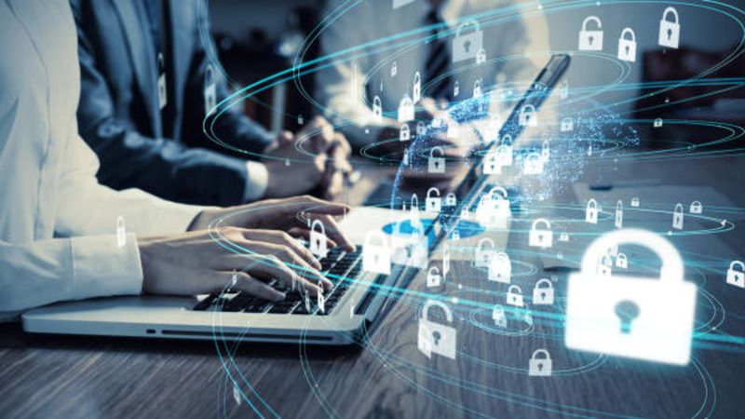
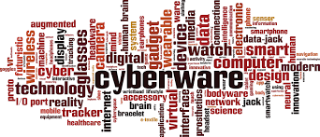
Emerging Threats : Cloud jacking
Cloud jacking is a form of cyber attack in which hackers infiltrate the programs and systems of businesses, stored in the cloud, and use these resources to mine for crypto currency.

Slide 14
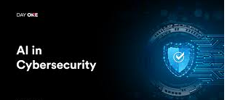
Emerging Threats AI-powered cyber attacks
Using artificial intelligence, hackers are able to create programs that mimic known human behaviors. These hackers can then use these programs to trick people into giving up their personal or financial information.

Slide 15
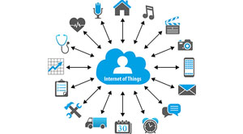
IoT Threats
Businesses need to be aware of the different IoT security threats and implement an all-round cyber security strategy to protect themselves.
The introduction of IoT has evolved multiple industries such as agriculture, utilities, manufacturing, Healthcare and retail. IoT solutions have helped improve productivity and efficiency in factories and workplaces.
IoT security threats such as DDoS, ransom ware, and social engineering can be used to steal critical data from people as well as organizations.

Slide 16
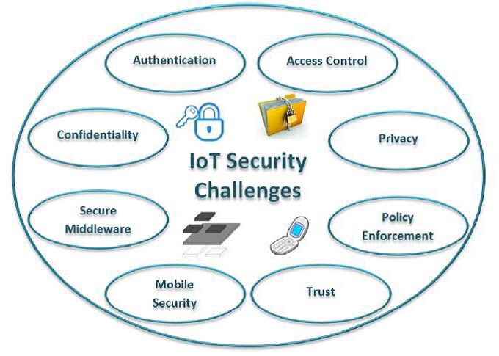

Slide 17
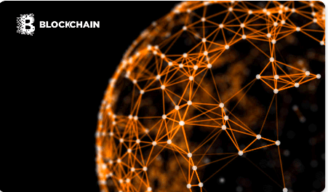
Block chain: A Boon for Cyber Security
Block chains are distributed networks that have millions of users all over the world. Every user can add information to the block chain and all data is secured through cryptography.
Bit coin is booming, but the block chain is evolving. Bit coin is always a point of reference for block chain technology. But block chain is much more than just Bit coin.
In terms of security, block chain and its public ledger have potential solutions for Big Data processing, end point protection software, financial tools and supply chain management software.

Slide 18
Block Chain: Case lets
1. The US Ministry of Internal Affairs and Communications implemented a block chain based system for processing government tenders in March 2018..
2. The US based Defense Advanced Research Projects Agency (DARPA) is also funding and backing the use of block chains to help secure highly sensitive data pertaining to everything from nuclear weapons to military satellites.
3. The HYPR Corp is a New York based company that provides enterprises with decentralized authentication solutions, which enable consumers and employees to securely and seamlessly access mobile, Web and Internet of Things (IoT) applications. It uses block chain technology to decentralize credentials and biometric data to facilitate risk based authentication.

Slide 19
A few ways in which block chain can aid in cyber security are given below.
-Protected edge computing with authentication
-Advanced confidentiality and data integrity.
-Secure private messaging.
-Intact Domain Name System (DNS)
-Diminished DDoS attacks
High-level block chains are known for their excellent security features and can limit the damage caused to infrastructure by cyber intrusion. Block chain DNA cyber defense security systems will provide a new state-of-art cyber defense system.

Slide 20
Global Cyber Security Index (GCSI)
The Global Cyber security Index (GCI) is a trusted reference that measures the commitment of countries to cyber security at a global level – to raise awareness of the importance and different dimensions of the issue

Slide 21
Global Cyber Security Index (GCSI)
Method for GCI v4: For each of the pillars –
(i) legal,
(ii) technical,
(iii) organizational,
(iv) capacity building, and
(v) cooperation – country commitment was assessed through a question-based online survey, which further allowed for the collection of supporting evidence. Through consultation with a group of experts, these questions were weighted in order to arrive at an overall GCI score.

Slide 22
Quiz time ?
What is Bit Coin ?
1.Cryptography Technique
2.Virtual Money
3.Cyrptocurrency
4. Block chain enabled technology

Slide 23
Quiz time ?
GCSI Index stands for …….
1. Global Computer safety Index
2. Global cyber Secure index
3. Global Cyber Safety index
4. None of These

Slide 24

Cyber World !!
The Invisible criminals are more Dangerous than the visible one”
THANKS!
Any questions?
You can find me at:
dr.pandeysurabhi@gmail.com

