Slide 1



Welcome !
Indian Institute of Public Administration , New Delhi (IIPA)
Cyber Security Strategy
Dr. Surabhi Pandey
Subject Expert

Slide 2



National and International issues in Cyber Security Domain
Session 8.1
Individual Privacy v/s National Security V/s International Threats
Role of non state actors in cyber warfare
Case Study
No. of Sessions :1
Activities
Case Discussion
Quiz & FAQ

Slide 3








Learning Objectives
To understand fundamentals of cyber safety
Current Vulnerabilities
Security goals,
Information ethics ,
Functionality and Usability .

Slide 4

INSTRUCTIONS
Course Prerequisite:
Basic knowledge of
computer and a mindset
to ensure safety and
security of organizational data.
Pedagogy:
Mix pedagogy of Blended Interactive sessions , case discussion , panel discussion and lab sessions are planned
Course duration: 10 sessions
Credit : 0.5
Specific modules : 5
Mode of evaluation: Assignment and Practical Lab

Slide 5

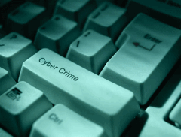
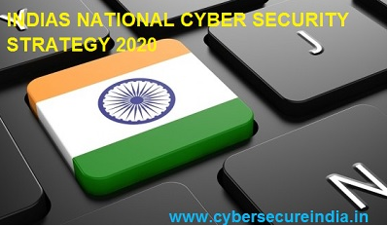
Strategies under National Cyber Policy,
Need for NCSS 2020 India was one of the first few countries to propound a futuristic National Cyber Security Policy 2013(NCSP 2013). Since the adoption of NCSP 2013, the technologies, platforms, threats, services and aspirations have changed tremendously.
The transformational Digital India push as well as Industry 4.0 is required to be supported by a robust cyberspace. However, Cyber intrusions and attacks have increased in scope and sophistication targeting sensitive personal and business data, and critical information infrastructure, with impact on national economy and security.
Source :https://ncss2020.nic.in/

Slide 6
NATIONAL CYBER SECURITY STRATEGY 2020 (NCSS 2020)
-Present cyber threat landscape poses significant challenges due to rapid technological developments such as Cloud Computing, Artificial Intelligence, internet of Things, 5G, etc.
-New challenges include data protection/privacy, law enforcement in evolving cyberspace, access to data stored overseas, misuse of social media platforms, international cooperation on cybercrime & cyber terrorism, and so on.
-Threats from organised cybercriminal groups, technological cold wars, and increasing state sponsored cyber-attacks have also emerged.

Slide 7
NATIONAL CYBER SECURITY STRATEGY 2020 (NCSS 2020)
The Indian Government under the aegis of National Security Council Secretariat through a well-represented Task Force is in the process of formulating the National Cyber Security Strategy 2020 (NCSS 2020) to cater for a time horizon of five years (2020-25).

Slide 8
NATIONAL CYBER SECURITY STRATEGY 2020 (NCSS 2020)
Proposed vision is to ensure a safe, secure, trusted, resilient and vibrant cyber space for our Nation’s prosperity.
The Indian government is working on a new cybersecurity policy that would address all the concerns related to cyber threats and data vulnerabilities happening across government departments and the private sector in India.

Slide 9
NATIONAL CYBER SECURITY STRATEGY 2020 (NCSS 2020)
Pillars of Strategy
various facets of cyber security under the following pillars: -
a. Secure (The National Cyberspace)
b.Strengthen (Structures, People, Processes, Capabilities)
c.Synergies (Resources including Cooperation and Collaboration)

Slide 10
Some Facts :
According to the Data Security Council of India, Indian is the second most cyber-attacked country in the world after the US. In the recent past, there has been a significant increase in cyber threats, and if the situation is not addressed, this could impact the GDP of the country, massively.
he average cost for a data breach in India has risen up to 7.9% since 2017, with the average cost per breached record of INR 4,552 ($64). In fact, the increase in cyber-attacks has resulted in more and more companies opting for cyber insurance policies to mitigate cyber vulnerability risk, where 350 cyber insurance policies have been sold in India till 2018, which is a 40% increase from that in 2017.

Slide 11

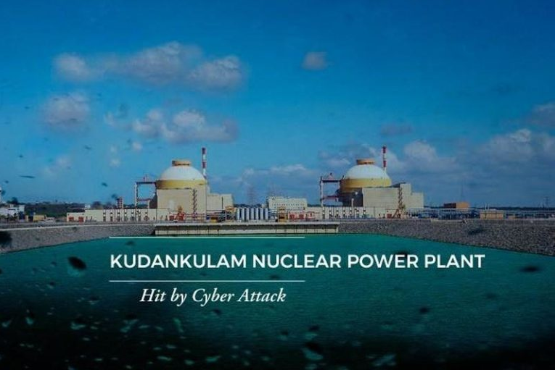
Case Study:
India’s new State or Non-State Enemy after the Cyber Attack on Kudankulam Nuclear Power Plant
https://cybersecureindia.in/indias-new-state-or-non-state-enemy-after-the-cyber-attack-on-kudankulam-nuclear-power-plant-lazarus-group/

Slide 12

Cyber World !!
The Invisible criminals are more Dangerous than the visible one”
THANKS!
Any questions?
You can find me at:
dr.pandeysurabhi@gmail.com

