Slide 1
Governance, Risk Management, and Compliance
(GRC)

Slide 2
Governance, Risk Management, and Compliance of every organization is different and varies based on the type of organization.
It depends on organization mission, size, industry, culture, and legal regulations.

Slide 3
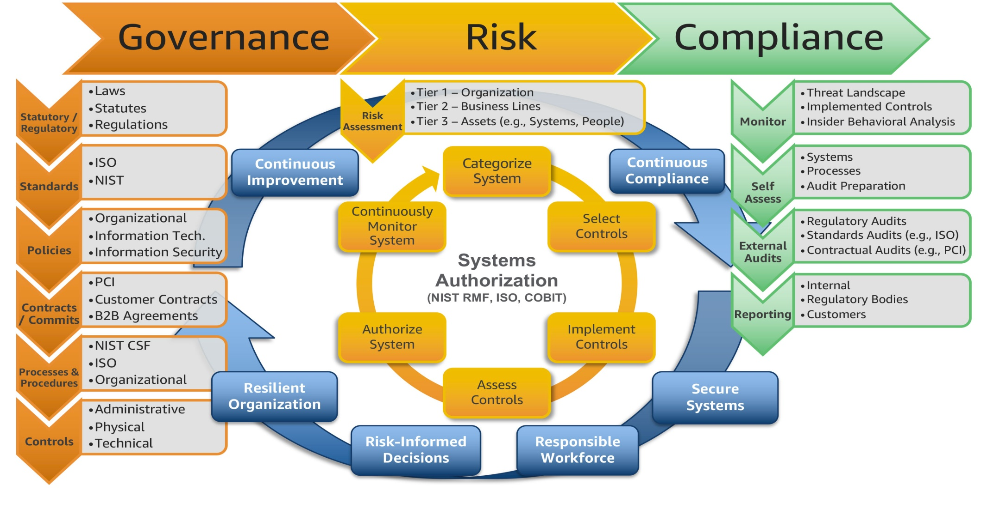

Slide 4
Responsibility of GRC
The ultimate responsibility of the GRC program is to protect organization’s assets and operations IT, including their infrastructure and information.

Slide 5
GRC-Governance
The board of directors and senior management of an organization are responsible for Governance.
WHY GOVERNANCE?
Provides strategic direction
Ensures that the objectives are achieved
Ascertains whether risk is being managed appropriately
Verifies that the organization's resources are being used responsibly

Slide 6

GRC-Risk Management
It is the process by which the organization manages risks to acceptable levels. These risks may include investment risk, physical risk, and cyber risk.

Slide 7

GRC-Compliance
It is the act of adhering to mandated requirements defined by laws and regulations.

Slide 8
Cybersecurity Roles
The success of a cybersecurity role is ultimately the responsibility of the board of directors.

Slide 9

Board of Directors in cybersecurity

Slide 10
Board of Directors
Security Management
Executive Committee
Cybersecurity Practitioners

Slide 11
Approaches to Cybersecurity
Compliance based security
Risk based security
Ad-hoc Approach

