Slide 1


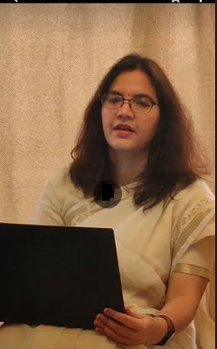
Welcome !
Indian Institute of Public Administration , New Delhi (IIPA)
Cyber Security Strategy
Dr. Surabhi Pandey
Subject Expert

Slide 2



Session 6: Social Media Security and Digital Footprints
Session 6.1
Safety of Social Media Apps/ Platforms
Digital Footprint and Safety
No. of Sessions :1
Activities
Case Discussion
Quiz & FAQ

Slide 3








Learning Objectives
To understand fundamentals of cyber safety
Current Vulnerabilities
Security goals,
Information ethics ,
Functionality and Usability .

Slide 4

INSTRUCTIONS
Course Prerequisite:
Basic knowledge of
computer and a mindset
to ensure safety and
security of organizational data.
Pedagogy:
Mix pedagogy of Blended Interactive sessions , case discussion , panel discussion and lab sessions are planned
Course duration: 10 sessions
Credit : 0.5
Specific modules : 5
Mode of evaluation: Assignment and Practical Lab

Slide 5

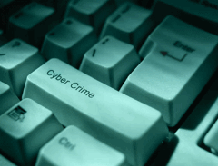

Agenda
Social Media Safety
Safety Tips .
Cyber bullying
Digital Footprint
Steps to Reduce Your Digital Footprint

Slide 6


Slide 7
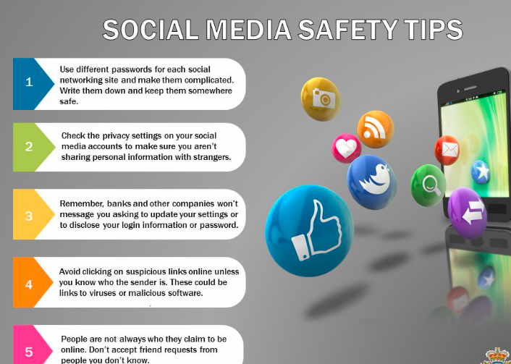


Slide 8

-Use a strong password.
-Use a different password for each of your social media accounts.
-Set up your security answers.
-If you have social media apps on your phone, be sure to password --protect your device.
-Be selective with friend requests
-Click links with caution.
-Be careful about what you share.
-Become familiar with the privacy policies of the social media channels
-Protect your computer by installing antivirus software to safeguard. Also ensure that your browser, operating system, and software are kept up to date.
-Remember to log off when you’re done.

Slide 9
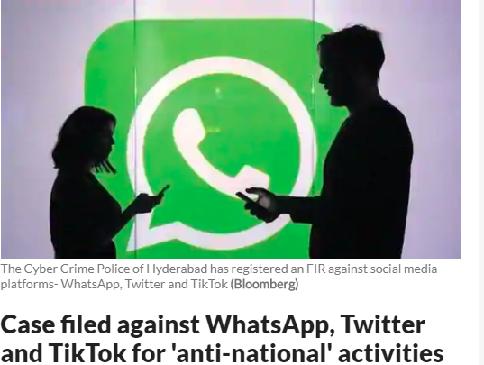
Social Media Case study
https://www.livemint.com/news/india/case-filed-against-whatsapp-twitter-and-tiktok-for-anti-national-act-11582826367113.html

Slide 10
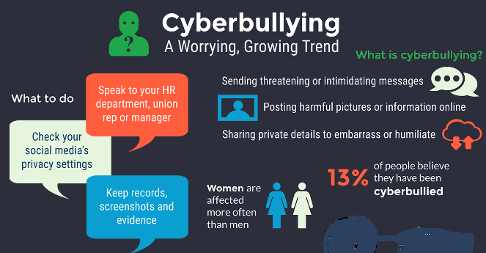

Slide 11
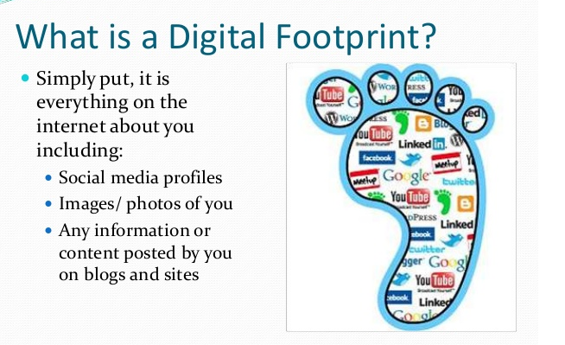

Slide 12
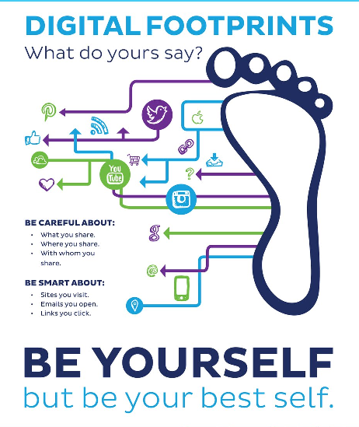

Slide 13

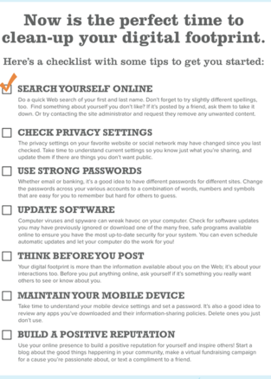

Slide 14
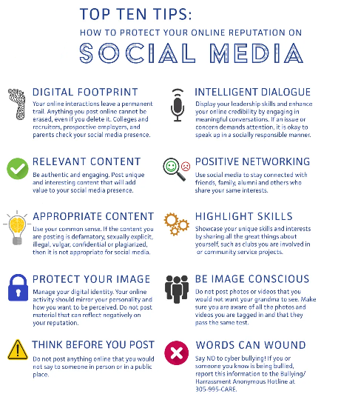

Slide 15
Steps to Reduce Your Digital Footprint
.
Delete or deactivate old accounts
Remove yourself from data collection sites
Don’t post personal information online
Get rid of old email accounts
Check your privacy settings
Unsubscribe from mailing lists
Use stealth mode
Think before posting
Use a VPN

Slide 16
Quiz time ?
Which online tools you use to help craft a digital footprint ?
  A. Twitter
  B. Personal web site
  C. Linked In
  D. All of these answers are correct.

Slide 17
Quiz time ?
Your digital footprint ?
  A. Isn't as important as what the people who know you in real life think.
  B. Something you should be aware of and make positive efforts to control.
  C. Doesn't matter, because the Internet changes too often for anything to stick for a long time.
  D. Not too important, because everybody's got something embarrassing online by now.

Slide 18

Cyber World !!
The Invisible criminals are more Dangerous than the visible one”
THANKS!
Any questions?
You can find me at:
dr.pandeysurabhi@gmail.com

