Slide 1



Welcome !
Indian Institute of Public Administration , New Delhi (IIPA)
Cyber Security Strategy
Dr. Surabhi Pandey
Subject Expert

Slide 2



Session 5 : Data Protection & Recovery
Session 5.1
Data Protection and Recovery Defined,
The Data-Recovery Solution ,
Recovery of hidden Data using different Intelligence Tools
No. of Sessions :1
Activities
Case Discussion
Quiz & FAQ

Slide 3








Learning Objectives
To understand fundamentals of cyber safety
Current Vulnerabilities
Security goals,
Information ethics ,
Functionality and Usability .

Slide 4

INSTRUCTIONS
Course Prerequisite:
Basic knowledge of
computer and a mindset
to ensure safety and
security of organizational data.
Pedagogy:
Mix pedagogy of Blended Interactive sessions , case discussion , panel discussion and lab sessions are planned
Course duration: 10 sessions
Credit : 0.5
Specific modules : 5
Mode of evaluation: Assignment and Practical Lab

Slide 5



Agenda
Data Backup and Recovery
Why Backup and Recovery Is Important
Types of Data Backup
Data Recovery Tools
Device Forensics Tools

Slide 6
What is Backup and Recovery?
Backup and recovery describes the process of creating and storing copies of data that can be used to protect organizations against data loss. This is sometimes referred to as operational recovery.

Slide 7
Why Backup and Recovery Is Important
-The purpose of the backup is to create a copy of data that can be recovered in the event of a primary data failure.
-Primary data failures can be the result of hardware or software failure, data corruption, or a human-caused event, such as a malicious attack (virus or malware), or accidental deletion of data.

Slide 8
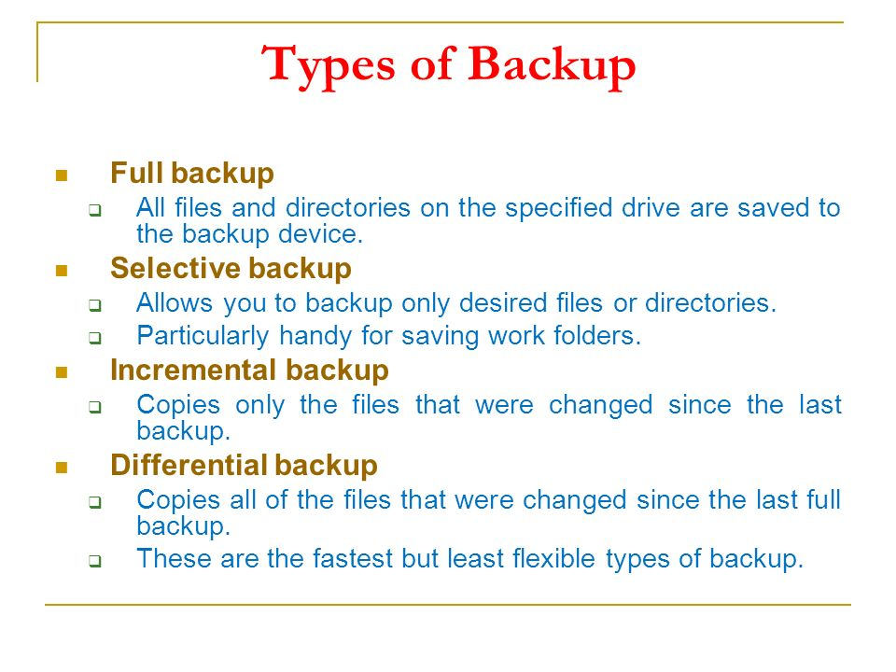
Desktop Security

Slide 9

Data Recovery Tools
-Autopsy
-Stellar Data Recovery
-Crash Plan
-OnTrack Easy Recovery
-EaseUS Data Recovery
-Data Rescue 5
-Paragon Backup and Recovery
-MiniTool Power Data Recovery
-Recover My Files Professional
-Wise Data Recovery
-Get Data Back

Slide 10
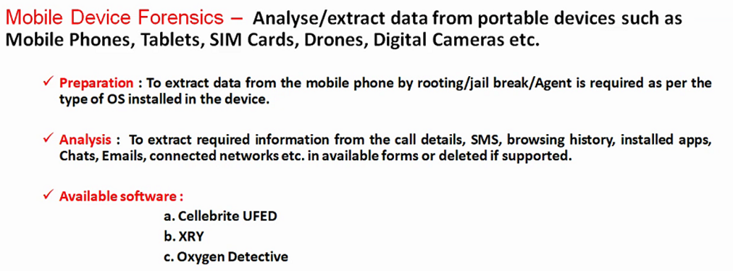

Slide 11
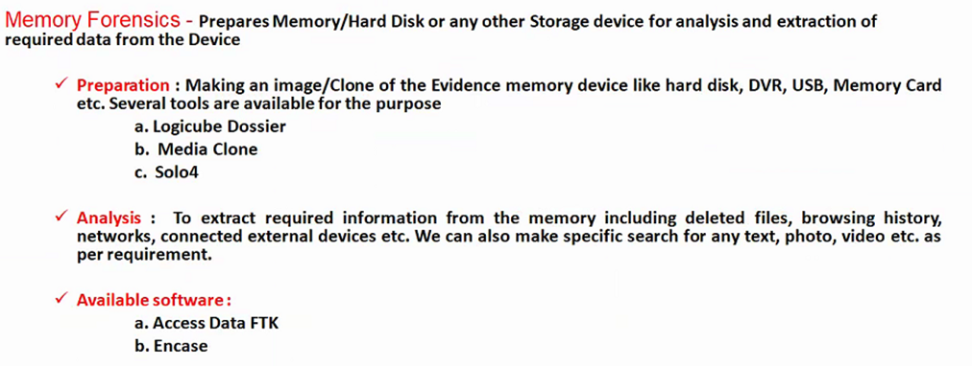

Slide 12

Secure Ur Data

Slide 13
Quiz time ?
Name one data recovery software.................................

Slide 14
Quiz time ?
Data extraction of deleted data from mobile is possible ?
1. Yes
2. No

Slide 15

Cyber World !!
The Invisible criminals are more Dangerous than the visible one”
THANKS!
Any questions?
You can find me at:
dr.pandeysurabhi@gmail.com

