Slide 1



Welcome !
Indian Institute of Public Administration , New Delhi (IIPA)
Cyber Security Strategy
Dr. Surabhi Pandey
Subject Expert

Slide 2



Session 4: Network Security
Session 4.1
Demonstration of software to ensure network security
Security Compliance Manager and Security baselines
No. of Sessions :1
Activities
Case Discussion
Quiz & FAQ

Slide 3








Learning Objectives
To understand fundamentals of cyber safety
Current Vulnerabilities
Security goals,
Information ethics ,
Functionality and Usability .

Slide 4

INSTRUCTIONS
Course Prerequisite:
Basic knowledge of
computer and a mindset
to ensure safety and
security of organizational data.
Pedagogy:
Mix pedagogy of Blended Interactive sessions , case discussion , panel discussion and lab sessions are planned
Course duration: 10 sessions
Credit : 0.5
Specific modules : 5
Mode of evaluation: Assignment and Practical Lab

Slide 5


Agenda
Network Security and Types of Attacks
Network Scanning Tools
Network Security Tools and Techniques
Security Audits
Security Compliance Manager

Slide 6
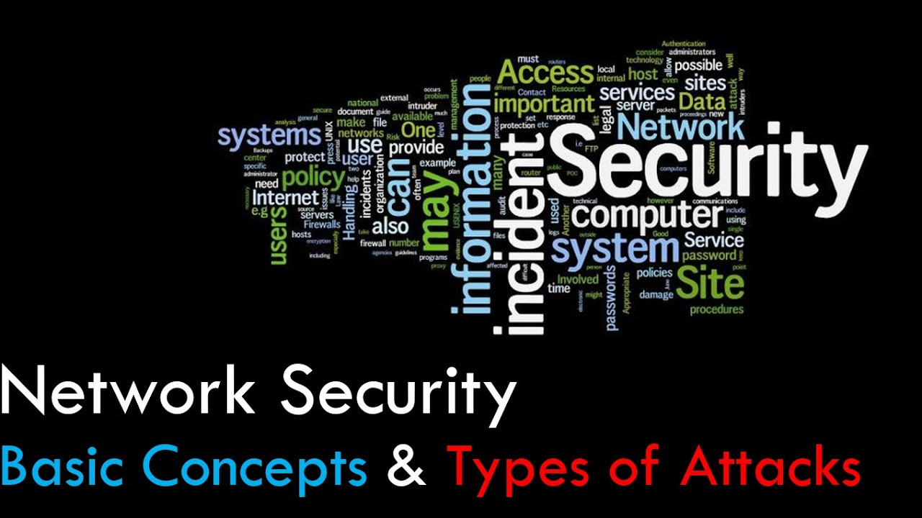
Network Security
Network security is a term that describes the tools, tactics and security policies designed to monitor, prevent and respond to unauthorized network intrusion, while also protecting digital assets, including network traffic.

Slide 7

Benefits of Network Security
-Network security exists to help your organization protect not only its sensitive information, but also its overall performance, reputation and even its ability to stay in business.
-Continued operational ability and an intact reputation are two key benefits of effective network security.

Slide 8
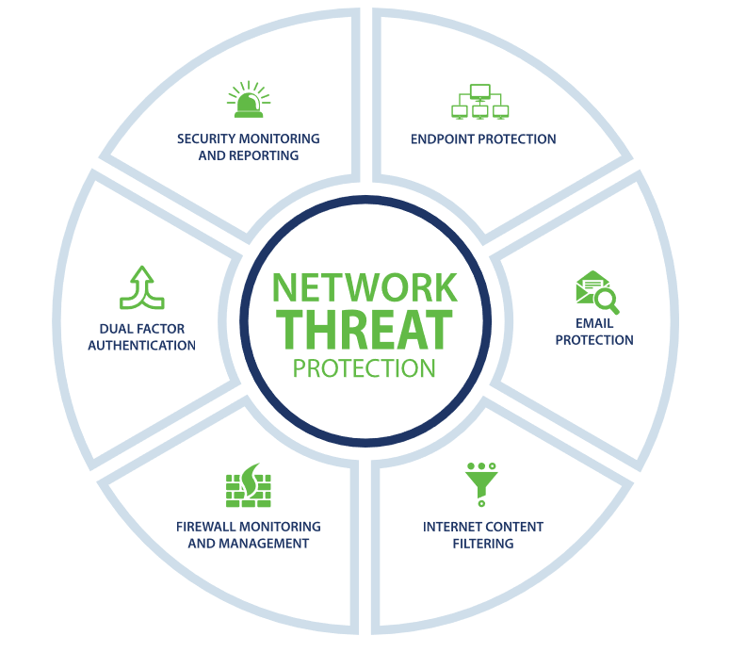
Desktop Security

Slide 9

Network Scanning Tools

Slide 10
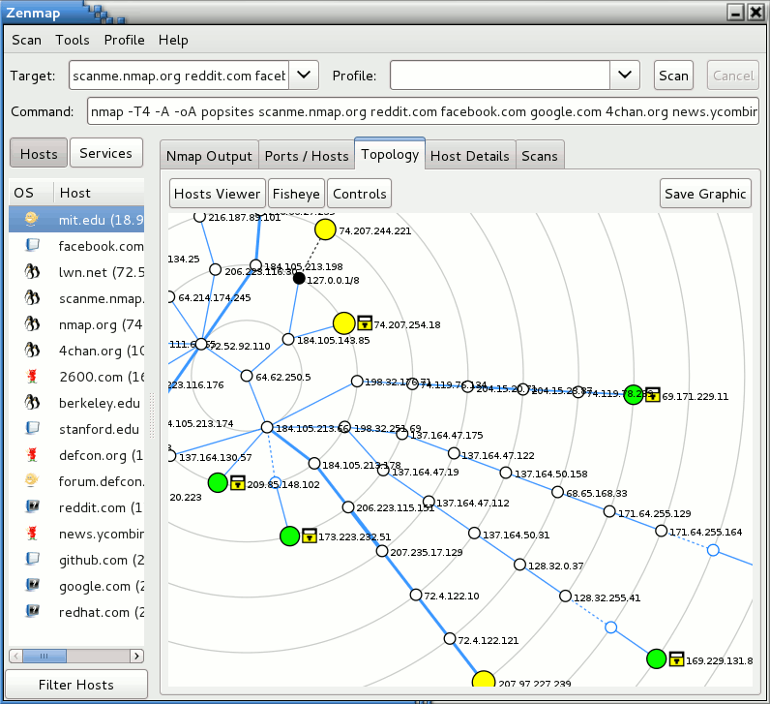
Network Scanning Tools : Zenmap Demo

Slide 11
Network Security Tools and Techniques
-Access control
-Anti-malware software
-Anomaly detection
-Application security
-Data loss prevent (DLP)
-Email security
-Endpoint security
-Firewall
-Intrusion prevention systems
-Network segmentation
-Security information and event management (SIEM)
-Virtual private network (VPN)
-Web security
-Wireless security

Slide 12
Introduction to Network Security Audit Checklist
-Check and update computer itinerary ( both server and workstation, a comprehensive list should be maintained and appended as and when new systems are integrated into the network .
-Check and install latest security patches.
-Check event log monitoring.
-Check End Point Security reports.
-Test your firewall security
-Evaluate firewall configuration
-Test and run antivirus software
-Perform routine network maintenance

Slide 13
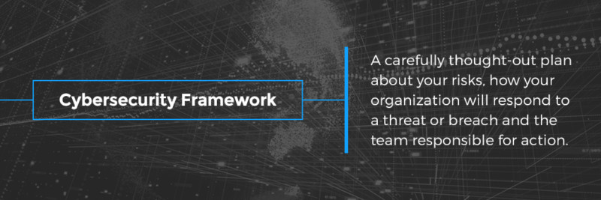
Cyber Security Compliance as a Best Practice
Key to cyber security compliance and the audit process is to recognize the cyber security framework approach as common sense — a matter of security and executive management best practices. It’s about having a carefully thought-out plan about your risks, how your organization will respond to a threat or breach and the team responsible for action.

Slide 14

Secure Ur network

Slide 15
Quiz time ?
Which one is Network scanning tool
1. Nikto
2. NAMP
3. Nexpose
4. All the above

Slide 16
Quiz time ?
Network Threat Protection ?
1. End point protection
2. Dual Factor Authentication
3. Filtering
4. All the Above

Slide 17

Cyber World !!
The Invisible criminals are more Dangerous than the visible one”
THANKS!
Any questions?
You can find me at:
dr.pandeysurabhi@gmail.com

