Slide 1


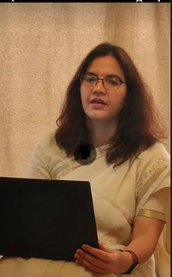
Welcome !
Indian Institute of Public Administration , New Delhi (IIPA)
Cyber Security Strategy
Dr. Surabhi Pandey
Subject Expert

Slide 2



Session 3: Desktop, Email, Browser and Mobile Security
Session 3.1
Overview of Desktop, Browser and Mobile Security
IP Tracking, E-Mail safety and Recovering deleted evidences.
No. of Sessions :1
Activities
Case Discussion
Quiz & FAQ

Slide 3








Learning Objectives
To understand fundamentals of cyber safety
Current Vulnerabilities
Security goals,
Information ethics ,
Functionality and Usability .

Slide 4

INSTRUCTIONS
Course Prerequisite:
Basic knowledge of
computer and a mindset
to ensure safety and
security of organizational data.
Pedagogy:
Mix pedagogy of Blended Interactive sessions , case discussion , panel discussion and lab sessions are planned
Course duration: 10 sessions
Credit : 0.5
Specific modules : 5
Mode of evaluation: Assignment and Practical Lab

Slide 5

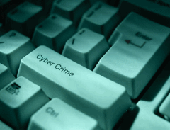
Agenda
Desktop Security
Browser Security
Mobile Security
IP Tracking and Email safety
Data recovery

Slide 6
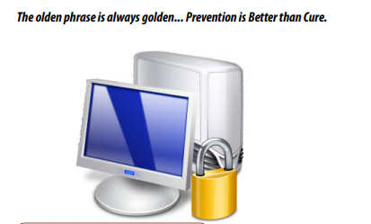
Desktop Security
-Always install Licensed Software so that you have regular updates of your Operating system and Applications.
In case of open source software, make sure to update frequently.
-Read the “Terms and Conditions” / “License Agreement” provided by vendor/software before installation.
-Properly shutdown and switch off your personal computer after the use along with your external devices like Monitor, Modem, Speakers etc.

Slide 7
Desktop Security :software Installation
Installation of Operating System
-Get proper Licensed Operating System and read License agreement carefully before installing the OS.
-Switch on your personal computer and go to BIOS Settings and change your first boot drive to CD Drive.
-Insert your CD/DVD into the CD drive and restart your system using Ctrl+Alt+Delete.
After restart, the system boots from the CD/DVD.
-Follow the installation steps as specified by the vendor document.
-Use the CD provided by the Vendor to install your
-Motherboard drivers
-Monitor drivers
- Audio & Video drivers
-Network drivers

Slide 8
Desktop Security
Enable Auto-updates of your Operating System and update it regularly.
Download Anti-Virus Software from a Trusted Website and Install.
Make sure it automatically gets updated with latest virus signatures.
Download Anti-Spyware Software from a Trusted Website and Install.
Use “Encryption” to secure your valuable Information.
Note: For encryption password is required, always remember the password used while encrypting it, else data would not be available thereafter.
Strong password should be used for “Admin” Account on computer and for other important applications like E-mail client, Financial Applications (accounting etc).
Periodically backup your computer data on cloud or USB drive etc.. in case it may get corrupted due to Hard Disk failures or when reinstalling/format ting the system.

Slide 9
Tips for Desktop Security
Configure your browser’s security and privacy settings
Use a browser that allows you to take your bookmarks with you between devices
Block Pop-ups and Be cautious when installing plug-ins
Use an ad blocker
Enable “do not track” in your browser
Clear your web browser cache and cookies
Turn on private browsing
Use a VPN
Use a password manager
Ensure you have up-to-date antivirus and firewall protection

Slide 10
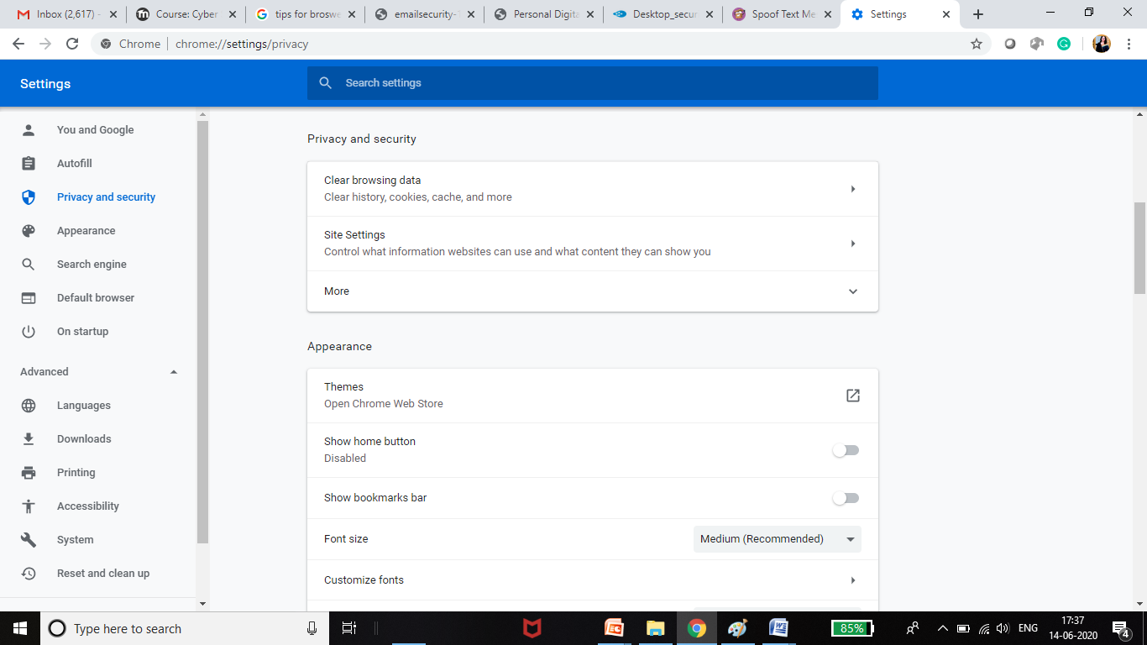
Configure Privacy Setting of Browser

Slide 11
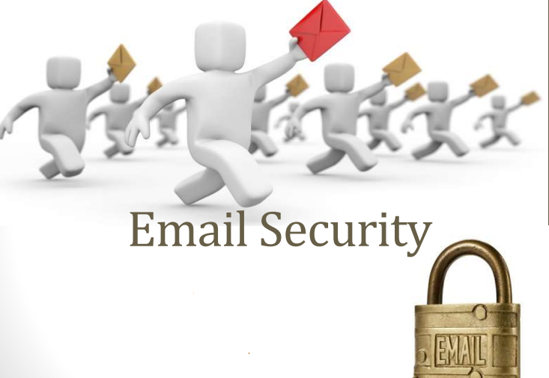
Always use strong password for your email account
Always use Anti-Spyware Software to scan the emails for Spam.
Always scan the e-Mail attachments with latest updated Anti-Virus and Anti-Spy ware before opening.
Always remember to empty the Spam folder.
Notes:
Email security is dealing with issues of unauthorized access and inspection of electronic mail. This unauthorized access can happen while an email is in transit, as well as when it is stored on email servers or on a user computer. • Email has to go through potentially untrusted intermediate computers (email servers, ISPs) before reaching its destination, and there is no way to tell if it was accessed by an unauthorized entity

Slide 12
WHAT DOES EMAIL SECURITY INVOLVE?
• The three main principles of Information Security involve
• Maintaining the confidentiality,
• Integrity, and
• Availability of information resources.
• A weakness in any one of these three key areas will undermine the security posture of an email system and open the door to exploitation

Slide 13
How to secure Email
Web browsers maintain a history of visited sites, and a cache of browser data that help them load frequently visited pages more quickly.
The history and cache may also inadvertently expose your e-mail messages. When you are done using your Web mail, you can go into the settings for the browser and clear out the cache.
• Better yet, use private browsing.
The most popular Web browsers--such as Internet Explorer, Firefox, and Chrome-- have an option to surf the Web using a private or anonymous mode. When you use the private browsing mode, your entire Web session is more secure, since no data is retained in the history or cache

Slide 14
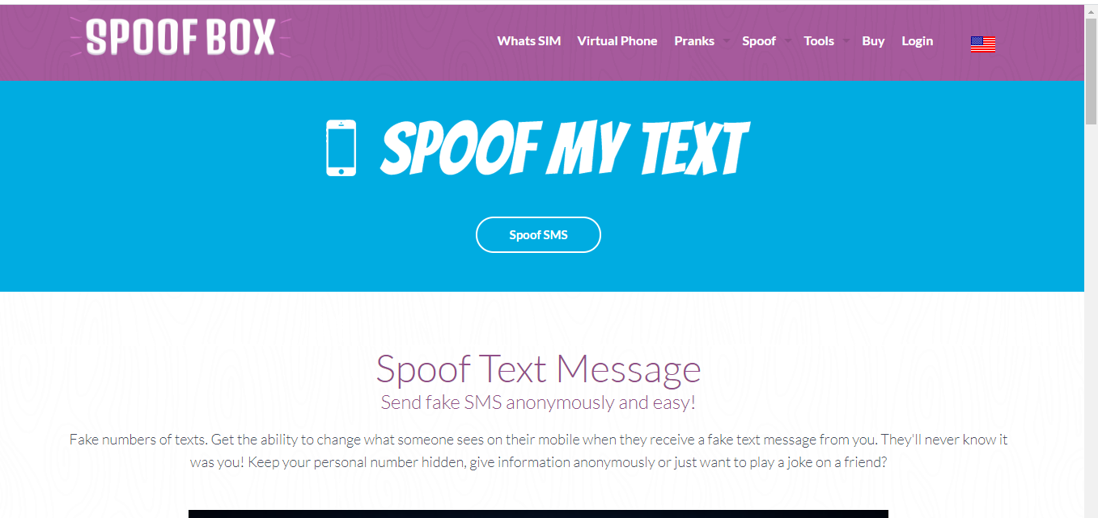
Beware of Fake SMS Techniques
MK.Cz – to send spoofed email
SMSGang .com - to send fake sms

Slide 15
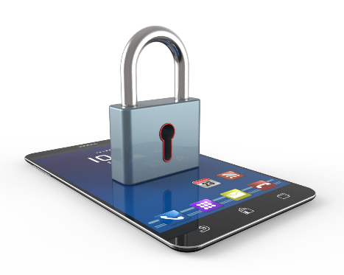
Mobile Security

Slide 16
There are a number of threats to mobile devices, including annoyance, stealing money, invading privacy, propagation, and malicious tools.
-Bonnets: attackers infect multiple machines with malware that victims generally acquire via e-mail attachments or from compromised applications or websites. The malware then gives hackers remote control of "zombie" devices, which can then be instructed to perform harmful acts.[
-Malicious applications: hackers upload malicious programs or games to third-party Smartphone application marketplaces. The programs steal personal information and open backdoor communication channels to install additional applications and cause other problems.
-Malicious links on social networks: an effective way to spread malware where hackers can place Trojans, spyware, and backdoors.
-Spyware: hackers use this to hijack phones, allowing them to hear calls, see text messages and e-mails as well as track someone's location through GPS updates
Source : Leavitt, Neal (2011). "Mobile Security: Finally a Serious Problem?". Computer. 44 (6): 11–14.

Slide 17
Few Mobile Codes for safety
*#06# --- for IMEI ( international mobile equipment identity )
*#21# --- find out whether your calls, messages and other data are being diverted .
##002# --- universal code to block all redirected calls.
*#30# --- hide your identity .
*#62# --- Data being directed
14422 Toll Free number to block IMEI of lost device
( DoT CEIR .gov.in active in Delhi and Maharashtra as of now )

Slide 18
Know about wifi /IP /DNS
netsh wlan show profile wifiname key = clear
netsh wlan show profile wifiname key = clear
What is my DNS
https://www.iplocation.net/
Gpedit .msc typed in run

Slide 19
Quiz time ?
VPN stands for
1. Virtual Private Network
2. Virtual Public Network
3. Visual Public Net
4. None of these

Slide 20
Quiz time ?
Which dial up code use to get IMEI number
1.#06
2. *#06#
3. #066#
4. *066#

Slide 21

Cyber World !!
The Invisible criminals are more Dangerous than the visible one”
THANKS!
Any questions?
You can find me at:
dr.pandeysurabhi@gmail.com

