Slide 1



Welcome !
Indian Institute of Public Administration , New Delhi (IIPA)
Cyber Security Strategy
Dr. Surabhi Pandey
Subject Expert

Slide 2



Session 1: Fundamentals of Cyber Safety and Security
Digital Greetings & Networking
Session 1.1
Background and Current Scenario, Security goals, Information ethics and issues essential terminology
The Security, Functionality, and Usability Triangle
No. of Sessions :2
Activities
Case Discussion
Quiz & FAQ

Slide 3








Learning Objectives
To understand fundamentals of cyber safety
Current Vulnerabilities
Security goals,
Information ethics ,
Functionality, and Usability triangle.

Slide 4

INSTRUCTIONS
Course Prerequisite:
Basic knowledge of
computer and a mindset
to ensure safety and
security of organizational data.
Pedagogy:
Mix pedagogy of Blended Interactive sessions , case discussion , panel discussion and lab sessions are planned
Course duration: 10 sessions
Credit : 0.5
Specific modules : 5
Mode of evaluation: Assignment and Practical Lab

Slide 5
Agenda
What is cyber security
CIA Triad
Why cyber security is important
Introduction to Cyber security
Types of Cyber Threats
NIST Cyber Framework

Slide 6

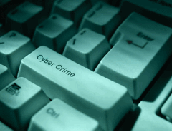
The general security objectives comprise the following:
Cyber security strives to ensure the attainment and maintenance of the security properties of the organization and user’s
Data
Availability
Integrity
Data Security revolves around these three pillars
Data
Data
Confidentiality

Slide 7

What is Cybersecurity?
Cybersecurity refers to a set of techniques, used to protect the integrity of network programs and data from attack damage and unauthorized access.
Notes:
© Copyright PresentationGO.com – The free PowerPoint and Google Slides template library

Slide 8
Cyber security is important because of:
-Unauthorized attacks
-Malware & Spyware
-Address threats on computer networks
-Damage to security infrastructure

Slide 9
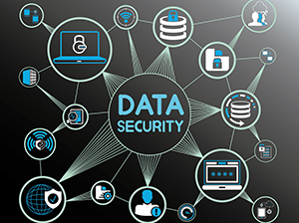
Cyber security strengthens data security
The world relies on technology more than ever before, and as a result digital data creation has surged.

Slide 10
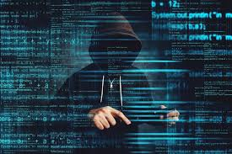
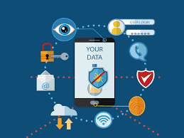
Why Cyber security is Important ????????
Cyber security is important because it encompasses everything that pertains to protecting our sensitive data, personally identifiable information, protected health information, personal information, intellectual property, data, and governmental and industry information systems from theft and damage attempted

Slide 11
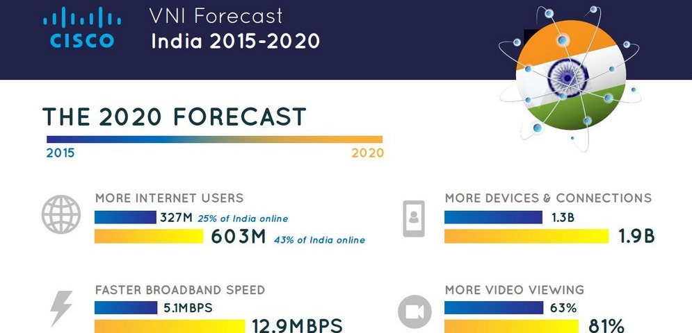

Slide 12
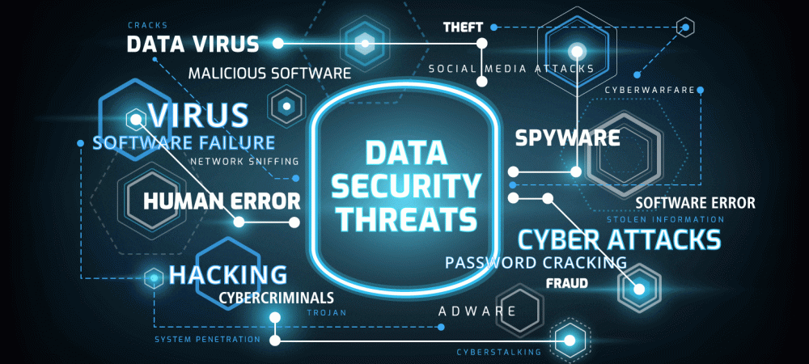

Slide 13
Cyber Threats :: Key Concepts
Cyber Threats get converted into Cyber Crime which is unlawful acts
Crime committed with a computer
    Computer as a Target
    Computer as a Weapon
Cyber Crime regulated by Cyber Laws or Internet Laws (IT Act 2000)

Slide 14
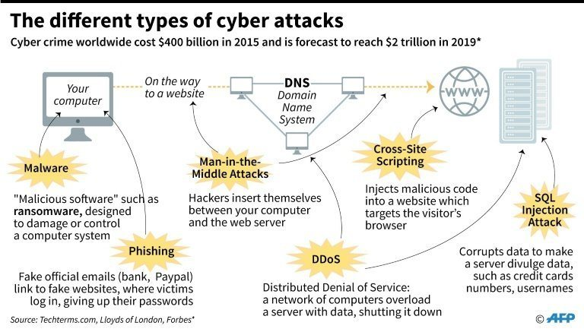

Slide 15
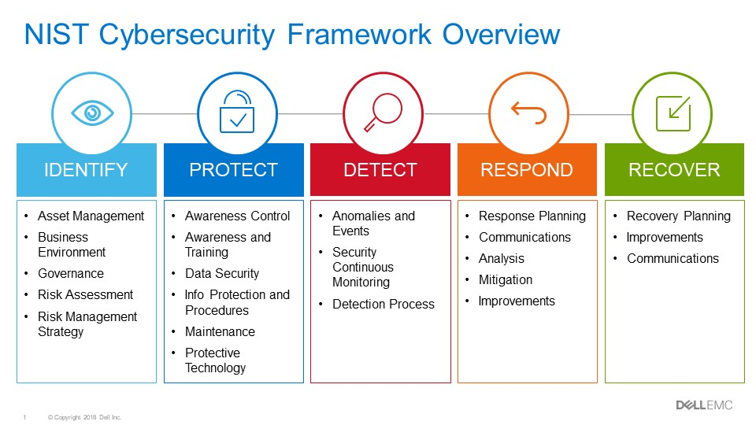

Slide 16
Quiz time ?
Ransamware is a ….
Malware
Phishing
Virus
Malicious software
All of these

Slide 17
Quiz time ?
Confidentiality , Authenticity , Integrity
Cyber , Availability and Integrity
Confidentiality , Availability and Integrity
Non of these

Slide 18

Cyber World !!
The Invisible criminals are more Dangerous than the visible one”
THANKS!
Any questions?
You can find me at:
dr.pandeysurabhi@gmail.com

