Slide 1

Agrarian Distress in Rural India
Issues and Challenges
Dr. Amit Kumar Singh
IIPA, New Delhi

Slide 2
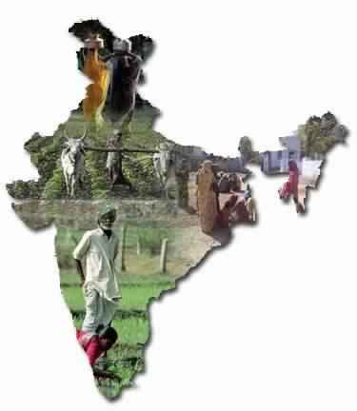
Slide Title
Introduction
Agriculture sector has a pivotal role in Indian economy.
  It is a major occupation in the rural India where majority of the poor reside. It provides the principal means of livelihood for over 65 percent of India's rural population.
  Its direct and indirect impact being undeniably significant and multifaceted
The share of agriculture sector in G.D.P. of India was 44.0% during 1973-74 and now it has reduced to 15.9 %.

Slide 3
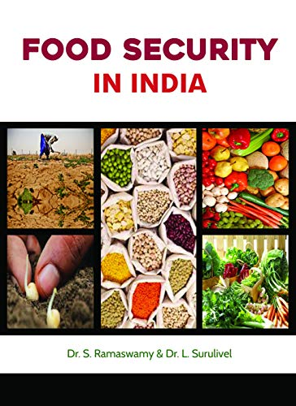
Slide Title
Food Security
Agriculture in India has played an important role in meeting almost the entire food needs of the people.
The production of food grains In India has increased from 51 million tonnes in 1950-51 to 291.89 million tonnes in 2018-19
This has enabled the country to overcome the problems of food grain shortages. The country almost self sufficient in food grains & no longer depends on import of foodgrains.
Many industries like cotton industry, sugar industries, jute industries etc,. depends on agriculture for their raw material requirements.

Slide 4
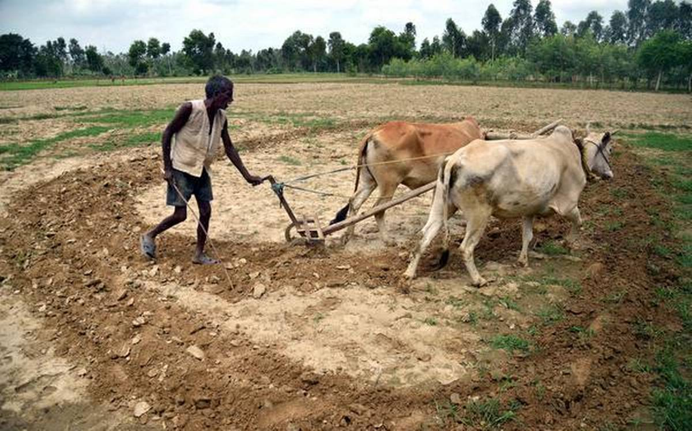
Slide Title
Sign of Distress
At the height of the farm output, Indian farmers are a disappointed lot. Despite spectacular rise in agricultural production, they continue to languish in poverty.
Agrarian distress in India, is not a recent phenomenon, built-up over time, has further deteriorated recently.
Over the past decade, agricultural growth has been fairly volatile ranging from 5.8% in 2005-06 to 0.4% in 2009-10 and -0.2% in 2014-15.
Such a variance in agricultural growth has an negative impact on farm incomes as well as on farmers

Slide 5
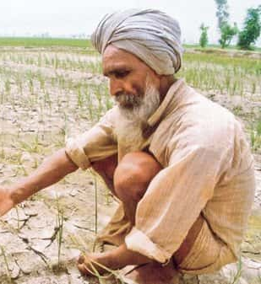
Slide Title
Sign of Distress
The underlying symptoms of agrarian distress is quite apparent:
a) Agriculture is becoming unviable;
b) Inability to absorb upcoming labour force;
c) Farmers’ suicide;
d) High Rural indebtedness;
e) Growing farmer’s agitation;

Slide 6
Slide Title
Status of Agriculture in India
Status of Agriculture in India (Sector-wise percentage share in Employment and Gross Domestic Product
Sector | 1981 |  | 1991 |  | 2001 |  | 2016-17
 | Empl. | GDP | Empl. | GDP | Empl. | GDP | Empl. | GDP
Primary | 68.87 | 41.8 | 66.75 | 34.9 | 59.9 | 27.3 | 42.74 | 15.1
Secondary | 13.48 | 21.85 | 12.77 | 24.48 | 11.9 | 24.28 | 23.79 | 31.1
Tertiary | 17.65 | 36.62 | 20.5 | 40.6 | 28.2 | 48.42 | 33.48 | 53.77
Source: Census of India and National Accounts Statistics (Various Issues)
Share of agriculture and allied sectors in the total GDP of the country has declined from 41.8 % in 1981-14 to 15.1 % in 2016-17
Till today there is a excessive dependence on agriculture as a source of livelihood. A significant percentage of people is still dependent on agricultural sector.

Slide 7
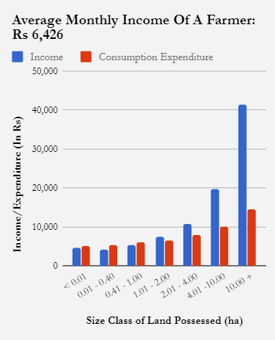
Slide Title
Unviable Agriculture
Agriculture has become a highly unviable occupation.
A recent repeat survey (NSS 70th round 2014) reveals, that consumption expenditure of two third of agriculture households in India was higher than their net income received.
Large number of farmers have been managing their farming activities and other expenditure by borrowing.
This affects capital formation in agriculture and raising the cost of cultivation.

Slide 8
Slide Title
Unviable Agriculture………
Daily wages by broad economic sector and employment status, 2011–12(INR in nominal terms)
There is a huge Wage differentials between primary, secondary and tertiary sectors.
Wage levels remain lowest in the primary sector.

Slide 9
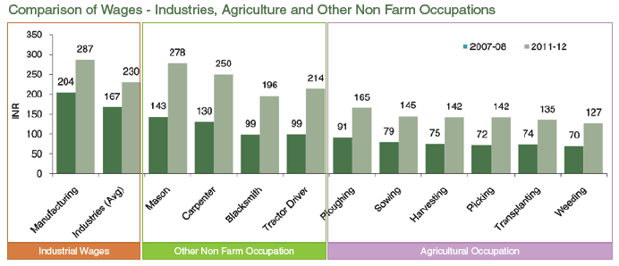
Slide Title
Labour Scarcity in Agriculture

Slide 10
Slide Title
Farm Suicides
Year | Total Suicides | Of which suicides by farmers and agricultural labourers | % of total suicides
2010 | 1,34,599 | 15,963 | 11.86
2011 | 1,35,585 | 14,207 | 10.48
2012 | 1,35,445 | 13,755 | 10.16
2013 | 1,34,739 | 11,772 | 8.74
2014 | 1,31,666 | 12,360 | 9.39
2015 | 1,33,623 | 12 602 | 9.43
The incidence of farm suicides still remained at an alarming level notwithstanding some moderation in the recent years.
In 2015, 12,602 people involved in agriculture committed suicide in India, and indebtedness was listed as the primary reasons for suicides by farmers
Besides crop failures on account of bad weather and erratic monsoon, the rising cost of cultivation, lack of credit and drastic fall in prices are the main reasons of Farmer’s suicide

Slide 11
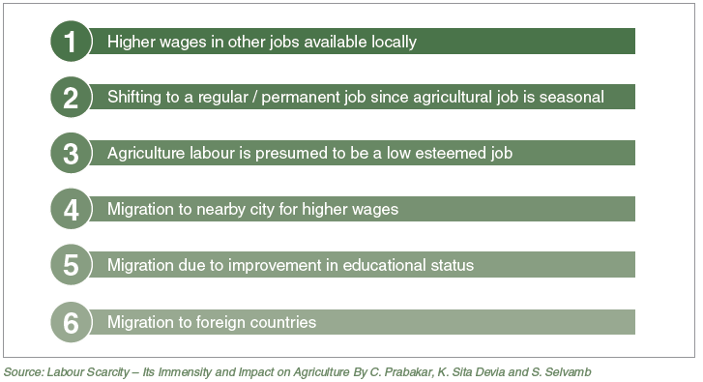
Slide Title
Migration of Agricultural Labour
As per the NSSO report on farmer situation assessment says 40 per cent of farmers would like to quit agriculture if alternative employment opportunities are made available to them.
The CSDS study report, “State of Indian Farmers’ (2018) based on 5,000 farm households across 18 states says that 76 per cent farmers would prefer to do some work other than farming.

Slide 12
Slide Title
Factors of Agrarian Distress
Agriculture is no more profitable
Dependencies on monsoon and climate.
Declining size of operational holdings
Indebtedness of farmer households
Lack of easy credit to agriculture and dependence on money lenders
Lack of motivation amongst the rural youth in farming
Crop insurance flaws aggravating farm distress
Lack of mechanisation
Conversion of agriculture land for other purposes
Soil degradation
Decline in government investment in the agriculture sector
Failing in to reduce post-harvest losses

Slide 13
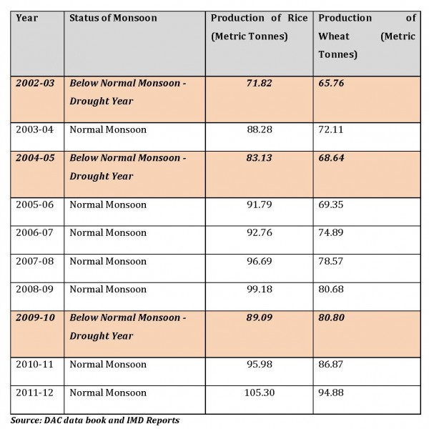
Slide Title
Vulnerability of Indian Agriculture
55-60 percent of its net sown agricultural area is dependent on rain for farm production
The southwest monsoon (June-September) provides about 80 percent of the area’s precipitation.
A good monsoon season with sufficient rainfall results in enhanced agricultural production, whereas a bad monsoon season with low precipitation negatively impacts the economy through lower production.

Slide 14
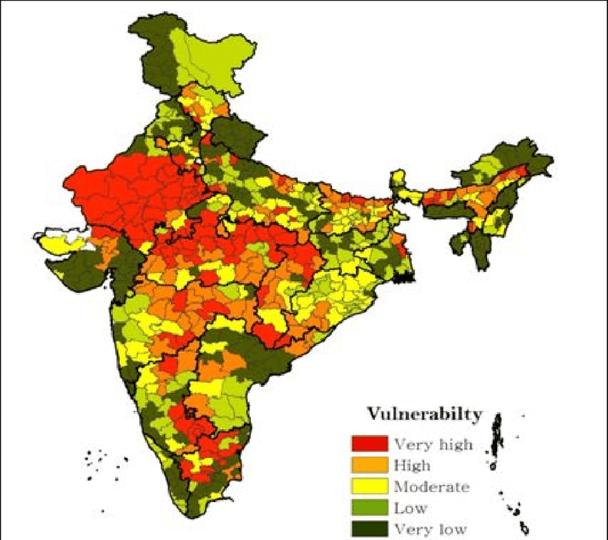
Slide Title
Vulnerability of Indian Agriculture………..
India has diverse climatic zones and agriculture is heavily dependent climatic conditions
Global temperature has made our monsoon more prone to extreme weather events.
Only 47.68 per cent of gross cropped area is irrigated
Faulty irrigation practices
States like Maharashtra has barely 18 per cent of area under irrigation.
Low irrigation also results in low cropping intensity

Slide 15
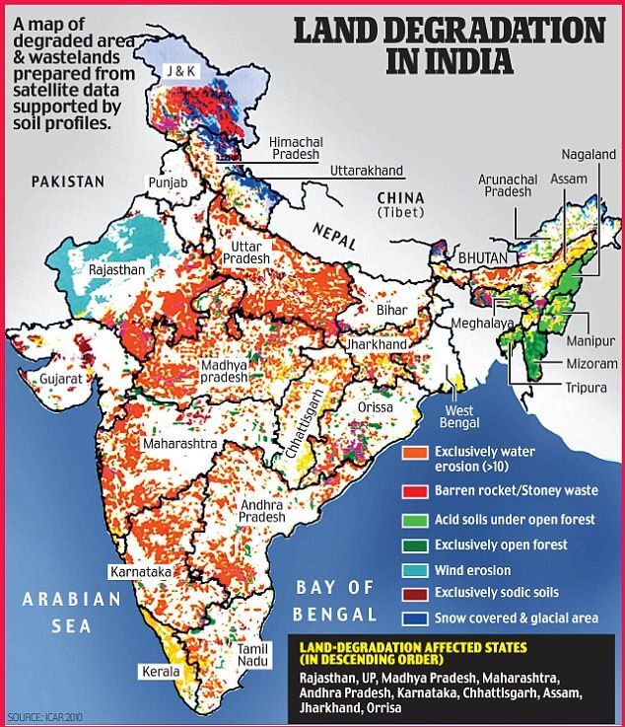
Slide Title
Deterioration in Soil Quality Effecting Productivity
It is estimated that out of 179.9 M ha (60.47% of TGA) area under agriculture, almost 120.4 M ha area is degraded through one or more degradation types.
The quality of soil has deteriorated over time due to a combination of factors, such as injudicious use of fertilizer, accumulation of heavy metals and metalloids through various forms of emissions, removal of natural vegetative cover, over grazing.
Land degradation leading to change in cropping and agricultural productivity and also threatening the agricultural sustainability of India.

Slide 16
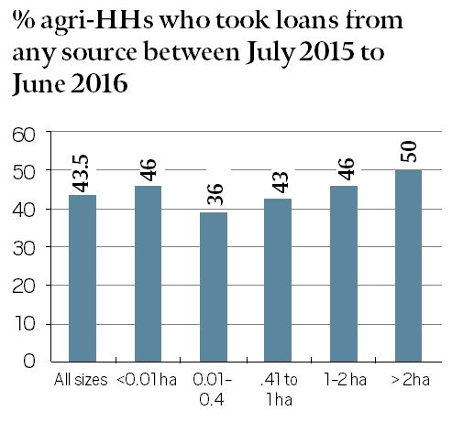
Slide Title
Indebtness
% of Agri HHs who took loans from any source between
July 2015 to June 2016
Farmer’s indebtedness is a big concern in rural India, rural people are borrowing a heavy amount of loan regularly for meeting their requirements needed for production, consumption and for meeting social commitments.
43.5 % of farmers have taken loan.
It is an indicator of the weak financial infrastructure in our Rural India.
It shows inability of our economic system to reach to the needy farmers, landless people in the villages and the agricultural wage labourers.

Slide 17
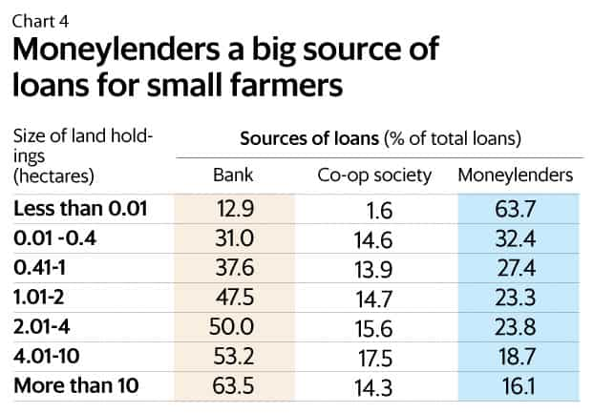
Slide Title
Indebtness
According to NSSO reports, the share of institutional credit is lowest among small farmers in India.
Farmers’ dependence on Moneylenders credit increases significantly from 16.1 per cent in large farmers to 63.7 percent in small and marginal farmers.
The average amount of outstanding loan was highest in Kerala (Rs. 2,13,600) followed by Andhra Pradesh and Punjab, this survey showed.
Moneylenders a big source of Loans for Farmers

Slide 18
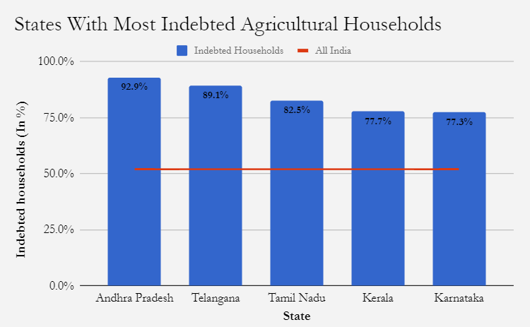
Slide Title
Households in southern India are most indebted
Andhra Pradesh has the highest share of indebted agricultural households (93%), followed by Telangana (89%) and Tamil Nadu (82.1%).
State wise more farmers committed suicide in Maharashtra (4,291) in 2015 than any other state, followed by Karnataka (1,569) and Telangana (1,400).
“Indian farmer is born in debt, lives in debt and dies in debt”
Source: Ministry of Statistics and Programme Implementation

Slide 19
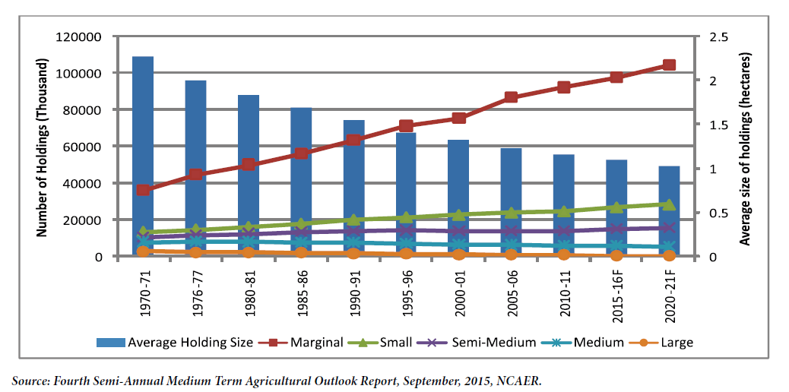
Slide Title
Small and Fragmented land
Farmers profiles in India
Marginal: land below one hectares( 62%)
Small: land between one and two hectares(19%)
Semi medium: land between 2 and 4 hectares(12%)
Medium farmers: land between 4 and 10 hectares(6%)
Large farmers: land more than 10 hectares(1%)
Small and marginal farmers account for more than 80% of total farm hrs. But their share in operated area is around 44%.
The average size of holdings in India declined from 2.28 ha in 1971 to 1.08 in 2015-16

Slide 20
Slide Title
Problems of Middlemen in Agriculture
Producer
Pre-harvest Contractor/ Consolidator
Commission Agent
Wholesaler
Retailer
Consumer
Buying and selling agricultural produce takes through a value chains, in which many market functionaries are involved.
A recent NABARD study that suggests that producers of crops like onions, barely get 25 per cent to 30 per cent of the price consumers pay for the vegetable.
The biggest beneficiary of a spike in prices are undoubtly, the middlemen. But when prices fall, farmers suffer the most.
For a five minute auction, e.g., in the Azadpur market in Delhi or the Vashi market in Mumbai, the commission agents charge as high as a 6-15 per cent commission on the value of output sold. Ashok Gulati

Slide 21
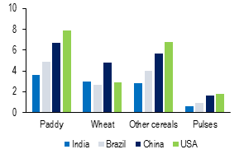
Slide Title
Low Productivity in Agriculture
Yield in different countries (tonne/ha)
India ranks second in the production of rice & Wheat and highest in pulses production.
But except wheat, in most of the other crops its yield is lower than Brazil, China and the United States.

Slide 22
Slide Title
Low and volatile growth in agricultural sector
Annual Growth Rates of real GDP at factor cost by industry of origin
Agriculture production is extremely volatile.
Adding to its vulnerability, it is the slowest growing sector of the Indian economy.
Such a variance in agricultural growth has an impact on farm incomes as well as farmers’ ability to take credit for investing in their land holdings.
Year | Agriculture | Manufacture | Trade | Finance & Insurance | Common Service
2004-05 | 1.1 | 10.0 | 9.5 | 6.8 | 6.8
2006-07 | 4.3 | 12.7 | 11.6 | 2.8 | 9.6
2008-09 | 0.4 | 4.7 | 7.5 | 12.5 | 6.7
2010-11 | 8.3 | 7.6 | 12.2 | 4.2 | 8.9
2012-13 | 1.4 | 3.6 | 9.8 | 4.3 | 5.4
2014-15 | 1.5 | 7.0 | 9.0 | 8.1 | 7.2
2016-17 | 4.4 | 6.0 | 7.8 | 11.3 | 6.6
2017-18 | 2.3 | 4 | 8.7 | 9.4 | 6.1

Slide 23
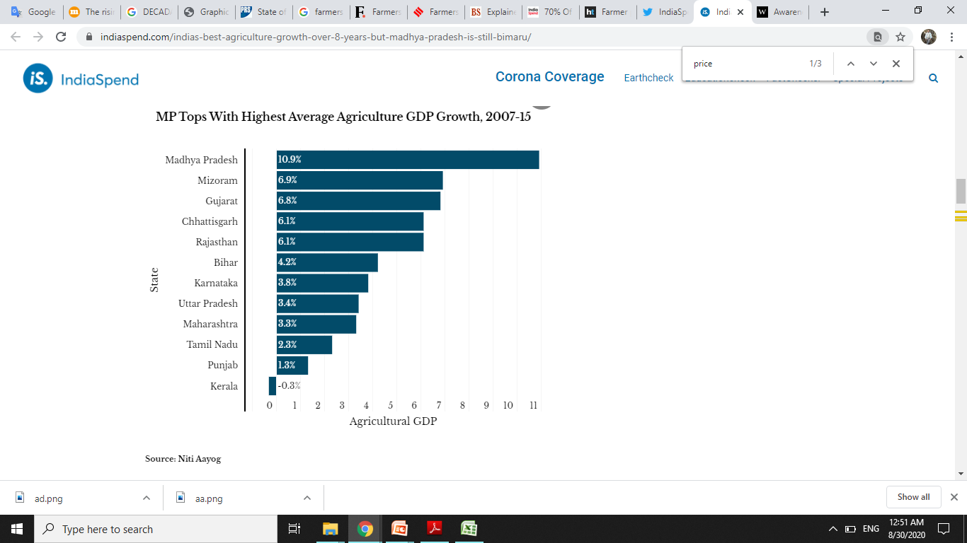
Slide Title
Low and volatile growth in agricultural sector,,,,,,
Madhya Pradesh (MP) has reported the best agricultural growth in India over eight
years, increased, on average, 10.9% per annum, the highest in India and higher than the national average of 4.3%.
Achieved bumper crops production in 2017, which led to a 30-50% drop in prices of cash crops like onion, green peas, potato and garlic that farmers were encouraged to cultivate under crop diversification.
Source: Niti Aayog

Slide 24
Slide Title
Ineffective MSP
An evaluation study on MSP was carried by NITI Ayog to find out the Efficacy of Minimum Support Prices (MSP) on Farmers. The study covered 14 States.
  79% respondent expressed their dissatisfaction about MSP declared by the Government due to various reasons. Certain problems noticed in the implementation of MSP were.
  Procurement centres being far away resulting into heavy transportation cost
  Distress sales by small and marginal farmers due to urgent need for money
  Non-opening of Procurement Centres timely
  Insisting for revenue records by the authorities
  Lack of covered storage/godowns facility for temporary storage of produces
  Lack of electronic weighing equipment in some places
  Delays in payments

Slide 25
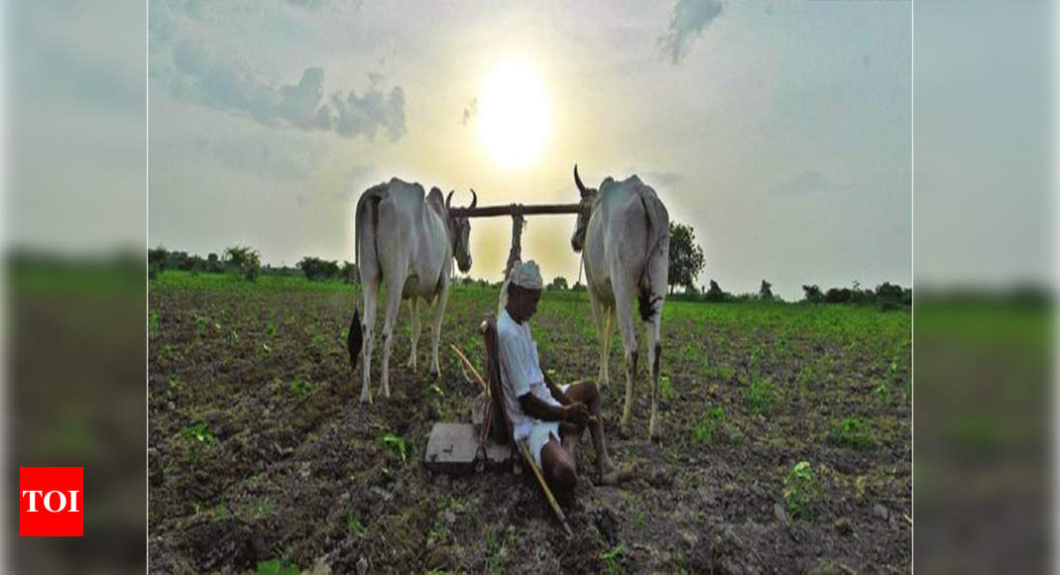
Slide Title
Impact of Agriculture Distress
Agriculture crisis in India is very vast and likely to hit all the other sectors and the national economy in several ways.
Income uncertainty
Incidence of Poverty
Food Security
Farmer’s Suicide
Transfer of Land
Cost of Living
Health and nutrition
Employment
Labour Market
Land loss from agriculture
Foreign Exchange Earnings

Slide 26
Slide Title
Solutions….
Agrarian distress in India is deep rooted. Provisions of farm loan waiver, MSPs are short-term solutions. Ending farmer’s distress is a formidable task though may not be altogether impossible if proper strategies are implemented. Certain policy measures needs to be taken:
Strengthening irrigation facilities
Need for technological interventions
Compensating farmers for loss of income/food products
Market reforms to enable better price discovery - Expansion of e-Mandis
Improvements in allied sectors and generating employment opportunities

Slide 27
Slide Title
Solutions…..
Decentralization of procurement process
Land consolidation
Irrigation
Productivity
Rainfed Agriculture
Increase investments in agri-R&D
For better price for farmers, agriculture has to go beyond farming and develop a value chain comprising farming, wholesaling, warehousing, logistics, processing and retailing.

Slide 28
Slide Title
Government Steps to reduce Agrarian Distress….
The Government of India has recently set an ambitious target to double the income of farmers by 2022-23. It aims to promote farmers welfare, reduce agrarian distress and bring parity between the income of farmers and those working in non-agricultural professions.
Doubling farmers income has the following seven sources of agricultural growth:
  Big focus on irrigation with large budgets, with the aim of “per drop, more crop”;
  Provision of quality seeds and nutrients based on soil health of each field;
  Large investments in warehousing and cold chains to prevent post-harvest crop losses;
  Promotion of value addition through food processing;
  Creation of a national farm market and removing distortions;
  Introduction of a new crop insurance scheme to mitigate risks at affordable cost; and,
  Promotion of ancillary activities like poultry, beekeeping and fisheries

Slide 29
Slide Title
Implementing Swaminathan Committee Recommendations
Need for extensive land reforms:
Preventing diversion of prime agricultural land and forest:
Increases in public investment: irrigation, drainage, land development, water conservation, and promotion of conservation farming and biodiversity
Expansion of formal credit
Integrated credit-cum-crop-livestock-human health insurance
MSP should be at least 50% more than the weighted average cost of production

Slide 30
Slide Title
Thank You

