Slide 1

The Role and Importance of Rural Roads
in India
Dr. Amit Kumar Singh
IIPA, New Delhi

Slide 2
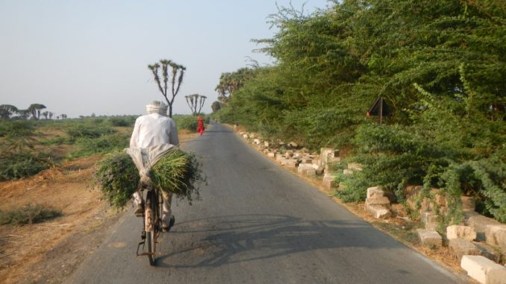
Slide Title
Introduction
An efficient road network is prerequisite for the overall economic development
It contributes significantly in the socio-economic development of rural people by creating opportunities to access goods and services located in nearby villages or major town/market centres.
Roads are life line for villages as it provides amenities like education, health, marketing etc. to them.

Slide 3
Slide Title
Advantages of (Rural) Roads
Easy to construct and cheaper.
Provides quicker, convenient and user friendly transport system.
More flexible than others and can be constructed in difficult terrains.
Helps farmers to move their products quickly to the market.
Increase in the outreach of the public services and functionaries.
Better road connectivity enhances employment opportunities in non farm sector.

Slide 4
Slide Title
Importance of Roads for Rural India
As per the 2011 census, rural areas account for 69 % of India's total population.
According to Census 2011, there are around 649,481 villages in India.
Connecting the huge rural population of India with the local/regional/national market and economy through roads is a big challenge as many of them are located in remote areas.
Historically, there has been skewed development of rural road network in the country.

Slide 5
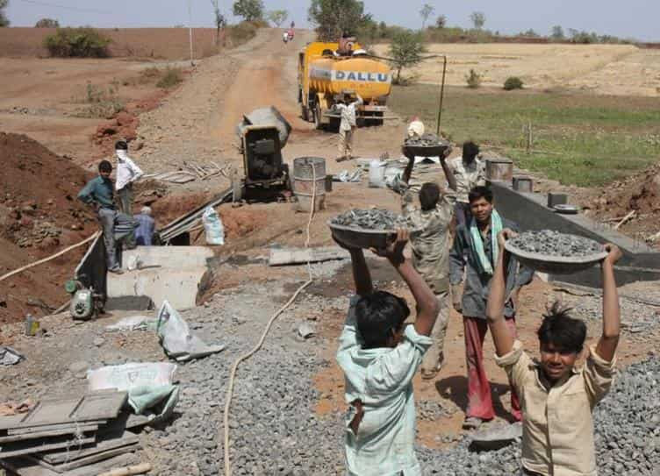
Slide Title
Rural Roads- Precondition for Development
Investment in road infrastructure creates economic opportunities for the poor directly through employment in construction and maintenance, and the provision of rural transport services.
An expenditure of Rs. 1 crore in rural roads is likely to create 20,000 man days of employment. (Planning Commission, 2011)
Have large employment potential for the maintenance of rural roads

Slide 6
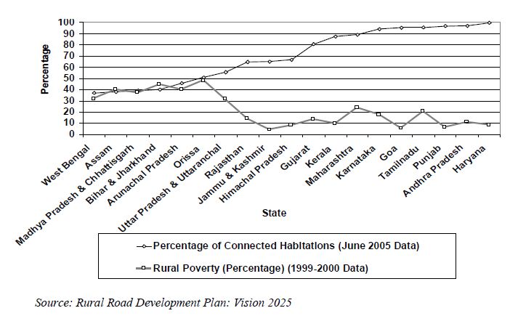
Slide Title
Reduce Poverty
Relationship between Rural Habitations Connectivity and Rural Poverty
Rural Roads are proven poverty reducers by providing access to basic services, reducing vulnerabilities, increasing resilience and providing opportunities.
In India, states having low connectivity had higher poverty levels.

Slide 7
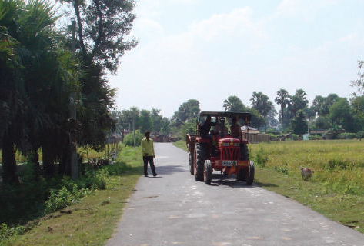
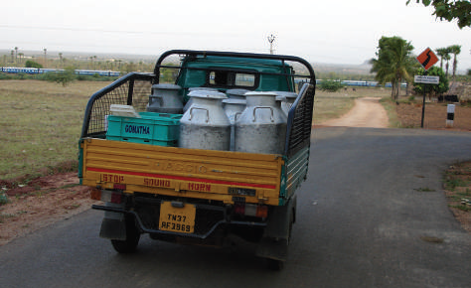
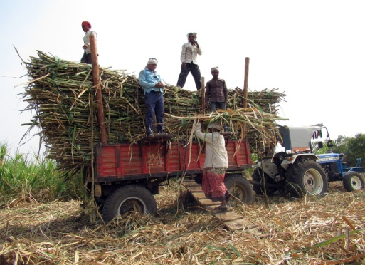
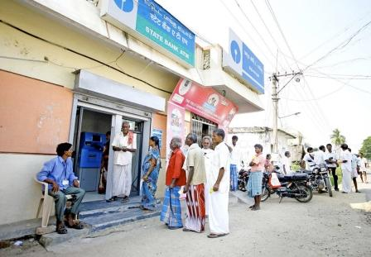
Slide Title
Impact of roads on the agriculture
Minimizes isolation of villages
Better access to agriculture inputs
Saving of Wastage in Marketing
Changes in Cropping Pattern
Support to Milk /Fish Production
Facilitate agro-processing
Introduction of New Farm Technology
Minimizes the role of the middle man
Access to financial institutions

Slide 8
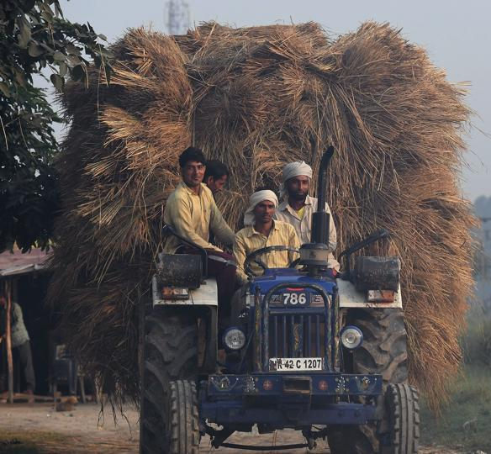
Slide Title
Cont……
As per Central Road Research Institute report (1987) , provision of rural road increases the-
Agricultural production
Fertilizer consumption
Nonagricultural activities
Utilisation of advance agricultural equipments.
A study (1999) carried out by the International Food Policy Research Institute (IFPRI) on linkages between government expenditure and poverty in rural India has revealed that an investment of Rs 1 crore in roads lifts 1650 poor persons above the poverty line.

Slide 9
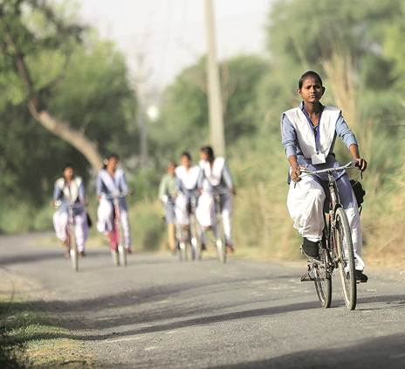
Slide Title
Accessibility to Basic Services……
Rural road connectivity improves the accessibility of -
Schools and Colleges
Health Care Centres
Local Mandies/Market
Sale of Motor Vehicles.

Slide 10
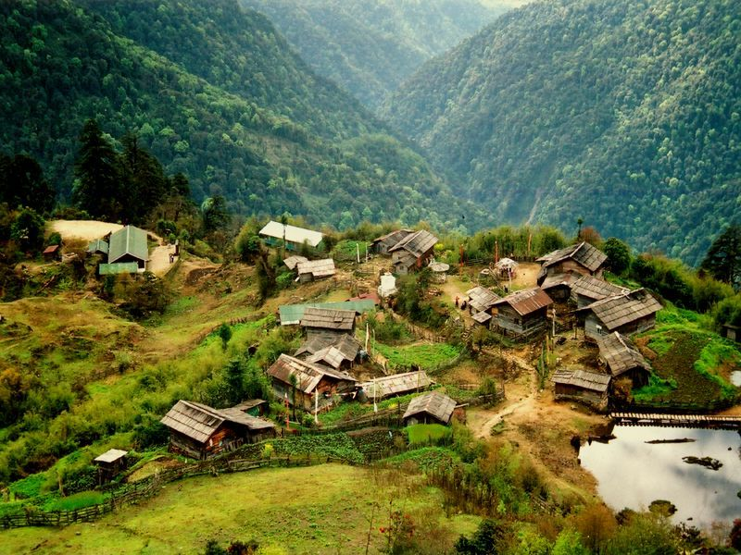
Slide Title
Challenges for Rural Roads in India
India is a diverse country where a large number of the villages are located in difficult geographical conditions
Major challenge before the country was both expansion of the network to connect all unconnected villages and to upgrade and maintain the existing village road network.

Slide 11
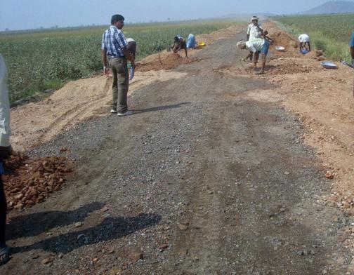
Slide Title
Challenges for Rural Roads………
Rural roads is a state subject, lacked in adequate funds, planning, management and coordination.
Investing in rural roads was given low priority and viewed in isolation from the need for State and National Highways.
Rural roads constructed in the past were without proper design and engineering and are hardly all-weather roads, did not last long.

Slide 12
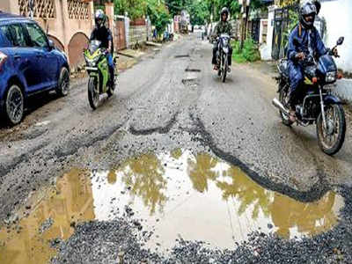
Slide Title
Challenges for Rural Roads………
Many rural roads were of poor quality, potholed and unable to withstand the loads of heavy farm equipments.
Road network continuously damages from adverse climatic conditions, e.g. prolonged floods, sudden cloudbursts, high rainfalls, landslides, and other climatic events.

Slide 13
Slide Title
Status of Rural Road Prior to PMGSY
Till the late 90s, almost 46 % of the villages were not linked with all-weather roads.
National Rural Roads Development Committee (NRRDC) constituted by Government of India in the year 1999 made an assessment of the requirement of construction of rural roads for providing all weather connectivity to unconnected villages of India.
Particulars
Total Number of Unconnected Villages | 2,90,480
Villages with population 1000 and above | 13,852
Villages with less than 1000 population | 2,76,628
Length of road required to be constructed | 11,62,000 km
Requirement of funds | Rs. 93,000 cr.
It was realized that Rural Roads require proper design and the same engineering attention as for any other higher order roads.

Slide 14
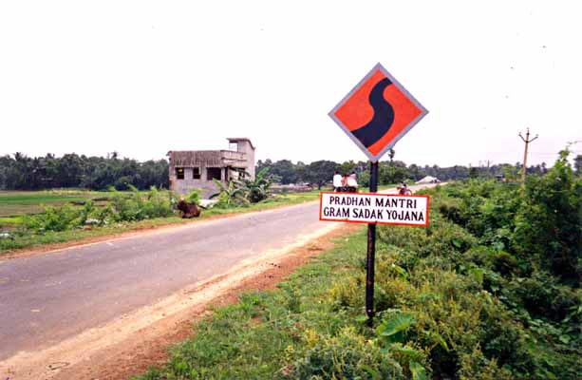
Slide Title
Pradhan Mantri Gram Sadak Yojna, (PMGSY)
On the recommendations of the National Rural Road Development Committee, GoI Launched PMGSY on the 25th December 2000.
Initially it was a 100 % Centrally Sponsored Scheme
Since 2015, Centre- State Sharing: : 60:40 in plain areas and 90:10 in NE and Hilly Area
The PMGSY covers only the rural areas.

Slide 15
Slide Title
PMGSY - Salient Features
The objective of the program is to provide good quality all-weather roads to all eligible habitations and upgradation of existing roads.
Planned to provide connectivity in a phased manner and first priority is accorded for new connectivity.
The order of priority for new connectivity and upgradation is given in the table
Priority | Population size of habitations being connected
I | 1000 and above
II | 500 – 999
III | 250 – 499* (hilly, backward and special areas
IV | Up gradation of through routes
V | Upgradation of selected link roads

Slide 16
Slide Title
PMGSY - Salient Features…..
Funding
Cess on High Speed Diesel (HSD) (Rs. 0.75 / litre)
Budgetary Support from Govt of India
ADB funding
World Bank funding
Internal Borrowings– NABARD Loans.
Five-year Maintenance initial Guarantee of Contractor
All PMGSY roads should be covered under five year maintenance contract along with construction contract.
Maintenance budgeted by the States. Provision of financial incentives for maintenance works by MoRD also provided to the states.

Slide 17
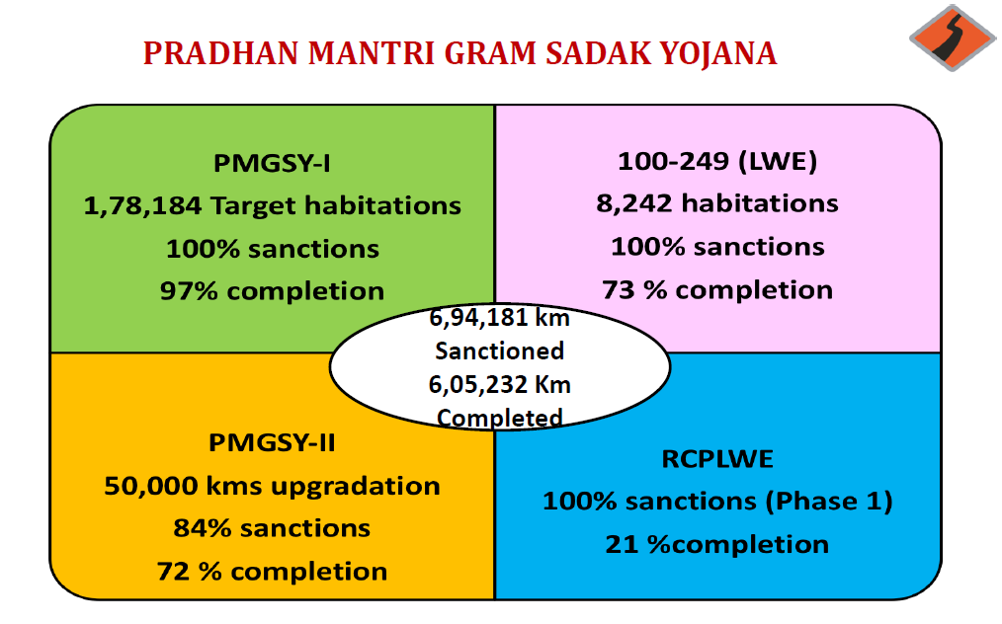
Slide Title
PMGSY Physical Progress
Overall, government has Sanctioned proposal for 6.94 lakh kms road out of which 6.05 lakh Km has been Completed till September 2019.
And In order to achieve these targets, government has spent about Rs. 2.12 lakh crore up to Sept 2019 against the sanctioned projects of Rs. 2.66 lakh crore.

Slide 18
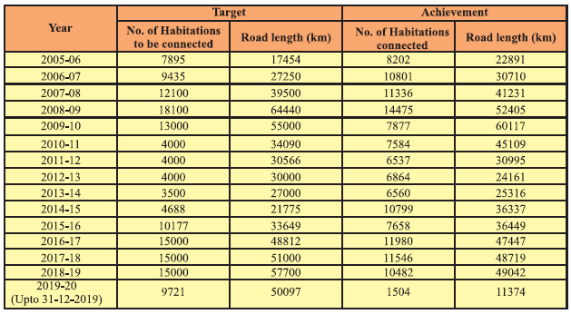
Slide Title
Physical Progress: Road Length Constructed (Km)
As of 31st December 2019, a total of 6,10,182 kms of rural roads were constructed under PMGSY scheme between 2005-19 against the total sanction 7,03,798 kms.
Madhya Pradesh (76,731 kms), Rajasthan (67,189 kms), Odisha (56565 kms), Uttar Pradesh (56309 kms) and Bihar (51487 kms) were the biggest beneficiaries of this scheme.

Slide 19
Slide Title
Status of Rural Roads in India…..
The total road length in the country increased significantly from 3.99 lakh km in 1951 to 62.04 lakh in 2018.
Now India’s road network is the second largest in the world after USA
Credit goes to successive plans, such as, the Minimum Needs Program (MNP), National Rural Employment Program (NREP), Rural Landless Employment Guarantee Programme (RLEGP), Jawahar Rozgar Yojana (JRY) etc.;

Slide 20
Slide Title
Status of Roads in India
Indian Roads are classified into following categories
National Highways (NHs)
State Highways (SHs)
Major District Roads (MDRs)
Other District Roads (ODRs)
Village Roads (VRs)
Category | Category Wise Road Length (Kms) | % share of total road length
National Highways | 114158 | 1.9
State Highways | 175036 | 3.0
District Roads | 586181 | 9.9
Rural Roads (including JRY Roads) | 4166916 | 70.7
Urban Roads | 526483 | 8.9
Project Roads | 328897 | 5.6
Total | 5897671 | 100.0

Slide 21
Slide Title
Status of Rural Roads in India…..
Rural roads consist of Panchayati Raj Roads (Zila Parishad, Panchayat Samiti, Gram Panchayat), Roads of the Pradhan Mantri Gram Sadak Yojna (PMGSY) and those constructed by the PWDs.
The length of rural road in India has been increased from 2.06 lakh kms in 1950-51 to 44.04 lakh kms. in 2017-18

Slide 22
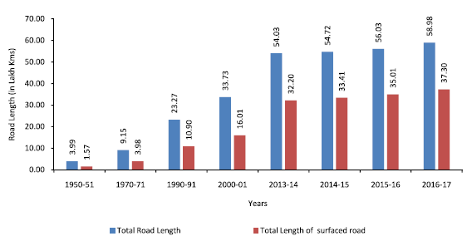
Slide Title
Status of Rural Roads in India…..
Total and Surfaced Road Length (lakh/kms) in India (1951-2017)
% of Surfaced Road in India

Slide 23
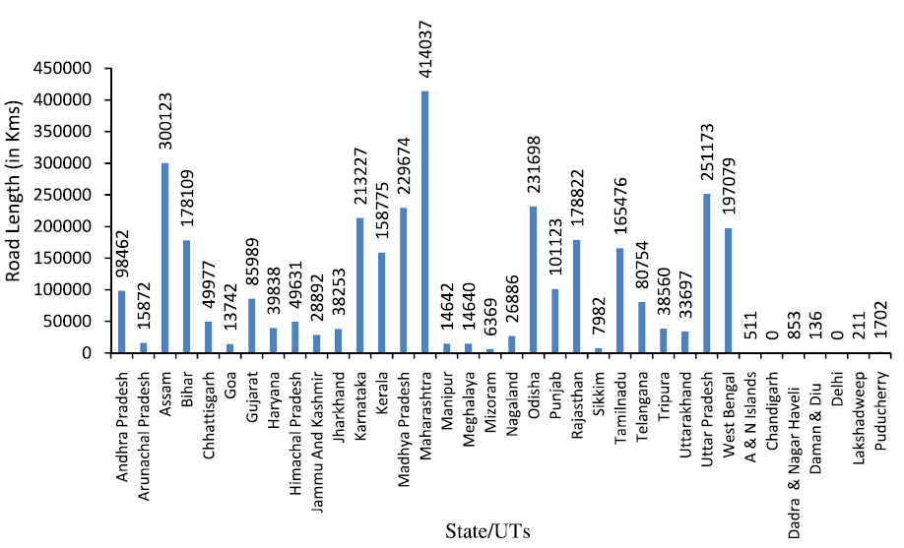
Slide Title
Status of Rural Roads in India…..
State Wise Road Length (lakh/kms) in India as on March, 2017

Slide 24

Slide Title
“Meri Sadak” – a Mobile Application for Citizens Feedback System
Launched on 20th July, 2015 by Hon’ble Minister (RD) for Citizens Feedback System for PMGSY Roads.
Mobile application for citizens to enable them to submit their feedback related to slow pace, abandoned works, poor quality of work and for other categories of any PMGSY roads
On registration of the complaint, the application provides the e-mail and contact number of the concerned State Quality Coordinator.
Support Hindi and other languages

Slide 25
Slide Title
PMGSY-III - Features
The third phase of the PMGSY was implemented in July 2019, under this;-
Up-gradation of existing Through Routes (TR) and Major Rural Links (MRL)
Priority to critical facilities like :
Agricultural and Rural Markets (GrAMs)
Educational facilities (High School, HSC, Girls High School, ITIs, Degree college)
Health facilities (PHC, Veterinary hospital, Bedded hospital, CHC)
Cabinet approved for 1,25,000 kms. and estimated outlay for PMGSY-III: Rs 80,000 Cr
The target date of completion of PMGSY-III programme is March 2025.
Under the third phase of PMGSY (Pradhan Mantri Gram Sadak Yojana), the government has made it conditional for the release of funds that the state governments first undertake reforms to their respective Agriculture Produce Marketing Committee (APMC) laws

Slide 26
Slide Title
Evaluation of PMGSY
Several impact assessment studies have been conducted to find out the feasibility of the PMGSY scheme. Some of the findings of two latest studies (1) The International Labour Organization (ILO), 2015 and World Bank, 2018 is as follows;
ILO-2015 (Bihar, Jharkhand, Rajasthan and UP)
Road construction attracted very complementary investments made by people
Many farmers shifted to crops which were considered feasible and more profitable with the new connectivity.
Significant savings in travel time and cost to reach the market
The employment scenario in non farm sector also improved significantly.
Access to health facilities also improved post construction of the road
Improvements in girls enrolment in high schools
Increase in number of institutional deliveries

Slide 27
Slide Title
Evaluation of PMGSY
World Bank- 2018 (Himachal Pradesh, Madhya Pradesh and Rajasthan)
PMGSY has improved the village accessibility, particularly in hilly areas
It has increased access to economic opportunities, triggering a change in the structure of employment in rural areas
Improved farm to market connectivity..
Increased access to markets had some effects on farming practices.
Had a positive impact on human capital formation (education)
Improved the living standard of rural people
The share of babies delivered at home decreased by 30 percent.
Vaccination among children increased by 15 percentage.

Slide 28
Slide Title
Conclusion
The growth of rural and other roads has been phenomenal. Despite this growth, there are still some concerns with respect to rural road.
As per Fifteenth finance commission, there is a lack of maintenance of rural roads in India and if repairs and renewals are not done in time, the rate of deterioration of the roads would accelerate and economic gains from building the roads would be lost.
Delayed completion of works in some Hilly areas and Naxal affected areas is delaying the rural connectivity targets in these areas.
Use of new technologies for construction and monitoring of rural roads need to be adopted in the entire rural road sector to take full advantage of the available technologies for cost effective and sustainable rural road.

Slide 29
Slide Title
Further Readings
MoRd (2011): Working Group on Rural Roads in the 12th Five Year Plan, 2011, Ministry of Rural Development, GoI, Downloaded from https://niti.gov.in/planningcommission.gov.in/docs/aboutus/committee/wrkgrp12/transport/wgrep_rural.pdf
S. Aggarwal (2018): Do rural roads create pathways out of poverty? Evidence from India, Journal of Development Economics, 133 (2018) 375–395, Downloaded from https://www.isb.edu/faculty/shilpa_aggarwal/files/shilpa-aggarwal-rural-roads.pdf.
V. Anand & Patel F. (2015): Roads Facilitating Rural Accessibility: A Critique of the PMGSY, Institute of Rural Management Anand, Working Paper 275, ISSN 2454-7115 , Available from https://www.irma.ac.in/uploads/randp/pdf/1526_24192.pdf

Slide 30
Slide Title
Thank You

