Slide 1

Housing for Poor in Rural India
A critical Analysis
Dr. Amit Kumar Singh
IIPA, New Delhi

Slide 2

Slide Title
Introduction
Among the three basic necessities of human being, i.e. food, clothes and shelter– shelter is the most expensive need and therefore remains unattended for poor or not easy to achieve.
Owning a house is dream for the common man across the world.
But to construct or buy a house, one needs to spend huge amount of money, especially in a country like India where a large section of rural population are landless and do not have any financial means.

Slide 3
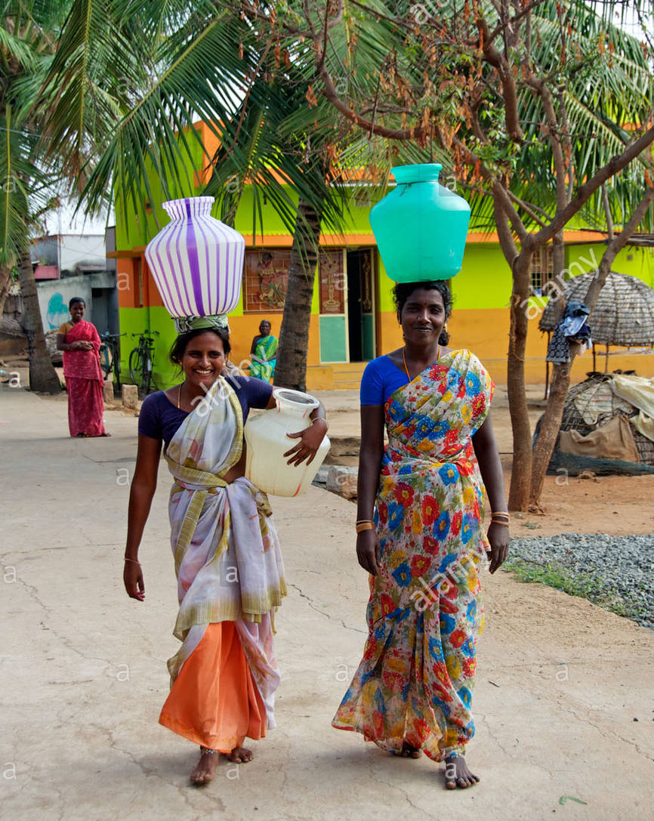
Slide Title
Introduction
Housing is a package of services (land, public facilities and access to jobs) as well as the structure itself (UN-Habitat, 2010).
Housing determines the quality of life and welfare of people and places.
Housing is both a consumer good as well as a capital good.

Slide 4
Slide Title
Contribution of Housing
Consumer Goods
In rural India, housing is viewed from the perspective of consumption by villagers. People build and repair their homes according to the needs of the family as and when they have saved enough money.
People need homes and not just houses, a home where people construct their dreams and their family life is taken care of.
Economic Goods
Investment in housing has a very high multiplier effect on income and employment. It is estimated that overall employment generation in the economy due to additional investment in the housing/construction is eight times the direct employment (IIM-Ahmedabad Study, 2000).
In India, housing directly contributes 11% of gross domestic product (GDP) and triggers another 5-6% on average in downstream expenditures.

Slide 5
Slide Title
Housing for Good Governance
For a welfare state like India, housing is a foundation for democracy, governance, and security.
Housing construction in low-income neighborhoods reduces poverty
Economic security to the poor
Empowering women
Housing may bring people to jobs
Social security
Gives stability & increases productivity
Reduces morbidity & Mortality

Slide 6
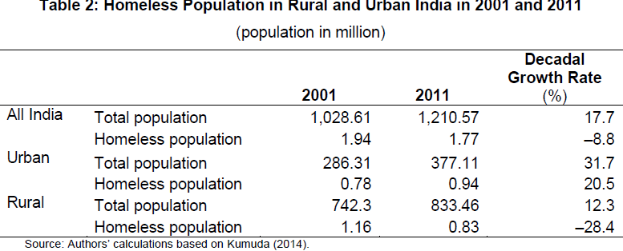
Slide Title
State of Housing in Rural India
In rural India, Housing Quality is a big issue rather than Housing Quantity
Considering the size of the 1.21 billion population in the country, the housing shortage in rural India with regard to houseless population does not appear very big.
Housing problem in Rural India is more related with the replacement needs of houses in bad physical condition (due to age and structural durability), as well as the ones that offer substandard living conditions.
Homeless population in Rural and Urban India in 2001 & 2011
(population in million)
Source: ADBI, 2016

Slide 7
Slide Title
Housing Policies in India
Housing Policies in India can be divided into four phases;
1st phase comprising of first two decades (1950s to 1970s) where the policies were taking shape that focused more upon integrating all sections of the society.
The second phase (1970s to mid-1980s), shifting the focus to the economically weaker section (EWS) of the society.
The third phase (1980s to 2000s), focusing more on physical provision of housing as well as housing finance mechanisms.
The last phase (2000s to present) shifting the role of government as facilitator of housing.
Sr. No. | Housing Schemes | Launched in Year
1 | Village Housing Projects Scheme | 1957
2 | Land Acquisition and Development Scheme | 1959
3 | Provision of House Sites of Houseless Workers in Rural Areas | 1971
4 | Indira Awas Yojana | 1985
5 | 2 Million Housing Programme | 1998
6 | Pradan Mantra Gramodaya Yojana | 2001
7 | Jawaharlal Nehru National Urban Renewal Mission | 2005
8 | Rajiv Awas Yojana | 2011
9 | Pradhan Mantri Awas Yojana- Housing for All (Urban) | 2015

Slide 8

Slide Title
Indira Awas Yojana (IAY)
The Indira Awas Yojna (IAY) was launched during 1985-86 as a sub-scheme of RLEGP.
In 1989, IAY was made a sub-scheme of JRY.
Six percent of JRY Funds were allocated for the implementation of IAY.
Initially targets was to provide grant for construction of houses to members of Scheduled Castes/ Scheduled Tribes, freed bonded labourers and also to non-SC/ST rural poor below the poverty line.
In 1996, IAY was made an independent scheme and become the flagship scheme programme of MoRD.

Slide 9
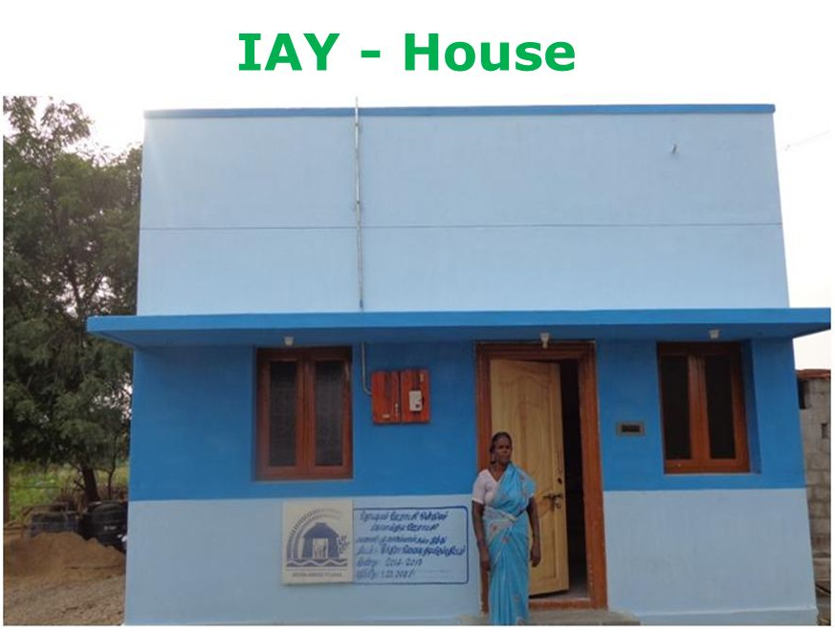
Slide Title
Indira Awas Yojana- Salient Feature
From 1995-96, the IAY benefits have been extended to ex-servicemen, widows or next-of kin of defence personnel and para military forces killed in action irrespective of the income criteria subject to the condition
NON-SC/ST should not exceed 40% of total IAY allocation during a financial year.
3% of the funds have been earmarked for the benefit of disabled persons below poverty line
Financial assistance under IAY given for
  Construction of new house (Rs. 70,000 -75,000)
  Up gradation of kutcha or dilapidated house (Rs. 15,000)
  Purchase of house site (Rs. 20,000)

Slide 10
Slide Title
Performance of House Construction under IAY during the XI Plan period
Implementation of IAY scheme has yielded mixed results in the area of housing and human settlements.
Under IAY, since inception, 320.55 lakh houses have been constructed, incurring an expenditure of Rs. 1,05, 518.85 crores.
The target set for IAY under the XI Five year plan was 150,00,000 houses over a period of five years.
Year | Central Allocation (Inn Lakh rs.) | Central Allocation | Utilization | Target (No. of Houses in Lakh) | Constructed (No. of Houses in Lakh)
2002-3 | 165640 | 162852 | 279496 | 13.14 | 15.49
2003-4 | 187050 | 187107 | 258009 | 14.84 | 13.61
2004-5 | 246067 | 288310 | 326208 | 15.62 | 15.21
2005-6 | 273240 | 273822 | 365409 | 14.41 | 15.52
2006-7 | 290753 | 290753 | 425342 | 15.33 | 14.98
2007-8 | 403270 | 388237 | 546454 | 21.27 | 19.92
2008-9 | 564577 | 879579 | 834834 | 21.27 | 21.34
2009-10 | 849470 | 863573 | 1329236 | 40.52 | 33.86
2010-11 | 1005370 | 1013945 | 1346572 | 29.08 | 27.15
2011-12 | 949120 | 986477 | 1292632 | 27.26 | 24.71

Slide 11
Slide Title
Rural Housing Condition
The brief highlights on different indicators shows that living conditions of Rural Households was still very poor in rural areas
Household Amenities in India (Census 2011) (in%)
Area | Water within Premises | Kitchen within house | Toilet within premises | Bathroom | Drainage | Electricity
Rural | 35 | 45 | 31 | 25 | 33 | 55
Urban | 71 | 78 | 81 | 77 | 82 | 93
Total | 47 | 56 | 47 | 42 | 51 | 67

Slide 12
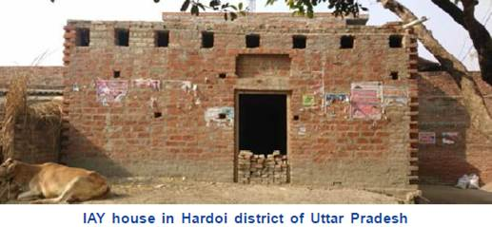
Slide Title
Performance of House Construction under IAY
To some extent IAY could helped rural people to realise the dream of having one’s own house to lead safe, secure life.
However, IAY also faced lots of challenges; people could not get comfortable and healthy life as desired.
Houses constructed under the IAY were usually of small size – 20 sq. metres including the verandah.
Large scale discrepancy found in beneficiaries list.
Week monitoring system of IAY
Difficulty in getting land as the cost of land is very high across India. If land was available, it was very far away from the main panchayat and some places in Agricultural fields and even in forest areas.

Slide 13
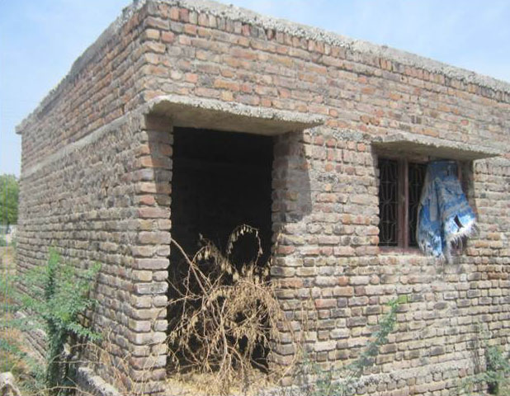
Slide Title
Performance of House Construction under IAY during the XI Plan period
The proportion of IAY assistance to the total construction cost of the house was very low in India. It was observed very low in states like H.P (28.38%) followed by Kerala (33.8%), Orissa (37.7%) etc. where construction is very high.
People borrowed money, usually through informal sources, to meet the additional requirement of funds.
Banks were not willing to pay loans as the credit amount seems to be very low in almost of all the states
Amount was utilized for household consumption during construction by beneficiaries.
Alternative technologies and building materials have not reached large parts of rural India.
Lack of convergence with other schemes

Slide 14
Slide Title
Estimation of Rural Housing Shortage (2012)
In 2011, the Planning Commission constituted a Working Group on Rural Housing for the Twelfth Five-Year Plan “to provide a perspective and approach on rural housing.”
The Working Group made their estimate for the rural housing in India for the period 2012-2017 shortage by applying the following method;
Rural Housing Shortage = Houseless Population + No. of temporary houses + Shortage due to Obsolescence +Shortage due to congestion + additional housing shortage arising between 2012 to 2017

Slide 15
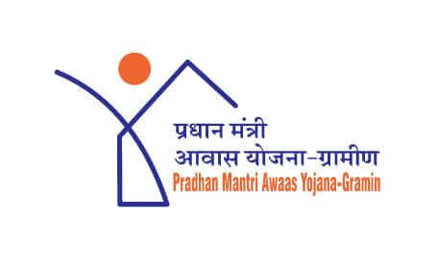
Slide Title
Pradhan Mantri Awaas Yojana-Gramin
“By the time country completes 75 years of its sovereignty, every family will have a pucca House with water connection, toilet amenities, 24*7 supplies of electricity and right to use.”
Honorable President of India in his address to the Joint Session of Parliament on 9th June 2014

Slide 16
Slide Title
Salient Features of Pradhan Mantri Awaas Yojana-Gramin
To address the gaps in the earlier scheme, GoI decided to re-construct the IAY scheme into Pradhan Mantri Awas Yojna – Gramin (PMAY-G) w.e.f. April, 2016.
Its objective is to provide financial assistance and/or pucca houses along with all the basic amenities, such as power supply, sanitation, etc. to families without houses or living in kutcha and dilapidated houses in rural areas of India, except Delhi and Chandigarh.
Convergence
with other schemes
SECC 2011 used to select beneficiary
Loan facility up to Rs. 70000
Rs. 1.2 lakh for Plain Area & 1.3 lakh for hilly
29.5 Million House till 2022
Inclusion of female member in Registry
Unit Size fixed at 25 sq.mt
Mandatory
DBT
Rs.90.95/day of unskilled labor from MGNREGS

Slide 17
Slide Title
Salient features of PMAY (Gramin)
This scheme aims to build 29.5 million houses for the rural poor for 2022.
The cost of unit (house) assistance is to be shared between central and state governments in the ratio 60:40 in plain areas and 90:10 for north-eastern and hilly states.
Beneficiaries of the rural houses would be chosen according to data taken from the Socio-Economic Caste Census of 2011
An allowance of Rs. 120,000 in plain areas and Rs. 130,000 in hilly areas will be provided for construction of homes.

Slide 18
Slide Title
Salient features of PMAY (Gramin)……….
The unit size has been enhanced from the existing 20 sq.mt. to up to 25 sq.mt. including a dedicated area for hygienic cooking.
Provision of 90-95 man days of unskilled labor from MGNREGS.
Beneficiaries are identified using parameters from Socio Economic and Caste Census (SECC) and verified by Gram Sabhas.
Funds are being transferred electronically directly to the Aadhaar linked account of the beneficiary.

Slide 19
Slide Title
Salient features of PMAY (Gramin)………
The beneficiary can be facilitated to avail loan of up to 70000 rupees for construction of the house which is optional.
The houses under the mission should be designed and constructed to meet the requirements of structural safety against earthquake, flood, cyclone, landslide, etc
The houses constructed/acquired with central assistance under the mission should be in the name of the female head of the household or in the joint name of the male head of the house hold and his wife, and only in cases when there is no adult female member in the family, the house can be in the name of male member of the house hold.

Slide 20
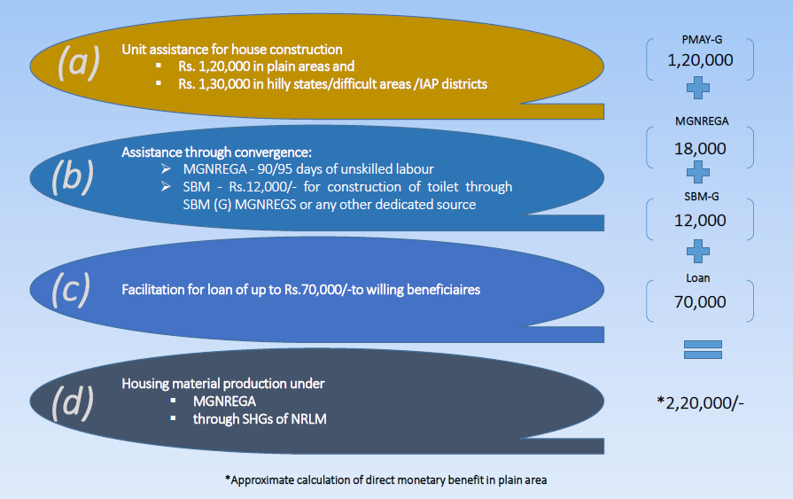
Slide Title
Assistance through convergence

Slide 21
Slide Title
Sanction of house to Beneficiaries
Mapping of villages & SECC data verification by Gram Sabha
Target Setting By States
Registration
Uploading of geo-tagged photographs using Awaas App
Mobile No
Bank A/c N
Aadhaar No.
Existing dwelling unit
Site for construction
SANCTION

Slide 22
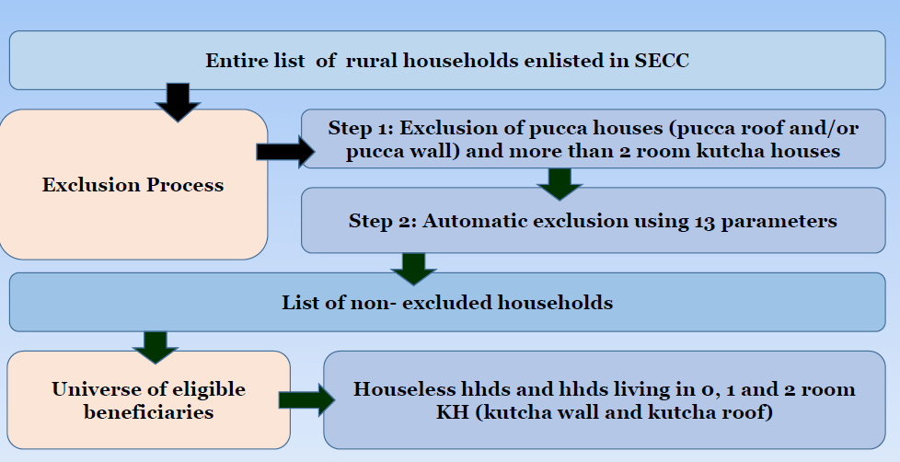
Slide Title
Selection of Beneficiaries

Slide 23
Slide Title
Automatic Exclusion Criteria
1. Motorised two/three/four wheeler/ fishing boat
2. Mechanised three/ four wheeler agricultural equipment
3. Kisan Credit Card with credit limit of Rs.50,000 or above
4. Household with any member as a Government employee
5. Households with non-agricultural enterprises registered with the Government
6. Any member of the family earning more than Rs.10,000 per month
7. Paying income tax
8. Paying professional tax
9. Own a refrigerator
10. Own landline phone
11. Own 2.5 acres or more of irrigated land with at least one irrigation equipment
12. 5 acres or more of irrigated land for two or more crop seasons
13. Owning at least 7.5 acres of land or more with at least one irrigation equipment

Slide 24
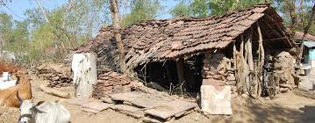
Slide Title
Automatic Inclusion and Deprivation Criteria
Automatic Inclusion
Households without shelter
Destitute / living on alms
Manual scavengers 4. Primitive Tribal Groups
Legally released bonded labourer
Deprivation Parameters- Each Having Equal Weightage
No adult member between the ages of 16 and 59
Female headed households with no adult male member between 16 and 59
Households with disabled member and no able bodied adult member
Households with no literate adult above 25 years
Landless households deriving a major part of their income from manual casual labour.

Slide 25
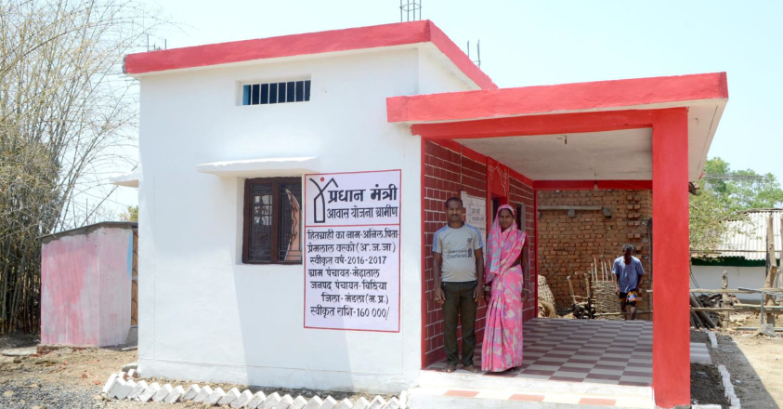
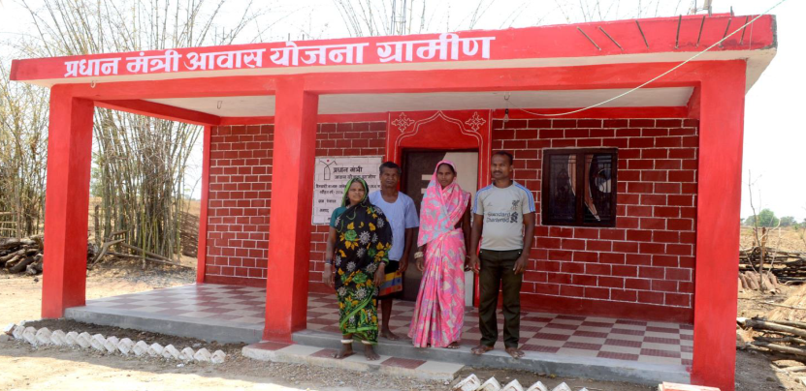
Slide Title
Achievements of Pradhan Mantri Awaas Yojana (Gramin)
Financial year | Houses completed under IAY | Houses completed under PMAY-G | Total rural houses completed.
2014-15 | 11.93 |  | 11.93
2015-16 | 18.23 |  | 18.23
2016-17 | 32.12 | 0.02 | 32.14
20 17-18 | 6.36 | 38.18 | 44.54
Sub-total | 68.64 | 38.20 | 106.84
2018-19 | 1.06 | 5.34 | 6.40
Grand Total | 69.7 | 43.54 | 113.24

Slide 26
Slide Title
Challenges and policy issues
Identification – Mapping of beneficiaries to villages, deletion of eligible households, addition of ineligible households, wrong capturing of category in SECC, Addressing of grievances through Appellate Mechanism.
Land to landless :
PFMS – Bank account verification, Pending transfer of assistance, False success / reject cases.
Mason Training – Identification of Training Provider, Conduct of pilot training, scaling of training, linking of trained masons to the beneficiaries

Slide 27
Slide Title
Challenges and policy issues
Quality – Ensuring quality in construction of house, availability of material at reasonable rates, use of locally available materials
Awareness to beneficiaries – about the scheme, eligibility, house designs, quality construction material, loan to willing beneficiaries.
Monitoring – Geo-tagging, Setting up of PMU at different levels, disposal of grievances
House designs – Identification, construction of demo houses, Penetration / adoption of identified house designs

Slide 28
Slide Title
Further Readings
Gopalan Kalpana and Madalasa Venkataraman (2015); Affordable housing: Policy and practice in India; IIMB Management Review 27, 129-140; www.sciencedirect.com
Hirway I. (1987), “Housing for the Rural Poor”; Economic and Political Weekly, Vol. 22, Issue No. 34, 22 August, pp. 1455-1460.
Kumar Arjun (2014), Estimating Rural Housing Shortage, Economic & Political Weekly Vol. 49 No. 26-27, 28 June, pp. 74-79.
MORD (2011): National Housing Bank (2012) “Report on Rural Housing- Report on Trend and Progress of housing in India, 2012”, Retrieved from http://www.nhb.org.in/Whats_new/Report-on-Trendand- Progress-of-Housing-in-India-2013.pdf Dated 5th January, 2015)
MoHUPA (2013): State of Housing In India A Statistical Compendium, 2013, Retrieved from http://mohua.gov.in/upload/uploadfiles/files/Housing_in_India_Compendium_English_Version2.pdf
National Housing Bank (2012) “Report on Rural Housing- Report on Trend and Progress of housing in India, 2012”, Retrieved from http://www.nhb.org.in/Whats_new/Report-on-Trendand-Progress-of-Housing-in-India-2013.pdf Dated 5th January, 2015).
Tiwari, Piyush (2007), “Rural Housing in India”, India Infrastructure Report 2007: Rural Infrastructure, New Delhi: Oxford University Press.

Slide 29
Slide Title
Thank You

