Slide 1
RURAL ECONOMY IN INDIA
Saket Bihari
Indian Institute of Public Administration,
New Delhi-110002.

Slide 2
Rural Economy:
Rural economy may be conceptualized as a collection of economic, social, institutional, legal, political and technological arrangements through which individuals in society seek to increase their material and spiritual well being.
The elementary functions of an economy are: (i) Consumption, and (ii) Production
Indian Rural Economy comprises two main sectors:
(A) Agricultural sub-sector
(B) Non-Agriculture sub-sectors
Agricultural sub-sector comprises agriculture and allied activities, such as (i) Animal husbandry and dairying, (ii) Fisheries , (iii) Poultry, and (iv) forestry etc..
The non-agricultural sub-sector consists of economic activities relating to small-scale village industries, rural craft, business and service industry (cottage and village industries, Khadi, handloom, handicrafts and so on)
Business refers to microeconomic enterprises , trading of general goods, small shops, petty traders and so on.
Services refers to transport, communications, banking, input supply, marketing of farm and non-farm produce and so on.
The main stakeholders of rural sector include farmers, agricultural and non-agricultural laborers, artisans, traders, money lenders and those engaged in providing such services as transport, communications, processing, banking and education and extension.

Slide 3
As per the Census-2011, 72.4 per cent of workforce stayed in rural areas.
According to UNDP report 2012, population projections indicate that India will continue to be predominantly rural till the year 2050 after which urban population is estimated to overtake rural population.
About half of the national income and more than two third of the total employment is generated from rural areas.
The higher dependency on rural areas for employment is a major reason for low level of per worker income.
Rural economy help fulfil basic requirements of the people.
The

Slide 4
Sectors | %
1. Mineral Based Industry (MBI) | 12
Pottery
Lime
2. Agro Based & Food Processing Industry (ABFPI) | 16
Pulses & Cereals Processing Industry
Gur & Khandsari Industry
Palmgur Industry
Fruit & Vegetable Processing Industry
Village Oil Industry
3. Polymer & Chemical Based Industry (PCBI) | 13
Leather Industry
Non Edible Oils & Soap Industry
Cottage Match Industry
Plastic Industry
4. Forest Based Industry (FBI) | 3
Medicinal Plants Industry
Bee Keeping Industry
Minor Forest Based Industries
5. Hand Made Paper & Fibre Industry (HMPFI) | 14
Hand Made Paper Industry
Fibre Industry
6. Rural Engineering & Bio Technology Industry (REBTI) | 18
Non Conventional Energy
Carpentry & Blacksmithy
Electronics
7. SEP/Service Industry | 24
V. I. Co-ordination

Slide 5
KHADI PRODUCTION AND SALES (IN Cr.)
Year | Production | Sales
2013-14 | 811.08 | 1081.04
2014-15 | 879.98 | 1170.04
2015-16 | 1065.6 | 1510.00
2016-17 | 1404.14 | 2007.61
 | 2004-14 | 2015-18
Growth in Average Khadi Production | 6.52% | 26.43%
Growth in Average Khadi Sales | 6.62% | 31%
Number of Khadi Outlets funded for Modernization | Nil | 728
Computer, Hardware/Software Supplied to Khadi Institution for Digitalization | Nil | 400

Slide 6
As per the “Basic Animal Husbandry Statistics” 2019 (Department of Animal Husbandry & Dairying:
MILK PRODUCTION
Total milk Production in our country is 187.75 Million Tonnes
The milk production has increased by 6.5% over the previous year
The per capita availability of milk is 394 grams per day.
The average yield per animal per day for crossbred is 7.95 Kg (8.7%**), and indigenous: 3.01 (5.7%**) Kg per day.
The top milk producing States are: UP (16.3%), Rajasthan (12.6%), MP (8.5%), AP (8.0%) Gujarat (7.7%): Together: (53.1%).
Maximum Milk production: 35% from Buffalo (indigenous): Buffalo Non-descriptive (14%)
EGG PRODUCTION
The total egg production in our country is 103.32 Billion Numbers.
8.5% increase in the number of egg production.
The per-capita availability of egg is 79 eggs per annum.
The top Egg producing States are: AP (19.1%), Tamil Nadu (18.2%), Telangana (13.2%), West Bengal (8.3%) and Haryana (5.9%).

Slide 7
MEAT PRODUCTION
The total meat production in our country is 8.11 Million tonnes.
The meat production has increased by 6.0% as compared to previous year.
The meat production from Poultry is 4.06 Million tonnes, contributing about 50% of the total meat production. The poultary meat production has increased by 7.86% over previous year.
The top five meat producing states are: U P (15.1%), Maharashtra (12.6%), West Bengal (10.2%), AP (9.6%) and Telangana (9.3%). Together: 56.9%
Poultry: 50.06%, Buffalo: 19.05%, Goat: 13.53%, Pig: 4.98% and Cattle: 4.02%
WOOL PRODUCTION
The total wool production in our country is 40.42 million Kgs.
The wool production has declined by 2.5% as compared to previous year.
The top four wool producing States are: Rajasthan (35.9%), Telangana (10.5%), Karnataka (7.6%) and Gujarat (5.6%)

Slide 8
FISHERIES
Indian fisheries and aquaculture is an important sector of food production providing nutritional security, besides livelihood support and gainful employment to more than 14 million people, and contributing to agricultural exports. With diverse resources ranging from deep seas to lakes in the mountains and more than 10% of the global biodiversity in terms of fish and shellfish species, the country has shown continuous and sustained increments in fish production since independence. The total fish production during 2017-18 was estimated to be 12.60 million metric tonnes, of which nearly 65% is from inland sector and about 50% of the total production is from culture fisheries, and constitutes about 6.3% of the global fish production.
Commencing as a purely traditional activity, fisheries have now transformed in to a commercial enterprise. The share of fisheries sector in the total GDP increased from 0.40% in 1950-51 to 1.03% in 2017-18, recording an increase of 157%.
The sector contributed Rs. 1,75,573 crore to the GDP during FY 2017–18 (Ministry of Statistics and Programme Implementation, 2020).
The sector has been showing a steady growth in the total Gross Value Added and accounts for about 6.58 per cent share of Agricultural GDP. (DRAFT NATIONAL FISHERIES POLICY, 2020: National Fisheris development Board, department of Fisheries, Ministry of Fisheries, Animal Husbandry, Dairying, GoI).

Slide 9
Agriculture is the primary source of livelihood for about 58 per cent of India’s population.
The Indian food industry is poised for huge growth, increasing its contribution to world food trade every year due to its immense potential for value addition, particularly within the food processing industry.
Indian food and grocery market is the world’s sixth largest, with retail contributing 70 per cent of the sales. The Indian food processing industry accounts for 32 per cent of the country’s total food market, one of the largest industries in India and is ranked fifth in terms of production, consumption, export and expected growth.

Slide 10
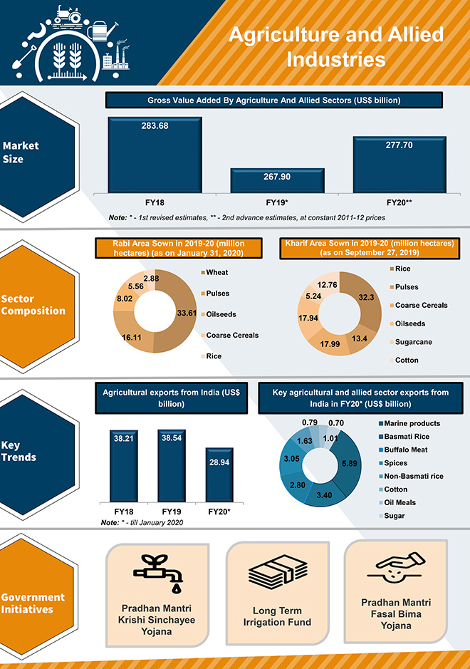

Slide 11
