Slide 1

Emotional Intelligence

Slide 2
Topics to be discussed
1. What are Emotions?
2.Defining Emotional Intelligence
3. Domains of Emotional Intelligence (EI)
4. Steps in developing EI
5. Importance of EI

Slide 3

Emotions
A feeling and its distinctive thoughts, psychological and biological states and range of propensities to act.” -Daniel Goleman
Hundreds of emotions along with their blends, variations, mutations and nuances. More subtleties of emotions than we have words for

Slide 4
Emotions are neither positive nor negative.
Neither good nor bad.
But, their effect is good or bad.
Emotions are neutral, powerful and important.
If you are tuned-out of your own emotions, You will be poor at reading them in other people.

Slide 5
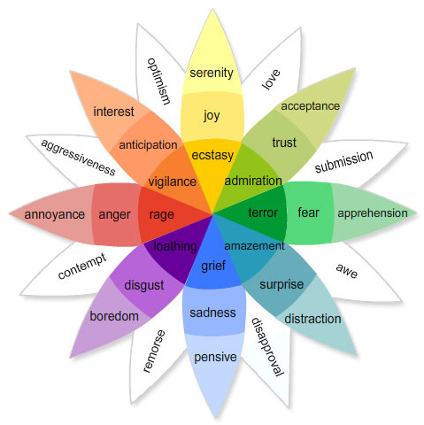
Plutchik’s Wheel of Emotions

Slide 6
"Emotion is the Key"

Slide 7
THINK
And
FEEL
“Without the guidance of emotions, reasoning has neither
principles nor power.” - Prof R. C. Soloman

Slide 8
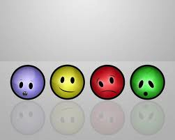
What is Emotional Intelligence?
Emotional intelligence (EI) refers to the ability to perceive, control and evaluate emotions.
Ability to use the power of emotions intelligently
Ability to recognise emotions in self and others
& to deal with them effectively.

Slide 9
The ability to recognize and respond to the emotions and feelings of others as well as the skill to help others manage their emotions.
The capacity to be aware of, control, and express one's emotions, and to handle interpersonal relationships judiciously and empathetically.
It is the ability to sense , understand and effectively apply the power and acumen of emotions as a source of human energy, information connection and influence. -Robert K Cooper & Ayman Sawaf

Slide 10





What is Emotional intelligence?

Slide 11
“Great leaders move us. They ignite our passion and inspire the best in us. When we try to explain why they are so effective, we speak of strategy, vision or powerful ideas. But the reality is much more primal. Great leadership works through emotions”.
- Daniel Goleman
“One of the biggest impediments to effective decision making today is that literature and all the consultants have recommended that emotions and passion be taken out of management. They think that strategy is purely an analytical exercise.”
--Prof C K Prahalad

Slide 12
DOMAINS OF EMOTIONAL INTELLIGENCE
Self
Others
Awareness /
Recognition
Self Awareness
Social Awareness
EI
Regulation
Self Management
Relations Management
Personal Competence
Social Competence

Slide 13
The Four Emotional Quotient (EQ) Skills
Daniel Goleman's – Theory
PERSONAL COMPETENCE
SOCIAL COMPETENCE
Self Awareness
Social Awareness
Self Management
Relationship Management
WHAT I SEE
WHAT I DO

Slide 14
Self Management
Emotional Self Control
Keeping disruptive emotions and impulses under control. Calm & clear headed. Delaying gratifications.
  Research on kids: offered chocolate

Slide 15
Understanding others’ Emotions
Nonverbal Communication
Focus on the other person
Make eye contact
Pay attention to nonverbal cues

Slide 16
Developing EQ
1. Acceptance of the EI
  Importance of Emotions.
  Power or Need of Emotional Intelligence.
  Scope of developing
2. Self Awareness
  Emotional Scanning & Establishing the current Emotional Status
    Awareness of own emotions.
    Admit your emotions, do not ignore or deny them
    Own your emotions and accept responsibility for what you do
    Degree of expression & suppression.
    Experiencing Emotions at will.

Slide 17
3. Awareness and Acceptance of Emotions in others.
  Degree of Empathy possessed.
  Awareness of Response to Emotions.
  Is yardstick same for self & others?
  Emotional Response depends upon.
    Physiological consideration.
    A learnt behaviour.
    Conditioned Response.
4.Defining the Emotional Road Map.
  Desired EI (Ideal EI State)
  EQ- Self audit. Check your thoughts & feelings.
  Identification of gaps or specific need felt.

Slide 18
5. Sharpening the Cutting Edge.
  Conscious learning process.
6 Integrating “Thoughts” & “Feelings”
Integrate your emotions with your intellect and allow yourself
to learn to grow as a person.
Report your emotions congruent with the communication
means –an accurate match between what you are saying and
what you are experiencing.
Developing Action Plan based on learning.

Slide 19
  Action, Action & Action
    Maintaining a Journal.
    Group intervention.
    Self Analysis.
    Meditation.
    Review.

Slide 20
Importance of Emotional Intelligence
Performance at work
More conscious of your performance
Physical health
Only by being aware of our emotional states and reaction to stress in our lives can we hope to manage stress and maintain good health
Mental health
Helps to alleviate anxiety and avoid depression and mood swings
Affects our attitude and outlook in life
Relationships
Helps to communicate our feelings in a constructive way
Helps in understanding the needs, feelings and emotions of people we care about
Enables easier coordination among people

Slide 21
Importance of Emotional Intelligence (continued..)
Conflict Resolution
Helps in empathizing with others
Negotiation Skills
Success
Leadership
Improves self confidence
Ability to focus on a goal
Helps in understanding how own emotions and actions affect others
Helps in relating to others

Slide 22
    THANK YOU

