Slide 1
PERCEPTION

Slide 2
Topics to be discussed
1.What is Perception?
2.Process of Perception
3. Factors affecting Perception
4.Percpetual errors
5. Implications

Slide 3
Perception
Perception is the process of selection and organization of environmental stimuli and interpreting them to provide meaningful experiences for the perceiver.
Perception represents the psychological process whereby people take information from the environment and make sense of their world. (Banks and Krajicek, 1991).

Slide 4
Our acquired learning can assist and distort our judgement of others.
Awareness Choice of Appropriate Action

Slide 5
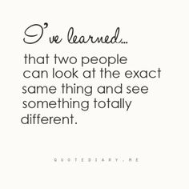

Slide 6
Process of Perception
1. Receiving
2. Selecting
3.Organising
4. Interpreting

Slide 7
Factors influencing Perception
Characterstics of Perceiver
Characterstics of Target
Characterstics of Situation

Slide 8


Perceiver Characteristics
Attitudes/Self concept
Mood
Learning
Need
Target Characteristics
Physical appearance
Size
Contrast
Repitition
Location
Errors/Barriers
Stereotyping
Halo Effect
First-impression error
Projection
Self-fulfilling prophecies
Attribution
Social
Perception
Factors influencing Perception
Situational Characteristics
Interaction context

Slide 9
Characteristic of the Perceiver
1.Attitude : A negative attitude & self concept can lead perceiver to pick out negative traits in other person.
2.Mood : In positive mood we form more positive impression of others.
3. Learning
4.Needs

Slide 10
Characteristics of the situation
1. Social Context of the interaction
The situation in which the interaction between the perceiver and target takes place.
Business conversations after working hours or at lunch are taboo in Japan. If you try to talk business during these times, you may be perceived as rude.

Slide 11
Errors in Perception
Stereotyping:
We judge someone on the basis of group.
Halo Effect:
When we draw a general impression about an individual on the basis of a single characteristic, such as intelligence, sociability or appearance.
Projection :
Tendency of people to see their own traits in other people. People project their feelings, tendencies, motives into their judgement of others
First impression error:

Slide 12
Expectancy /Pygmalion Effect:
Self fulfilling Prophecy:
Individual behavior is determined by other person’s expectations. If a boss expects big things from his people, they are not likely to let him down.
A boss’s expectations of an individual affect both his/her behavior towards the individual and the individual’s response.

Slide 13
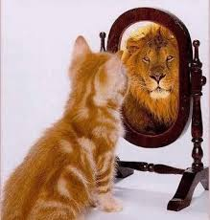

Slide 14
Attribution Theory
The process by which people interpret the reasons or causes for their behavior. People are interested not only in observing behavior in organisation but in determining its causes.
Fundamental attribution Error:
Tendency to attribute the behavior of other people more to internal than external factors. If an employee is late for work, observers are more likely to conclude that the person is lazy than to think that external factors may have caused this behavior.
Self serving bias:
Tendency to attribute our favorable outcomes to internal factors and our failures to external factors. We take credit for our successes and blame others or situation for our mistakes.

Slide 15
Perceptual defence
Tendency of people to protect themselves against ideas, objects or situations that are threatening.
People see and hear what they want to see and hear and disregard the rest.
People tend to perceive things that are supportive and satisfying and ignore the disturbing things.

Slide 16
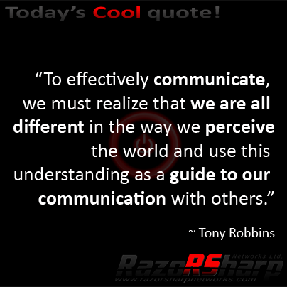

Slide 17
Implications
1. Overcoming Perceptual errors
2. Become more open and tolerant to other person’s views as focus should be on intent and the message
3. If we can realize that everyone perceives things differently, we can develop a society that is more understanding and less judgmental.

Slide 18
THANK YOU

