Slide 1












Stream Name
Digital Transformation of Governance
Session Number: 03
Session Topic
Life Cycle of Digital Transformation
CHARRU MALHOTRA, Ph.D. (IIT-D)
COORDINATOR ( Centre of e-Governance) Associate Professor (e-Governance and ICT) Indian Institute of Public Administration charrumalhotra [at]gmail.com
charrumalhotra[dot]iipa[at]gov[dot]in
1

Slide 2





Agenda
Session 03
Life Cycle of Digital Transformation
01
Terms – GTO, KTA, PPTB Interventions
02
Digital Transformation Life Cycle: 6 Steps
03
PSP Case Study : Applying Porter Value Chain F/w to PSP to evolve GTO, KTA,PPTB & its Design Artifacts
04
Summarizing
charrumalhotra[dot]iipa[at]gov[dot]in
1

Slide 3
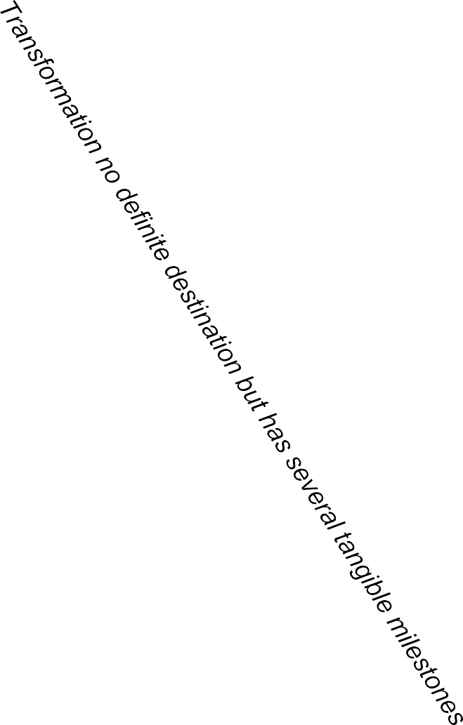
Preamble : IMP TERMS of DT Life Cycle
VISION- First is the redefined vision of the project .
Global Transformational Objectives (GTO) : GTOs are evolved to ensure
that the new project
achieves Efficiency-Doing things right, Effectiveness- Doing the right things, Citizen Centricity, Transparency (Value) , Excellence ( extra-ordinary), Quality (TQM, 6Sigma), SQ Values ( Green, Diversity, Honesty ).
In context of Gov, it is 4As (Affordability, Availability, Accessibility and Adaptability).
Key Transformation Areas (KTAs) : Key activities that need to be transformed.
identified using techniques such as Porter’s Value Chain Model, SWOT, Criticality/Feasibility Matrix, BCG matrix- ISM-Interpretive Structural Modeling, FishBone etc.
Interventions: Convert thoughts into actions--Key tools & recommendations that are applied to KTAs to achieve GTO; identified by PPTB f/w ( People, Process, Tech, Business).
Objectives to Outcome (O2O) – The life cycle of how transformation works using O2O methodology
charrumalhotra[dot]iipa[at]gov[dot]in ³

Slide 4
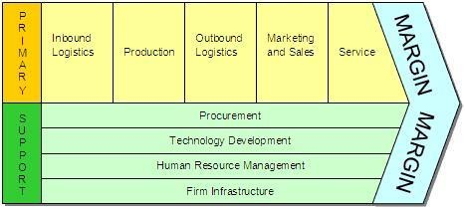
Porter’s Value Chain Framework
Primary activities are supported by Secondary activities.
Making changes in the value chain activities can increase competitive margins
Source : Michael Porter, Competitive Advantage, 1985
4

Slide 5
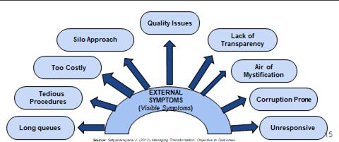
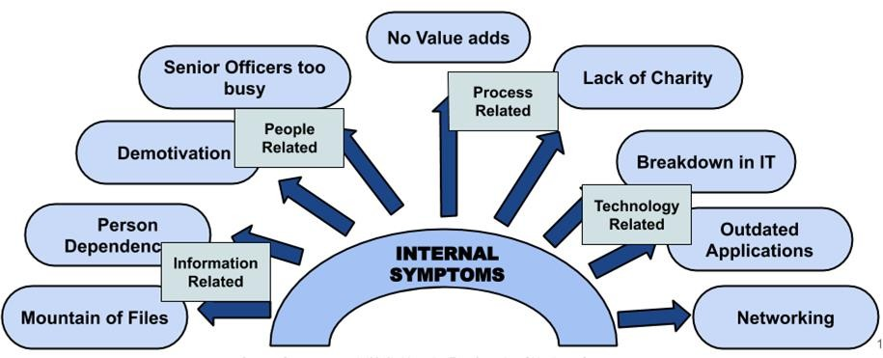

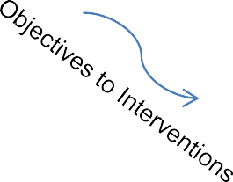
DT Life Cycle
DEFINING
ReDefined Vision & GTOs
Pain Areas
Problems
Enhance using Feedback
Evaluate & Choose the
Best Alternative
(Identify Interventions , Reengineer, Specify Functional Requirements
Citizens (Inform Consult Involve Collaborate Empower)
Manage & Assess
Design the Transformation
Implement & Operate
charrumalhotra[dot]iipa[at]gov[dot]in
5
Source: Satyanarayana J (2012). Managing Transformation: Objective to Outcomes.

Slide 6
Passport System in India
The system deteriorated due to factors such as afflux of time, pressure of volumes, disruptive technologies and rising expectations and the system reported external and internal symptoms.
EXTERNAL SYMPTOMS ( pain areas)
Long Queues: “We have to stand in queues for 6/7 hours ; come at 5am…”
Tedious Procedures : “ to fill and attach so many documents; varies from RPO to RPO”
Difficult Access: “ only 34 RPOs; tough to get a chance- so got to rely on intermediaries”
Air of Mystification : “ suspense started after I had submited my form; no clue – kyaa hoga”
Unresponsiveness : “ too much pressure on the staff- very impersonal/ reluctant replies”
High Cost : “Indirect costs are so high – travel-agent fees, travel cost , willing to pay 1K if processes are streamlined”
INTERNAL SYMPTOMS ( problems)
Excessive Paper Work
Inaccessibility of Senior Officers
Too much of Repetitive Manual Work
Use of Outdated Technologies
6
Source: Satyanarayana J (2012). Managing Transformation: Objective to Outcomes.

Slide 7
STEP ONE : Defining
INTERNAL Problems ( in the passport system)
EXTERNAL Pain Areas ( Citizens’ Perspective)
KTAs
Long & Indefinite wait; mostly standing
Complicated Processes; numerous forms
Existence of an intermediary/middl emen/touts
Difficulty in Accessing Passport Services
Bad Ambience
Delays/Uncertain Outcome
Lack of Transparency
High Costs
I. Passport procedures
(Primary)
Forms 5
B
Verification 5
Miscellaneous Services
Processing
4
Long Queues
Inadequate Staff
Pressure of ever-
increasing volumes
Air of mystification
Old / Outdated Procedures
Minimal use of Tech
5
II. Service Delivery System (Primary)
A
5
Access
D
1
G
Service Levels
Service Centres E
3
Delivery
H
Grievance Management
F
C
III. Technology
(Support)
Submission of requests D
Identification
Request processing 6
Security
Motivation
D
Training
Performance 2
IV. HR (Support)
Responsiveness
Redefined Vision of Passport Seva Project (PSP, 2005) to deliver passport services to citizens in a timely, transparent, more accessible, reliable manner and in a comfortable environment through streamlined process and committed, trained and motivated workforce
Need to REVITALISE on Priority basis --- Passport related procedures, Delivery Systems, Technology (ICT), HR7
Source: Satyanarayana J (2012). Managing Transformation: Objective to Outcomes.

Slide 8
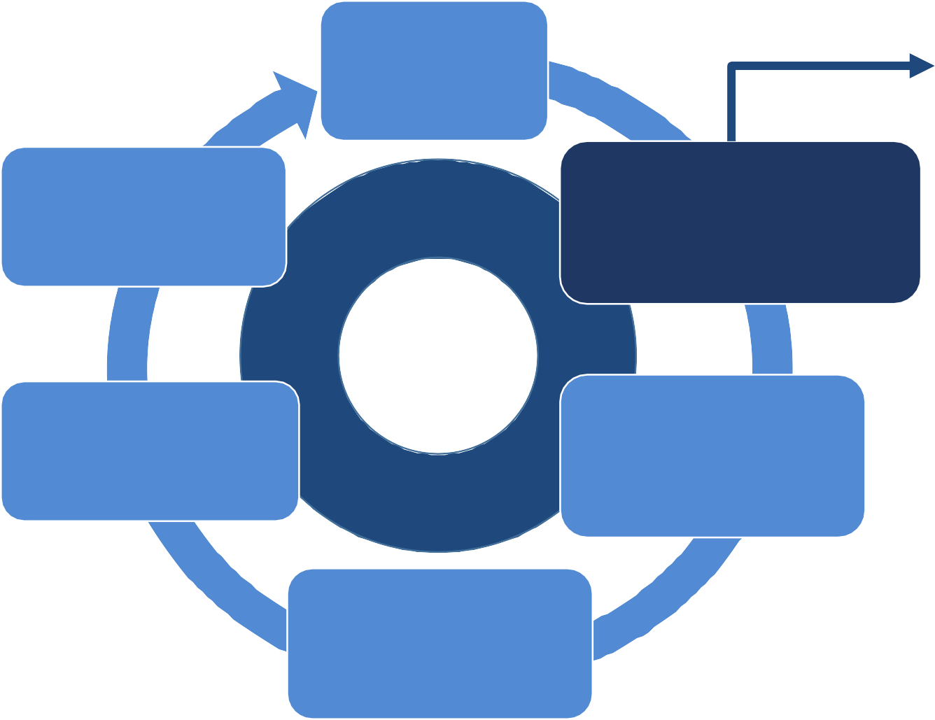
STEP TWO : Evaluate
ReDefined Vision and GTOs
IDENTIFY THE BEST SET OF INTERVENTIONS
based on PPTB f/w
( People, Process, Technology, Business
for achieving GTOs so that Better engagement, better
information, more innovation
Does the proposed service design achieve one or more of the following:
Evaluate & Choose the
Best Alternative
(Identify Interventions , Reengineer, Specify Functional Requirements
Enhance using
Feedback
Citizens (Inform Consult Involve Collaborate Empower)
Better engagement – particularly b/w govt, citizens, delivery partners
Better information – moving towards best practices, open, standardized formats of reporting
More innovation – allowing for lower risk delivery models to explore new ideas
Manage & Assess
Design the Transformation
Implement & Operate
charrumalhotra[dot]iipa[at]gov[dot]in
8

Slide 9
GTOs derived from it should match KTAs to fulfill the basic requirements as follows:
Redefined Vision of Passport Seva Project (PSP, 2005) : to deliver passport services to citizens in a timely, transparent, more accessible, reliable manner and in a comfortable environment through streamlined process and committed, trained and motivated workforce
‘ S.No. | KTAs | I. Passport Procedures- F O R M S (Primary) | I. Passport Procedures- P R O C E S S (Primary) | II. Service level management (Primary) | III. Technology (Secondary) | IV. HR (Secondary)
 | GTOs
1. | Affordability (Efficiency) | GPR for UX- Undertake comprehensive forms re-engineering | Enhance process efficiency to confirm to defined service levels | Design service levels, benchmarking with the best in the world e.g. deliver passport in three working days etc | SYSTEMS APPROACH Establish comprehensive and integrated passport management system | Enhance employee commitment and efficiency through trng and reskilling
2. | Availability (UI Citizen Centricity) | GPR for UI Make the forms simple and easy/intuitive to fill | MULTICHANNEL Establish multiple channels for receipt of requests | X | Focus on usability | Bring about behavioral changes among employee
3. | Accessibility (Transparency & Accountability) | X | Publish status of request | X | X | Enhance accountability
4. | Adaptability ( Quality) | X | X | X | Adopt international standards | X
9
Source: Satyanarayana J (2012). Managing Transformation: Objective to Outcomes.

Slide 10
Proposed Interventions in PSP
Area | Nature of Intervention | Intervention
Process | Recommendations | BPR in identified key process areas
 | Internal Strategy | Delivery channel strategy Approach to service-orientation
 | External Strategy | Marketing Strategy/Awareness
People | Internal Strategy | Change management strategy
 | Plan | Training plan
 | External Strategy | Capacity building strategy
Technology | Architecture | Technology architecture
 | Policy | Security policy
 | Plan | IT infrastructure plan
Business model | Analysis | Business case analysis
 | Internal Strategy | Procurement strategy
 | Internal Model | Revenue model
 | External Model | Business model
 | External Strategy | Partnership strategy 10
Source: Satyanarayana J (2012). Managing Transformation: Objective to Outcomes.

Slide 11
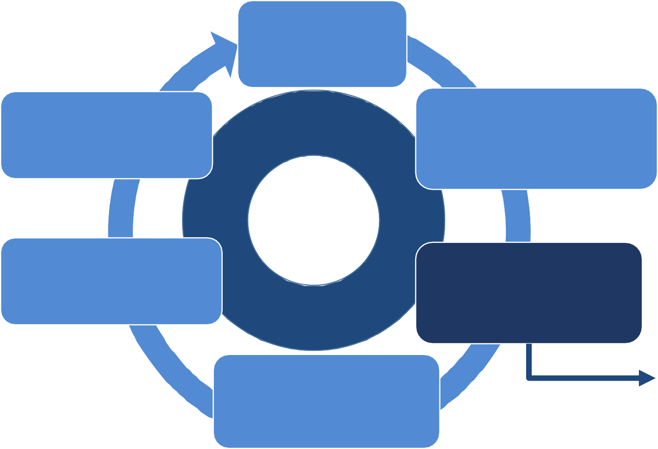
STEP THREE : Design the Transformation,
ReDefined
Vision and GTOs
Key Goal of this phase should be be AGILE , stay ‘Technology Agnostic’
WHO ,WHAT, HOW, WHERE
Evaluate & Choose the Best Alternative
(Identify Interventions , Reengineer, Specify Functional Requirements
Enhance using Feedback
Who - are the developers
Model of Outsourcing
Team Composition ( Number, Profile)
Citizens (Inform Consult Involve Collaborate Empower)
What is the extent of collaboration
Manage & Assess
Design the Transformation
level of team collaboration
Citizens’ participation -ICICE
How
Agile, Micro-Service
Where
  Which site to implement
Implement &
Operate
charrumalhotra[dot]iipa[at]gov[dot]in

Slide 12
STEP THREE : Design the Transformation
Design Artifacts
The list of design items drawn is in the context of large service enterprises that is undertaking large transformational initiative, involving both digital and non digital components and delivery channels,
Designing can be done in parallel manner (several stream run simultaneously) but in a collaboration by separate project teams.
There is the critical need for involving domain experts of the sector to which transformation project relates in people and process-related design items.
charrumalhotra[dot]iipa[at]gov[dot]in

Slide 13
STEP THREE : Design Artifacts
The following Design Artifacts require intensive efforts and specialized/expert resources.
People | Process | Technology | Business Model
New/revised HR policy | Re-engineered processes | High-level architecture | Estimated project cost CapEx OpEx
Change Management Plan | Services service levels service level metrics | Detailed architecture (Optional) | Revenue model
 | Detailed project plan | Security systems Physical Digital | Procurement policy
 |  |  | Promotion ₁₃

Slide 14
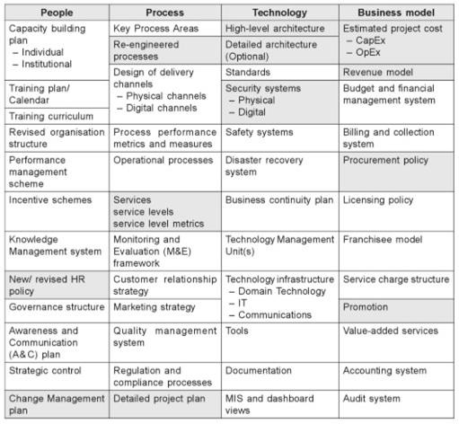
STEP THREE : Design Artifacts
Source: Satyanarayana J (2012). Managing Transformation: Objective to Outcomes.
charrumalhotra[dot]iipa[at]gov[dot]in

Slide 15
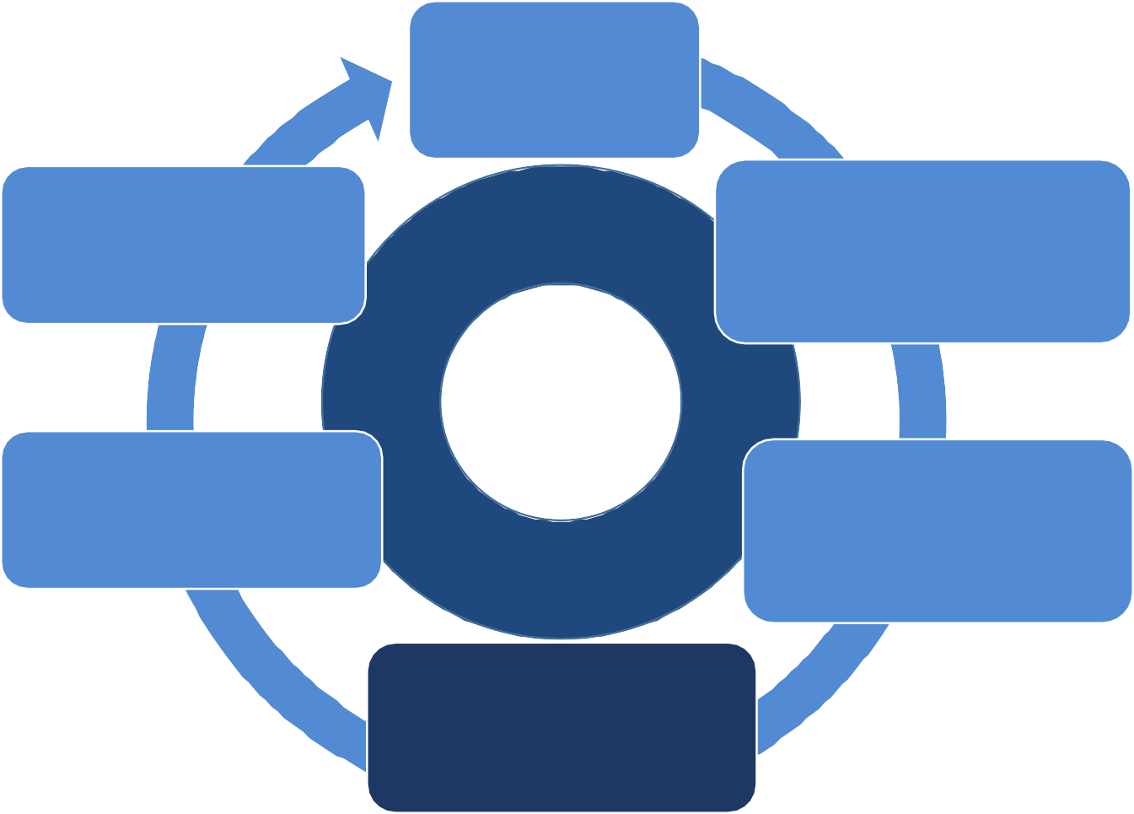
STEP FOUR : Implement & Operate,
ReDefined Vision and GTOs
Implementation Aspects:
Awareness: How the awareness about the
service is raised?
Transact: key activities and channels that are required to provide the proposed ‘Value
Proposition’? How the users are allowed to transact with the service ( identify the channels)?
Delivery: How the Value Proposition is delivered to users- thru which channels?
  Through which channels do the user segments want to be implemented?
  How the agency is reaching the users now? How are the existing channels integrated?
  Which of these channels work best? Which of these channels are most cost-efficient?
  How are these channels going to be integrated with the users’ jobs?
Evaluate & Choose the Best Alternative
(Identify Interventions , Reengineer, Specify Functional Requirements
Enhance using Feedback
Citizens (Inform Consult Involve Collaborate Empower)
Manage &
Assess
Design the Transformation
Implement &
Operate
Continuous Delivery: How is the post-delivery support provided to users?
Evaluation: How the users are helped to evaluate the Value Proposition?
charrumalhotra[dot]iipa[at]gov[dot]in

Slide 16
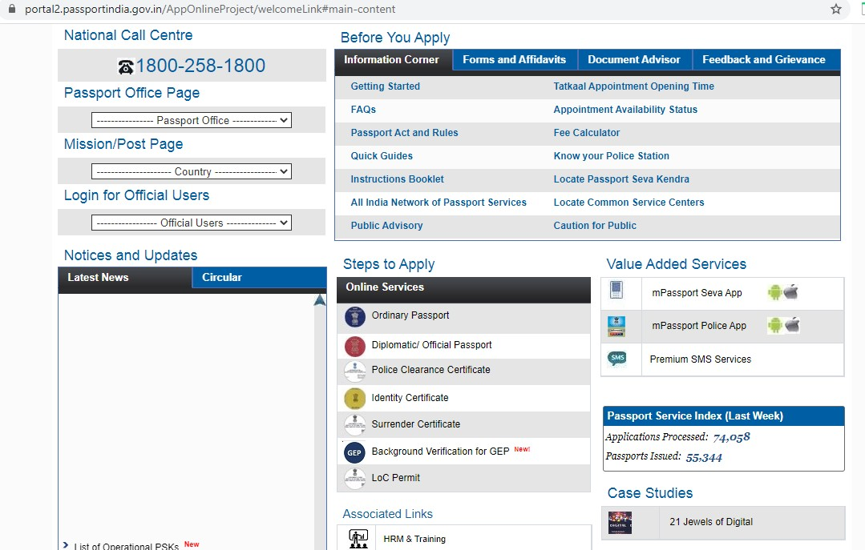
PSP Digital Creation
16

Slide 17
STEP FIVE : Manage & Assess,
ReDefined Vision and GTOs
Manage & Assess:
Evaluate & Choose the
Best Alternative
(Identify Interventions , Reengineer, Specify Functional Requirements
Enhance using
Feedback
Ensuring that the transformed system stabilizes fully into a steady state.
Re-engineered process work without hitches or exceptions.
Agile and independent.
Ensuring its up-to-date with the current time/system.
Technical system works without
breakdowns.
People within and outside accept and assimilate the changes.
Citizens (Inform Consult Involve Collaborate Empower)
Manage & Assess
Design the Transformation
Implement & Operate
charrumalhotra[dot]iipa[at]gov[dot]in
17

Slide 18
Objectives to Outcome (PSP Example)
S.No | Objective | Output | Outcome | Outcome Measure
1. | Enhance process efficiency to conform to defined service levels | Re-engineered processes | A factor improvement in process efficiency Error-free processing | Continuous conformance to service levels
2. | Establish multiple channels for receipt of requests | Multiple channels like service centres, internet, mobile | Citizen convenience 24 x 7 access | Mix of different channels, indicating relative popularity among different segments
3. | Enhance transparency by publishing the status of requests | Online real-time information system | Citizen informed of status of request at each stage 24 x 7 accessibility | Number of complaints/grievances
4. | Enhance employee commitment and efficiency through training and reskilling | Series of training programmes conducted for all levels of employees | All employees comfortable with the transformed system | Minimum number of mistakes in processing

Slide 19
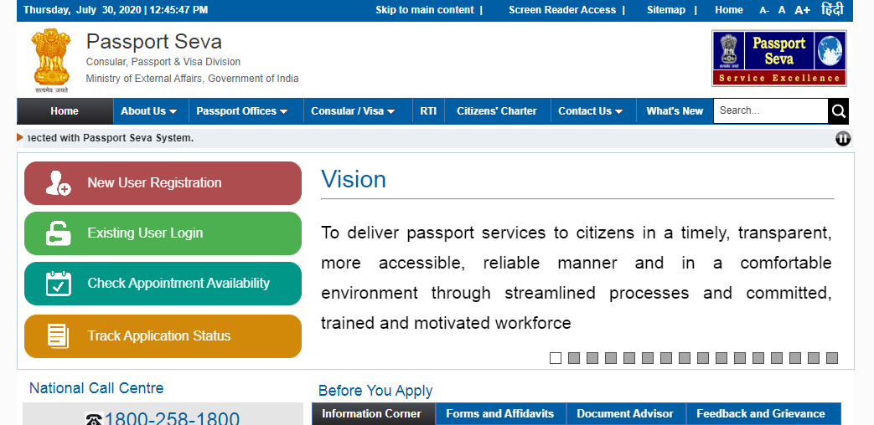
Online Service of PSP

Slide 20
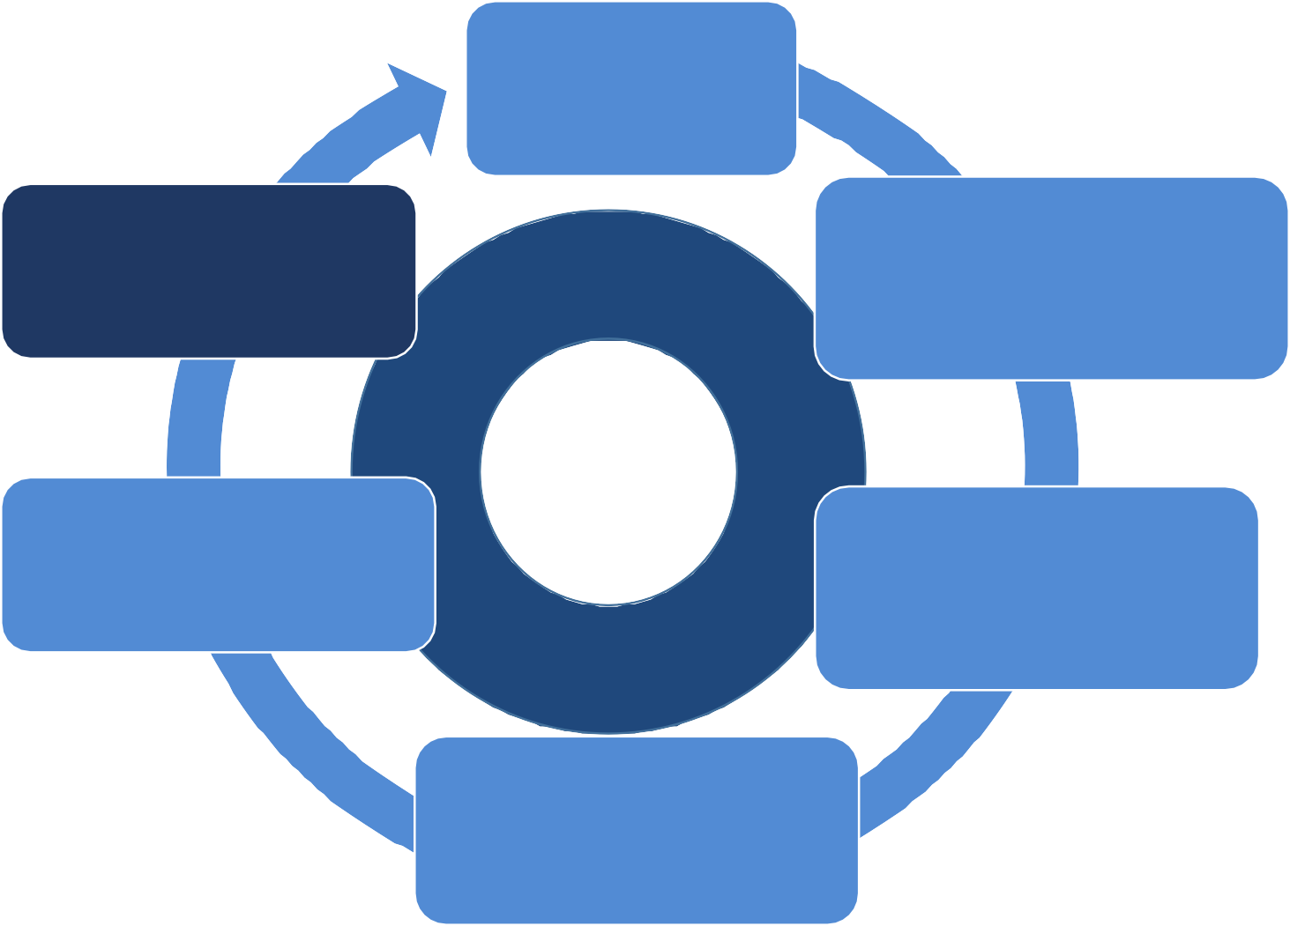
STEP SIX : Enhance using Feedback
ReDefined Vision and GTOs
Evaluate & Choose the Best Alternative
(Identify Interventions , Reengineer, Specify Functional Requirements
Enhance using Feedback
Enhance using Feedback
1. Obtaining the feedback on the quality of the service.
Citizens (Inform Consult Involve Collaborate Empower)
1. Ensuring the usability of the obtained feedback.
Manage & Assess
Design the
Transformation
1. Implementing feedback for a better and improved version.
Implement &
Operate
charrumalhotra[dot]iipa[at]gov[dot]in

Slide 21
Summarizing DT Life Cycle
The concept of the entire workplace of governance is undergoing a change.
The fundamentals will not change but approach to work, workforce and workplace will.
Sequential decision-making will give way to a more dexterous approach.
The focus of DT life cycle too should be on Agility (quick on the feet) and adaptability (willing to adopt to any situation).
charrumalhotra[dot]iipa[at]gov[dot]in

Slide 22
Challenges with DT Life Cycle
While proceeding with DT , some critical business challenges CIOs and decision
makers need to address are:
Gap between strategy and execution;
An uncertain, fast and varying landscape;
Extra cross-business-cross-silos coordination;
Intrinsic internal and external security;
Collaborative business units resulting into more decision makers and६. long term sustainability.
( Golok Smili, CTO, PSP , 2020)
22

Slide 23


Our next session, Session 04 would be on :
"Role of Emerging Technologies (ET) in Governance”
Any questions?
You can find me at:
charrumalhotra[dot]iipa[at]gov[dot]in
23
Charrumalhotra[dot]iipa[at]gov[dot]in

Slide 24
References/Further Readings
Article on Digital Transformation Life Cycle, link: https://www.linkedin.com/pulse/digital-transformation-life-cycle-pedro- robledo-bpm/
Bobbio, L. (2018), Designing effective public participation, link: https://www.researchgate.net/publication/327835222_Designing_effec tive_public_participation
OECD (2016),Comparative study Digital Government Strategies for
Transforming Public Services in the Welfare Areas, http://www.oecd.org/gov/digital-government/Digital-Government- Strategies-Welfare-Service.pdf
link:
charrumalhotra[dot]iipa[at]gov[dot]in
24

