Slide 1
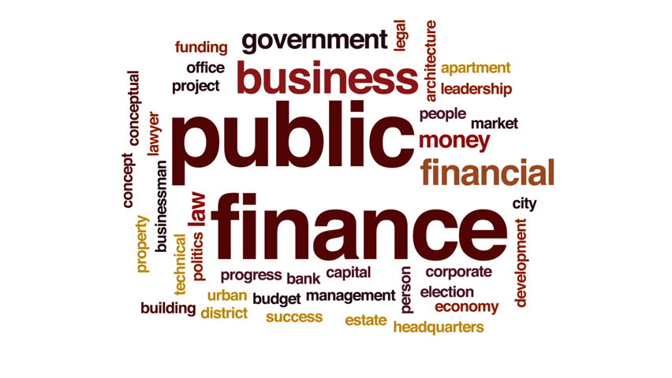
Module
Public Finance
&
Its Few Concepts

Slide 2
Public finance
Public Finance is the study of income & expenditure of the Government at the State, Central & Local levels.
It also deals with the sources of income & its utilization.
Shares similar broad objectives with Private Finance.
Public Finance → community welfare maximization Private Finance → individual welfare maximization.
Further Private Finance sub-divided into:
    Personal Finance
    Business Finance
Notes:
Personal finance involves optimizing of finances by individuals such as families, people & single consumers. Eg: an individual financing his/her car by mortgaging.
Business finance involves optimizing of finances by business organizations. It involves asset acquisition & proper allocation of funds in a way that maximizes the probability of achieving the goals. Businesses can require finances on either of the three level: Short, Medium or Long Term.

Slide 3
Constituents of public finance
Public Expenditure: Expenses Incurred by the Government for its own maintenance & for preservation & welfare of society & economy as a whole.
Public revenue: Deals with the various sources from which the State might derive its income.
Public debt: Loans raised by & is a source of public finance which carries with it the obligation of repayment to the individuals, along with interest, from whom the debt was raised.
Notes:
Sources of public revenue: Income from taxes, commercial revenues in the form of goods & services supplied by public enterprises, administrative revenues in the form of fees, fines etc. & gifts & grants.

Slide 4
Constituents of public finance (contd.)
Public Financial Administration: As per Walter Bagehot, money cannot manage itself. An efficient, energetic & scientific management is required to look after the public expenditure, revenue & debt.
Economic stabilization & growth: Maintaining stability & promoting sustainable balanced growth through the functions mentioned above.

Slide 5
Government budgeting
Budget is the financial statement of the Government comprising of expenditures & revenues for a year.
Categorization of Public Revenue:
    Non-Tax Revenue: Dividends, Grants, Interest receipts
    Tax Revenue: Indirect taxes(Sales, Service tax) & Direct taxes(Income, Interest tax)

Slide 6
Government budgeting (contd.)
Categorization of Public Expenditure:
    Object Classification
    Functional Classification
    Economic Classification: further subdivided into
        Current Expenditure
        Capital Expenditure
        Principal Repayment

Slide 7
Principles & Components of budget
Principles of Budget:
    Balanced Budget Principle: Govt. expenditure (G) = Taxes (T)
    Unbalanced Budget Principle: G ≠ T
Components of Budget:
    Revenue Receipts: Income generated from the operating activities of the business.
    Revenue Expenditure: Incurred for normal running of Government departments.
    Capital Receipts: Income generated from the investment & financing activities of business.
    Capital Expenditure: For creation of Govt. assets or reduction in Govt. liabilities

Slide 8
Fiscal Policy, it’s objectives
It refers to a policy concerning the use of state treasury or the government finances to achieve the macro-economic goals.
Objectives:
    Price Stability
    To Achieve Equal Distribution of Wealth
    Optimum allocation of resources
    Full employment
    Economic Growth

Slide 9
Instruments of fiscal policy
Instruments:
    Deficit Policy: Taking loans from RBI by the government to meet the deficit.
    Public Expenditure: Further sub-divided as Developmental & Non-Developmental expenditure.
    Taxation Policy: Helps in mobilization of resources; promoting savings; bringing equality of income & wealth.

Slide 10
Types of deficit
Types of Deficit:
    Revenue Deficit: Revenue deficit = Revenue expenditure - revenue receipts
    Fiscal Deficit: Fiscal deficit = Total Expenditure - total receipts (excluding borrowings)
    Primary Deficit: Primary Deficit= Fiscal Deficit – Interest payments (on previous borrowings)

Slide 11
References
Chand, S. N. (n.d.). Public Finance: An Overview (Vol. 1).
http://www.differencebetween.net/business/ finance-business-2/difference-between-public-finance-and-private-finance/
https://www.rapodar.ac.in/pdf/elearn/Introductiontopublic%20finance.pdf
https://www.slideshare.net/gauravhtandon1/public-finance-81308560
https://economictimes.indiatimes.com/budget-faqs/what-are-the-three-types-of-government-budgets/articleshow/67466774.cms?from=mdr
https://www.economicsdiscussion.net/budget/union-central-budget-of-india-its-meaning-and-components/759
https://www.economicsdiscussion.net/fiscal-policy/top-8-objectives-of-fiscal-policy/4694
Froyen, Richard T, ”Macroeconomics: Theories & Policies”
https://economictimes.indiatimes.com/budget-faqs/budget-2020-types-of-deficits/articleshow/73159003.cms?from=mdr

