Slide 1
Fiscal Responsibility and Budget Management
V N Alok
Indian Institute of Public Administration
vnalok@gmail.com

Slide 2
Why fiscal responsibility legislation?
Since the 1990s many Governments have intensified search for mechanisms to curb fiscal populism.
FRL confers credibility for the macroeconomic policies by removing discretionary interventions
A government that abides by the FRL enjoys greater credibility among the rating agencies and market participants – both national and international
Economic fundamentals remain robust and predictable.

Slide 3
What is fiscal responsibility legislation (FRL)?
FRL is a commitment device- controls impulse of an individual government to run excessive deficits.
For a group it enforces a mutual agreement that each one of them would avoid running excessive deficits.
The agreement to protect the common interest would have to restrain the behavior of the federal government and sub-national governments.

Slide 4
Why was the FRBM Act enacted in India?
In the late 1980s and early 1990s, Indian economy faced with the problem of large fiscal deficit and its monetization spilled over to external sector which resulted in an economic crisis in 1991.
Economic reforms were introduced in 1991 and fiscal consolidation emerged as one of the key areas of reforms.
The fiscal consolidation faltered after 1997-98 and the fiscal deficit started rising after that period.
The Government of India adopted FRBM Act, 2003 to check the deteriorating fiscal situation.

Slide 5
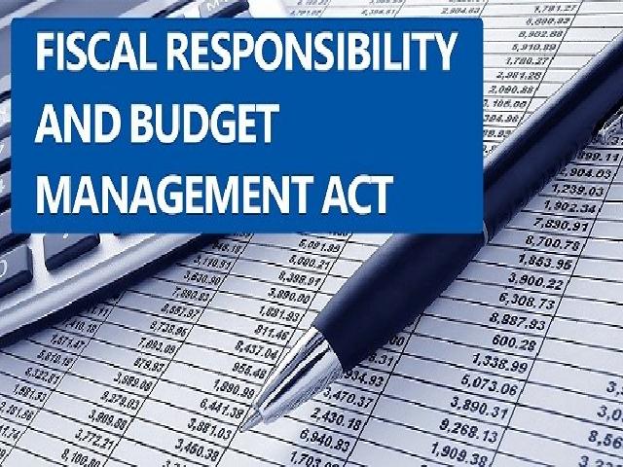
Objectives of the FRBM Act
The main objectives of the FRBM Act:
Elimination of the Revenue Deficit and bringing down the Fiscal Deficit
Ensuring equitable distribution of debt over the years
Ensuring Fiscal stability in the long run
Introduction of a transparent system of Fiscal management within the country.
To give the necessary flexibility to Reserve Bank of India for managing inflation in India.

Slide 6
Features of the FRBM Act
It was mandated by the act that the following statements must be placed along with the Budget documents annually in the Parliament:
The Medium-Term Fiscal Policy Statement
The Fiscal Policy Strategy Statement
The Macro-Economic Framework Statement
The Medium-Term Expenditure Framework Statement

Slide 7
FRBM Indicators
The FRBM Rules, 2004 mandate four fiscal indicators to be projected in the medium-term fiscal policy statement:
Revenue Deficit (as percentage of GDP)
Fiscal Deficit (as percentage of GDP)
Tax Revenue (as percentage of GDP)
Union government’s debt (as percentage of GDP)
Additional Indicators added in 2018
Primary Deficit (as percentage of GDP)
Non-tax Revenue (as percentage of GDP)

Slide 8
Initial FRBM Targets (to be met by 2008-09)
Revenue Deficit Target – revenue deficit should be 0 (zero)by March 31, 2009. The minimum annual reduction target was 0.5% of GDP.
Fiscal Deficit Target – fiscal deficit should be reduced to 3% of GDP by March 31, 2009. The minimum annual reduction target was 0.3% of GDP.
Contingent Liabilities – The Central Government shall not give incremental guarantees aggregating an amount exceeding 0.5 per cent of GDP in any financial year beginning 2004-05.
Additional Liabilities – Additional liabilities (including external debt at current exchange rate) should be reduced to 9% of the GDP by 2004-05. The minimum annual reduction target in each subsequent year to be 1% of GDP.
RBI purchase of government bonds – to cease from 1 April 2006. This indicates the government not to borrow directly from the RBI.
The targets were not met as the global financial crisis led the government to infuse resources in the economy as the fiscal stimulus in 2008.
Therefore, fiscal targets had to be postponed temporarily in view of the global crisis.

Slide 9
Amendments in the FRBM Act, 2003
FRBM Rules 2004
Changed Rules in 2012: The requirement of ‘Medium-Term Expenditure Framework statement’ and concept of ‘Effective Revenue Deficit’ were introduced.
  By 31 March 2015 - RD be 0.5% of GDP and FD be 3% of GDP
Changed Rules in 2015: The targets for achieving the prescribed rates of Effective Revenue Deficit and Revenue Deficit were further extended.
    By 31 March 2018 - RD be 0.5% of GDP and FD be 3% of GDP
Changed Rules in 2018: Deferred its targets by two years from 2018-19
  By 31 March 2021 - FD be 3% of GDP

Slide 10
Fiscal responsibility legislation in States
To ensure that the States too are financially prudent, the 12th Finance Commission’s recommendations in 2004 linked debt relief to States with their enactment of similar laws.
The States have since enacted their own respective Fiscal Responsibility Legislation and set the same 3% of Gross State Domestic Product (GSDP) cap on their annual fiscal deficit:
Before 12th FC:
Karnataka (2002), Punjab (2002), Kerala (2003), TN (2003), UP (2004),
After 12th FC:
Maharashtra, Orissa, Rajasthan, Assam, Haryana, AP, H.P. Bihar etc. Most states (22) had enacted FRL.

Slide 11
Recommendations of NK Singh Committee
Revenue Deficit Targets
Formation of the Fiscal Council to advise the Government.
Public Debt to GDP ratio should be considered as a medium-term anchor for fiscal policy in India.
Fiscal Deficit as the operating Target
Escape Clauses to accommodate Counter Cyclical issues
Fiscal Consolidation responsibility for States
Congruence of Fiscal and Monetary Policies.

Slide 12
Escape Clause in the FRBM Act
Escape clause refers to the situation under which the central government can flexibly follow fiscal deficit target during special circumstances such as the external crisis.
The clause allows the Government to relax the fiscal deficit target for up to 50 basis points or 0.5 per cent.
The Escape Clauses can be invoked:
  by the Government after formal consultations and advice of the Fiscal Council.
  with a clear commitment to return to the original fiscal target in the coming fiscal year.

Slide 13

Latest FRBM Targets
The latest FRBM Act Targets are:
To limit the Fiscal Deficit to 3.1% of the GDP by March 31, 2023.
To limit the debt of the Union Government to 40% of the GDP by 2024-25.
The Act provides room for deviation from the annual fiscal deficit target under certain conditions.

