Slide 1
Role of Finance Commissions and NITI Aayog

Slide 2
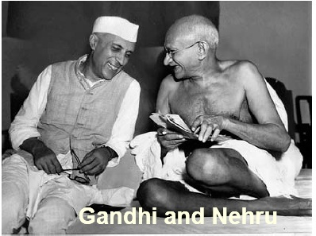
Federal ensemble of India comprises:
Union Government
28 States
Union territories
Rural local governments
Urban local governments

Slide 3
Division of Taxes between Union and States (major taxes)
UNION LIST
Personal Income Tax
Corporate Income Tax
Central Goods and Services Tax (GST)
Custom Duties
STATE LIST
State Goods and Services Tax (GST)
Motor vehicles tax
Passengers and goods tax
State Excise
Electricity Duty

Slide 4
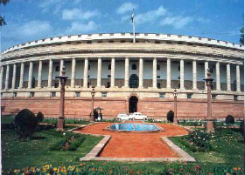
Intergovernmental Institutions
Finance Commission
NITI Aayog [replaced Planning Commission]
Inter State Council
Team India [replaced NDC]
State Finance Commissions
Parliament

Slide 5
Horizontal Distribution (for States)
Criteria | 11 FC | 12 FC | 13 FC | 14 FC
Population | 10 | 25 | 25 | 17.5
Income | 62.5 | 50 | - | 50
Area | 7.5 | 10 | 10 | 15
Index of Infrastruc | 7.5 | - | - | -
Tax Efforts | 5 | 7.5 | - | -
Fiscal Discipline | 7.5 | 7.5 | 17.5 | -
Fiscal Capacity | - | - | 47.5 | -
Demo Change | - | - | - | 10
Forest Cover | - | - | - | 7.5

Slide 6

Finance Commission and Its mandate
The President of India selects the Chairman and the four other members of the Finance Commission of India under Article 280.
The Commission distribute proceeds of Union taxes between the Union and State Governments.
The Commission allocates grants-in-aid to States out of the consolidated fund of India.
The Commission allocates grants-in-aid to Panchayats and Municipalities through States
The 15th Finance Commission was constituted in 2017 and is set to give its recommendations.

Slide 7
Key Recommendations of the 15th Finance Commission
Devolution of taxes to States: The share of states in the Union divisible pool was recommended to be 41% for 2020-21.
Tax Effort: This criterion has been used to reward states with higher tax collection efficiency.
Income Distance
Grants-in-Aid: The following grants are provided to the States for 2020-21
  Revenue Deficit Grants
  Grants to Local Governments
  Disaster Management Grants

Slide 8
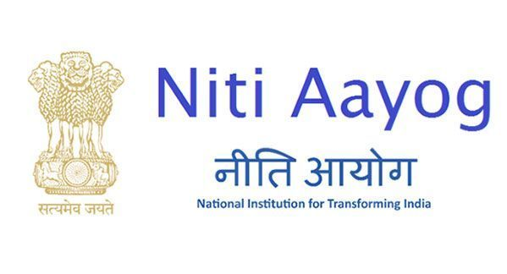
NITI Aayog and its structure
NITI Aayog is the policy think-tank of the Indian federation which replaced the Planning Commission that was set up in 1950.
NITI Aayog comprises:
Chairperson – Prime Minister of India
Governing Council - composed of Chief Ministers of all the States and lieutenant governors of Union Territories.
Regional Council – formed to address specific issues and contingencies impacting more than one state or region.
Full-time organizational framework composed of a Vice-Chairperson, four full-time members, two part-time members, four ex-officio members of the Union Council of Ministers, a CEO.
Experts and specialists in various fields.

Slide 9

Functions of NITI Aayog
To foster cooperative federalism and to evolve a national consensus on developmental goals.
Conflict Resolution: to act as a platform for resolution of cross-sectoral issues between Center and State Governments.
To act as a Knowledge and Innovation hub.
Vision and Scenario Planning: To design the medium and long term strategic frameworks of the big picture vision of India’s Future.
Capacity Building
Decentralised Planning

Slide 10
Achievements of NITI Aayog
Following are the few achievements of NITI Aayog:
The two-standout initiatives of the NITI Aayog were the model law on land leasing and the framework of priorities for disinvestment.
The Atal Innovation Mission was launched to seed innovations to teach young minds new skills.
The NITI Aayog has made serious efforts on Swachh Bharat, Skill Development and Central Sponsored Schemes.
Agricultural transformation was envisaged with the objective of doubling farmer’s income by 2022.
The NITI Aayog monitored the implementation of the Sustainable Developmental Goals.

