Slide 1
: Business Intelligence
Information Systems Development

Slide 2
Business Analytics, BI, Big Data, Data Mining - What’s the difference?
Business Analytics – Tools to explore past data to gain insight into future business decisions.
BI – Tools and techniques to turn data into meaningful information.
Big Data –data sets that are so large or complex that traditional data processing applications are inadequate.
Data Mining - Tools for discovering patterns in large data sets.

Slide 3
Businesses Need Support for Decision Making
Uncertain economics
Rapidly changing environments
Global competition
Demanding customers
Taking advantage of information acquired by companies is a Critical Success Factor.

Slide 4
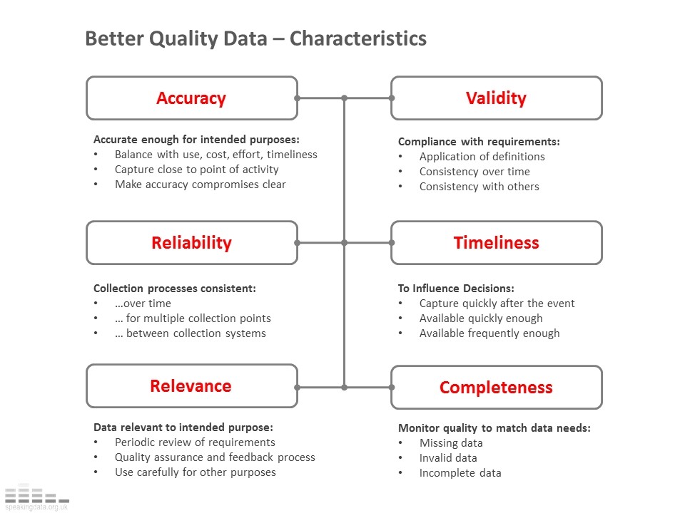
Characteristics of Data for Good Decision Making
Source: speakingdata blog

Slide 5
The Information Gap
The shortfall between gathering information and using it for decision making.
Firms have inadequate data warehouses.
Business Analysts spend 2 days a week gathering and formatting data, instead of performing analysis. (Data Warehousing Institute).
Business Intelligence (BI) seeks to bridge the information gap.

Slide 6
Data Mining
“Data mining is an interdisciplinary subfield of computer science. It is the computational process of discovering patterns in large data sets involving methods at the intersection of artificial intelligence, machine learning, statistics, and database systems.” - Wikipedia
Examining large databases to produce new information.
Uses statistical methods and artificial intelligence to analyze data.
Finds hidden features of the data that were not yet known.

Slide 7
BI
Tools and techniques to turn data into meaningful information.
Process: Methods used by the organization to turn data into knowledge.
Product: Information that allows businesses to make decisions.

Slide 8
BI Applications
Customer Analytics
Human Capital Productivity Analysis
Business Productivity Analytics
Sales Channel Analytics
Supply Chain Analytics
Behavior Analytics

Slide 9
What is Business Intelligence?
Collecting and refining information from many sources (internal and external)
Analyzing and presenting the information in useful ways (dashboards, visualizations)
So that people can make better decisions
That help build and retain competitive advantage.

Slide 10
Klipfolio - sample of a marketing dashboard

Slide 11
FitBit – Health Dashboard

Slide 12
BI Applications
Customer Analytics
Human Capital Productivity Analysis
Business Productivity Analytics
Sales Channel Analytics
Supply Chain Analytics
Behavior Analytics

Slide 13
BI Initiatives
70% of senior executives report that analytics will be important for competitive advantage. Only 2% feel that they’ve achieved competitive advantage. (zassociates report)
70-80% of BI projects fail because of poor communication and not understanding what to ask. (Goodwin, 2010)
60-70% of BI projects fail because of technology, culture and lack of infrastructure (Lapu, 2007)

Slide 14
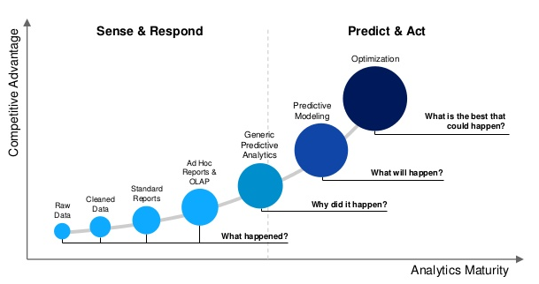
Evolution of BI
Source: Delaware Consulting

Slide 15
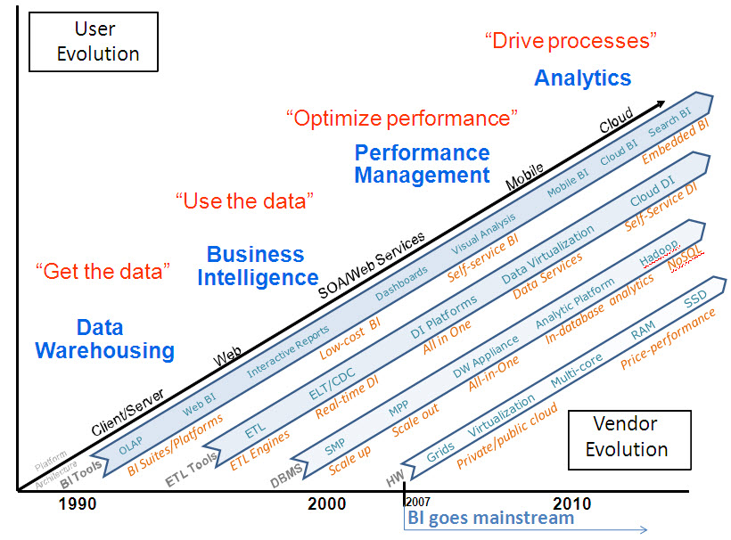
Evolution of BI (contd.)
Source: b-eye-network.com

Slide 16
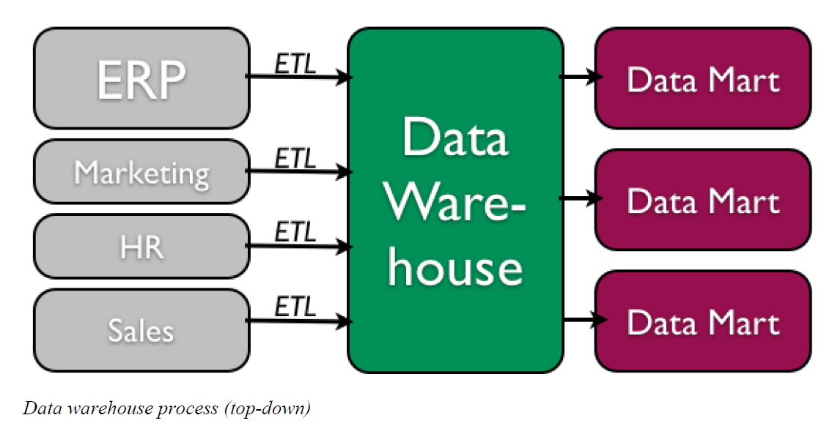
Data Warehouse
Collection of data from multiple sources (internal and external)
Summary, historical and raw data from operations.
Data “cleaning” before use.
Stored independently from operational data.
Broken down into DataMarts for use.
Chapter 4 of ISBB Text

Slide 17
5 Tasks of Data Mining in Business
Classification – Categorizing data into actionable groups. (ex. loan applicants)
Estimation – Response rates, probabilities of responses.
Prediction – Predicting customer behavior.
Affinity Grouping – What items or services are customers likely to purchase together?
Description – Finding interesting patterns.

Slide 18
Data Mining Techniques
Market Basket Analysis
Cluster Analysis
Decision Trees and Rule Induction
Neural Networks

Slide 19
Market Basket Analysis
Finding patterns or sequences in the way that people purchase products and services.
Walmart Analytics
Obvious: People who buy Gin also buy tonic.
Non-obvious: Men who bought diapers would also purchase beer.

Slide 20
Cluster Analysis
Grouping data into like clusters based on specific attributes.
Examples
Crime map clusters to better deploy police.
Where to build a cellular tower.
Outbreaks of Zika virus.

Slide 21
Summary
Explained BI, Analytics, Data Marts and Big Data.
Defined the characteristics of data for good decision making.
Described data mining in detail.
Explained and gave examples of market basket and cluster analysis.

