Slide 1
Social Inclusion – A Perspective
C.Sheela Reddy

Slide 2
Pledge Human Dignity for all….
November 26th – Constitution Day (Samvidhan Diwas)
December 3rd – World Disability Day
December 6th – Mahaparinirvan Diwas
December 10th – Human Rights Day

Slide 3
Some questions……
What should be the terms of participation for individuals and groups in society?
How to enhance opportunities, access to resources, voice and respect for rights, for people in society??
How and why are people being left out of the processes that make up society?
Whom does it affect the most?
What are the economic, social and political environments in which the problem is most apparent?

Slide 4
Defining Social Inclusion…
A multi-dimensional process …..
Creating conditions which enable full and active participation of every member of the society in all aspects of life, including civic, social, economic, and political activities, as well as participation in decision-making processes.

Slide 5
Provide Access to…..
Clean and safe places for living, work and recreation
Information and communication
Public spaces
Resources
Basic services, including education, health care, clean water and sanitation
Transportation
Domains of Social Inclusion
Ensuring……
Transparent and accountable decision-making processes
Adequate income and employment opportunities
Affirmation of human rights
Opportunity for personal development
Respect for diversity
Freedom (of choice, religion, etc.)
Participation in decision-making
Social protection
Solidarity

Slide 6
What is the challenge ?
How to dissociate the concept of social inclusion from the utopian realm of a “perfectly inclusive” world vision?
How to redefine it as a practical tool used to promote an inspirational, yet realistic set of policy measures geared towards a “society for all.”?

Slide 7
Some related terms……
Integration
Assimilation
Accommodation
Cohesion
What are the interlinkages among these terms and how do they determine the nature of inclusion ?

Slide 8
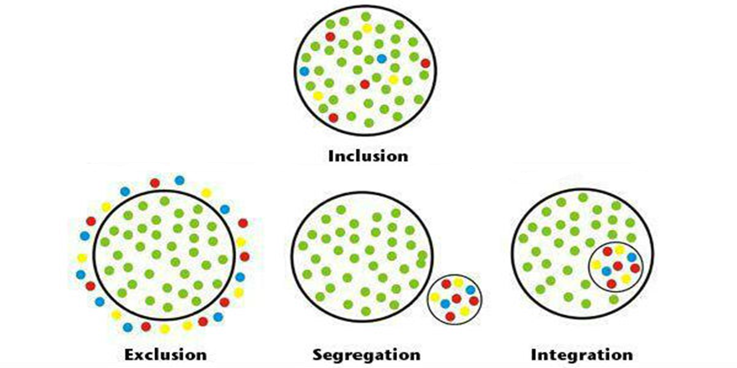
Where are societies heading towards?

Slide 9
Integration
Incorporation into society or an organisation of individuals of different groups
Creation of a group within the group
Integration does not require an effort to identify and change norms whereas inclusion requires changes
Do policies in a society advance inclusion or integration?

Slide 10
Ex: Integrated Classroom….
An integrated classroom is a setting where students with disabilities learn alongside peers without disabilities.
Extra supports may be implemented to help them adapt to the regular curriculum, and sometimes separate special education programs are in place within the classroom or through pull-out services.
In theory, integration is a positive approach that seeks to help students with disabilities be part of the larger group.
In practicality, the differences in the way all people learn can make this system of education less effective.

Slide 11
Inclusion…….
Inclusion is the actual merging of special education and regular education with the belief that all children are different, will learn differently, and should have full access to the same curriculum.
Students with disabilities are not expected to adjust to a fixed education structure. Rather the structure is adjusted so that everyone’s learning styles can be met.
Barriers to learning are removed to allow each student to participate fully in the curriculum and feel equally valued.
The end result is that all students with and without disabilities benefit.

Slide 12
What brings nearer to inclusive society ?
Assimilation or Accommodation ?

Slide 13
Assimilation….
Individual is treated as a part of the community/society, when he/she conforms to dominant culture and norms and downplays own uniqueness .
‘ When people are expected to act a certain way’
Is it making members of an ethnic minority or immigrant group etc part of the majority community?

Slide 14
Accommodation…….
Preventing and removing barriers that impedes the disadvantaged from participating fully in an environment in a way that is responsive to their own unique circumstances.

Slide 15
Accommodation - dignity, individualization and promoting inclusive design
Human dignity encompasses individual self-respect and self-worth. It is concerned with physical and psychological integrity and empowerment. It is harmed when individuals are marginalized, stigmatized, ignored or devalued.
Blanket approaches that rely solely on categories, labels and generalizations are not acceptable..
To ensure that communities/disadvantaged sections have equal access to resources, policies and services, the ‘providers’ in the society have an obligation to be aware of differences when making design choices to avoid creating barriers. This approach is referred to as “inclusive design” or “universal design.”

Slide 16
What should be the Larger Goal in a society ?
Absence of fractures or divisions within society and the ability to manage such divisions.
A cohesive society creates a sense of belongingness, promotes trust, fights exclusion and marginalization and offers its members the opportunity of upward mobility.
Such societies are not necessarily demographically homogenous.
Rather, by respecting diversity, they harness the potential residing in their societal diversity (in terms of ideas, opinions, skills, etc.).

Slide 17
How to make social inclusion operational ?
This requires a paradigm shift so as to recognize the dignity, value and importance of each person, not only as an ethical norm and moral imperative, but also as a legal principle, a societal goal, and ultimately, practice.
“No human being should be condemned to endure a brief or miserable life as a result of his or her class, country, religious affiliation, ethnic background or gender”

Slide 18
How can all-inclusive participation be ensured?
There must be universal access to public infrastructure and facilities.
Access alone does not necessarily ensure use of public facilities.
Unequal relations within communities and households may inhibit the use of facilities by vulnerable groups.
Addressing the unequal power relations is therefore a necessary step to increase participation.
Equal access to public information -mass media can be used as an effective tool to educate and enlighten members of society.

Slide 19
Critical Dimensions of Inclusion…..
Equity - How the resources are allocated and utilized will significantly affect the orientation of a society?
It could either lead towards a more integrated, inclusive society, or an exclusive, polarized, and disintegrated one.
Diversity - By celebrating diversity, there is a recognition and affirmation of the differences between and among members of society.

Slide 20
Contd….
Strong civil society is fundamental for active participation and making public policies and institutions accountable
Effective leadership
Create positive narratives of an inclusive society of the future, and enable each member of society to share, understand and contribute to those narratives.

Slide 21
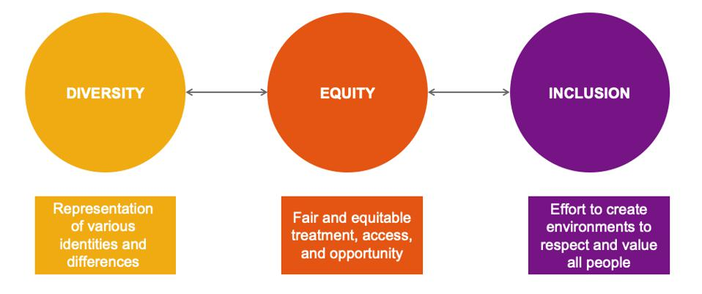
Interlinking and connecting three aspects

Slide 22
Goran Therborn (2007) - five categories of inclusion
Visibility
Consideration
Access to Social Interactions
Rights
Resources to fully participate in a society

Slide 23
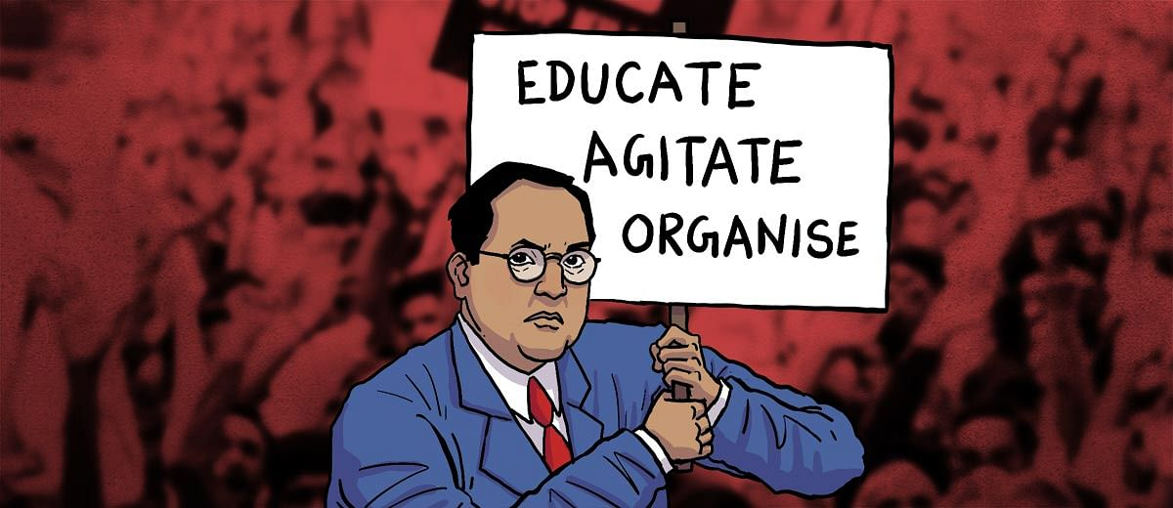
DR. B.R. AMBEDKARS VIEWS ON SOCIAL INCLUSION

Slide 24
Ambedkar’s view on social inclusion
Envisioned a society that would be educated, capable and progressive.
As India’s first law minister and as a social reformer post-Independence, he propagated concepts like….
equal pay for equal work,
maternity benefits and above all,
voting rights to all Indians, including women.
His views shaped the discourse on how India should march towards an egalitarian and casteless society.

Slide 25
Goals and Mechanisms that help in creating Inclusive policies
Goals | Mechanisms | Policies
Freedom | Capability | Equal opportunity, anti-discrimination Social investment: education, health & sanitation Mobility: transportation and communications access
Equality | Distributive Justice | Group or place specific anti-poverty programs, minimum income, land reforms
Democracy | Participation | Financial inclusion, seats in boardrooms, public-private partnerships, legislatures; Participatory budgeting, participation in research, access to public space; desegregation and mainstreaming
Recognition | Human Rights | Sovereignty, federalism, Celebrations, memorials, reconciliation commissions, penalties for hate crimes, multiculturalism/multilingualism

Slide 26
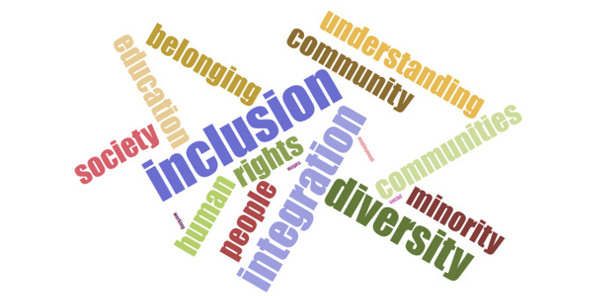
Strength lies in Differences not in Similarities – Stephen R.Covey

Slide 27
Towards Inclusion …………….

Slide 28
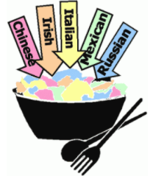
Melting Pot or Salad Bowl?
Learn to live together in the best possible way…….
Melting Pot
Salad Bowl

