Slide 1




Stream Name
Policy and Regulatory Framework for GovTech
Session Number: 10
Session Topic:
IT Act 2000 & its Amendments (2008 & 2018)
CHARRU MALHOTRA, Ph.D. (IIT-D)
COORDINATOR ( Centre of e-Governance)
Associate Professor (e-Governance and ICT) Indian Institute of Public Administration charrumalhotra [at]gmail.com
charrumalhotra[dot]iipa[at]gov[dot]in
1
Agenda
01
Background
02
IT Act 2000
03
Salient features of the Act
04
Statutory Bodies created out of
IT Act
05
Objectives of IT Act
06
Computer Crimes
07
Due Diligence by Intermediaries
08
IT Act amendment 2008
09
IT Act amendment 2018
10
Criticism of IT Act 2000
11
Problems with IT Act
charrumalhotra[dot]iipa[at]gov[dot]in
2

Slide 2

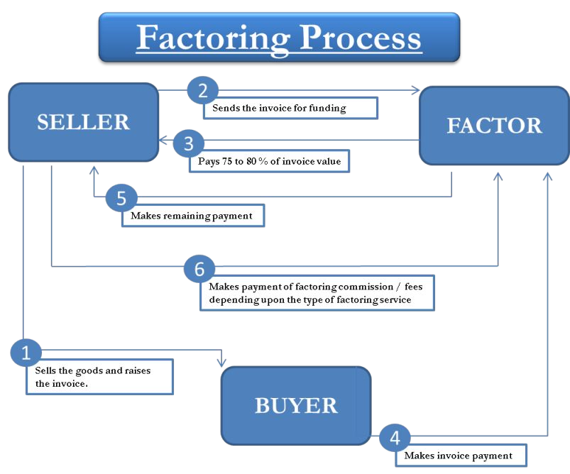
Background
It Act Enacted in year 2000
Based on UNICITRAL*Model
Amended in year 2008 and 2018
Objective was to promote e-Commerce
3
charrumalhotra[dot]iipa[at]gov[dot]in
*United Nations Commission on International Trade Law
Genesis of IT Act - The UNCITRAL Model Law
As electronic transac. extends across national boundaries, there's is a need for int. harmonization in IT Laws
The UNCITRAL is the legal body of the UN system in the field of int trade law
UNCITRAL drafted the “UNCITRAL Model Law on Electronic Commerce - 1996”
The e-Commerce / IT Laws of most countries are modelled on UNCITRAL Model Law
charrumalhotra[dot]iipa[at]gov[dot]in
4

Slide 3
IT Act 2000
India is the 12th nation in the world to adopt IT Laws
The Act applies to the whole of India and also applies to any offence or contravention there under committed outside India by any person irrespective of his nationality, if such act involves a computer, computer system or network located in India
There are 94 Sections segregated into 13 Chapters and 4 Schedules
Salient Features of the Act
Legal recognition of electronic records and electronic signature
Defines various types of computer crimes as well as provides for stringent penalties for each of them.
5
charrumalhotra[dot]iipa[at]gov[dot]in
Statutory Bodies Created Out of IT Act
National Critical Information Infrastructure Protection Centre (NCIIPC)
Computer Emergency Response Team – India (CERT-In)
Controller of Certifying Authority (CCA)
Cyber Appellate Tribunal (CAT)
Objectives
To suitably amend existing laws in India to facilitate e-commerce.
To provide legal recognition of electronic records and digital signatures.
To provide legal recognition to the transactions carried out by means of Electronic communication/form.
To provide legal recognition to business contracts and creation of rights and obligations through electronic media.
To establish a regulatory body to supervise the certifying authorities issuing digital signature certificates.
To create civil and criminal liabilities for breaching/flouting of the provisions of the Act.
charrumalhotra[dot]iipa[at]gov[dot]in
6

Slide 4
Objectives of IT Act 2000
To suitably amend existing laws in India to facilitate e-commerce.
To provide legal recognition of electronic records and digital signatures.
To provide legal recognition to the transactions carried out by means of Electronic communication/form.
To provide legal recognition to business contracts and creation of rights and obligations through electronic media.
To establish a regulatory body to supervise the certifying authorities issuing digital signature certificates.
To create civil and criminal liabilities for breaching/flouting of the provisions of the Act.
charrumalhotra[dot]iipa[at]gov[dot]in
7
Objectives of IT Act 2000 Contd…
To make consequential amendments in the Indian Penal Code, 1860 and the Indian Evidence Act, 1872
To amend the Reserve Bank of India Act, 1934 so as to facilitate electronic fund transfers between the financial institutions.
To amend the Banker’s Books Evidence Act,
To make law in tune with Model Law on Electronic Commerce adopted by the United Nations Commission on International Trade Law (UNCITRAL) adopted by the General Assembly of the United Nations in 1997.
charrumalhotra[dot]iipa[at]gov[dot]in
8

Slide 5
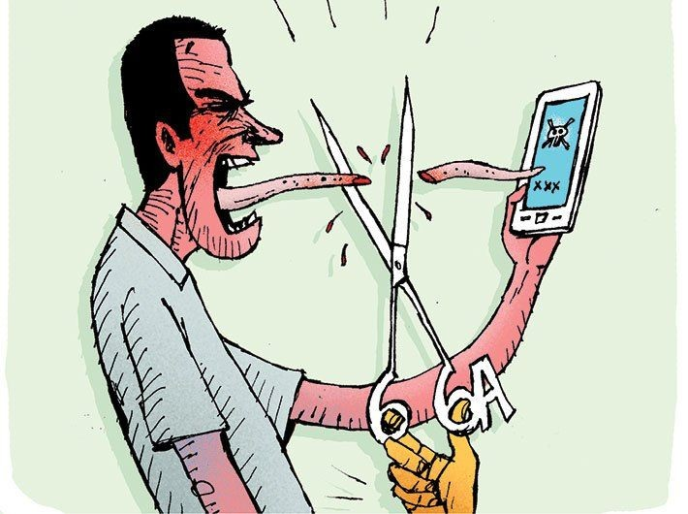
Computer Crime
Computer crimes in the Act are classified into two categories :
Civil offences
Criminal offences
Offense | Section
Civil | 43
Criminal | 65,66, 66B to 66F, 67, 67A, 67B, 72, 72A
charrumalhotra[dot]iipa[at]gov[dot]in
9
Offence and Section | Comprises of-
Civil Offence (Section 43) | Unauthorised copy or extract any data, database; Unauthorised access & downloading files; Introduction of virus; Damage to computer system and computer network; Disruption of computer, computer network; Denial to authorised person to access computer; Providing assistance to any person to facilitate unauthorised access to a computer; Changing the service availed by a person to an account of another person by tampering and manipulation of other computer; Failure to furnish information, return etc. to the Controller by certifying authorities; Failure to protect data
Criminal Offences (Section 65,66, 66B to 66F, 67, 67A, 67B, 72, 72A) | Tampering with computer resource; Electronic forgery; Spam and offensive messages; Stolen computer resource; Identity theft; Cheating by impersonation; Violation of privacy, video voyerism; Cyber terrorism; Unauthorised access to protected system; Confiscation of computer, network, etc. ; Publication of obscene information in electronic form Breach of confidentiality and privacy; Publishing false electronic signature certificate
charrumalhotra[dot]iipa[at]gov[dot]in
10

Slide 6
Sensitive Personal Data Protection
Section 43A – Body corporate to implement reasonable security practices for data protection
Rules notified
  Body corporate to implement ISO27001 or other industry approved security practices to protect sensitive personal information
  Sensitive personal information
Password
Financial information such as Bank account, credit/debit card or other payment instrument details
Physical, physiological and mental health condition
Sexual orientation
Medical records and history
11
Biometric information
charrumalhotra[dot]iipa[at]gov[dot]in
Certain Powers Given through
Section 69: Powers to issue directions for interception or monitoring or decryption of any information through any computer resource (MHA/ State Govts.)
Power to MeitY to issue directions for blocking Public Access of any information through any computer resource. (Section 69A).
Power to authorise to monitor and collect traffic data or information through any Computer Resource. (Section 69B): CERT-In has been authorised
charrumalhotra[dot]iipa[at]gov[dot]in
12

Slide 7
Section 69A
Power to issue directions for blocking for public access of any information through any computer resource
  Sovereignty or integrity of India
  Defence of India
  Security of the State
  Friendly relations with foreign States
  Public order
  For preventing incitement to the commission of any cognizable offence relating to above
Rule - Procedure and Safeguards for Blocking for Access of Information by Public
  Group Coordinator, Cyberlaw, MeitY empowered to issue direction as Designated Officer
  Nodal officers nominated from Ministries/Depts. and States to forward request for blocking
charrumalhotra[dot]iipa[at]gov[dot]in
13
Due Diligence by Intermediaries
Section 79 provides immunity to intermediaries provided they follow due diligence and guidelines
Intermediaries guidelines rules, 2011 notified on 11.4.2011
  Publish privacy policy and user agreement on website
  Inform users not to upload/publish/transmit content :
    grossly harmful, harassing, blasphemous, defamatory, obscene, pornographic, paedophilic, libellous, invasive of another's privacy, hateful, or racially, ethnically objectionable, disparaging, relating or encouraging money laundering or gambling, or otherwise unlawful
    harm minors in any way, insists there should be infringement of no patent, trademark, copyright or other proprietary rights;
    Not violates any law for the time being in force
charrumalhotra[dot]iipa[at]gov[dot]in
14

Slide 8
Due Diligence by Intermediaries Contd…
After being informed by affected person or come to know on its own, intermediary
  to work with user/owner of infringing content and initiate action within 36 hours to disable the content
Intermediaries to publish name of Grievance Officer on their website
charrumalhotra[dot]iipa[at]gov[dot]in
15
Notification of Examiner of Electronic Evidences
MeitY has been authorised to issue notification to State/Central Govt. forensics labs as Examiner of Electronic Evidence as per section 79A
charrumalhotra[dot]iipa[at]gov[dot]in
16

Slide 9
IT Act Amendment 2008
In order to ensure that law keeps pace with the rapidly changing technological environment IT Act, 2000, was amended in year 2008 by formulating changes in rules/government. Notifications
It came into effect from October 27, 2009
charrumalhotra[dot]iipa[at]gov[dot]in
17
Major Amendments in 2008
Technology Neutral
Section 15
Section 79 a
Establishes a Examiner
Section 69 and 69a
Gave power to the Government for electronic interception
Section 43/43a 66e/72a
Body corporate shall be liable to pay compensation if it is negligent in implementing reasonable security precautions with respect to sensitive personal data
Child pornography Cyber terrorism
8 New Cyber offences where added
Section 67b Section 66f
Section 66a to 66f and 67
are non Bailable
charrumalhotra[dot]iipa[at]gov[dot]in
18

Slide 10
Information Technology (Amendment) Bill 2018
The Ministry of Electronics and Information Technology has amended the Information
Technology Act, 2000 (‘IT Act’) by way of the Information Technology (Amendment) Bill, 2018
The IT Bill was prepared in response to certain recent online activities such as the Blue Whale Challenge which induced several individuals (primarily children) in India and across the world to commit self-harm.
charrumalhotra[dot]iipa[at]gov[dot]in
19
New Provisions in IT Act after amendment, 2018
Following new provisions in the IT Act after amendments in 2018
Section 67BA: Deals with penalty on publishing or transmitting any material repugnant to cultural ethos.
Section 67BB: Related with hosting of dangerous online games
charrumalhotra[dot]iipa[at]gov[dot]in
20

Slide 11
Special Provisions Relating to Online Gaming
Section 79B:
  One new section was introduced in 2018 amendment, it highlights the fact that if anyone that hosts online gaming resources or produces any storage media containing gaming resources to be sold offline, then he should ensure that:
    The game resource is categorized for use by appropriate age groups on the basis of content of the game
    The game must contain a mechanism that warns users against the repetition in real life of the dangerous acts depicted in the game
charrumalhotra[dot]iipa[at]gov[dot]in
21
Criticism of IT Act 2000
The law misses out completely the issue of Intellectual Property rights and makes no provisions whatsoever for copyrighting, trade marking or patenting of electronic data and information
The law even stays silent over the regulation of electronic payments gateway and fails to segregate the negotiable instruments from the applicability of the IT Act.
charrumalhotra[dot]iipa[at]gov[dot]in
22

Slide 12
Problems with IT Act - Social Media Intermediaries
Crowd Source: data posted is based on the data collection thus providing valuable insights.
Safe Harbour: most internet intermediaries enjoy and are not held responsible for the content displayed on their platforms.
No or Zero responsibility of the Social Media site for the content displayed.
Held responsible only if flagged by users.
Information can be Fake or Hate Content.
charrumalhotra[dot]iipa[at]gov[dot]in
23
Fact Checking or Surveillance?
Broadcast Engineering Consultants India Ltd. - seeking to appoint agency for fact verification & detection could be a source of surveillance.
The agency shall also get location of the users on social media - a form of surveillance
Thus should be accompanied by responded information requests.
Currently, it would be breach of privacy under IT Act, PDP Bill and IT Intermediary Guidelines if user platform data or information or activities is shared without prior consent.
charrumalhotra[dot]iipa[at]gov[dot]in
24

Slide 13

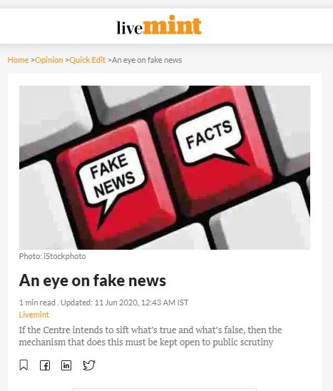
Tracking Fake News
Broadcast Engineering Consultants India Ltd. invites bids for services related to “fact verification and disinformation detection.”
Identification of key influencers behind disinformation and geo-tag them.
Framing of clear rules.
Agency that check facts for the ministry should be held accountable. Similarly, should not be in position to exercise unchechecked authority or take arbitrary decisions.
charrumalhotra[dot]iipa[at]gov[dot]in
25
Source: Livemint, June 11, 2020, retrieved from https://www.livemint.com/opinion/quick-edit/an-eye-on-fake-news-11591814803266.html
charrumalhotra[dot]iipa[at]gov[dot]in
26

Slide 14
Cyber Security in India
●
India accounts for just 3% of the global cybersecurity jobs.
●
While this low figure is due to the sensitive nature of securing region-specific digital assets, it is
also a result of the lack of specializations provided in this field.
●
India ranks 3rd in terms of the highest number of internet users in the world after USA and
China, the number has grown 6-fold between 2012-2017 with a compound annual growth rate
of 44%.
●
India secures a spot amongst the top 10 spam-sending countries in the world alongside USA
●
Companies lost 12.8 crore rupees between July 2018 nad April 2019 - IBM report 2019.
●
India as the most targeted nations - cyber criminals hailing from: Ukraine, Slovenia, China,
Czech Republic.
charrumalhotra[dot]iipa[at]gov[dot]in
27
Cyber Security and Work From Home
●
Low security standards of Wifi at home.
●
India does not have a dedicated cybersecurity law.
●
The Information Technology Act 2000 (the IT Act) read with the rules and regulations framed
thereunder deal with cybersecurity and the cybercrimes associated therewith.
●
Big companies still have guidelines for their workers but small startups/companies are at risk.
●
However, there is nothing as set guidelines or precautionary steps to take in regards to work
from home functioning.
●
Post covid-19 cyber attacks have grown & Indian organizations have reported an increase in
100% cyberattacks between March 17 and 20, 2020 ( Source: PWC report titled COVID-19
crisis, April 2020)
charrumalhotra[dot]iipa[at]gov[dot]in
28

Slide 15


What is Required ?
Cybersecurity is the need of the hour.
Strong and bold steps need required from the Government and its policy makers.
Need of agile policy making.
Different proactive approach using technology.
Focus more on preventions and pre-threat.
A system which is responsive to each individual stakeholder and receive feedbacks.
Takes strong consideration and acknowledges outliers and marginalised.
charrumalhotra[dot]iipa[at]gov[dot]in
29
Any questions?
You can find me at: Charrumalhotra[dot]iipa[at]gov[dot]in
charrumalhotra[dot]iipa[at]gov[dot]in 30
30

Slide 16
References with URL
Online content on MeitY’s website available on link:
http://meity.gov.in/content/acts-policies
Handbook of IIPA on ‘IT Act, Policies, Guidelines and Regulatory Frameworks for e-Governance’
https://www.youtube.com/watch?v=cQYACLLAPOw
charrumalhotra[dot]iipa[at]gov[dot]in
31

