Slide 1



Stream Name
Policy and Regulatory Framework for GovTech
Session Number: 09
Session Topic:
Internet Governance Policy Framework For India
CHARRU MALHOTRA, Ph.D. (IIT-D)
COORDINATOR ( Centre of e-Governance)
Associate Professor (e-Governance and ICT) Indian Institute of Public Administration charrumalhotra [at]gmail.com
charrumalhotra[dot]iipa[at]gov[dot]in
1
Agenda
01
Internet Governance
02
Internet Governance Knowledge Areas
03
India’s Approach
04
Roles and Responsibilities of Governing Organisation
05
Global Engagement and Coordination
06
Engagement with ICANN
07
Multi-stakeholder Consultations
08
Internet Governance Projects
09
An International Case Study
charrumalhotra[dot]iipa[at]gov[dot]in
2

Slide 2

... And who Governs Internet ?
This is Martha Payne. Martha's a 9-year-old Scot. Payne started a food blog called NeverSeconds, and she would take her camera with her every day to school to document her school lunches.
This blog acquired first dozens, and then hundreds, and then thousands of readers
People tuned in to watch her rate her school lunches, including on my favorite category, "Pieces of hair found in food."
One day, she posted this. A post that read: "Goodbye. "I'm very sorry to tell you this, but my head teacher pulled me out of class today and told me I'm not allowed to take pictures in the lunch room anymore. Goodbye."
You can guess what happened next, right? The outrage was so swift, so voluminous, so unanimous, that the Council reversed themselves and said, "We would, we would never censor a nine-year-old."
And this brings up the question, what made them think they could get away with something like that?
And the answer is, all of human history prior to now.
TED Talk: How the internet will one day transform government?
3
Internet Governance
Internet Governance, broadly defined, is the development and application by Governments, the private sector and civil society, in their respective roles, of shared principles, norms, rules, decision-making procedures, and programs that shape the evolution and use of the Internet.
Development and coordination of technical standards,
Operation of critical infrastructure
Public policy issues
4

Slide 3
Internet Governance Knowledge Areas
Internet Protocol Addressing (IP Addressing)
Domain Name System (DNS)
Routing
Technical Innovations
Standardization
Security
Public Policy
Privacy
Legal Issues
Cyber Norms
Intellectual Property
Taxation
charrumalhotra[dot]iipa[at]gov[dot]in
5
India’s Approach
Supports a multi-stakeholder approach for Internet Governance
Government’s supreme right and control on National security
Leveraging India’s strength in this sector’s industry and human resource
Aligned with our investment strategy for Digital India
Enabling the multi-billion-dollar business opportunity of Internet industry for India
6

Slide 4
Roles and Responsibilities of Governing Organisation
Representation of India’s Public Policy Concerns on global platform
Awareness on Internet Governance
Encouraging greater participation in Internet Engineering Task Force (IETF) Working groups
Engagement with Internet Society (ISOC)
Promotion of Multi-stakeholder model of Internet Governance within India
Strengthening internet
Internet Infrastructure of the country
charrumalhotra[dot]iipa[at]gov[dot]in
7
Global Engagement and Coordination
Continuous and effective engagement with the following organisations
Internet Governance Forum (IGF)
Internet Corporation for Assigned Names and Numbers (ICANN)
World Summit on the Information Society (WSIS)
Asia-Pacific Network Information Centre (APNIC) etc.
8

Slide 5
Engagement with ICANN
MeitY is closely monitoring all the activity of ICANN
Participating through GAC (Governmental Advisory Committee)
GAC's key role is to provide advice to ICANN on issues of public policy
charrumalhotra[dot]iipa[at]gov[dot]in
9
Multi-stakeholder Consultations
India has supported for multi-stakeholder model of Internet Governance Mechanisms
Preserve the character of the Internet as a unified, dynamic engine for innovation
Encourage equity and inclusion
Workshops, meetings and events
Open for all
10

Slide 6
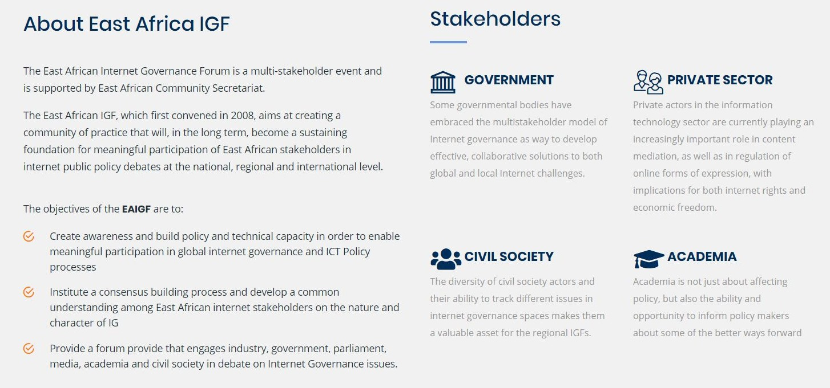
Internet Governance Projects
Some Internet Governance Projects awarded in the following domain.
“IG-SIM- Internet Governance – Structured Implementation Module” implemented by Centre for Development of Advanced Computing (C-DAC), Delhi.
Centre of Excellence in DNS Security
by C-DAC, Bangalore (Funded by NIXI).
ICANN Research and
Multi-stakeholder Engagement Assistant Programme by ICRIER (Funded by NIXI).
Advanced Internet Operations Research in India (AIORI): Software Technology Parks of India (STPI) Funded by MeitY.
“MEITY Chair for Internet
Policy: Value, Security and Governance” implementing by Indian Council for Research on International Economic Relations (ICRIER)
Research
Projects
Awareness
Development
charrumalhotra[dot]iipa[at]gov[dot]in
11
An International Case Study
The transformative effects of multistakeholderism in Internet governance: A case study of the East Africa Internet Governance Forum
EAIGF promotes capacity building, knowledge sharing, and policy transfer.
EAIGF reinforces influence of stakeholders with stronger institutional endowments.
EAIGF policy framing likely reflects preferences of stronger stakeholders.
https://www.sciencedirect.com/science/article/abs/pii/S03085 96115002049?via%3Dihub
12

Slide 7
Challenges
Concerns about accountability, legitimacy, diversity and capacity in Internet governance
Lack of participation by civic societies in mitigating these challenges
Lack of engagement on government level with international organisations on global policymaking.
Lack of participation from the Indian Private sector in global policymaking process related to the internet.
charrumalhotra[dot]iipa[at]gov[dot]in
13
Recommendations
At the international level, actively participate in the bottom-up policy development processes of GNSO and CCNSO of ICANN, and the IETF through Working Groups.
At the regional level, India should strengthen participation in APNIC through
  executive positions in the APNIC EC and the NRO EC.
At the domestic level, enhance the accountability of NIXI (which manages India’s Critical Internet Resources) towards India’s strategic goals by introducing an
  Oversight mechanism
  Organizational restructuring
Encouraging the participation of domestic private partners into global policymaking
Utilisation of Civic societies to overcome the various challenges related to internet governance within the country
https://web.iima.ac.in/assets/snippets/workingpaperpdf/8992574912015-03-23.pdf
14

Slide 8


References
Discussion: Current Internet Governance Challenges: What's Next?
DeNardis, L. (2010), The Emerging Field of Internet Governance.Yale Information Society Project Working Paper Series, link: https://ssrn.com/abstract=1678343
Chenou, J. (2011). Is Internet governance a democratic process? Multistakeholderism and transnational elites, paper presented at the ECPR General Conference 2011, University of Iceland, link:
http://ecpr.eu/filestore/paperproposal/1526f449-d7a7-4bed-b09a-31957971ef6b.pdf
Jain, R. (2015), A Model for Internet Governance and Implications for India, Working Paper No. 2015-03-23, link: https://web.iima.ac.in/assets/snippets/workingpaperpdf/8992574912015-03-23.pdf
Internet Governance content available at MeitY’s website, link: https://meity.gov.in/content/internet-proliferation-governance
15
Our next session would be on : It Act 2000 & its Amendments (208 & 2018)
Any questions?
You can find me at: charrumalhotra[dot]iipa[at]gov[dot]in
charrumalhotra[dot]iipa[at]gov[dot]in 16

